Slide 1
Databases and Visual Studio

Slide 2
Creating a database in Visual Studio
We can use Visual Studio as a DBMS
First steps:
Create a local database (is physically located on your PC)
Create tables, row, etc. by using a given database script

Slide 3
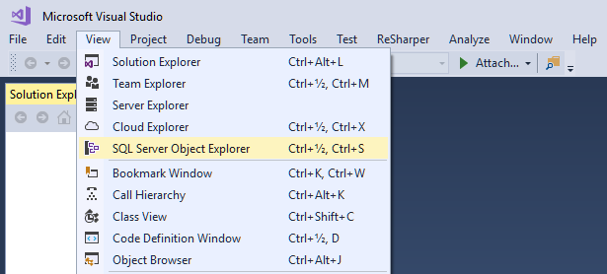

Slide 4
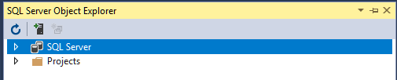
A database runs on a database server (found under SQL Server)

Slide 5
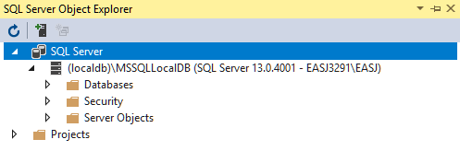
This is a built-in database server called (localdb)

Slide 6
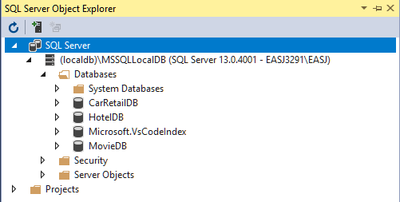
You probably don’t have all these databases (yet ☺)

Slide 7
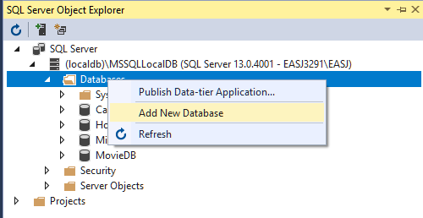
Right-click on Databases, and choose Add New Database

Slide 8
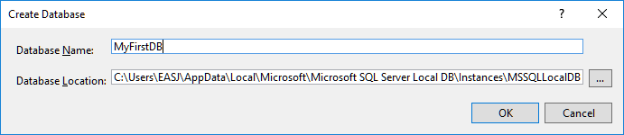

Slide 9
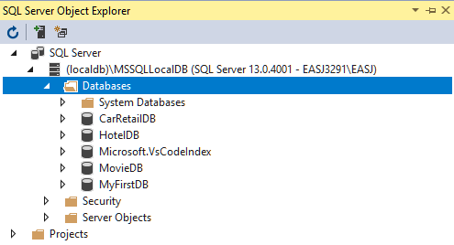

Slide 10
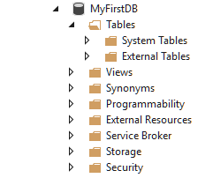

Slide 11
Creating a database in Visual Studio
We have created a (local) database called MyFirstDB
The database does not contain any (user-defined) tables yet
Table definitions can be created manually (later), or by running a database script
A script generally just contains SQL code, which may e.g.
Create a number of tables
Enter a number of rows into the tables

Slide 12
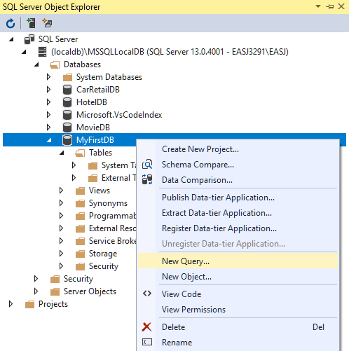
Right-click on MyFirstDB, and choose New Ouery…

Slide 13
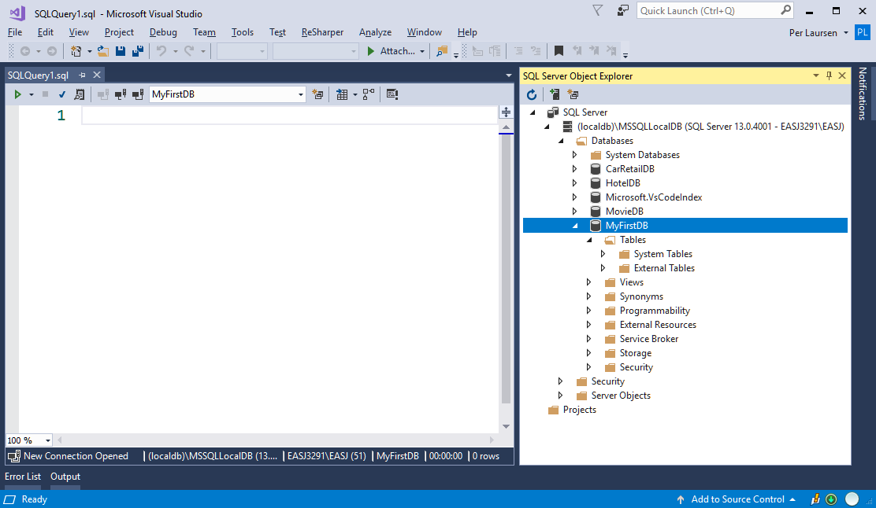
This opens a Query window

Slide 14
Here you can write SQL directly, or copy SQL from a given script

Slide 15
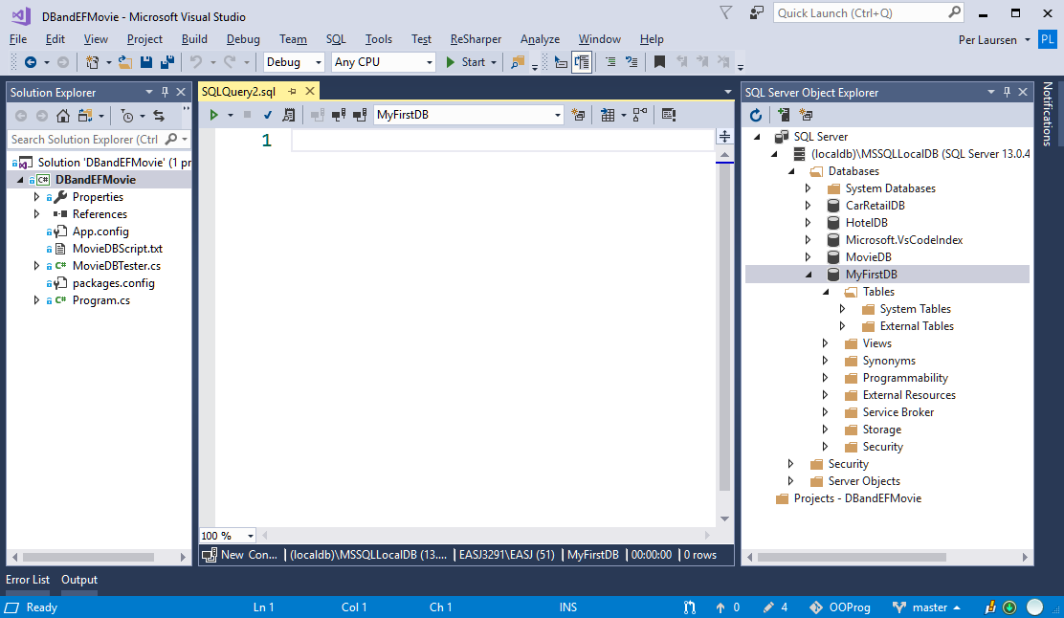
Example: Script included in exercise project, as a simple text file

Slide 16
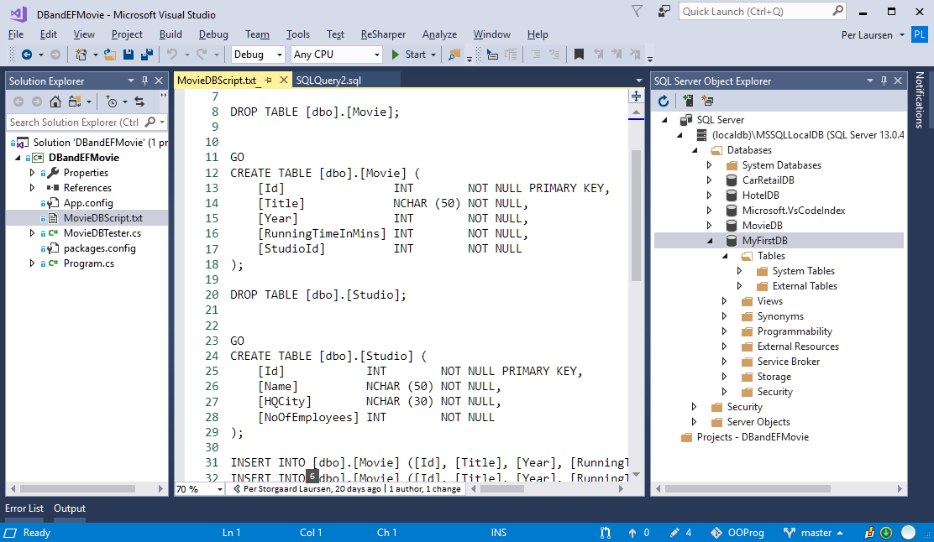
Copy content from text file into Query window

Slide 17
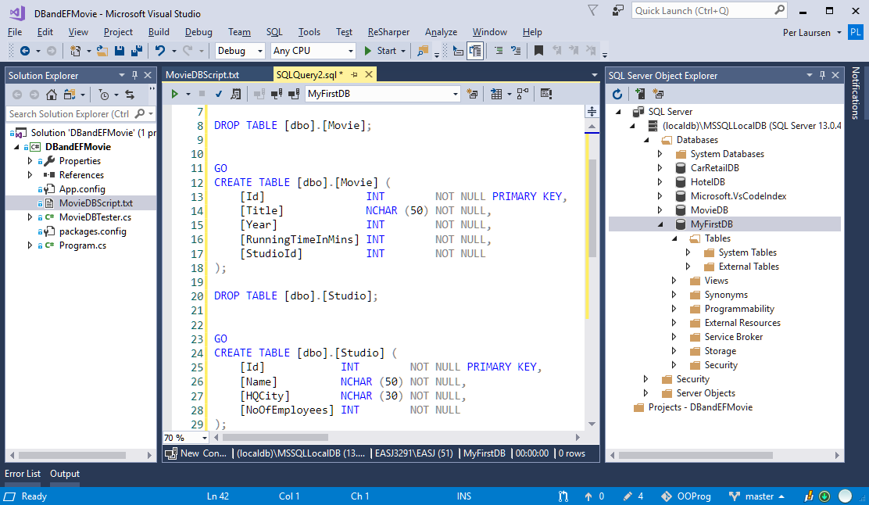

Slide 18
NOT THIS ONE!!! ☺
Run script by clicking the small green triangle

Slide 19
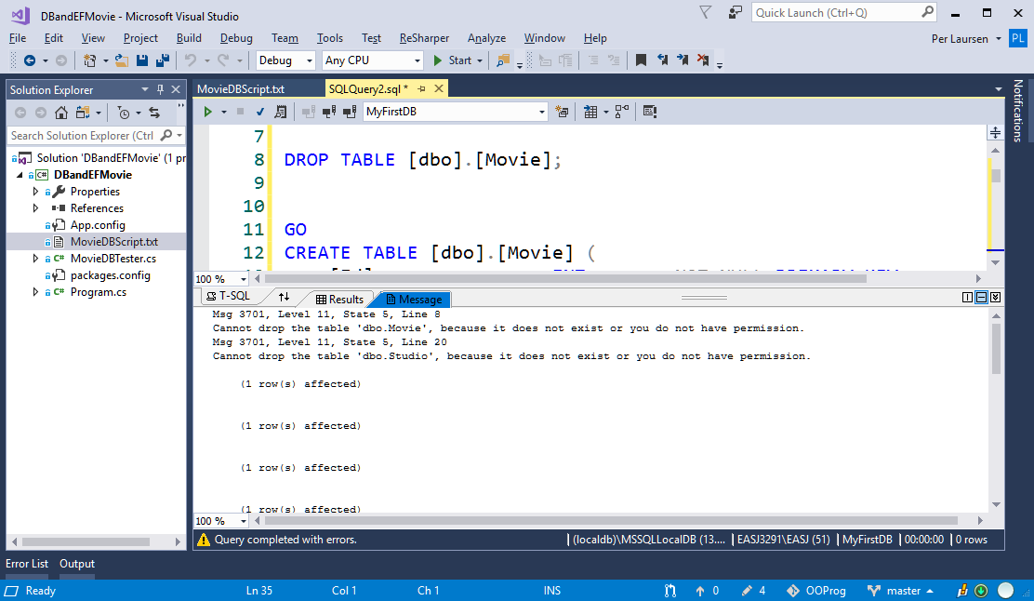
Don’t panic if some errors are reported when running the script ☺

Slide 20
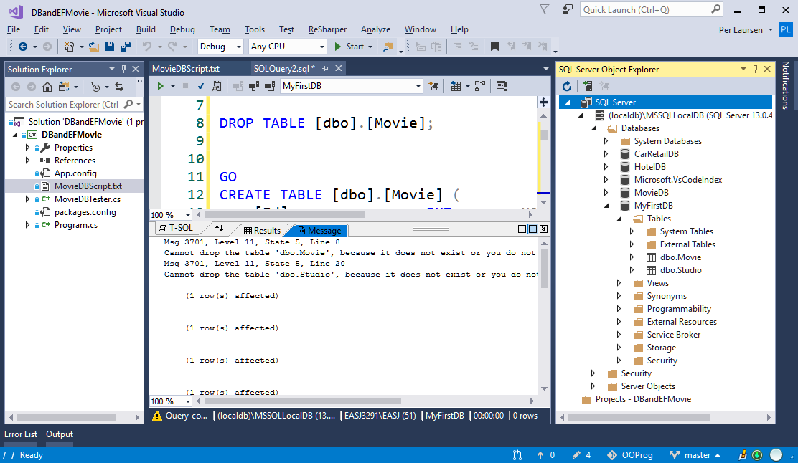
Now click the Refresh button…
…two new tables have been added to MyFirstDB ☺

Slide 21
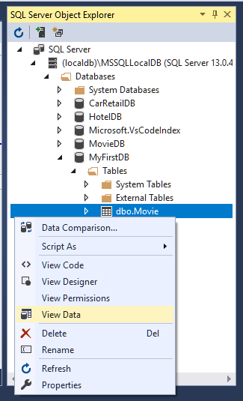
Right-click on Movie table, and choose View Data

Slide 22
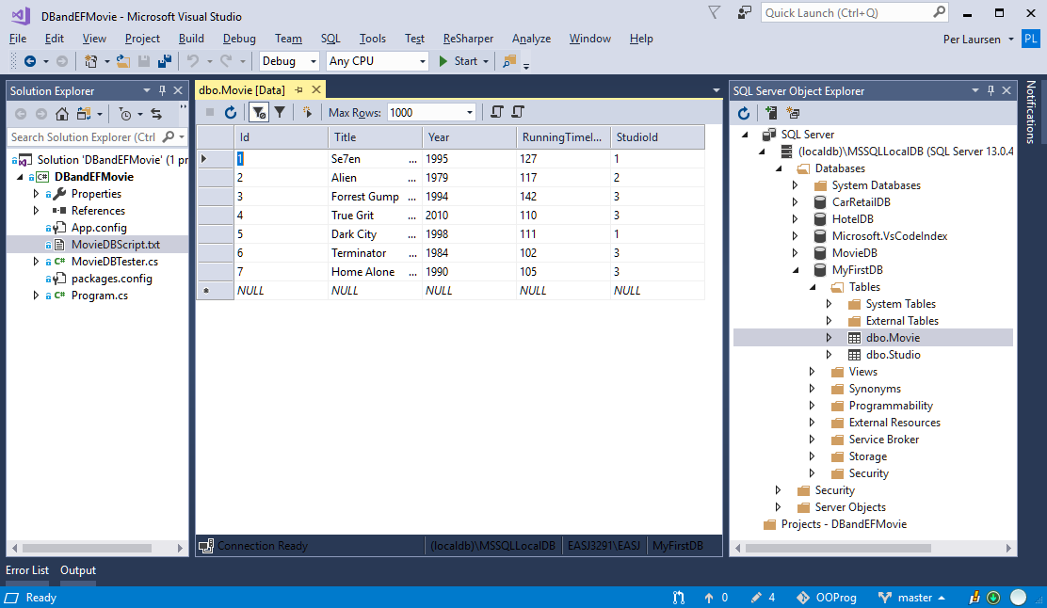
The Movie table contains 7 rows

Slide 23
You can type in additional rows simply by entering values into the bottom row

Slide 24
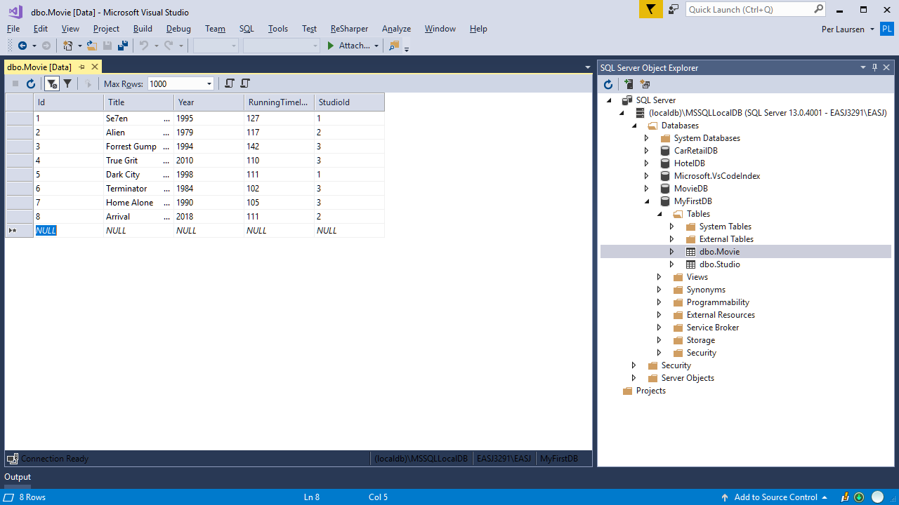

Slide 25
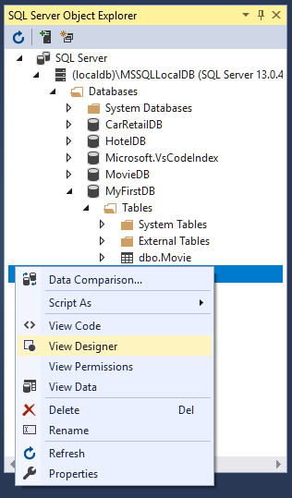
Right-click on Movie table, and choose View Designer

Slide 26
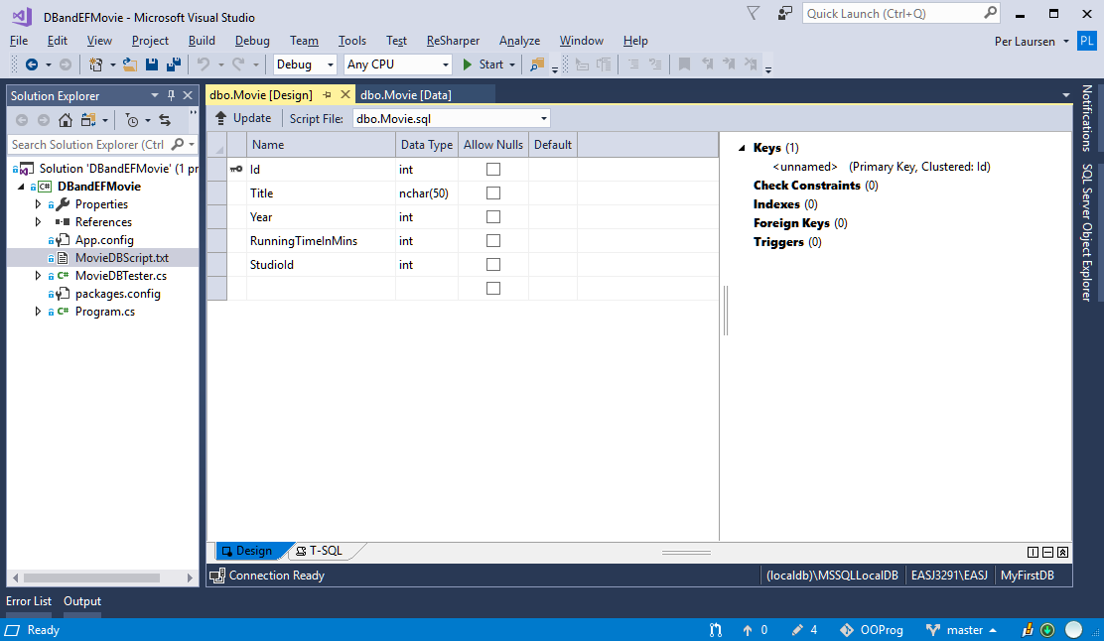
Column definitions for Movie table (designer view)

Slide 27
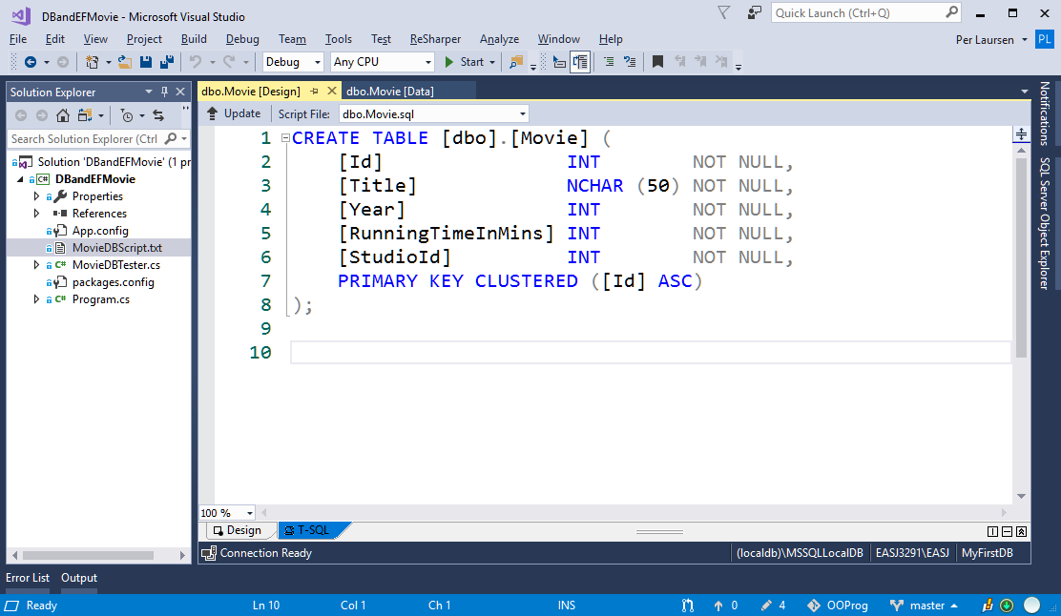
Column definitions for Movie table (SQL code view)

Slide 28
Creating a database in Visual Studio
We can now
Create a new database
Run a given script on the database
Next steps are
Execute SELECT queries on a database (and also INSERT, UPDATE and DELETE)
Define tables manually

Slide 29
Executing queries on a database
Same procedure as executing a given script
Open a Query Window
Type in your query
Execute the query

Slide 30
Right-click on MyFirstDB, and choose New Ouery…

Slide 31
This opens a Query window

Slide 32
Here you can write SQL directly, or copy SQL from a given script

Slide 33
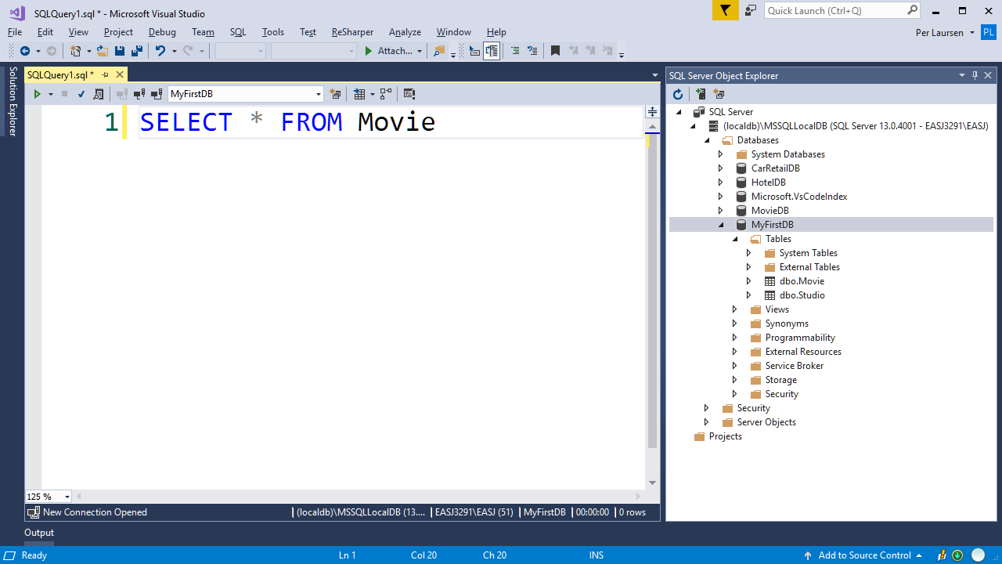
NOT THIS ONE!!! ☺
Run script by clicking the small green triangle

Slide 34
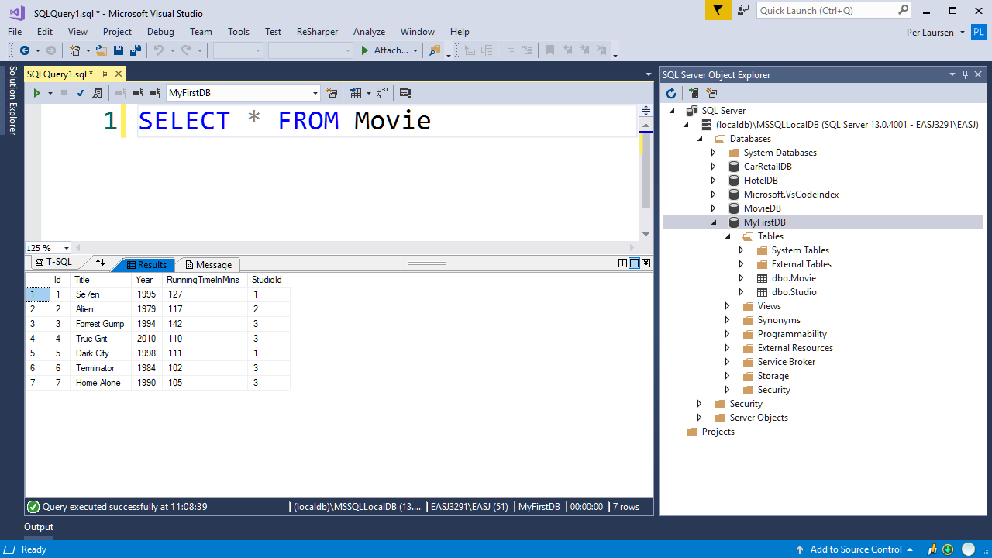

Slide 35

Correct keywords in blue (some…)
Syntax errors are indicated

Slide 36

NB: Logical errors not discovered before running the query!

Slide 37
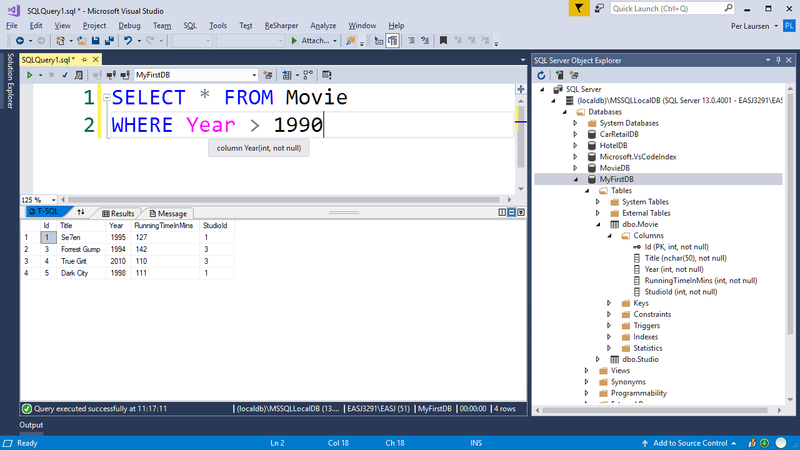
Column names in pink

Slide 38
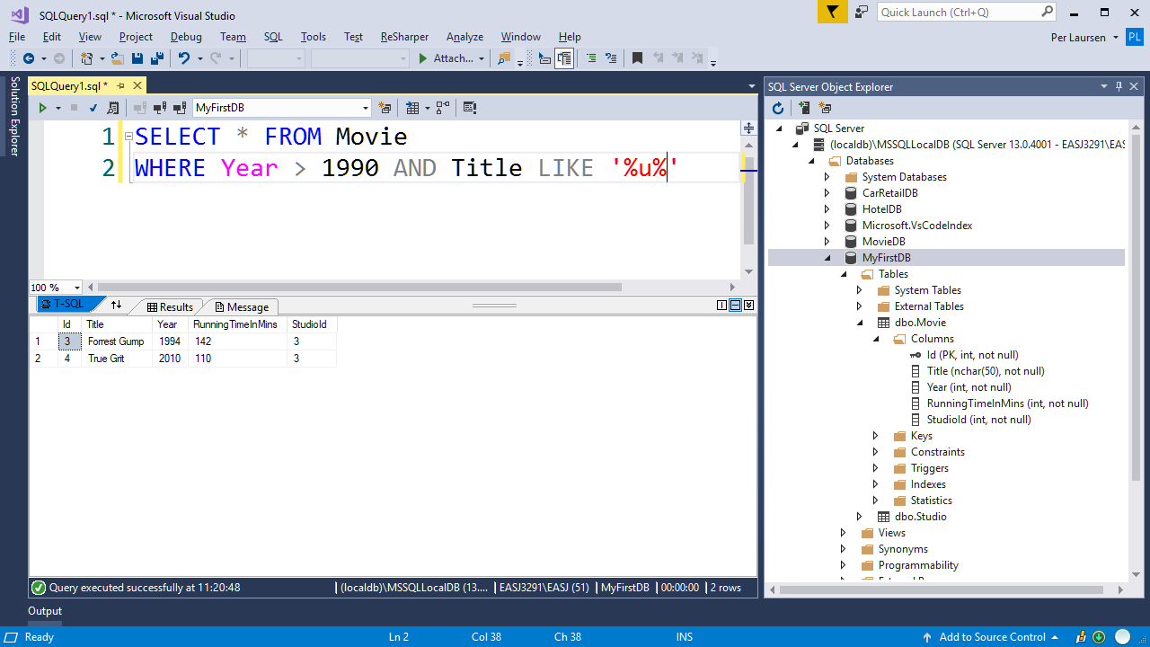

Slide 39
Defining a table manually
Two approaches:
Write SQL code for table definition directly in query window
Use the Designer to help with table definition. SQL code is then generated automatically
Last approach is recommended ☺

Slide 40
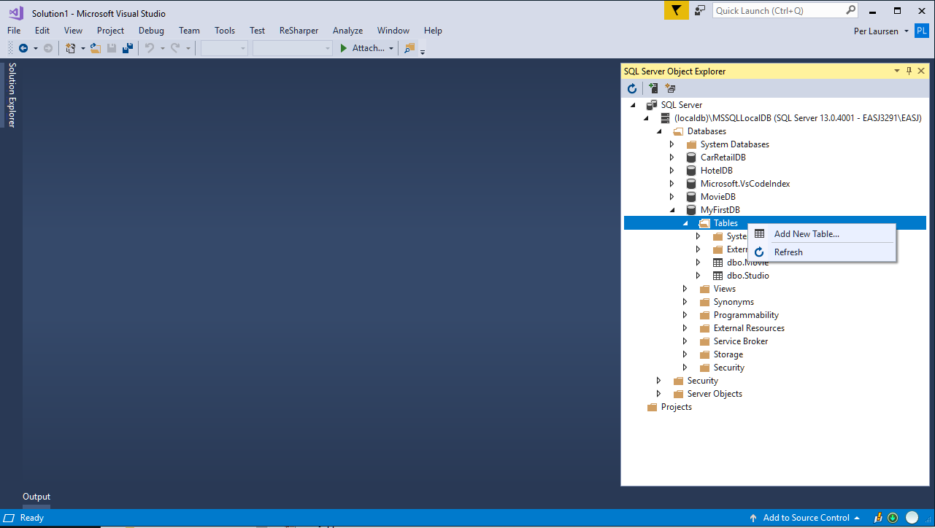
Right-click on Tables folder, choose Add New Table

Slide 41
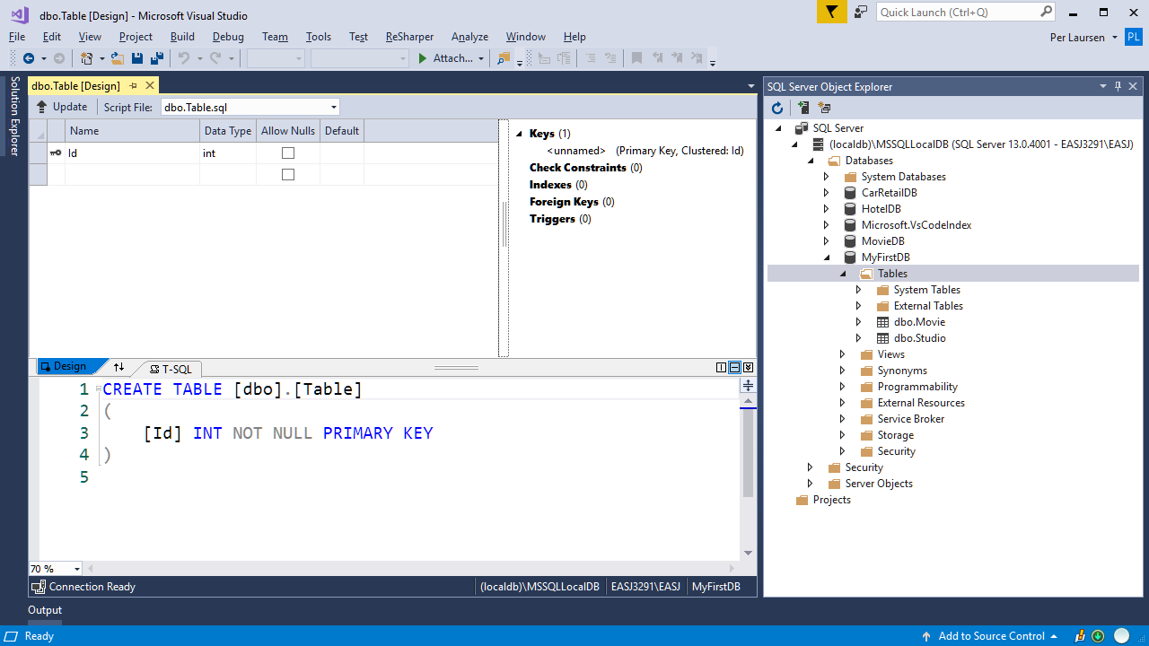
New table is initially named Table

Slide 42
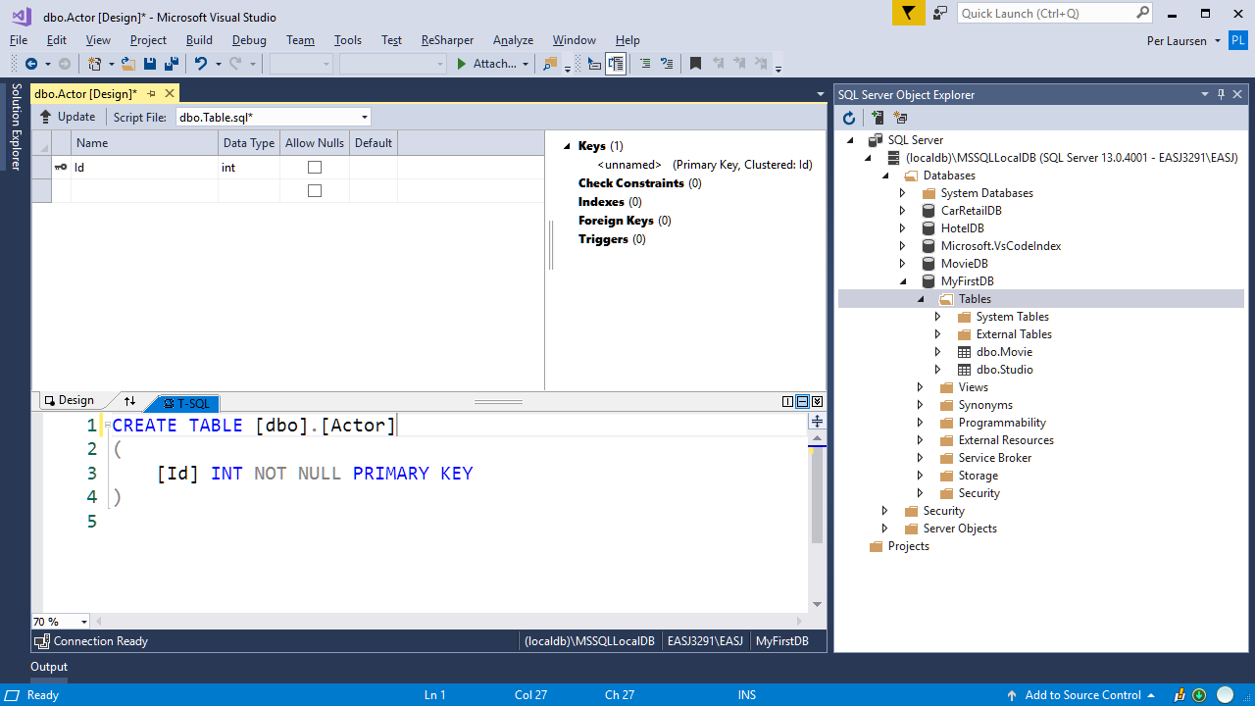
Change name manually here

Slide 43
Table initially has one column named Id

Slide 44
The column Id is:
A primary key
Of type int
Cannot be null

Slide 45
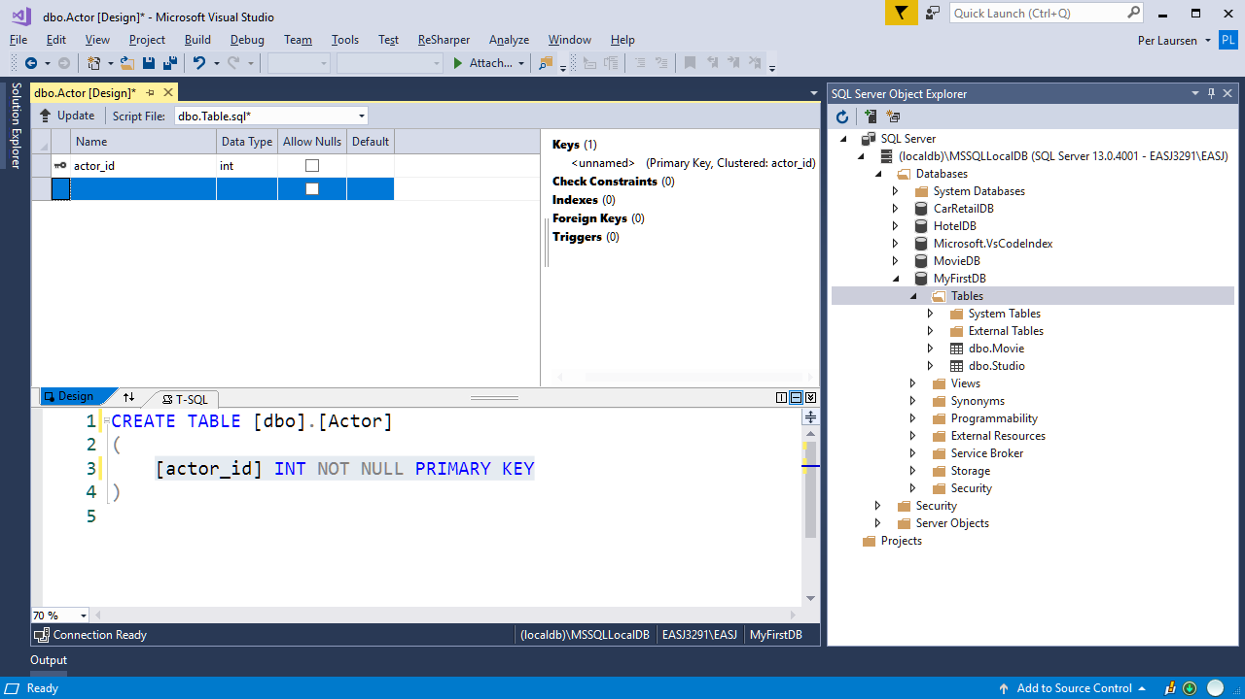
Change the column definition in the Design view

Slide 46
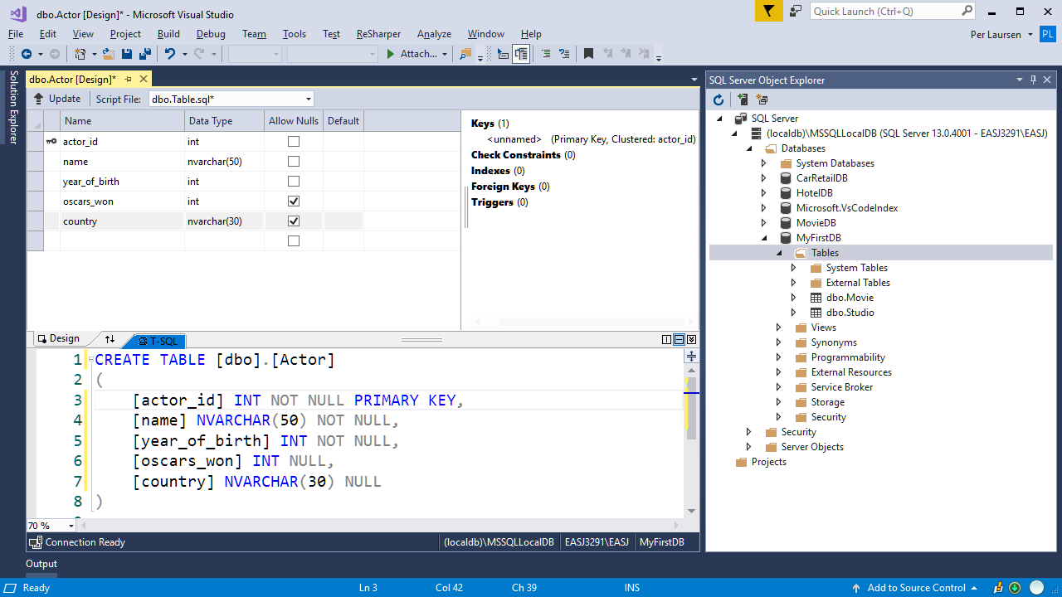
Add further column definitions in the Design view
SQL code for column definitions is auto-matically updated

Slide 47

Don’t click here
NB: A new table is not saved (i.e. added to the database) by clicking on Save!

Slide 48
Click on the Update button

Slide 49
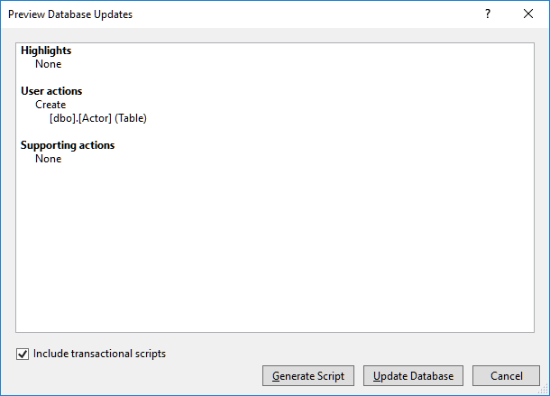
If all looks good, click on the Update Database button

Slide 50
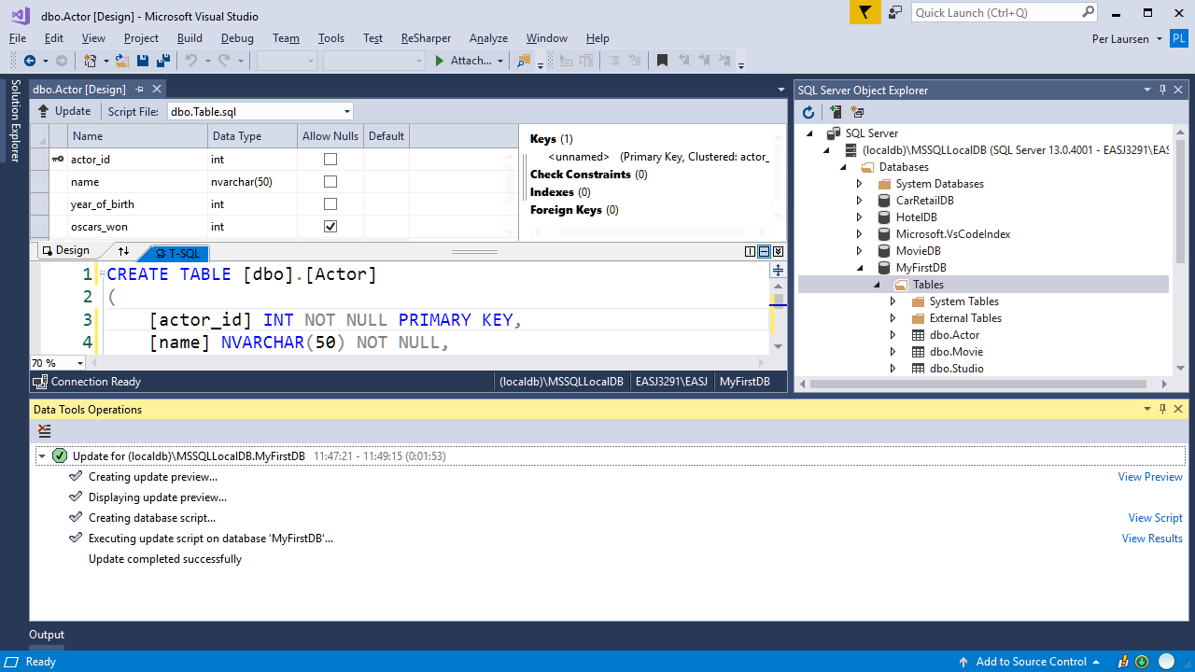
SUCCESS!!

Slide 51
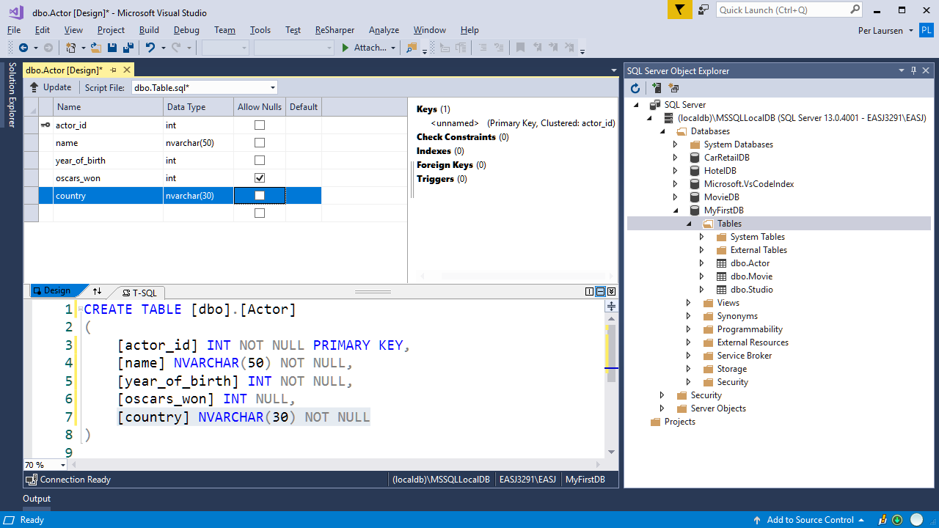
…and click on the Update button
If you want to update the table definition, then update it…

Slide 52
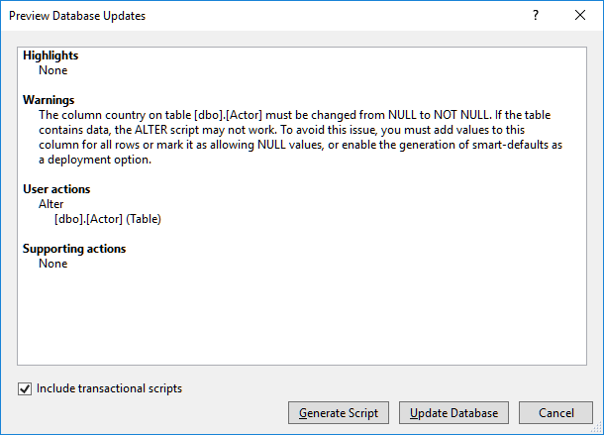
If all looks good (also the warning) click on the Update Database button
NB: Some change may result in warnings in the Preview Window!

Slide 53
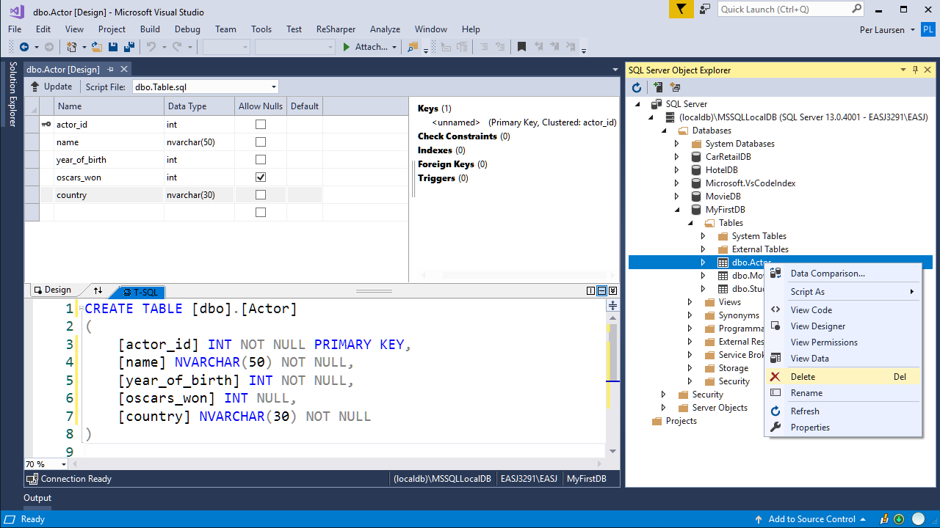
A table can also be deleted: Right-click on the table, and choose Delete

Slide 54
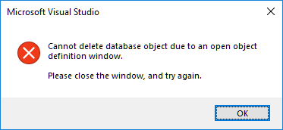
NB: Remember to close any windows relating to the table ☺

Slide 55
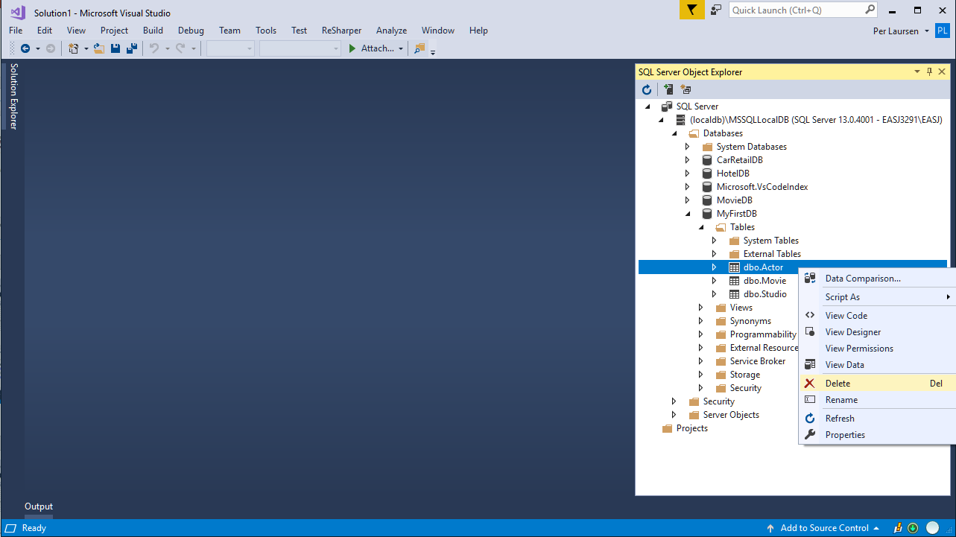

Slide 56
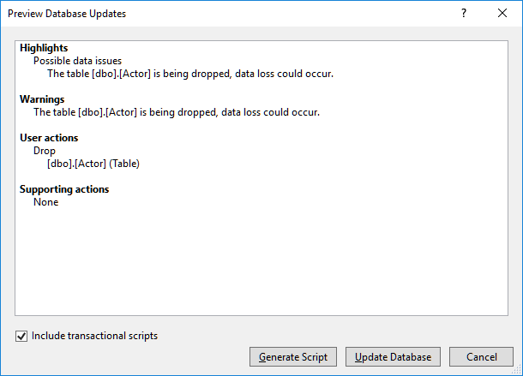
If all looks good (also the warning) click on the Update Database button

Slide 57
