Slide 1
Databases and Visual Studio

Slide 2
Creating a database in Visual Studio
We can use Visual Studio as a DBMS
First steps:
Create a local database (is physically located on your PC)
Create tables, row, etc. by using a given database script

Slide 3
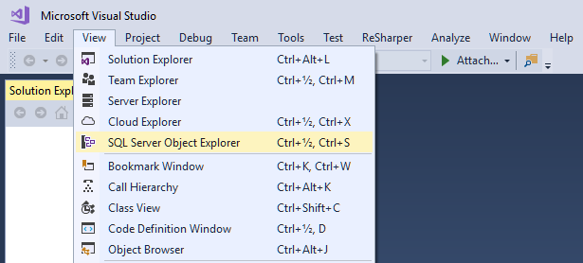

Slide 4
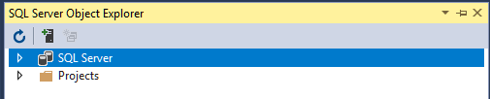
A database runs on a database server (found under SQL Server)

Slide 5
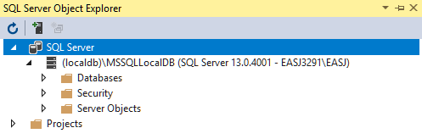
This is a built-in database server called (localdb)

Slide 6
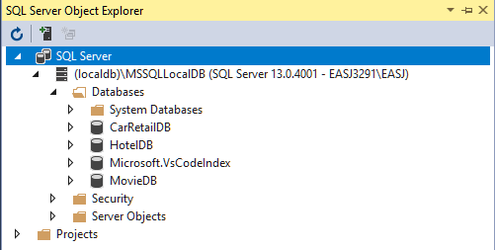
You probably don’t have all these databases (yet ☺)

Slide 7
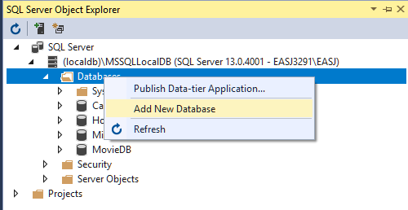
Right-click on Databases, and choose Add New Database

Slide 8
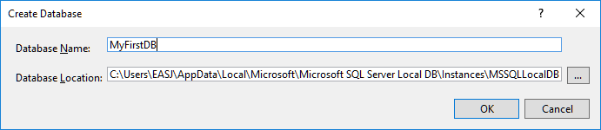

Slide 9
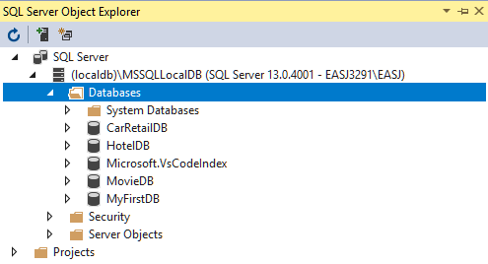

Slide 10
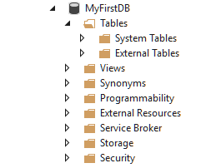

Slide 11
Creating a database in Visual Studio
We have created a (local) database called MyFirstDB
The database does not contain any (user-defined) tables yet
Table definitions can be created manually (later), or by running a database script
A script generally just contains SQL code, which may e.g.
Create a number of tables
Enter a number of rows into the tables

Slide 12
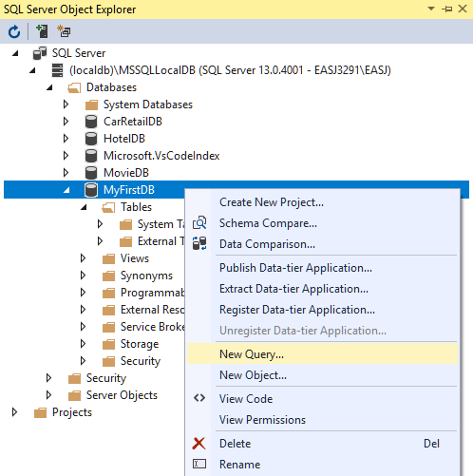
Right-click on MyFirstDB, and choose New Ouery…

Slide 13
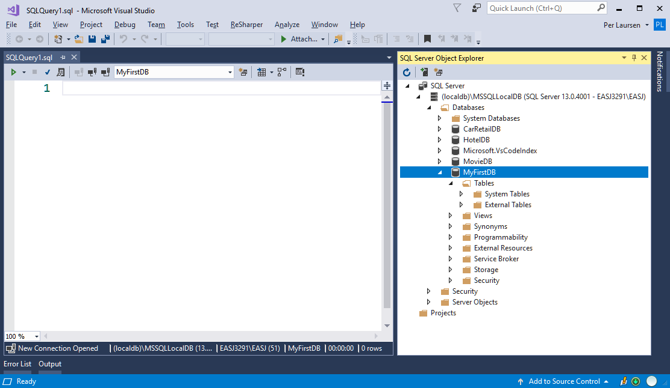
This opens a Query window

Slide 14
Here you can write SQL directly, or copy SQL from a given script

Slide 15
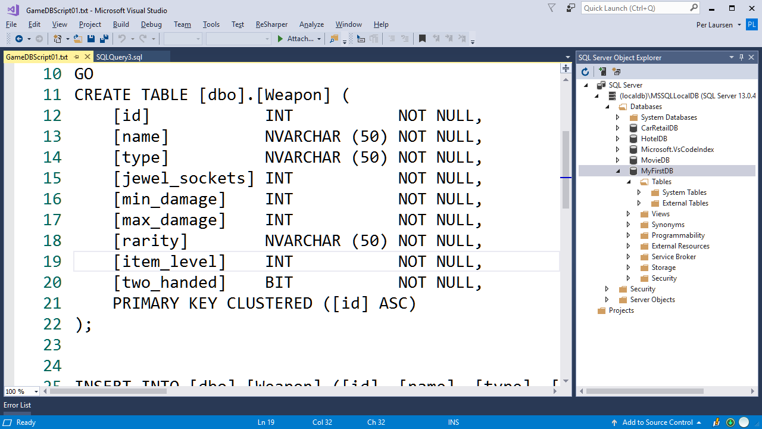
Copy content from text file into Query window

Slide 16
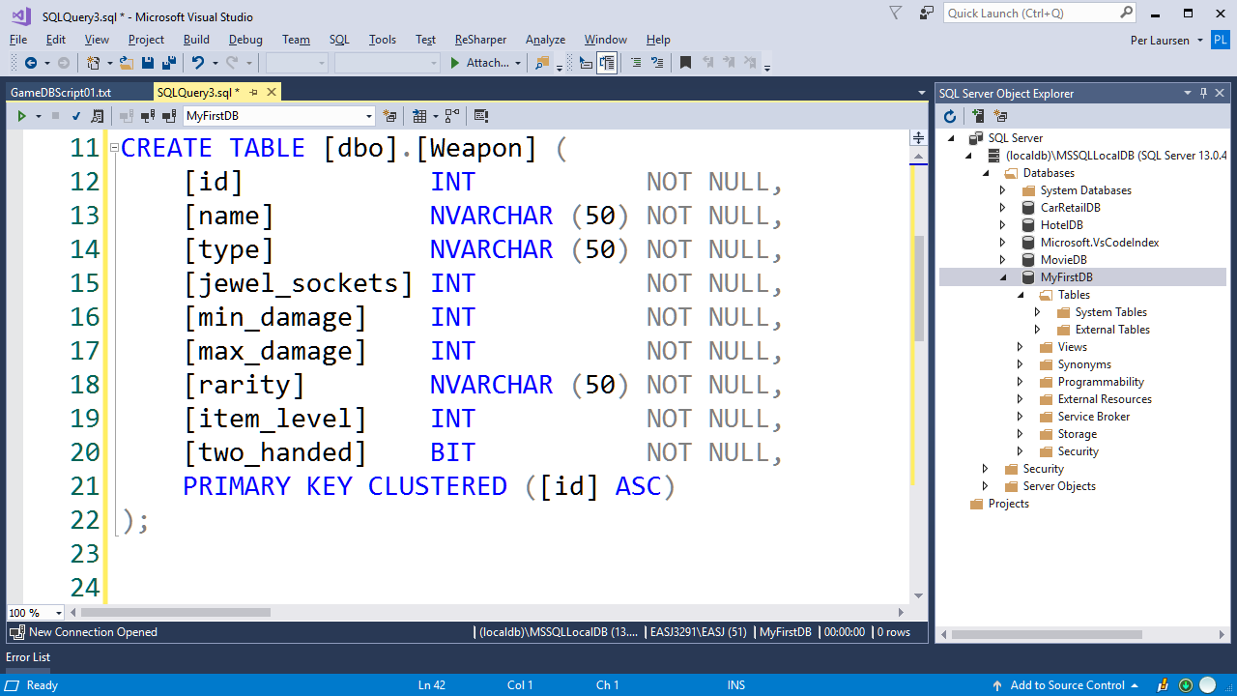

Slide 17
NOT THIS ONE!!! ☺
Run script by clicking the small green triangle

Slide 18
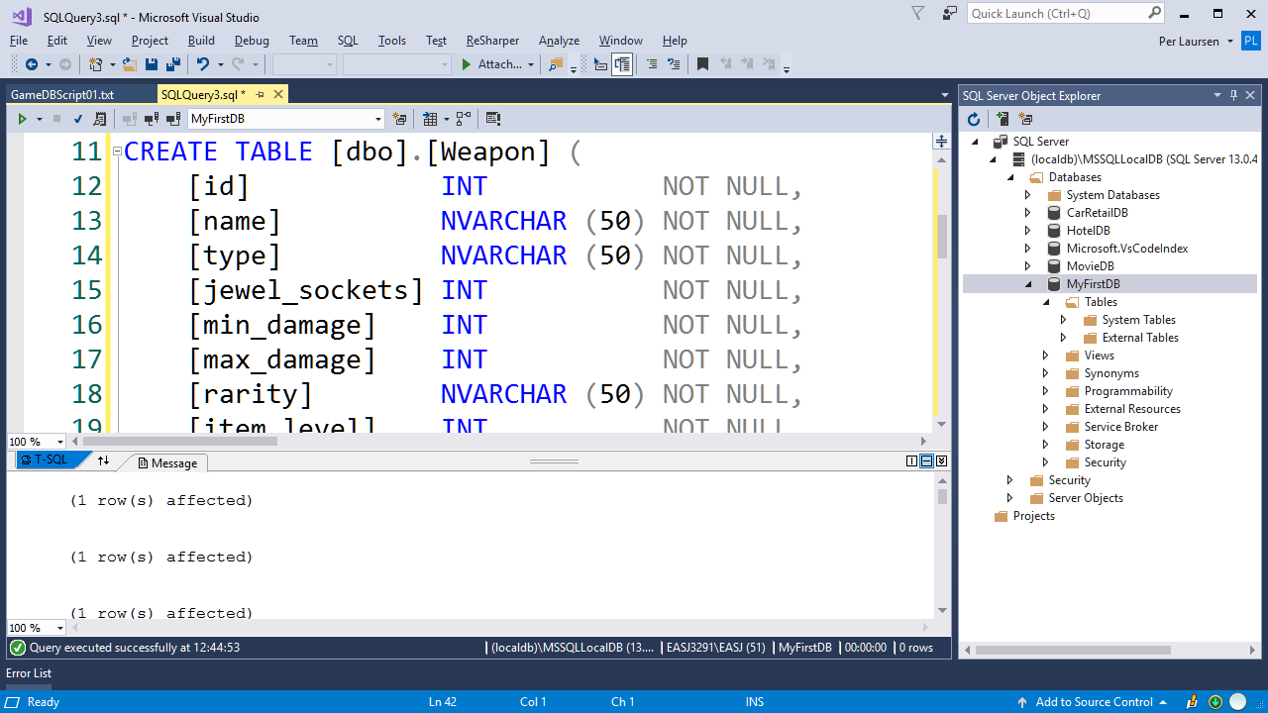
Result of executing query is shown here

Slide 19
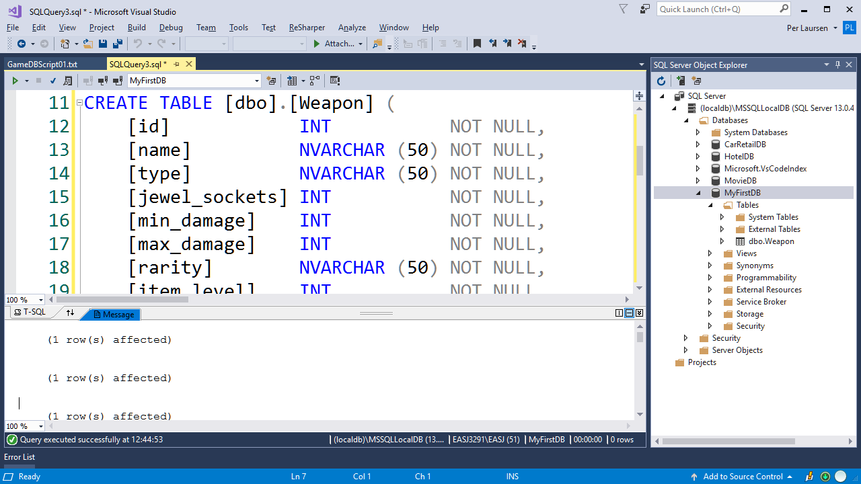
Now click the Refresh button…
…a new table has been added to MyFirstDB ☺

Slide 20
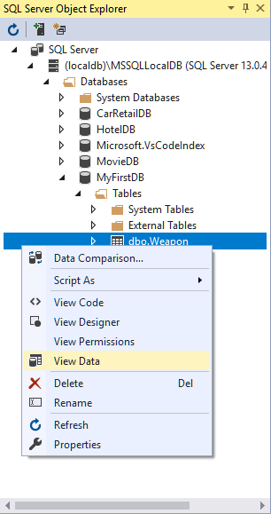
Right-click on Weapon table, and choose View Data

Slide 21
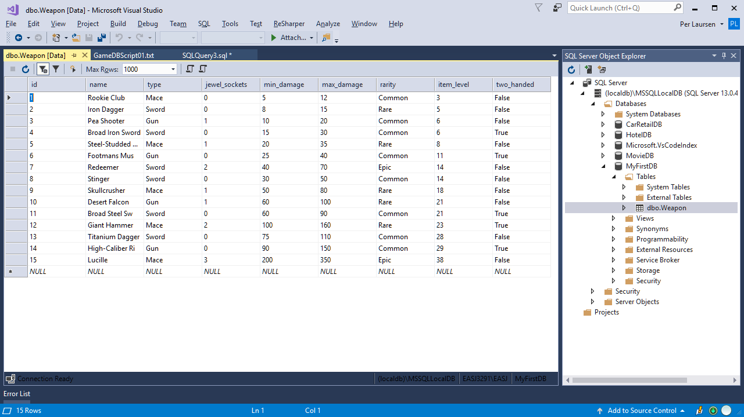
The Weapon table contains 15 rows

Slide 22
You can type in additional rows simply by entering values into the bottom row

Slide 23
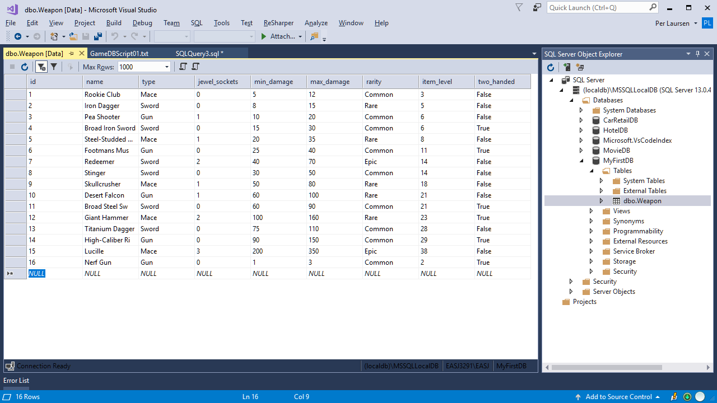

Slide 24
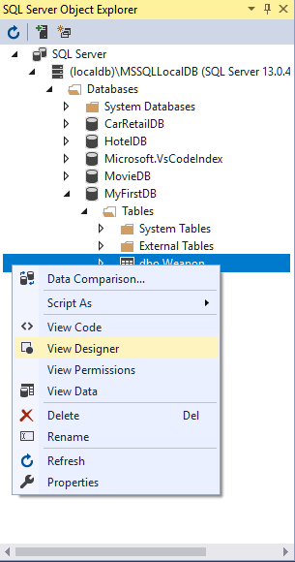
Right-click on Weapon table, and choose View Designer

Slide 25
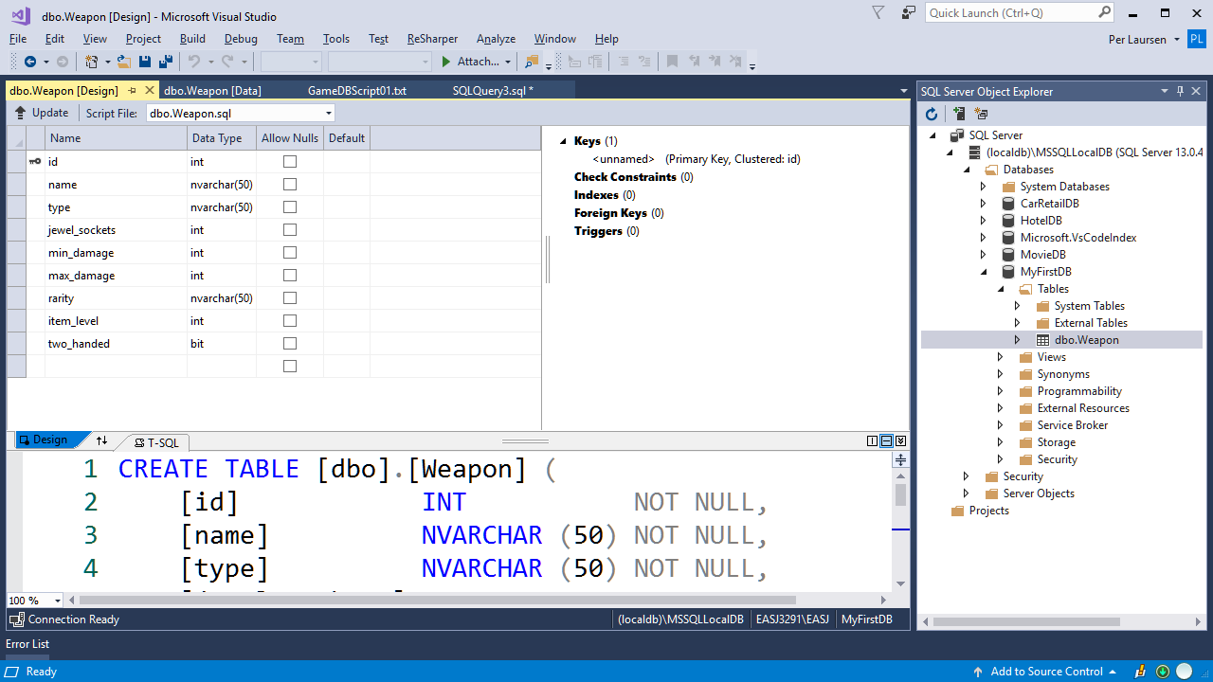
Column definitions for Weapon table (designer view)

Slide 26
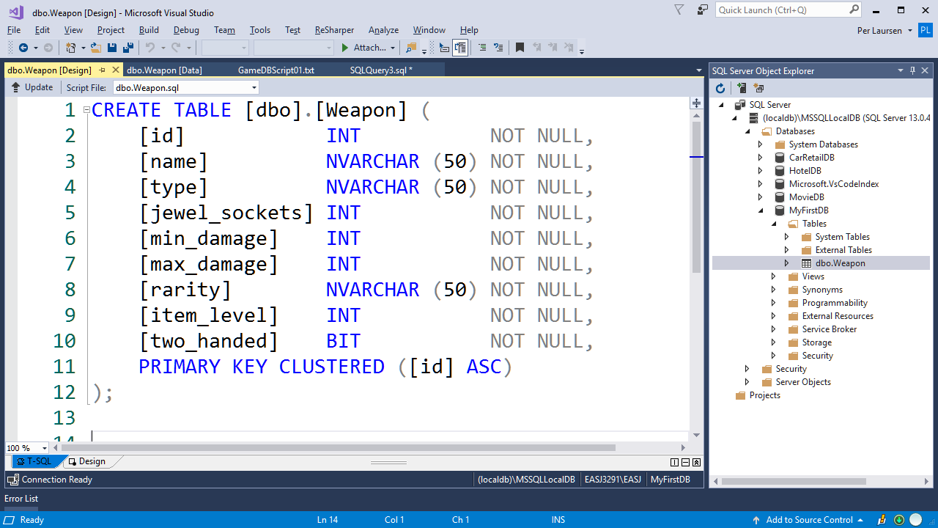
Column definitions for Weapon table (SQL code view)

Slide 27
Creating a database in Visual Studio
We can now
Create a new database
Run a given script on the database
Next steps are
Execute SELECT queries on a database (and also INSERT, UPDATE and DELETE)
Define tables manually

Slide 28
Executing queries on a database
Same procedure as executing a given script
Open a Query Window
Type in your query
Execute the query

Slide 29
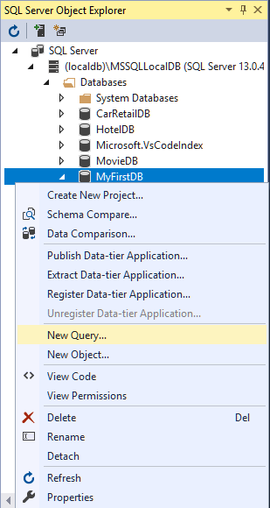
Right-click on MyFirstDB, and choose New Ouery…

Slide 30
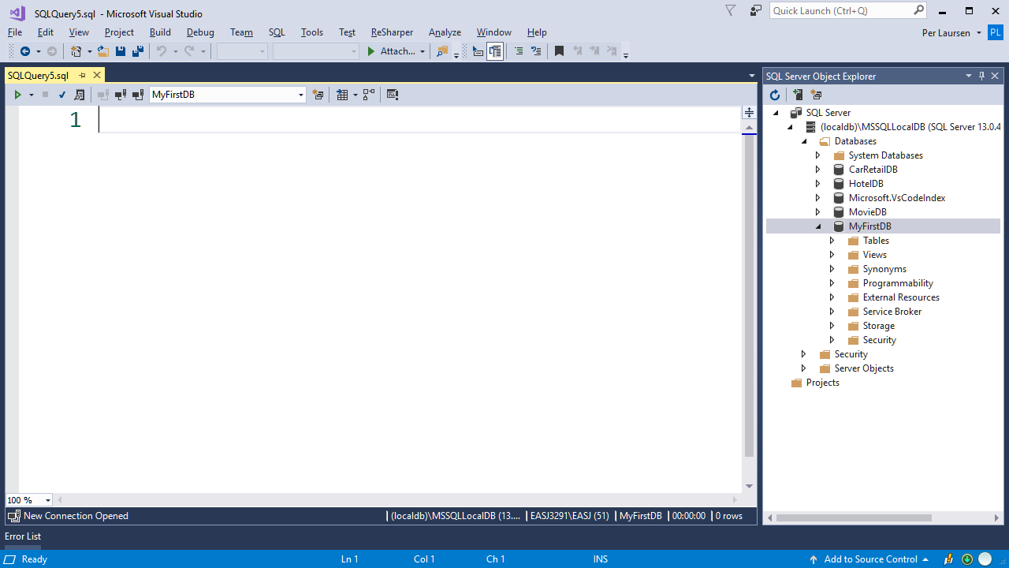
This opens a Query window

Slide 31
Here you can write SQL directly, or copy SQL from a given script

Slide 32
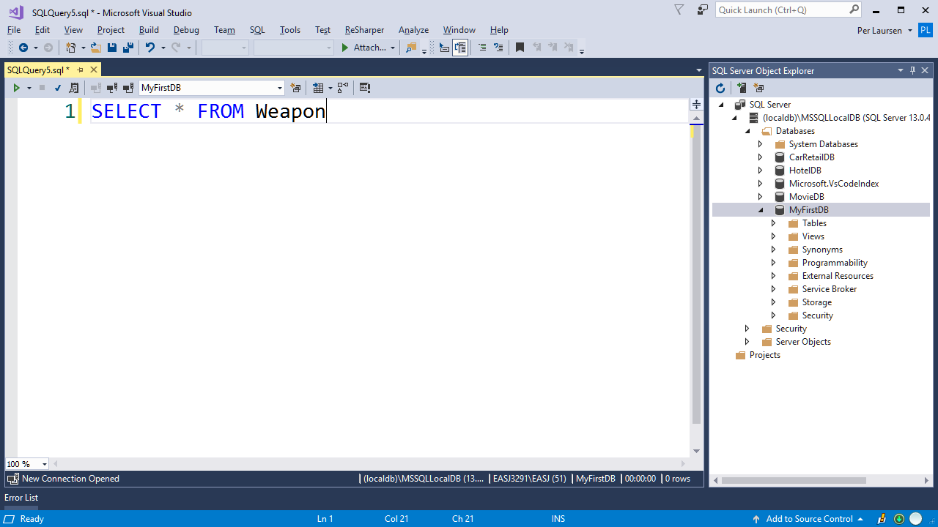
NOT THIS ONE!!! ☺
Run script by clicking the small green triangle

Slide 33
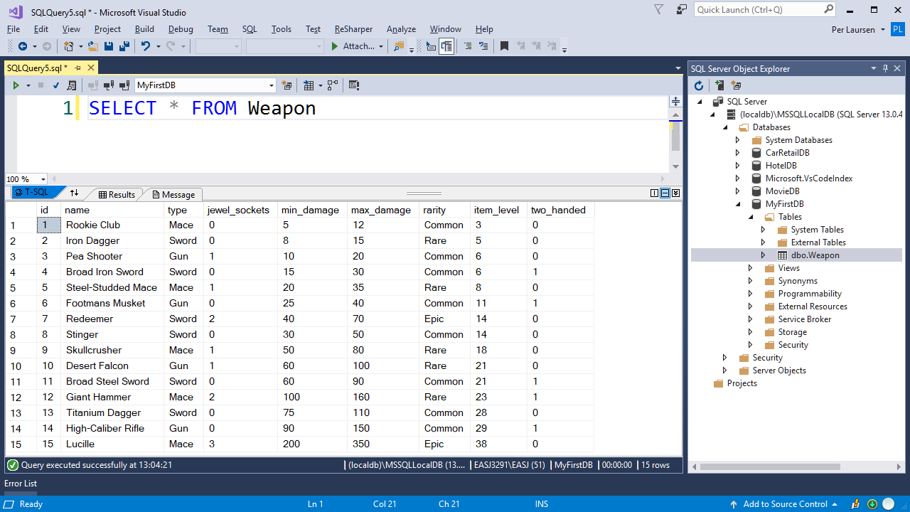

Slide 34
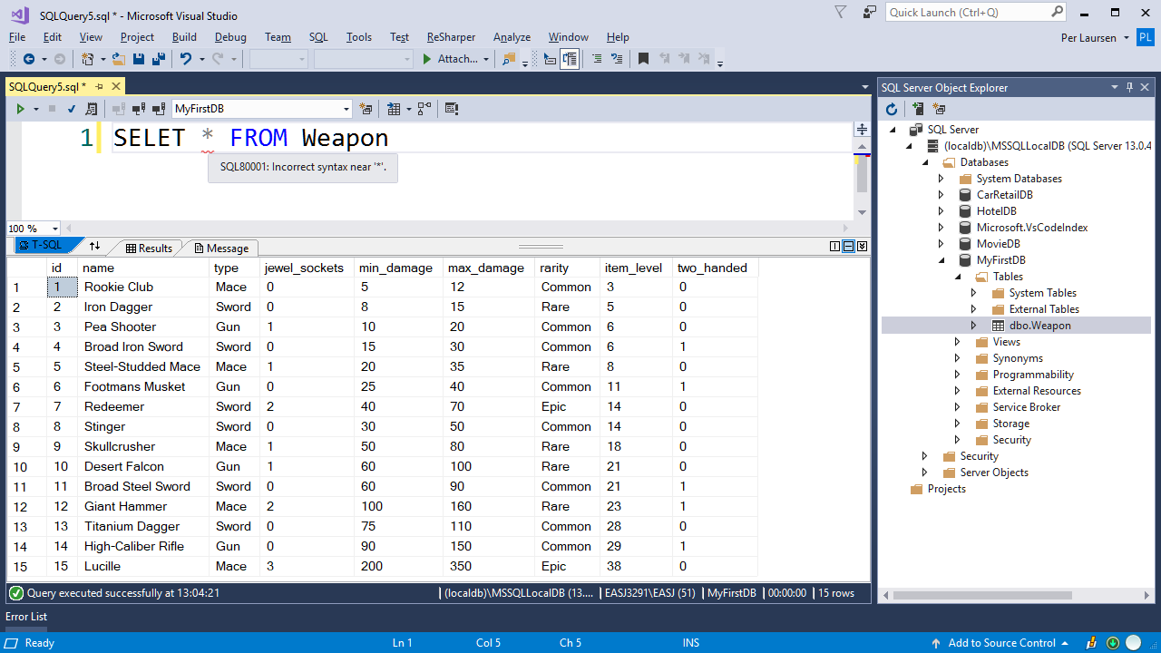
Main SQL keywords in blue
Syntax errors are indicated

Slide 35
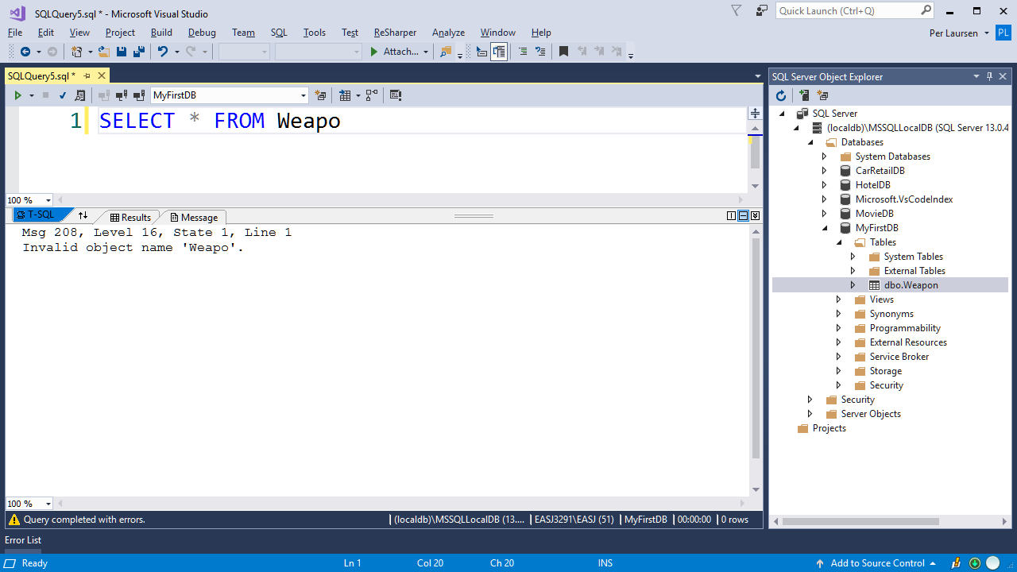
NB: Logical errors not discovered before running the query!

Slide 36
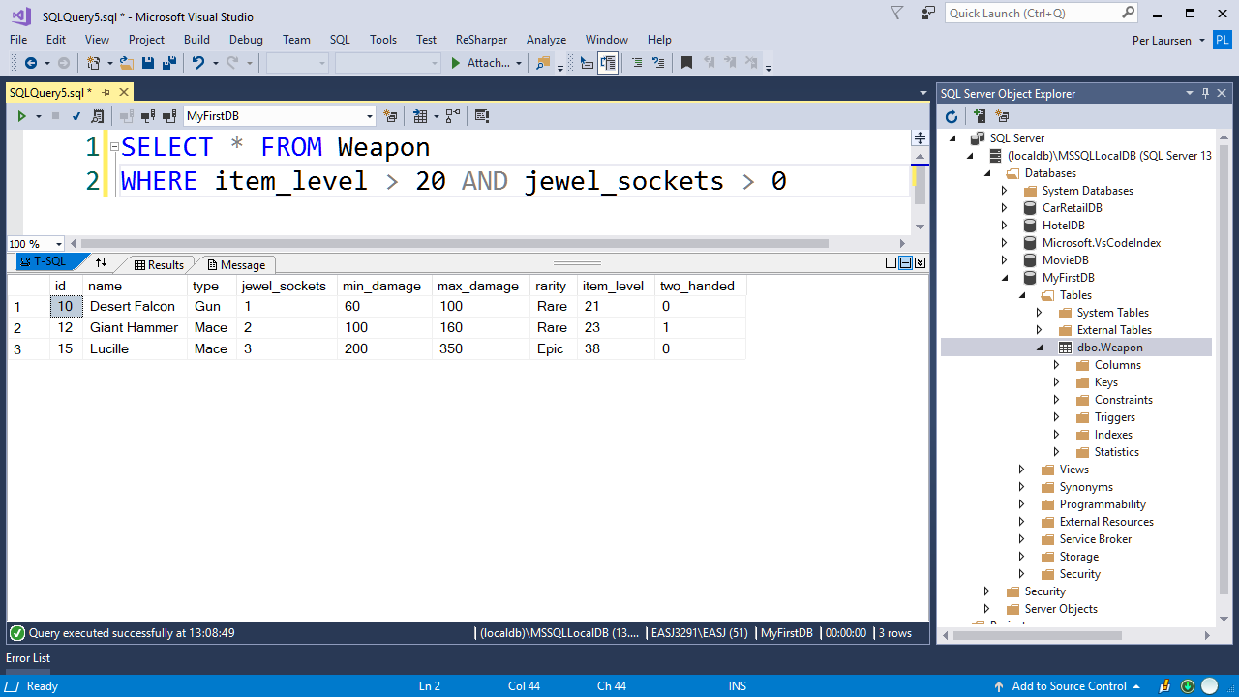

Slide 37
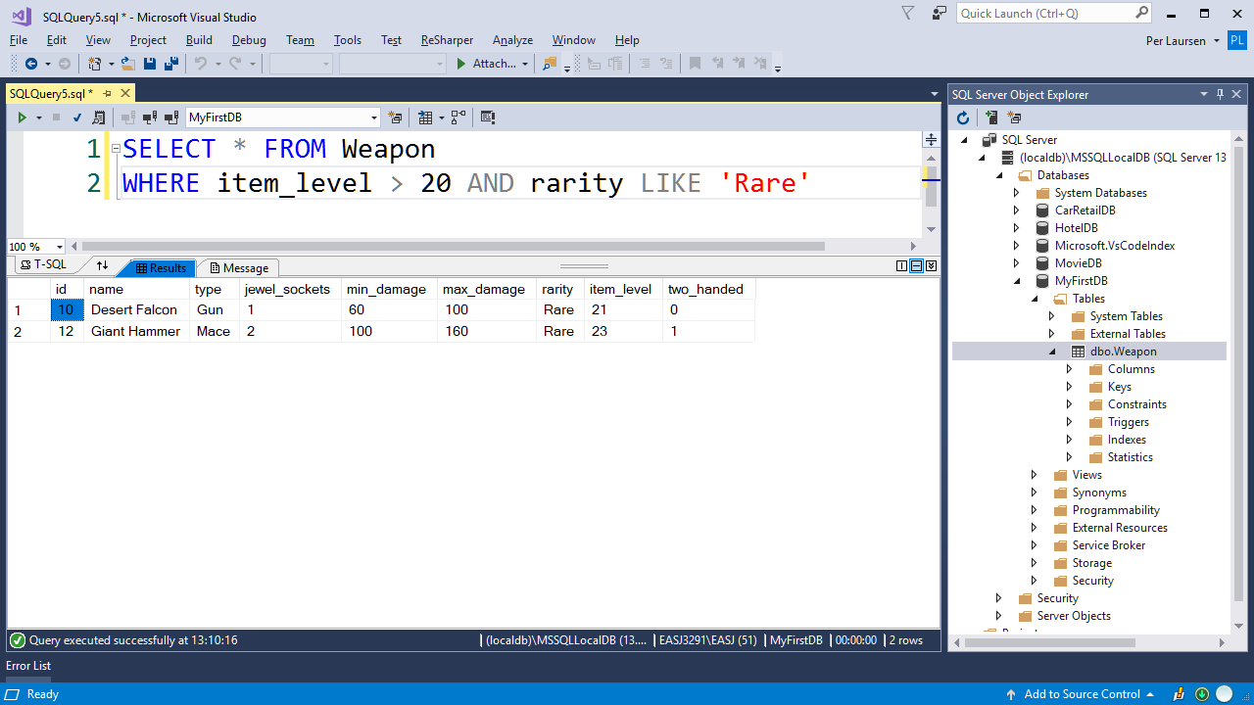

Slide 38
Defining a table manually
Two approaches:
Write SQL code for table definition directly in query window
Use the Designer to help with table definition. SQL code is then generated automatically
Last approach is recommended ☺

Slide 39
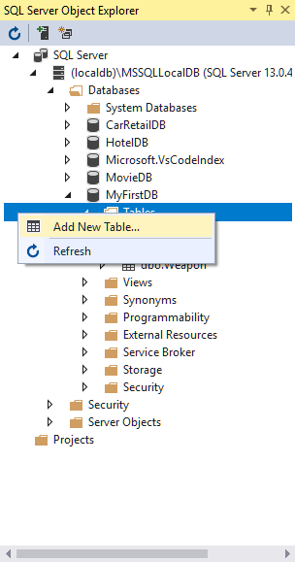
Right-click on Tables folder, choose Add New Table

Slide 40
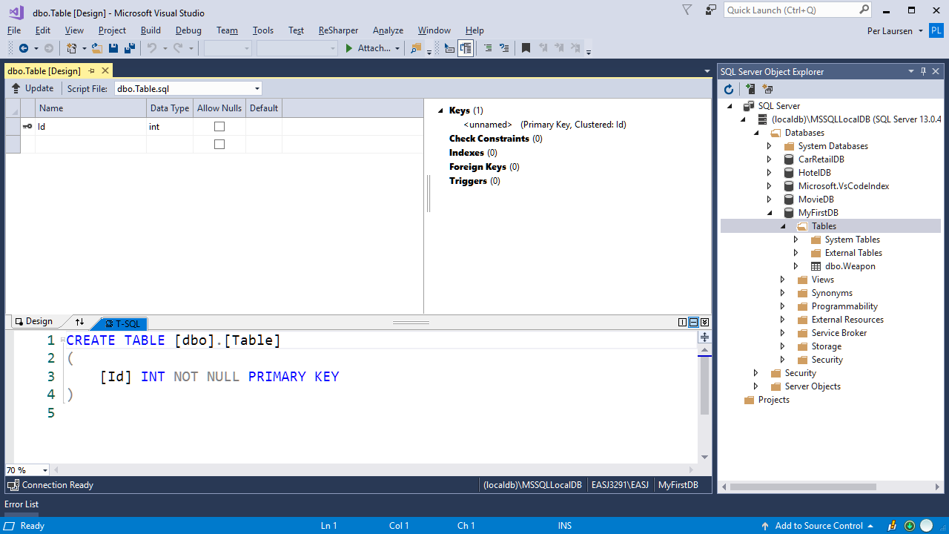
New table is initially named Table

Slide 41
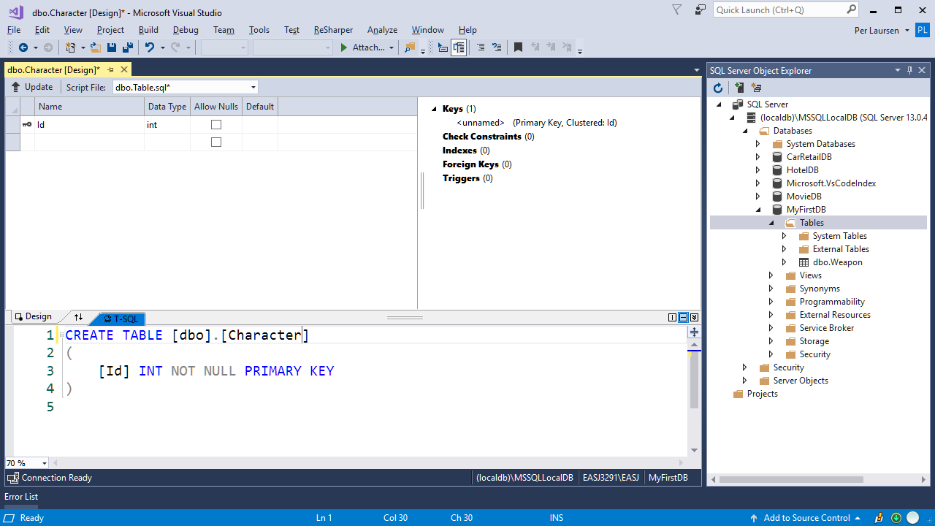
Change name manually here

Slide 42
Table initially has one column named Id

Slide 43
The column Id is:
A primary key
Of type int
Cannot be null

Slide 44
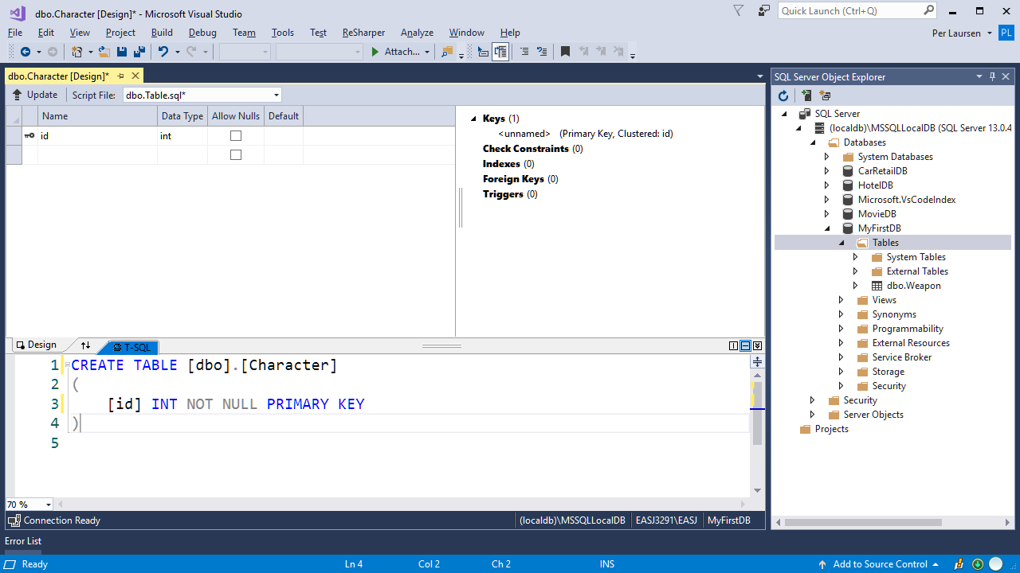
Change the column definition in the Design view

Slide 45
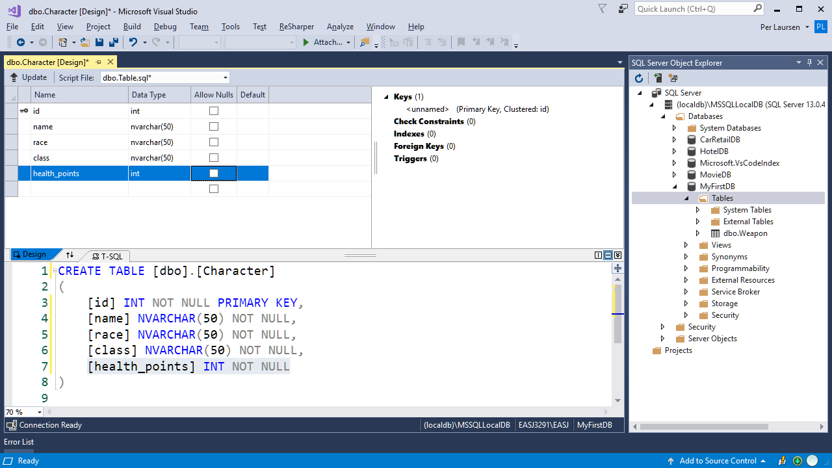
Add further column definitions in the Design view
SQL code for column definitions is auto-matically updated

Slide 46
Don’t click here
NB: A new table is not saved (i.e. added to the database) by clicking on Save!

Slide 47
Click on the Update button

Slide 48
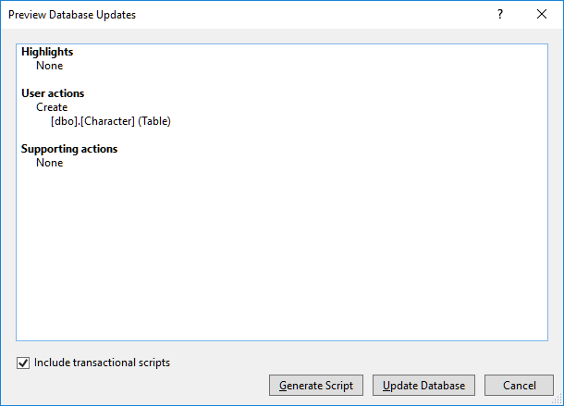
If all looks good, click on the Update Database button

Slide 49
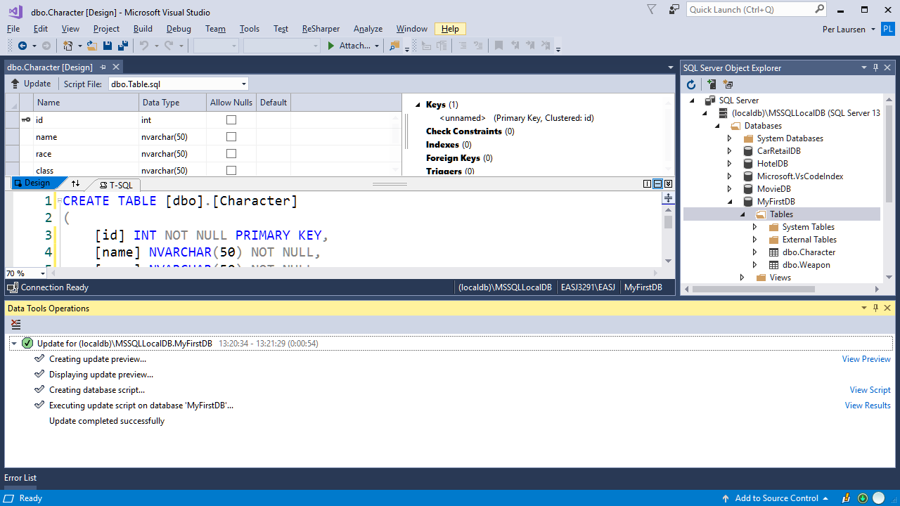
SUCCESS!!

Slide 50
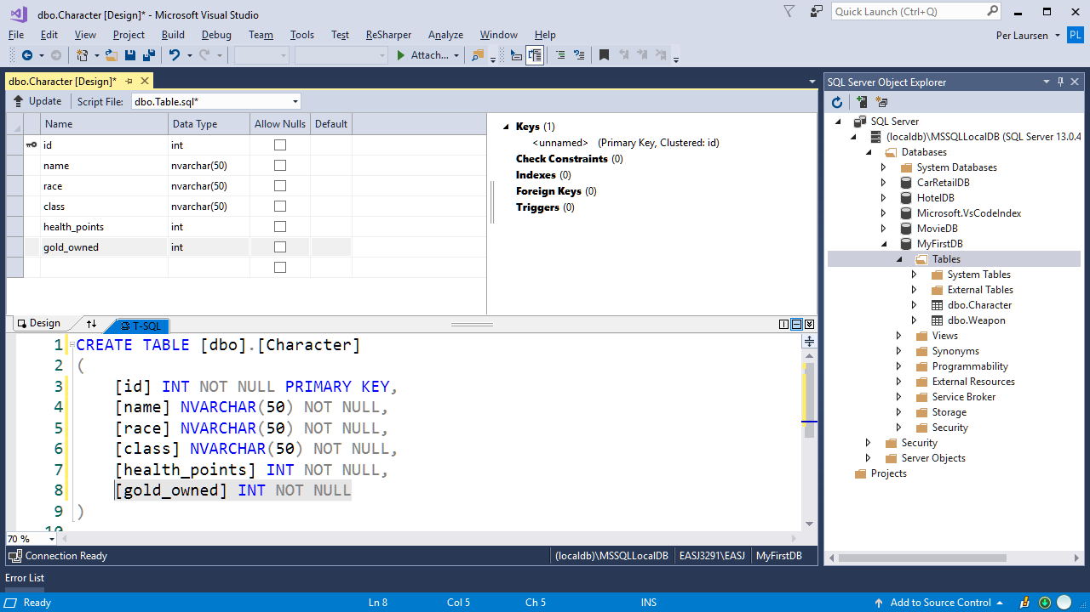
…and click on the Update button
If you want to update the table definition, then update it…

Slide 51
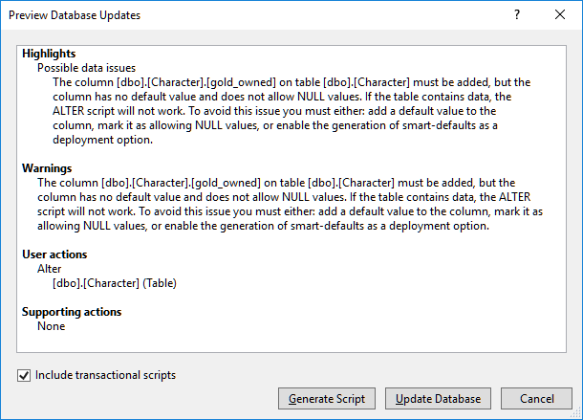
If all looks good (also the warning) click on the Update Database button
NB: Some change may result in warnings in the Preview Window!

Slide 52
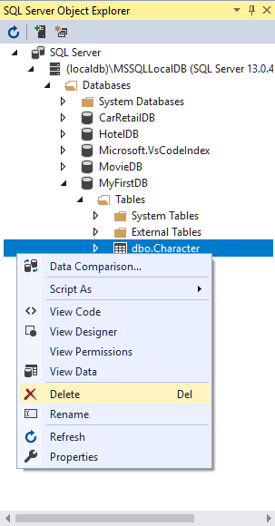
A table can also be deleted: Right-click on the table, and choose Delete

Slide 53
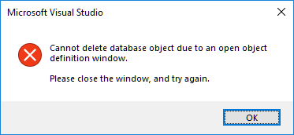
NB: Remember to close any windows relating to the table ☺

Slide 54
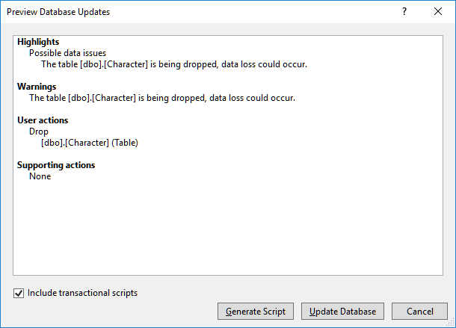
If all looks good (also the warning) click on the Update Database button

Slide 55
