Slide 1
SOLID
Design Principles

Slide 2
What goals do we strive at, when we develop software?

Slide 3
Zero Errors
Easy to reuse
Secure
Easy to use
Fast
Easy to extend

Slide 4
HIGH QUALITY
Zero Errors
Easy to reuse
Secure
Easy to use
Fast
Easy to extend

Slide 5
What is Quality?

Slide 6
What is Quality? “it depends…”

Slide 7


Slide 8



Slide 9


Slide 10
What is Quality?

Slide 11
What is Quality? “words ending with …bility”

Slide 12
Usability Reliability Extensibility Reusability Maintainability Portability …bility

Slide 13
Reusability Extensibility

Slide 14
How do we achieve… Reusability Extensibility

Slide 15
SOLID

Slide 16
Single responsibility Open/Closed Liskov Substitution Interface Segregation D…?

Slide 17
D…?
IoC
In some SOLID presentations: Dependency Injection (DI)
In other SOLID presentations: Dependency Inversion
Dependency Inversion aka Inversion of Control (IoC)
DI

Slide 18
Inversion of Control (IoC)
Maybe the most fundamental concept in Object-oriented programming
Applies at
Method level
Object level

Slide 19
Method-level IoC

Slide 20
public interface IAnimal
{
void Act();
}
public abstract class Animal : IAnimal
{
public abstract void Act();
}
public class Cat : Animal
{
// How to implement Cat behavior…
}

Slide 21
public class Cat : Animal
{
public override void Act()
{
// Traditional:
// I am the Cat class, so I am solely
// responsible for correct implementation
// of Cat behavior.
}
}

Slide 22
public class Cat : Animal
{
public override void Act()
{
if (MiceAround())
{
HuntMice();
}
else
{
Sleep();
}
}
private bool MiceAround() { … }
private void HuntMice() { … }
private void Sleep() { … }
}

Slide 23
Class responsibilities
Animal
Almost none…
Cat
Implements Act
Uses own methods for implementation
Has complete control of implementation

Slide 24
What if…
We need to implement additional animal classes, i.e. classes which inherit from Animal.

Slide 25
What if…
We need to implement additional animal classes, i.e. classes which inherit from Animal.
Very little potential for code re-use
Some methods could perhaps be moved to Animal class…?

Slide 26
public abstract class Animal
{
public abstract void Act();
public bool MiceAround() { … }
}

Slide 27
public class Cat : Animal
{
public override void Act()
{
if (MiceAround())
{
HuntMice();
}
else
{
Sleep();
}
}
public void HuntMice() { … }
public void Sleep() { … }
}

Slide 28
Class responsibilities
Animal
Library of common methods
Cat
Implements Act
Uses own methods and Animal methods for implementation
Has complete control of implementation, w.r.t. the ”algorithm”

Slide 29
Class responsibilities
Classic approach
(no IoC yet…)
Animal
Library of common methods
Cat
Implements Act
Uses own methods and Animal methods for implementation
Has complete control of implementation, w.r.t. the ”algorithm”

Slide 30
What if…
The behaviors of all animals follow a common pattern, but some steps are specific for each specific animal type.

Slide 31
What if…
The behaviors of all animals follow a common pattern, but some steps are specific for each specific animal type.
If this is the assumption…
…then we cannot allow specific animal classes to implement behavior freely!

Slide 32
public abstract class Animal
{
public void Act()
{
if (FoodAround(PreferredFood()))
{
GetFood();
}
else
{
Idle();
}
}
private bool FoodAround(string preferredFood) { … }
protected abstract string PreferredFood();
protected abstract void GetFood();
protected abstract void Idle();
}

Slide 33
public abstract class Animal
{
public void Act()
{
if (FoodAround(PreferredFood()))
{
GetFood();
}
else
{
Idle();
}
}
private bool FoodAround(string preferredFood) { … }
protected abstract string PreferredFood();
protected abstract void GetFood();
protected abstract void Idle();
}

Slide 34
public class Cat : Animal
{
protected override string PreferredFood()
{
return "Mouse";
}
protected override void GetFood()
{
HuntMice();
}
protected override void Idle()
{
Sleep();
}
private void HuntMice() { … }
private void Sleep() { … }
}

Slide 35
Class responsibilities
Animal
Implements the general algo-rithm for Act
Uses own methods and abstract methods for implementation
Act is not declared virtual; it can-not be changed by subclasses
Cat
Only implements methods which are abstract in the base class.

Slide 36
Class responsibilities
IoC approach
(Template Method pattern)
Animal
Implements the general algo-rithm for Act
Uses own methods and abstract methods for implementation
Act is not declared virtual; it can-not be changed by subclasses
Cat
Only implements methods which are abstract in the base class.

Slide 37
Classic
Animal
Cat calls Animal
Cat

Slide 38
Classic
IoC
Animal
Animal
Cat calls Animal
Animal calls Cat
Cat
Cat

Slide 39
public class Fox : Animal
{
protected override string PreferredFood()
{
return "Squirrel";
}
protected override void GetFood()
{
HuntSquirrel();
}
protected override void Idle()
{
Sleep();
}
private void HuntSquirrel() { … }
private void Sleep() { … }
}

Slide 40
Single Responsibility
Classes should only have one main responsibility
=> classes should only have one reason to change
Keep classes small, focused and abstract

Slide 41
public void ConvertData()
{
// Read data from database
string query = "SELECT * FROM CAR";
SQLServerDBConnection conn = SQLServerDBConnection.Connect("...");
RecordSet records = conn.ExecuteQuery(query);
// Convert data from RecordSet to XML
string XMLData = "";
foreach (var rec in records)
{
string licensePlate = rec.GetFieldAsString("LicensePlate");
int price = rec.GetFieldAsInt("Price");
string XMLelemStart = "<Car>\n";
string XMLelemLp = $" <Licenseplate>{licensePlate}</Licenseplate>\n";
string XMLelemPr = $" <Licenseplate>{price}</Licenseplate>\n";
string XMLelemEnd = "</Car>\n";
XMLData += XMLelemStart + XMLelemLp + XMLelemPr + XMLelemEnd;
}
// Write XML data to text file
FileWriterFAT32 fw32 = new FileWriterFAT32();
fw32.Write("C:\ConverterApp\Data\convData.txt", XMLData);
}

Slide 42
public void ConvertData(
IDBConnection conn,
IXMLConverter xmlConv,
IFileWriter fileWriter,
string query,
string fileTarget)
{
// Read data from database
RecordSet records = conn.ExecuteQuery(query);
// Convert data from RecordSet to XML
string xmlData = xmlConv.ConvertRecordSet(records);
// Write XML data to text file
fileWriter.Write(fileTarget, xmlData);
}

Slide 43
Open/Closed
Software entities should be open for extension, but closed for modification.
Open for extension: behavior can be extended with new behaviors
Closed for modification: Extension does not require change in the source code for the entity

Slide 44
public void ConvertData(
IDBConnection conn,
IXMLConverter xmlConv,
IFileWriter fileWriter,
string query,
string fileTarget)
{
// Read data from database
RecordSet records = conn.ExecuteQuery(query);
// Convert data from RecordSet to XML
string xmlData = xmlConv.ConvertRecordSet(records);
// Write XML data to text file
fileWriter.Write(fileTarget, xmlData);
}

Slide 45
public void ConvertData(
IDBConnection conn,
IRecordSetConverter rcConv,
IFileWriter fileWriter,
string query,
string fileTarget)
{
// Read data from database
RecordSet records = conn.ExecuteQuery(query);
// Convert data from RecordSet to text
string convData = rcConv.ConvertRecordSet(records);
// Write converted data to text file
fileWriter.Write(fileTarget, convData);
}

Slide 46
DB
Convert (to XML)
Text

Slide 47
DB
Convert (to JSON)
Text

Slide 48
// Call to convert to XML format
ConvertData(
new SQLServerDBConnection(),
new RecToXMLConverter(),
new FileWriterFAT32(),
query,
fileTarget);

Slide 49
// Call to convert to JSON format
ConvertData(
new SQLServerDBConnection(),
new RecToJSONConverter(),
new FileWriterFAT32(),
query,
fileTarget);

Slide 50

Liskov Substitution
Principle relating to how to create inheritance hierarchies
Ensures that a client can use subclasses of provided classes without changing the expected behavior
Maybe another time… ☺

Slide 51
Interface Segregation
Interfaces: abstract definitions of behavior
Clients should ”see” objects through interfaces
Smaller interfaces => less dependency between clients and objects
One object may implement many interfaces
Keep interfaces small and focused

Slide 52
ClassABC
MethodA
MethodB
MethodC
Client

Slide 53
public class Client
{
private ClassABC _abc;
public Client()
{
_abc = new ClassABC();
}
public DoUsefulStuff()
{
_abc.MethodB();
}
}

Slide 54
ClassABC
MethodA
MethodB
MethodC
Client

Slide 55
ClassABC
MethodA
MethodB
MethodC
Client
Composition

Slide 56
public class Client
{
private ClassABC _abc;
public Client(ClassABC abc)
{
_abc = abc;
}
public DoUsefulStuff()
{
_abc.MethodB();
}
}

Slide 57
ClassABC
MethodA
MethodB
MethodC
Client

Slide 58
ClassABC
MethodA
MethodB
MethodC
Client
Aggregation

Slide 59
ClassABC
MethodA
MethodB
MethodC
Client

Slide 60
InterfaceA
MethodA
ClassABC
MethodA
MethodB
MethodC
Client
InterfaceB
MethodB
InterfaceC
MethodC

Slide 61
public class Client
{
private InterfaceB _b;
public Client(InterfaceB b)
{
_b = b;
}
public DoUsefulStuff()
{
_b.MethodB();
}
}

Slide 62
Client
InterfaceB
MethodB
Aggregation
ClassABC
MethodA
MethodB
MethodC

Slide 63
InterfaceA
ClassABC
Client
InterfaceB
InterfaceC

Slide 64
InterfaceA
Client
InterfaceB
ClassB
InterfaceC

Slide 65
Client
InterfaceB
ClassB

Slide 66
Dependency Injection
A class should not itself establish (too) tight dependencies to other classes
Dependencies should be injected by a third party, by means of interfaces
Can also be applied at lower levels
Look for places in code where variation can occur, and turn them into extension points
Apply when relevant!

Slide 67
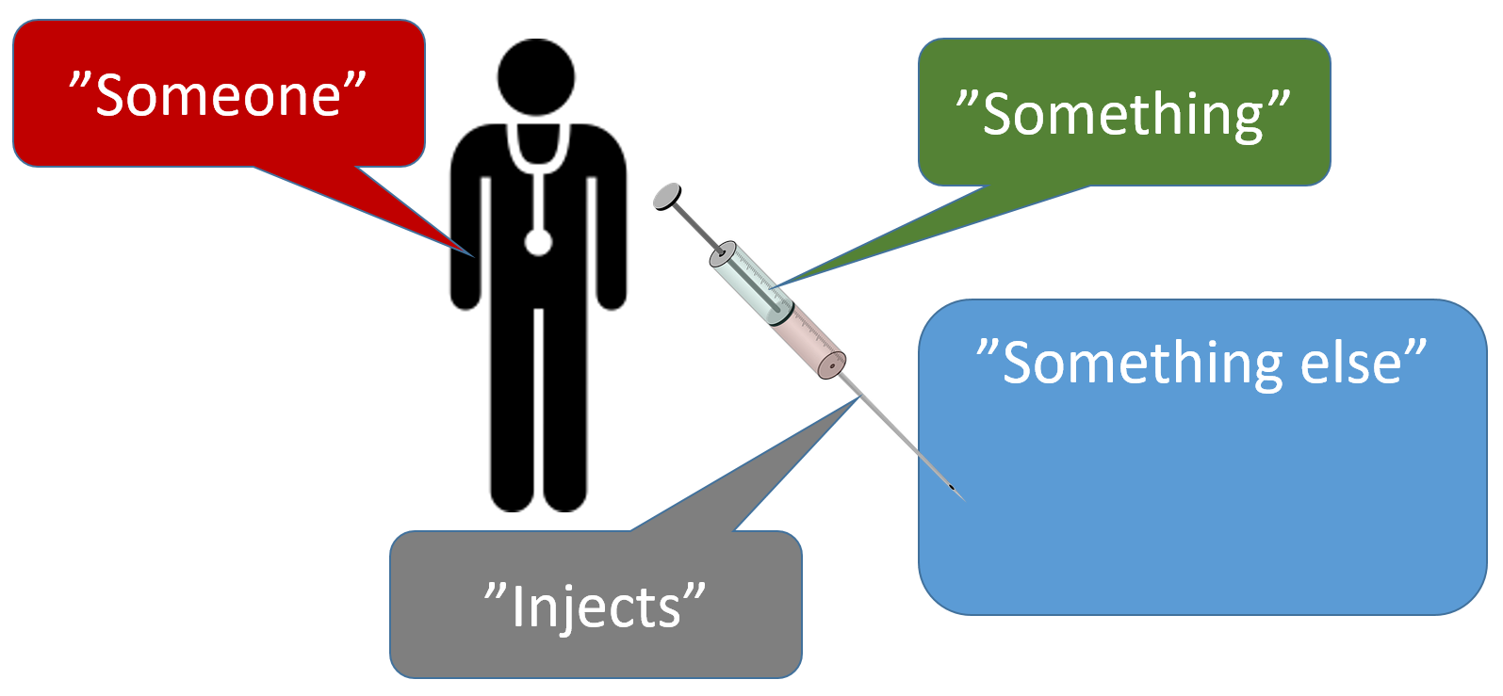

Slide 68


Slide 69
public int SquareOf4()
{
return 4 * 4;
}

Slide 70
public int SquareOf4()
{
return 4 * 4;
}
public int SquareOf6()
{
return 6 * 6;
}

Slide 71

public int Square(int n)
{
return n * n;
}

Slide 72
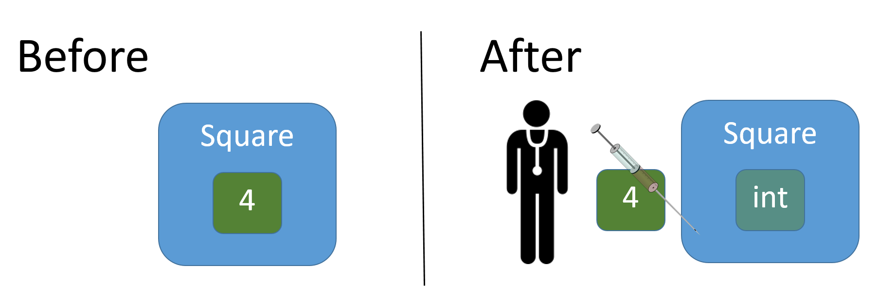

Slide 73
public class Die
{
private int _faceValue;
private static Random _random = new Random();
public Die()
{
Roll();
}
public int FaceValue
{
get { return _faceValue; }
}
public void Roll()
{
_faceValue = _random.Next(0,6) + 1;
}
}

Slide 74

public void Roll()
{
_faceValue = _random.Next(0,6) + 1;
}
public void Roll(int noOfSides)
{
_faceValue = _random.Next(0, noOfSides) + 1;
}

Slide 75
public class Die
{
private int _faceValue;
private int _noOfSides;
private static Random _random = new Random();
public Die(int noOfSides)
{
_noOfSides = noOfSides;
Roll();
}
public int FaceValue
{
get { return _faceValue; }
}
public void Roll()
{
_faceValue = _random.Next(0, _noOfSides) + 1;
}
}

Slide 76
Dependency Injection – filtering values
Given a set of integer values, filter out those values for which a certain condition becomes true.
Condition example: value is less than 12.
12
24
9
10
6
3
45
< 12
9
10
6
3

Slide 77
// Version 1.0
public List<int> FilterValues()
{
List<int> values = new List<int>{ 12, 24, 9, 10, 6, 3, 45 };
List<int> filteredValues = new List<int>();
foreach (int value in values)
{
if (value < 12)
{
filteredValues.Add(value);
}
}
return filteredValues;
}

Slide 78
// Call of Version 1.0
List<int> filteredValues;
FilterV10 fv10 = new FilterV10();
filteredValues = fv10.FilterValues();

Slide 79

// Version 1.0
public List<int> FilterValues()
{
List<int> values = new List<int>
{ 12, 24, 9, 10, 6, 3, 45 };
List<int> filteredValues = new List<int>();
foreach (int value in values)
{
if (value < 12)
{
filteredValues.Add(value);
}
}
return filteredValues;
}
What parts of this filtering process may vary?
How can we manage this variation?
30
25
20
15
10
5

Slide 80
// Version 1.0
public List<int> FilterValues()
{
List<int> values = new List<int>{ 12, 24, 9, 10, 6, 3, 45 };
List<int> filteredValues = new List<int>();
foreach (int value in values)
{
if (value < 12)
{
filteredValues.Add(value);
}
}
return filteredValues;
}

Slide 81
// Version 2.0
public List<int> FilterValues(List<int> values)
{
List<int> filteredValues = new List<int>();
foreach (int value in values)
{
if (value < 12)
{
filteredValues.Add(value);
}
}
return filteredValues;
}

Slide 82
// Call of Version 2.0
List<int> values = new List<int>{…};
List<int> filteredValues;
FilterV20 fv20 = new FilterV20();
filteredValues = fv20.FilterValues(values);

Slide 83
// Version 2.0
public List<int> FilterValues(List<int> values)
{
List<int> filteredValues = new List<int>();
foreach (int value in values)
{
if (value < 12)
{
filteredValues.Add(value);
}
}
return filteredValues;
}

Slide 84
public interface ICondition
{
bool Condition(int value);
}

Slide 85
// Version 3.0
public List<int> FilterValues(List<int> values, ICondition cond)
{
List<int> filteredValues = new List<int>();
foreach (int value in values)
{
if (cond.Condition(value))
{
filteredValues.Add(value);
}
}
return filteredValues;
}

Slide 86
public class ConditionLessThan12 : ICondition
{
public bool Condition(int value)
{
return (value < 12);
}
}

Slide 87
// Call of Version 3.0
List<int> values = new List<int>{…};
List<int> filteredValues;
ICondition condInt = new ConditionLessThan12();
FilterV30 fv30 = new FilterV30();
filteredValues = fv30.FilterValues(values, condInt);

Slide 88
// Version 3.0
public List<int> FilterValues(List<int> values, ICondition cond)
{
List<int> filteredValues = new List<int>();
foreach (int value in values)
{
if (cond.Condition(value))
{
filteredValues.Add(value);
}
}
return filteredValues;
}

Slide 89
public interface ICondition
{
bool Condition(int value);
}

Slide 90
public interface IConditionGeneric<T>
{
bool Condition(T value);
}

Slide 91
// Version 4.0
public List<T> FilterValues<T>(List<T> values, IConditionGeneric<T> cond)
{
List<T> filteredValues = new List<T>();
foreach (T value in values)
{
if (cond.Condition(value))
{
filteredValues.Add(value);
}
}
return filteredValues;
}

Slide 92
public class ConditionContainsS : IConditionGeneric<string>
{
public bool Condition(string value)
{
return value.ToLower().Contains("s");
}
}

Slide 93
// Call of Version 4.0
List<string> valuesStr = new List<string>{…};
List<string> filteredValuesStr;
IConditionGeneric<T> condStr = new ConditionContainsS();
FilterV40<string> fv40 = new FilterV40<string>();
filteredValuesStr = fv40.FilterValues(valuesStr, condStr);

Slide 94
// Version 4.0
public List<T> FilterValues<T>(List<T> values, IConditionGeneric<T> cond)
{
List<T> filteredValues = new List<T>();
foreach (T value in values)
{
if (cond.Condition(value))
{
filteredValues.Add(value);
}
}
return filteredValues;
}

Slide 95
// Version 5.0
public List<T> FilterValues<T>(IEnumerable<T> values, IConditionGeneric<T> cond)
{
List<T> filteredValues = new List<T>();
foreach (T value in values)
{
if (cond.Condition(value))
{
filteredValues.Add(value);
}
}
return filteredValues;
}

Slide 96
// Call of Version 4.0
List<string> valuesStr = new List<string>{…};
List<string> filteredValuesStr;
IConditionGeneric<T> condStr = new ConditionContainsS();
FilterV40<string> fv40 = new FilterV40<string>();
filteredValuesStr = fv40.FilterValues(valuesStr, condStr);

Slide 97
// Call of Version 5.0
LinkedList<string> valuesStr = new LinkedList<string>{…};
List<string> filteredValuesStr;
IConditionGeneric<T> condStr = new ConditionContainsS();
FilterV50<string> fv50 = new FilterV50<string>();
filteredValuesStr = fv50.FilterValues(valuesStr, condStr);

Slide 98
// Version 6.0 (with LINQ)
public List<T> FilterValues<T>(IEnumerable<T> values, IConditionGeneric<T> cond)
{
return values.Where(cond.Condition).ToList();
}
// Version 6.1 (with LINQ)
public List<T> FilterValues<T>(IEnumerable<T> values, Func<T, bool> condFunc)
{
return values.Where(condFunc).ToList();
}

Slide 99
// Call of Version 6.1
LinkedList<string> valuesStr = new LinkedList<string>{…};
List<string> filteredValuesStr;
FilterV61<string> fv61 = new FilterV61<string>();
filteredValuesStr = fv61.FilterValues(
valuesStr,
str => str.ToLower().Contains("s"));

Slide 100
Client

Slide 101
Client
ClassABC

Slide 102
public class Client
{
private ClassABC _abc;
public Client()
{
_abc = new ClassABC();
}
public DoUsefulStuff()
{
_abc.MethodB();
}
}

Slide 103
Client c = new Client();
c.DoUseufulStuff();

Slide 104
Client

Slide 105
Client
ClassABC

Slide 106
public class Client
{
private ClassABC _abc;
public Client(ClassABC abc)
{
_abc = abc;
}
public DoUsefulStuff()
{
_abc.MethodB();
}
}

Slide 107
ClassABC abc = new ClassABC();
Client c = new Client(abc);
c.DoUseufulStuff();

Slide 108
InterfaceB
Client
ClassABC

Slide 109
public class Client
{
private InterfaceB _b;
public Client(InterfaceB b)
{
_b = b;
}
public DoUsefulStuff()
{
_b.MethodB();
}
}

Slide 110
// Create object that implements InterfaceB
InterfaceB b = new …();
Client c = new Client(b);
c.DoUseufulStuff();

Slide 111
Client

Slide 112
Client
ClassABC

Slide 113
Injector

Slide 114
Injector
new ClassABC();
ClassABC

Slide 115
Injector
InterfaceB b = new ClassABC();
InterfaceB
ClassABC

Slide 116
Injector
InterfaceB b = new ClassABC();
Client c = new Client(…);
Client
InterfaceB
ClassABC

Slide 117
Injector
InterfaceB b = new ClassABC();
Client c = new Client(b);
Client
InterfaceB
ClassABC

Slide 118
Who is the Injector?

