Slide 1
Composite Design Pattern

Slide 2
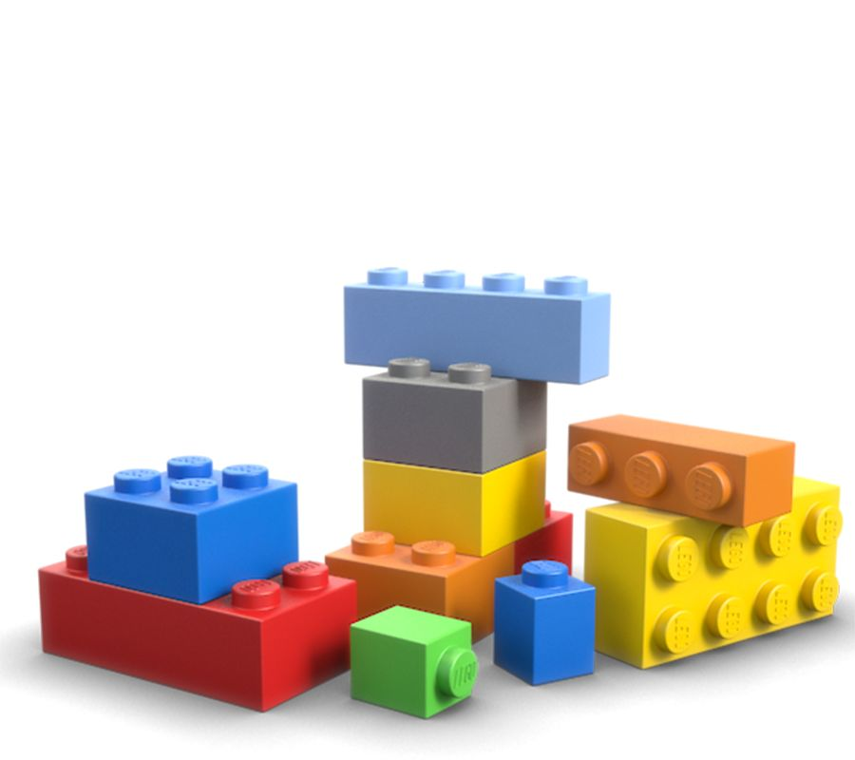
Modeling Part-Whole relationships
We often define something to be ”composed” of other things
A Car can be ”composed” of wheels, seats, engine, etc..
In some situations, it makes sense to be able to treat the ”whole” in the same way as the ”parts”

Slide 3
Modeling Part-Whole relationships
A Lego structure consists of Lego blocks

Slide 4
public interface ILegoBlock
{
double Weight { get; }
string Description { get; }
}

Slide 5
public interface ILegoStructure
{
double TotalWeight { get; }
int NoOfBlocks { get; }
}

Slide 6
public class LegoBlock : ILegoBlock
{
public double Weight { get; }
public string Description { get; }
public LegoBlock(double weight, string description)
{
Weight = weight;
Description = description;
}
}

Slide 7
public class LegoStructure : ILegoStructure
{
private List<ILegoBlock> _blocks;
public LegoStructure(List<ILegoBlock> blocks)
{
_blocks = blocks;
}
public double TotalWeight
{
get { return _blocks.Select(b => b.Weight).Sum(); }
}
public int noOfBlocks
{
get { return _blocks.Count; }
}
}

Slide 8
public class LegoBlock : ILegoBlock
{
public double Weight { get; }
public string Description { get; }
public LegoBlock(double weight, string description)
{
Weight = weight;
Description = description;
}
}

Slide 9
Modeling Part-Whole relationships
A Lego structure consists of
Lego blocks, and
Lego structures

Slide 10
public interface ILegoStructure
{
double TotalWeight { get; }
int NoOfBlocks { get; }
string Description { get; } // Added
}

Slide 11
public class LegoBlock : ILegoStructure
{
public string Description { get; }
public double TotalWeight { get; }
public LegoBlock(double weight, string description)
{
TotalWeight = weight;
Description = description;
}
public int noOfBlocks { get { return 1; } }
}

Slide 12
public class LegoStructure : ILegoStructure
{
private List<ILegoStructure> _parts;
public LegoStructure(List<ILegoStructure> parts)
{
_parts = parts;
}
public double TotalWeight
{
get { return _parts.Select(b => b.TotalWeight).Sum(); }
}
public int noOfBlocks
{
get { return _parts.Select(b => b.noOfBlocks).Sum(); }
}
public string Description { get { return "Composite"; } }
}

Slide 13
public void PlayWithLego()
{
ILegoStructure blockA = new LegoBlock(3, "6-dot");
ILegoStructure blockB = new LegoBlock(3, "6-dot");
ILegoStructure blockC = new LegoBlock(4, "8-dot");
List<ILegoStructure> listA = new List<ILegoStructure>{ blockA, blockB, blockC };
ILegoStructure structA = new LegoStructure(listA);
ILegoStructure blockD = new LegoBlock(8, "16-dot");
ILegoStructure blockE = new LegoBlock(4, "8-dot");
List<ILegoStructure> listB = new List<ILegoStructure>{ blockD, blockE, structA };
ILegoStructure structB = new LegoStructure(listB);
Console.WriteLine($"Structure A {structA.TotalWeight} gr., {structA.noOfBlocks} blocks" );
Console.WriteLine($"Structure B {structB.TotalWeight} gr., {structB.noOfBlocks} blocks");
Console.ReadKey();
}

Slide 14
ICompositable
Leaf
Composite

Slide 15
Client
ICompositable
Leaf
Composite

Slide 16
Composite pattern
Composite class will often contain methods and properties for building/ maintaining the ”composed” structure
AddChild
RemoveChild
Children
…etc.

