Slide 1
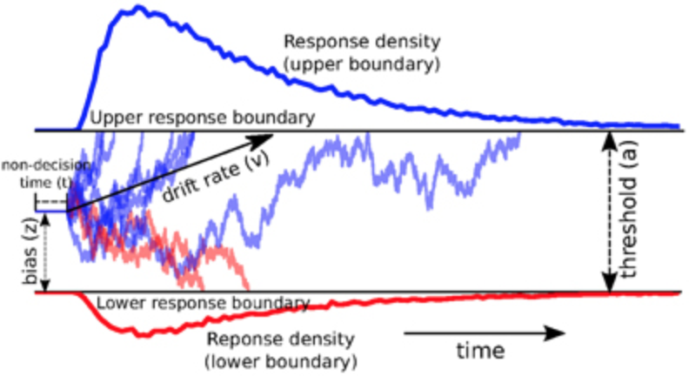
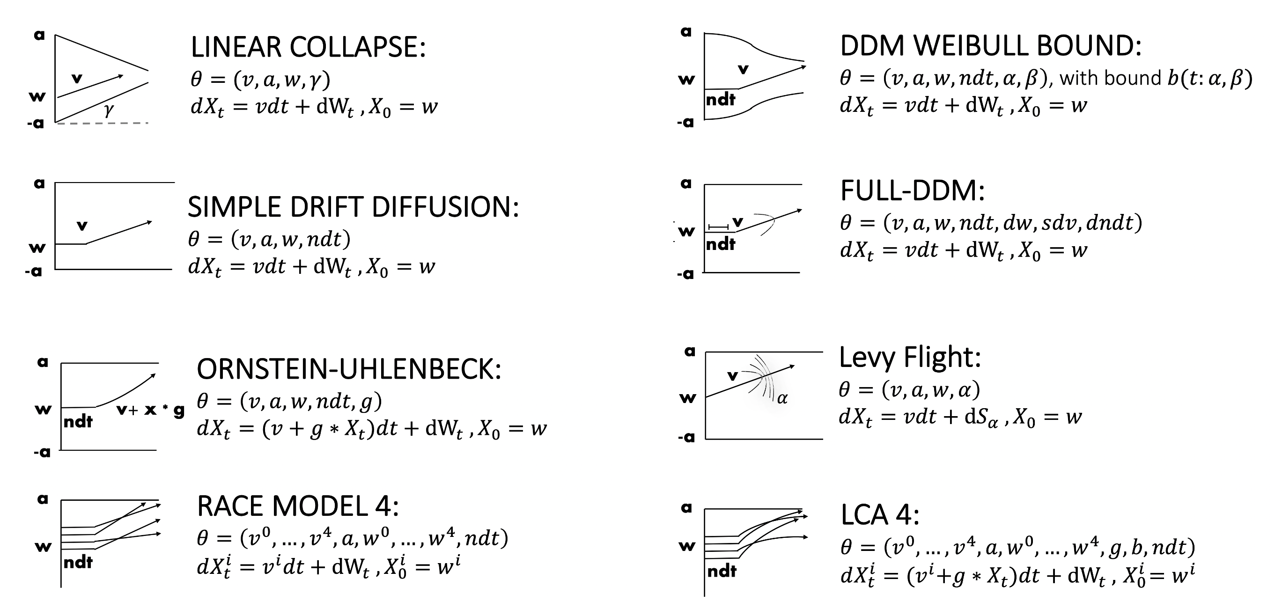
.
.
.
.
.
.

Slide 2

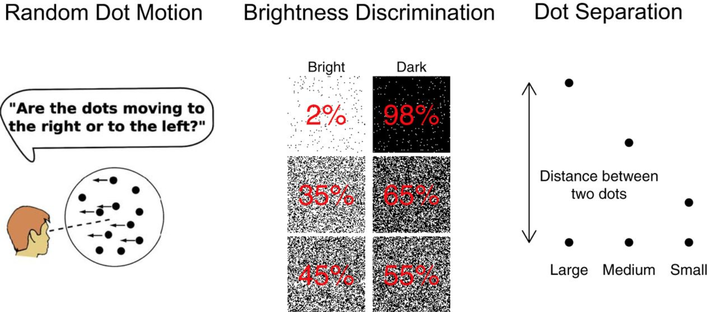


Slide 3
.
.
.
.
.
.

Slide 4
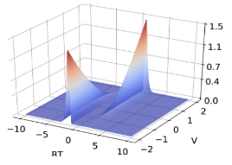
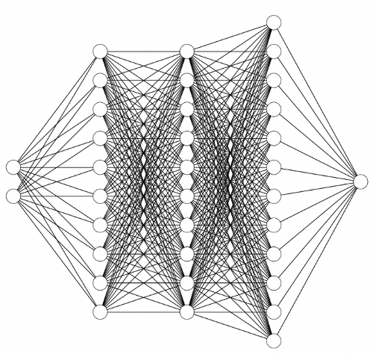
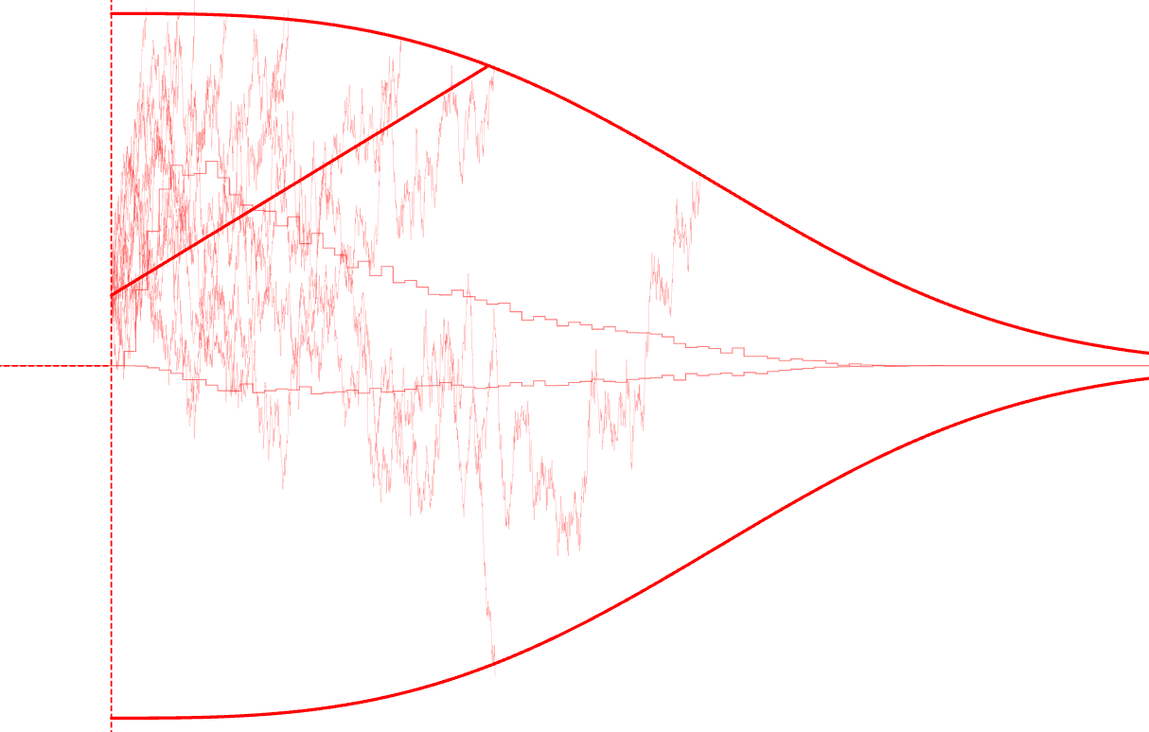
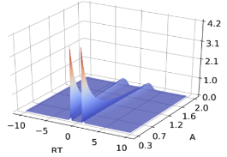
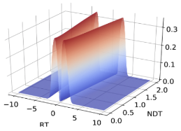






COMPUTATIONAL COGNITIVE PROCESS MODEL
AMORTIZE COMPUTATIONS
(neural networks)
AMORTIZED
LIKELIHOODS
drift: v
response boundary: b(t; a, 𝛼, β)
$$rt$$
$$v$$
starting-point bias: z
correct choices
mistakes
$$rt$$
$$a$$
non-decision time: 𝛕
$$rt$$
$$τ$$

