Slide 1

BIOM5405 Project Proposal
[1]
Long Short-term Memory Networks (LSTMN) in classifying Huntington's, Parkinson's and ALS from Gait Time Series Data
Presentation by Group 10: Alexander Fernandes and Curtis Lacelle

Slide 2
Classify Diseases using Gait Time Series Data
Problem | RNN and LSTMN | Feature Extraction |  | Software Framework | Questions and References
First Task : Classify between healthy and diseased
Binary Classifier
Second Task: Three Class problem
ALS, Huntington’s and Parkinson’s
Ideally use a classification method that is compatible with time series data

Slide 3
Recurrent Neural Network (RNN) and
Long Short Term Memory Network (LSTMN)
Problem | RNN and LSTMN | Feature Extraction |  | Software Framework | Questions and References
For our project we will be using LSTMN as our classifier
An LSTMN is a type of RNN where:
They both use a feedback loop in the recurrent layer to ‘remember’ previous information with memory
But LSTMN’s allows for long term memory and have more control over previous information

Slide 4
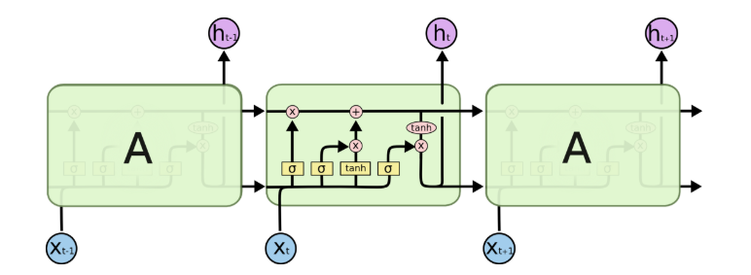
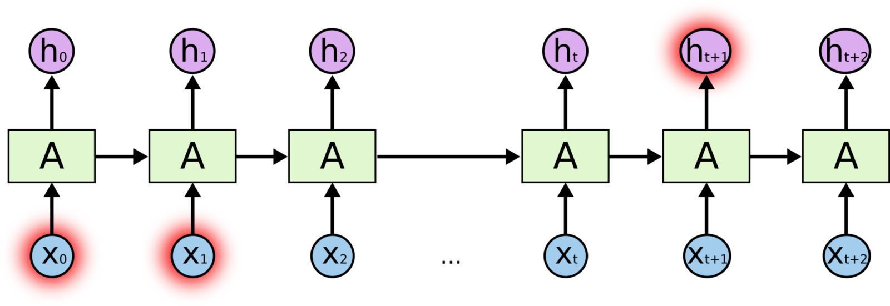
LSTMN Architecture
Problem | RNN and LSTMN | Feature Extraction |  | Software Framework | Questions and References
LSTM Cell Contains:
Input / Input Gate
Decide what values from input to update state of memory cell
Forget Gate
Determine what memory to throw away
Output Gate
Decide what to output based on input and state of memory cell
Figure 1: Recurrent Neural Network (RNN) [2]
Figure 2: Each cell in the RNN is an Long Short Term Memory cell [2]

Slide 5
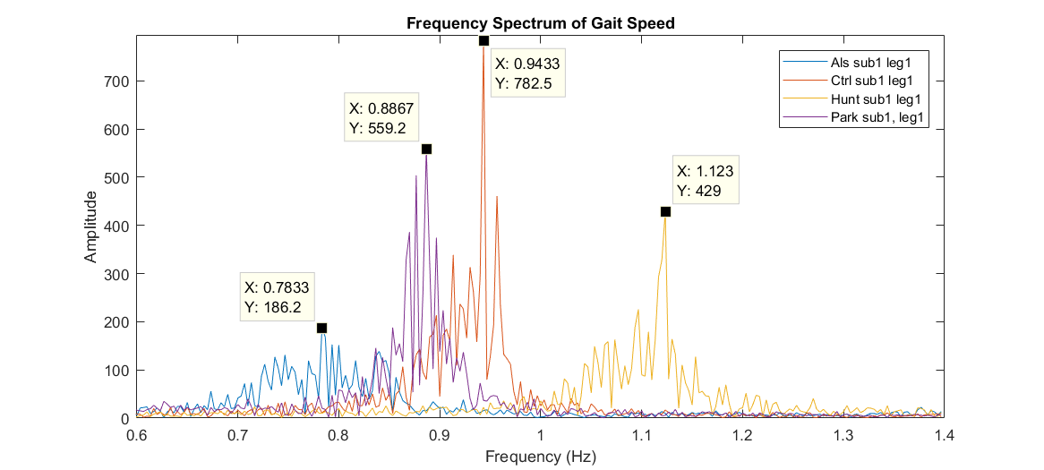
Using Frequency as a Scalar Feature
Problem | RNN and LSTMN | Feature Extraction |  | Software Framework | Questions and References
Use signal processing filters to reduce the noise and remove DC offset of the time series data
Convert data to frequency domain
Example of two scalar features extracted
Greatest non-DC frequency component:
Max Amplitude (y-axis)
Corresponding Frequency (x-axis)

Slide 6
Software Framework
Problem | RNN and LSTMN | Feature Extraction |  | Software Framework | Questions and References
train/
MATLAB
Preprocess and extract features from the dataset
Visualize data and extracted features
Python
LSTMN Classifier
Using keras, tensorflow, and theanos 3rd party libraries
MATLAB
features/
Python
classification

Slide 7
Questions?
Problem | RNN and LSTMN | Feature Extraction |  | Software Framework | Questions and References
GitHub Project Repository:
https://github.com/Catfider/BIOM5405-ClassProject

Slide 8
References
Problem | RNN and LSTMN | Feature Extraction |  | Software Framwork | Questions and References
[1] Carleton University, “Carleton logo”, 2001. [Online]. Available: http://oirp.carleton.ca/pi-2001/index/html/pi.htm. [Accessed: 14-Oct-2018]
[2] "Understanding architecture of LSTM cell from scratch with code.", Hacker Noon, 2018. [Online]. Available: https://hackernoon.com/understanding-architecture-of-lstm-cell-from-scratch-with-code-8da40f0b71f4. [Accessed: 19- Nov- 2018].
[3] S. Chauhan and L. Vig, "Anomaly detection in ECG time signals via deep long short-term memory networks", 2015 IEEE International Conference on Data Science and Advanced Analytics (DSAA), 2015.

Slide 9

Anomaly detection in ECG time signals via deep long short-term memory networks [3]
RNN and LSTMN | Implementation | Feature Extraction |  | Software Framwork | Questions and References
LSTM networks used to detect 4 different types of anomalies in ECG data
No manual feature extraction was performed (deep learning LSTM)
Optimized threshold value τ based on maximizing the F-score produced by validation set
High precision of detecting an anomaly, low recall but high TPR rate
Table 1: Abnormality Threshold τ = −9.4054 and β = 0.1

