Slide 1
AVS Host Specifications
Online service for static sites hosting.
General (default) flow
Flow for user (need authentication):
User requests /{some resource}
Redirect to dashboard
User requests /
App tries to find information about the site in db
NO
YES
User logged in
YES
Site found
NO
Show only general info content and proposal for sign in/registration
Show the list of the sites created by user. Ability to add/update/remove sites.
Try to determinate the resource: html, css, js.
Return 404
Return required resource from the site folder inside content directory

Slide 2
AVS Host Specifications
Site creation flow
User creates site rote binding (it must be validated)
User uploads all site files (separately or in zip-archive)
User can create a binding for site entry point (for example, for index.html)
Perhaps the app may change resources references in html files if needed (URL rewriting).
Site removal flow
Confirm if a user really wants to remove site instance.
Remove record from database with the site binding.
Remove site folder in content directory.
Site update flow
Allow a user to change site binding (with validation).
Add possibility to upload new site files set. If the files already exists in the site folder they should be rewritten.
Allow to change entry point binding.

Slide 3
User Roles
Roles (for now)
User – just authenticated user with default scope. Can manage only own sites.
Admin – super-user role. Can manage any sites
User
Role
ID (ObjectID)
UserName (login)
Password
Status (Active, Locked)
Roles [Array of user roles]
ID (ObjectID)
Name

Slide 4
Site Entity
ID (ObjectID)
SiteName (used for route binding and folder mapping)
Description
CreatedBy (User)
IsActive (Boolean flag)
Mappings: collection key-value for site resources
http://localhost:5000/alexs-blog
{
“ID”: “09f341df278dd1fa”,
“SiteName”: “alexs-blog”,
“Description”: “Simple Alex’s blog”,
“CreatedBy” : {“ID”: “144fat5432sxs2a” },
“IsActive”: true,
“Mappings”: [
{ “” : “/index.html” }
]
}
Content
alexs-blog
styles
assets
index.html
about.html
blog-details.html

Slide 5
Content Entity
Represents any resource of the site (HTML page, stylesheet, Javascript, etc.)
ID (ObjectID)
FileName (original content file name)
Site (reference to corresponding site, 1-N (one site can have multiple content files)
ContentType – file content type (text/html, application/javascript, text/css, etc.)
Uploaded – upload date
{
“ID”: “bg4fr331qax3fz12”,
“FileName”: “index.html”,
“Site”: { “ID”: “09f341df278dd1fa”},
“ContentType” : “text/html”,
“Uploaded”: “02/03/2020 12:09PM”
}

Slide 6
Layout
LOGO (Img)
Welcome, alex.svs.fl! | Sign out…
Dashboard | My Profile | Help
CONTENT HERE

Slide 7
User notifications about new messages from admin
LOGO (Img)
Welcome, alex.svs.fl! ⁽¹⁾| Sign out…
Dashboard | My Profile^{(!)} | Help
Shows notification icon if there is a change in profile (comment from Admin, etc.)
Shows amount of unread messages (maybe it is a good idea to show message icon here).

Slide 8
Home page
(available only for usual users, not admin)
Your sites
Storage used
Active sites
AVS Site
Offline sites
s1

Slide 9
Dashboard
Your sites:
New…
Name | Description | Launched On | Is Active
Alexs-blog | Alex’s simple blog | 03/22/2020 12:57 AM
Some-offline | This is test site | 03/20/2020 3:21 PM
V
Turn Off | Update | Delete
Turn On | Update | Delete
2 installations found
<< |1| >>
10

Slide 10
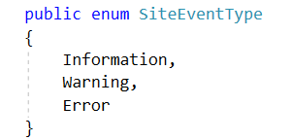
Site Events
Site created (Information)
Site started (Information)
Site stopped (Information)
Content changed (Information)
Content delivery error (Error, some content not found).
SiteEvent Entity
Id
SiteId
Type (enum)
Name (string)
Timestamp
Details (string)

Slide 11
Event Log page
LOGO (Img)
Welcome, alex.svs.fl! | Sign out…
Dashboard | My Profile | Event Log | Help
--
--
“Date to” is optional and is shown only when “Date from” set. If “Date from” is “—” “Date to” is hidden.
Date from
Date to
When a user click input, a datepicker opens
Site Name | Timestamp | Event Type
AVS Site #1 | 4/21/2021 4:31PM | Error | View details
AVS Site #1 | 4/18/2021 10:01AM | Information | View details
AVS Site #1 | 4/11/2021 12:07AM | Information | View details
<<1 2 3...121 >>
10

Slide 12
Login Page
Please sign in
Login:
alex.test.acc
Password:
Don’t have account? Register
Log in

Slide 13
Register screen
Register new account
Login:
alex.test.acc
Password:
Confirm password:
Sign in automatically
Register..

Slide 14
Create new/Update existing site
Site name:
Alexs-test-site
Upload files
Description:
Choose file…
V
Use destination path:
Upload
Uploaded:
Name | Size, kB | Uploaded Date
Index.html | 23.2 | 10/17/2020 | Download|Edit|Remove
Myimage.png | 14 | 10/17/2020 | Download|View|Remove
Site.css | 5.2 | 10/16/2020 | Download|Edit|Remove
Is active:
V
Resource mappings
New…
Name | Value
dashboard | dashboard.html
about-us | about.html
 | Index.html
Create Site

Slide 15
Help Subsystem
Help Section
Help Topic
Topic Paragraph
Id
Name
Parent Section
Id
Name
Section
OrdinalNo
Id
Name
Topic
Content

Slide 16
Help – Getting Started
General
AVS StaticSite Hosting allows a user to host simple static site and manage it. The user can turn site on or off, upload different types of content, remove some content, or delete site at all.
Currently the project consists of 2 different modules – specific static site middleware and dashboard UI with REST API.
All you need is to choose your site name & upload site content (*.html, *.js. *.css). You also may choose the landing page for your site. After it your site will be able on the route
http://{Your site name}/{landing page}.
To host your sites, the account registration is required. After registration you have a possibility to view your sites and manage them using our Dashboard.
Getting started
Dashboard
Create site
Site management

Slide 17
Help – Dashboard
General
Dashboard page shows all your sites and allows to manage them. Each site must have a name required for site routing, but you can also provide a site description which can be displayed in the dashboard grid. The dashboard also provide additional information about sites including site creation date.
Use action column buttons to manage the site selected. You can turn it on/off, edit (update), delete site, or browse it. If you select Update, the Edit Site page will open.
Please note that selecting Delete and confirming your operation will remove all site data with the site content. Use this option very carefully.
The link Browse appears only if you have provided the landing page for site. You can do it using the Edit Site page.
Getting started
Dashboard
Create site
Site management

Slide 18
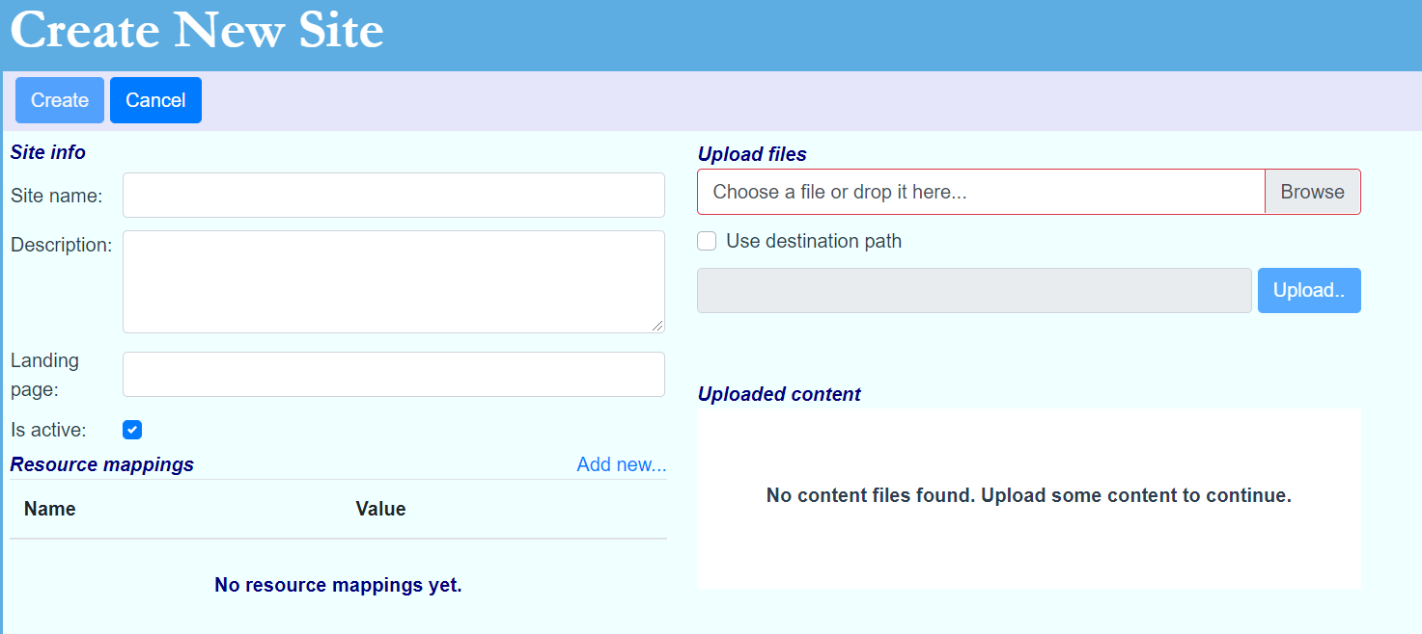
Help – Create Site
General
To create new site installation, click the link “Add new site…” in the Dashboard page. The Create Site page will open:
Getting started
Dashboard
Create site
Site management
Enter a site name (required), description (optional), and landing page (e.g. index.html).
Check “Is Active” if you want the new site to be accessible for routing.
Upload site content using Upload Files section
For upload you can specify destination path. For example, if you have a reference like js/my-site.js in your index.html, you should upload my-site.js and specify destination path as js. Files without destination path are placed in the site root directory.
You can provide resource mappings for the content files uploaded. For example, if there is a file like about.html and you have provided the resource mapping for it as “about”, the file will be available through the route http://{your site}/about.
To create a site, you have to upload some content and set the site name.

Slide 19
Help – Site Management
General
Use Update link in the dashboard page to start editing the site selected. The user interface used for site editing is the same that you saw when creating a new site.
Getting started
Dashboard
Create site
Site management
During editing, you can change site name, description, landing page and resource mappings. You can also make your site active or inactive. Also there is possibility to upload new files for the site content using Upload Files section.
Please note that the new site name you have entered is validated against the names of all existing sites. So, if you enter a name that is already in use by other user or site, you will be warned and you will have to change the site name. It must be unique among all users/sites to provide correct site routing.
Also if you try to upload a file that has already been uploaded with the site content, it just will be replaced.

Slide 20
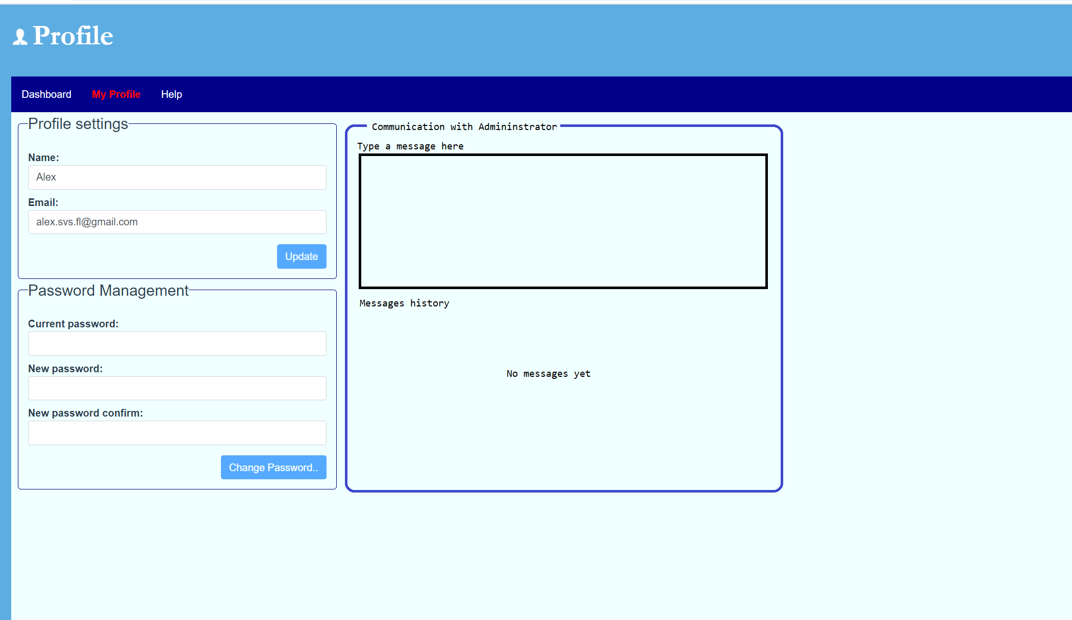
My Profile page
Send

Slide 21
Admin Dashboard

Slide 22
Conversation Message entity
Conversation entity
Id (String)
Name (String)
UnreadMessages (int)
Id (String)
ConversationID
UserID (String)
DateAdded (DateTime)
Viewed (Boolean)
Content (String)

Slide 23
Admin notifications about new message in user conversations
LOGO (Img)
Welcome, Admin | Sign out…
Dashboard | My Profile | Conversations ^{(New)} | Help
Shown for all client routes except Conversations
This is realtime
CONTENT HERE

Slide 24
The number of unread messages is updated in real-time
Conversations
Alex⁽¹⁾
User1
User2
User3
1/16/2021
Message content
1/15/2021
Message content
1/14/2021
Message content
This is a response from administrator
Send
Clear

Slide 25
User Profile
Welcome, Admin! | Sign out…
Name:
Date joined: 05/21/2020
Last locked: -
Alex
Email: alex.svs.fl@gmail.com
Status:
Active
Comment:
Save

Slide 26
Save..
View as HTML..
HTML Tree
<Page preview>
html
head
title (page title)
script (src)
script (src)
body
div#wrapper .wrap-1
div .inner-1
div .inner-2

Slide 27
Add New Element
Element:
Block (div)
Attributes: (none) Add…
CSS Classes: wrp-normal X large-w01 X Add…
Inner content:
OK
Cancel
Notes:
When element dropdown changes, attributes and css classes collections clear. Inner content should be visible only for div, paragraphs, label, span, title and lists - done

Slide 28
Add CSS Class
Name:
OK
Cancel
Add Attribute
Name:
Value:
OK
Cancel
Notes:
Done

Slide 29
Edit Element
Element: div (show id here)
Attributes: (none) Add…
CSS Classes: wrp-normal X large-w01 X Add…
Inner content:
OK
Cancel
Notes:
Inner content should be visible only for div, paragraphs, label, span, title and lists - done

Slide 30
Add Script or Stylesheet
JavaScript
Cascade stylesheet
From uploaded or exist
scripts/app-1.js
main.js
utils.js
Use dropdown here, check if a script has already been added
From script content:
OK
Cancel

Slide 31
Tags
Tags page (User view, all tags, add/remove tags).
New tag page (or add this form to tags page).
CreateOrUpdateSite page - add tag functionality
Dashboard - add tags column with filter

Slide 32
Tags
Tags available (4):
New tag
Tag name:
Draft
Redesign
My_tag
Test
Background color:
Text color:
Create tag

Slide 33
Tags
Tags available (0):
New tag
No tags found
Tag name:
Background color:
Choose
Text color:
Choose
Create tag

Slide 34
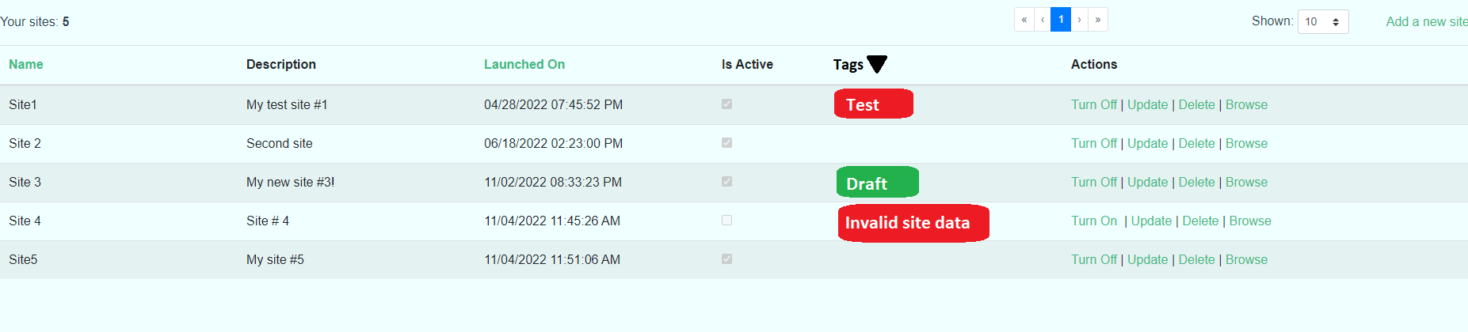
Add this column

Slide 35
Filter by tags
Test
X
Draft
Not completed
Filter
Cancel

Slide 36
Tag component
I am a tag!
Maximum text length = 15 chars
Longer strings - just show first 15 chars and …
I am very long…

Slide 37
Tag Entity
Site Entity
{
/* Site data fields */
Tags: [
“<tag1 Id>”,
“<tag2 Id>”,
“<tag3 Id>”
]
}
{
“ID”: “<some ID>”,
“Name”: “I am tag!”,
“UserId”: “<some ID>”,
“BackgroundColor” : “Navy”,
“TextColor”: “White”
}

Slide 38
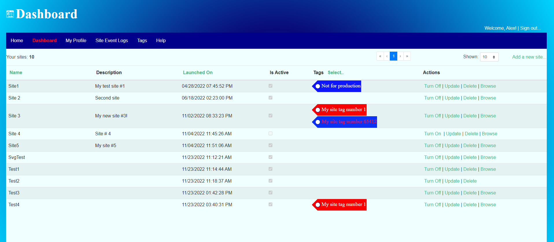
Add a filter to site name column
Site name:
Clear
OK

