Slide 1
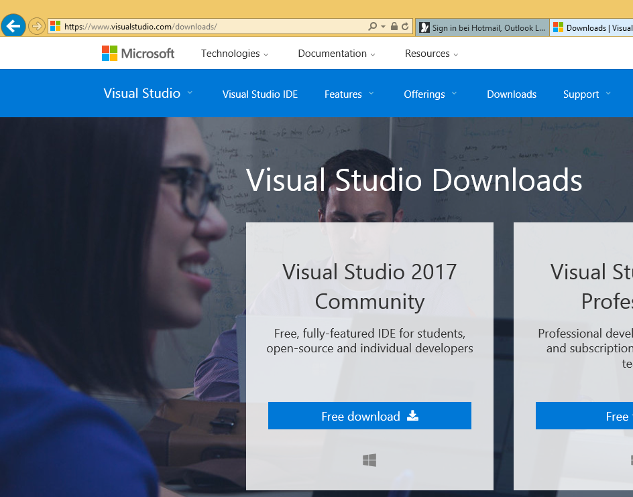
Download Visual Studio 2017 Community

Slide 2
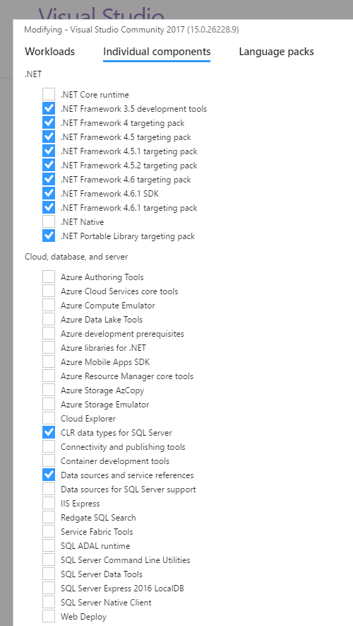
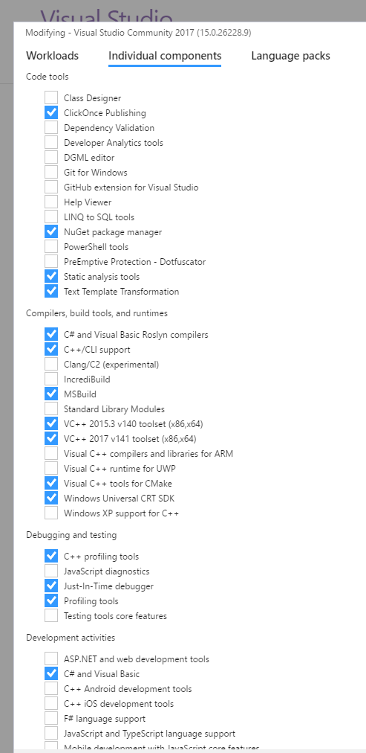
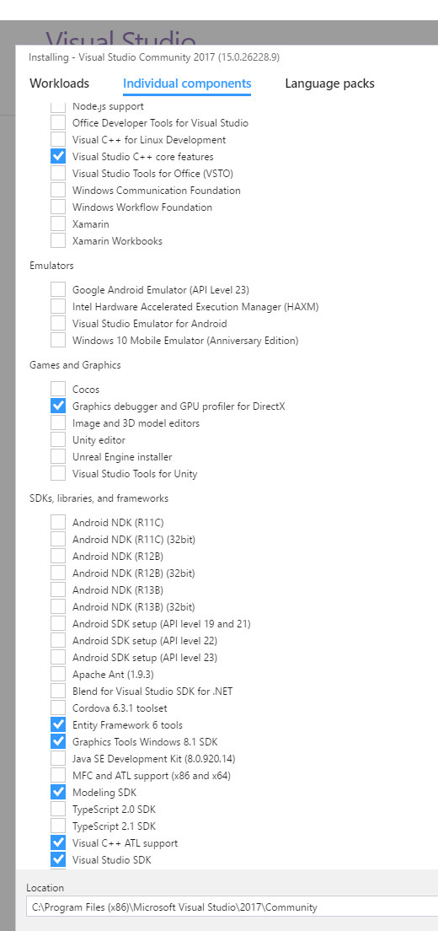
x
x
x
x
x
x
x
x
Make sure that the highlighted components are selected (required because our main development platform is VS 2015)

Slide 3
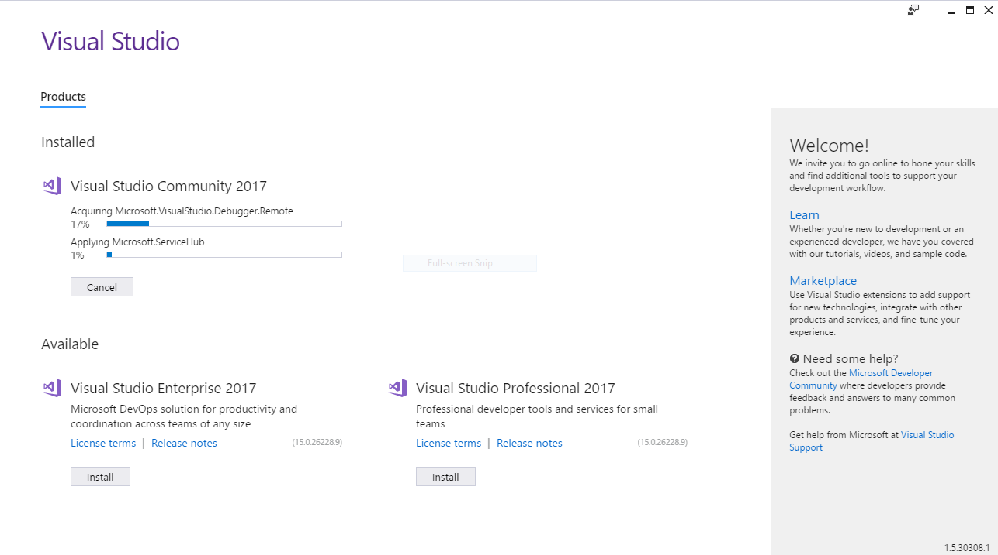
Visual Studio 2017 is getting installed

Slide 4
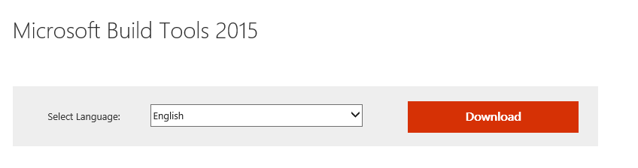
Download Microsoft Build Tools 2015 from https://www.microsoft.com/en-us/download/details.aspx?id=48159 (required because our main development platform is VS 2015)
Alternatively, use direct link http://download.microsoft.com/download/4/3/3/4330912d-79ae-4037-8a55-7a8fc6b5eb68/buildtools_full.exe

Slide 5
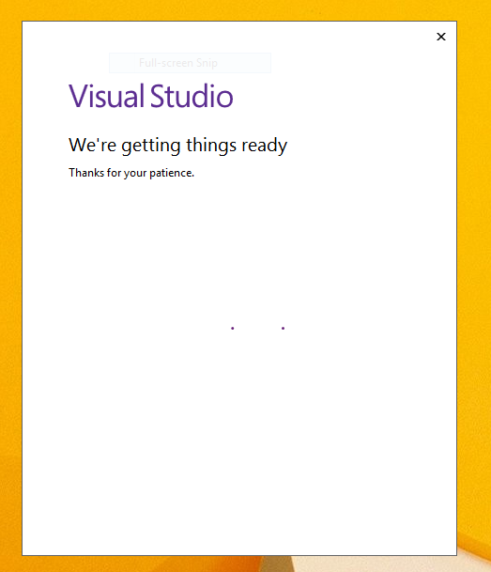
Start Visual Studio

Slide 6
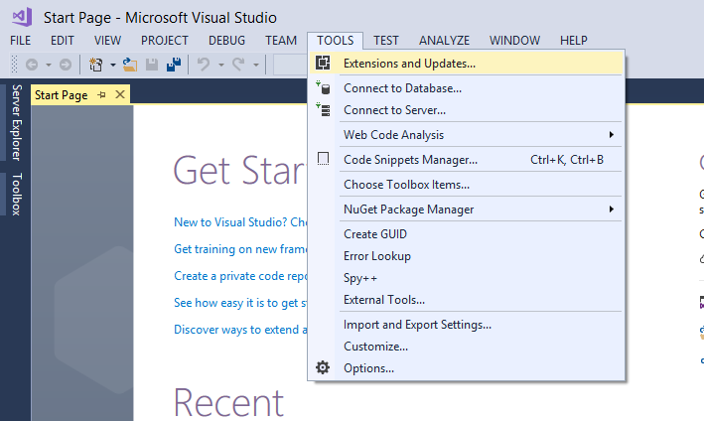
x
x
Open Tools -> Extensions and Updates

Slide 7
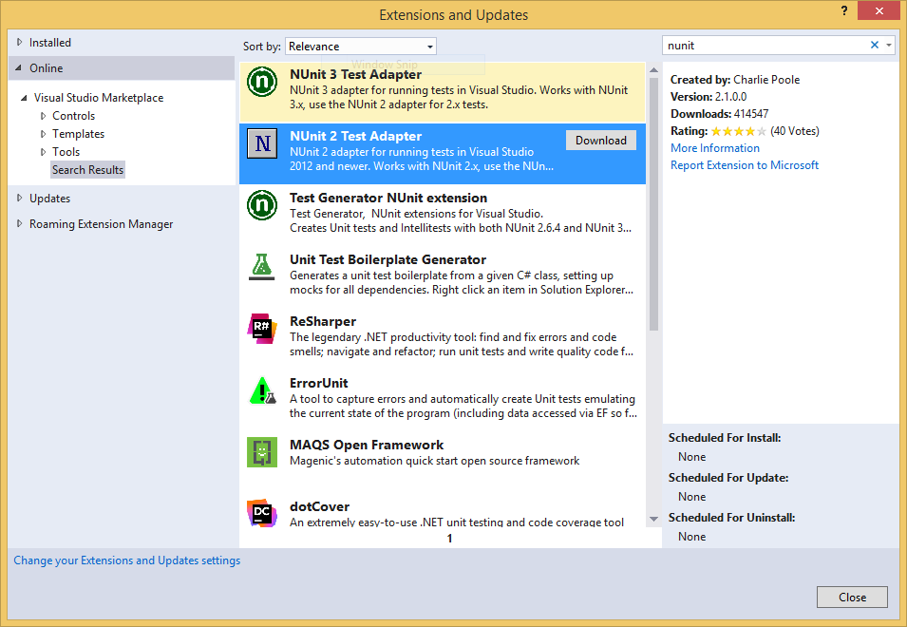
x
x
x
Select „Online“
search for „nunit“ on the right
Download Nunit 2 Test Adapter

Slide 8
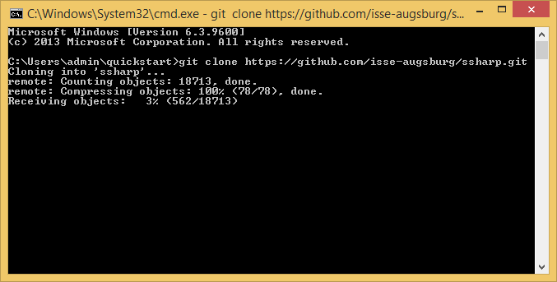
Download our git repositiory from https://github.com/isse-augsburg/ssharp.git
You can use your favorite git tool for that

Slide 9
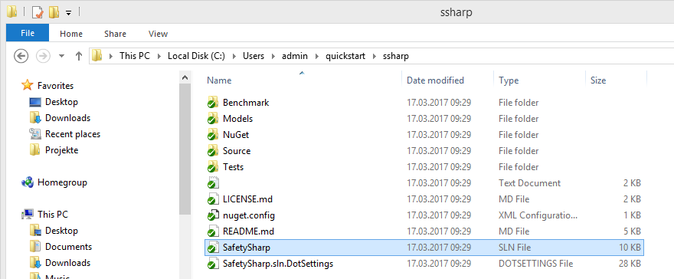
Open the SafetySharp.sln solution file

Slide 10
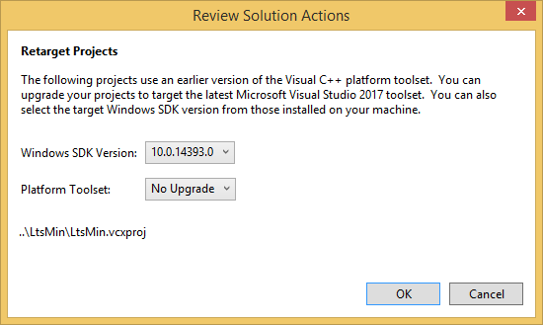
x
Select Platform Toolset „No Upgrade“ (required because our main development platform is VS 2015)

Slide 11
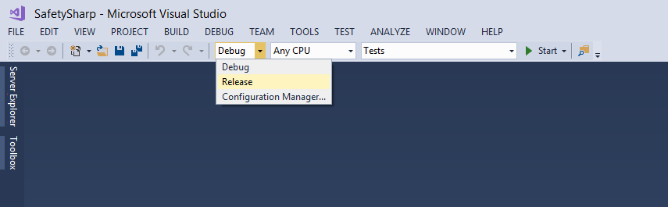
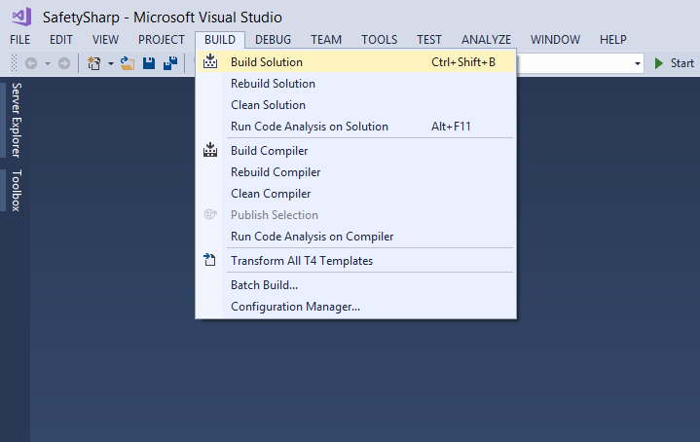
x
x
x
x
Select „Release“ and run „Build->Build Solution“ to create an optimized build

Slide 12
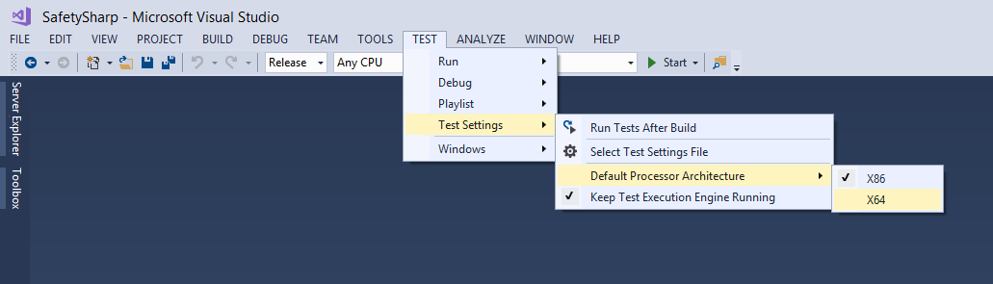
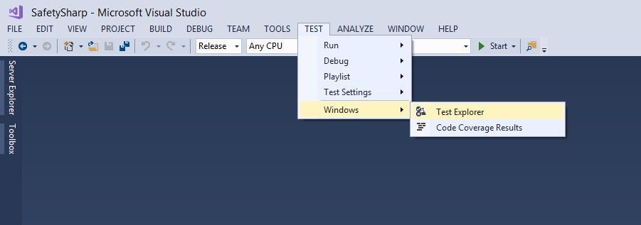
x
x
x
x
x
x
x
Select X64 as processor architecture for the tests
Open the Test Explorer

Slide 13
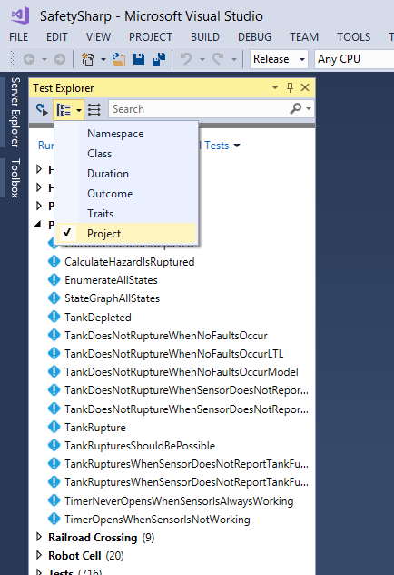
x
x
Sort the test cases by project
You may need to restart Visual Studio to see all projects in the test explorer

Slide 14
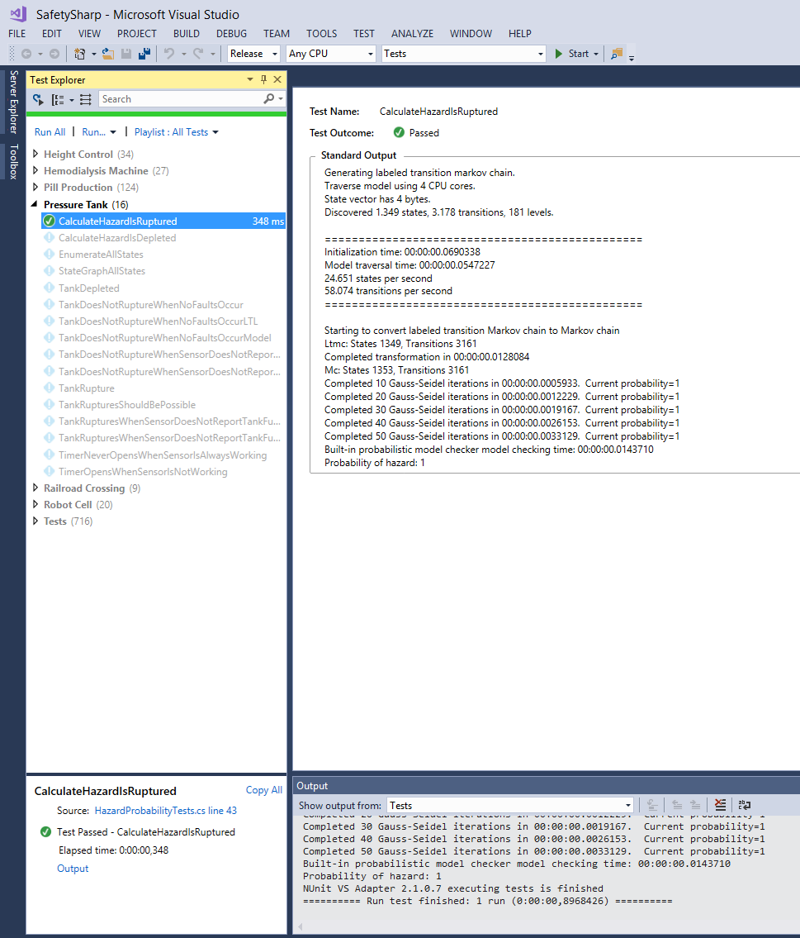
x
x
Right click on „CalculateProbability…„ and select „run…“ to conduct a quantitative analysis
The hazard probability is shown in the main windows after clicking „Output“

Slide 15
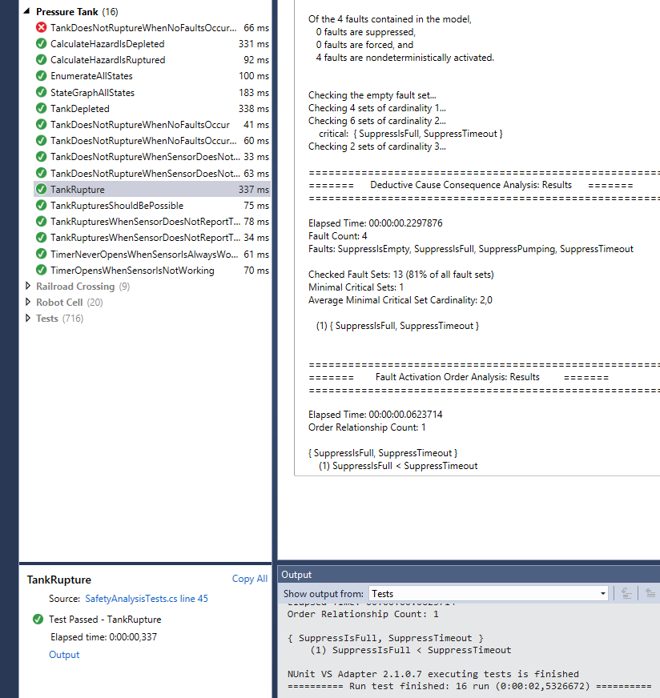
x
x
Right click on „CalculateProbability…„ and select „run…“ to conduct a DCCA analysis
The minimal cut sets are shown in the main windows after clicking „Output“

