Slide 1
Interactive Package for visualization & initialization: BTV [1]
Computation Packages using initializations from BTV: GLISTR [2], PORTR [3]
Visualizing results independently
CaPTk
Notes:
CaPTk – History

Slide 2
Packages like GLISTR [1] have become the hallmark of our lab due the attention they have generated by winning several international competitions like BRATS in MICCAI.
Brain Tumor Viewer (BTV) was created as a graphical tool to simplify creation of manual initializations for such packages but it was a cumbersome way of handling semi-automated tasks
It thus identified a need to provide a graphical front-end to complex command-line packages while preserving manual interactive capabilities
With the support from NIH/NCI via the U24 grant, we have created a flexible graphical interface (CaPTk Console) to integrate different computational packages.
Common preprocessing tools (registration, bias correction, smoothing, etc.), initialization interfaces (regions of interest and simple seed/tumor points) and result visualization are available for all applications integrated in CaPTk
The extensibility of the CapTk framework has allowed us to quickly incorporate cancer-research tools (LIBRA, SBRT, WhiteStripe) from various research groups at UPenn into a single distribution.
Notes:
CaPTk – History: notes for previous figure

Slide 3
CaPTk as an Evolution from Software for use by Computational Imaging Researchers
Intended users are primarily clinical researchers
Emphasis on usability (installation, interface, performance) by clinical researchers vs. accuracy in an HPC environment
Released products to be refactored from research code, integrated and maintained by a development group, not researchers writing novel algorithms
Cross-platform products

Slide 4
High integration: native C++, optimized for performance
Low integration: Language independent
Library of functions with C++ APIs
Example: ITK, OpenCV
Bridge: CaPTk Console calls library, passes data in memory
GUI, no API
LIBRA
GUI with API
ITK-SNAP
Stand-alone CLI
SBRT Lung
Application functions
EGFRvIII Estimator
Library functions
ITK Filters
Low Integration with Console & Optimization High
Notes:
CaPTk – Bridges between CapTk Applications and External Software

Slide 5
Library functions
ITK Filters
Application functions
EGFRvIII Estimator
Library of functions with C++ APIs
Example: ITK, OpenCV
Bridge: CaPTk Console calls library, passes data in memory
Stand-alone CLI
SBRT Lung
High Algorithm Developer Effort Low
Low CaPTk Developer Effort High
GUI with API
ITK-SNAP
GUI, no API
LIBRA
High integration: native C++, optimized for performance
Low integration: Language independent
Low Integration with Console & Optimization High
Notes:
CaPTk – Bridges between CapTk Applications and External Software

Slide 6
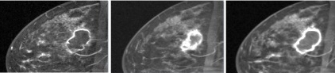
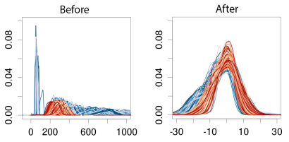
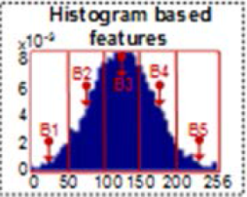
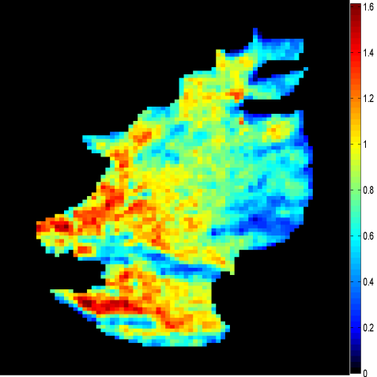
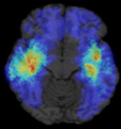
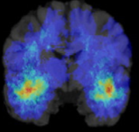
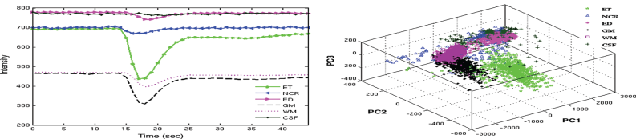
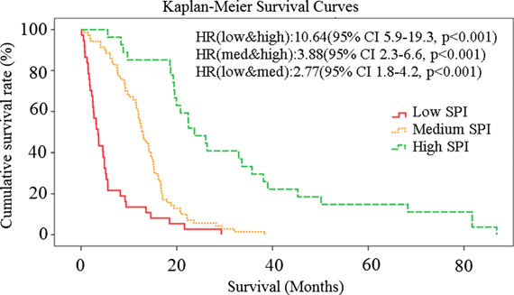
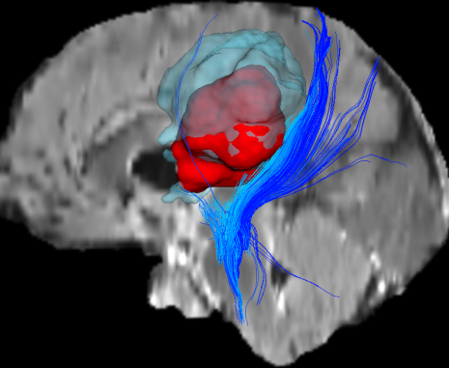
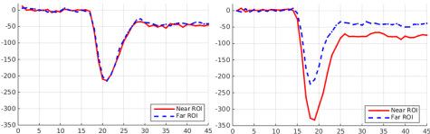
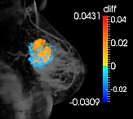
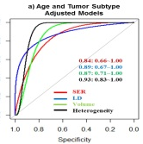


Input Images
First Level
Image Analysis Algorithms
Segmentation:
Regions of Interest (ROIs)
Registration:
Measure change with time:
A B B→A
Population atlases:
Common
vs.
Rare
Image Harmonization
Feature Extraction:
Texture, histogram, dynamics, spatial pattern
Image Operations:
DICOM access
Format conversion
Intensity normalization
Co-registration
Noise Reduction
ROI annotation
Seed-point initialization
Wavelet-DP1
Geodesic
WhiteStripe
Extensive Imaging Phenotypic Panel
Feature Synthesis and Integration
via Machine Learning
Modeling information (e.g. tumor growth, atlas)
Second Level
Output Modules and Outcomes
Precision Diagnosis, Risk Estimation:
Predictive Models
Personalized Treatment
Connectomics Infiltration
Radiogenomics -
Imaging signatures of molecular characteristics:
Imaging Signatures of GBM mutations in EGFRvIII gene
vIII-
vIII+
LIBRA
Survival
Confetti
EGFRvIII
Notes:
Caption: Overview of the structure of CaPTk. At the first level, image pre-processing and feature extraction methods are used to generate a variety of imaging features capturing various aspects of imaging signals, ranging from segmentation of tumors and its partitions, to extraction of textural and perfusion dynamic features, to population-wide spatial patterns of cancer, to fiber tracts. At the second level, various imaging features and maps are integrated into diagnostic and predictive markers, aiming to achieve precision diagnosis and guidance of treatment, prediction of clinical outcome, and estimation of molecular characteristics of a tumor.

Slide 7
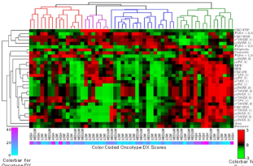
Input Images
First Level
Image Analysis Algorithms
Segmentation:
Regions of Interest (ROIs)
Registration:
Measure change with time:
A B B→A
Population atlases:
Common
vs.
Rare
Image Harmonization
Feature Extraction:
Texture, histogram, dynamics, spatial pattern
Image Operations:
DICOM access
Format conversion
Intensity normalization
Co-registration
Noise Reduction
ROI annotation
Seed-point initialization
Wavelet-DP1
Geodesic
WhiteStripe
Extensive Imaging Phenotypic Panel
Feature Synthesis and Integration
via Machine Learning
Modeling information (e.g. tumor growth, atlas)
Second Level
Output Modules and Outcomes
Precision Diagnosis, Risk Estimation:
Predictive Models
Personalized Treatment
Connectomics Infiltration
Radiogenomics Imaging signatures of molecular characteristics:
vIII-
vIII+
Breast MRI Phenotypes vs. Oncotype DX
Imaging Signatures of GBM mutations in EGFRvIII gene
LIBRA
Survival
Confetti
Notes:
Caption: Overview of the structure of CaPTk. At the first level, image pre-processing and feature extraction methods are used to generate a variety of imaging features capturing various aspects of imaging signals, ranging from segmentation of tumors and its partitions, to extraction of textural and perfusion dynamic features, to population-wide spatial patterns of cancer, to fiber tracts. At the second level, various imaging features and maps are integrated into diagnostic and predictive markers, aiming to achieve precision diagnosis and guidance of treatment, prediction of clinical outcome, and estimation of molecular characteristics of a tumor.

Slide 8
Binding and
API
Client-
dependent
Applications
Client-
independent
Applications
Python,
Perl,
Octave/
Matlab
Slicer, ITK
XTK,
XNAT,
IPP
QT, GTK
Proof-of-Concept Workstations

