Slide 1
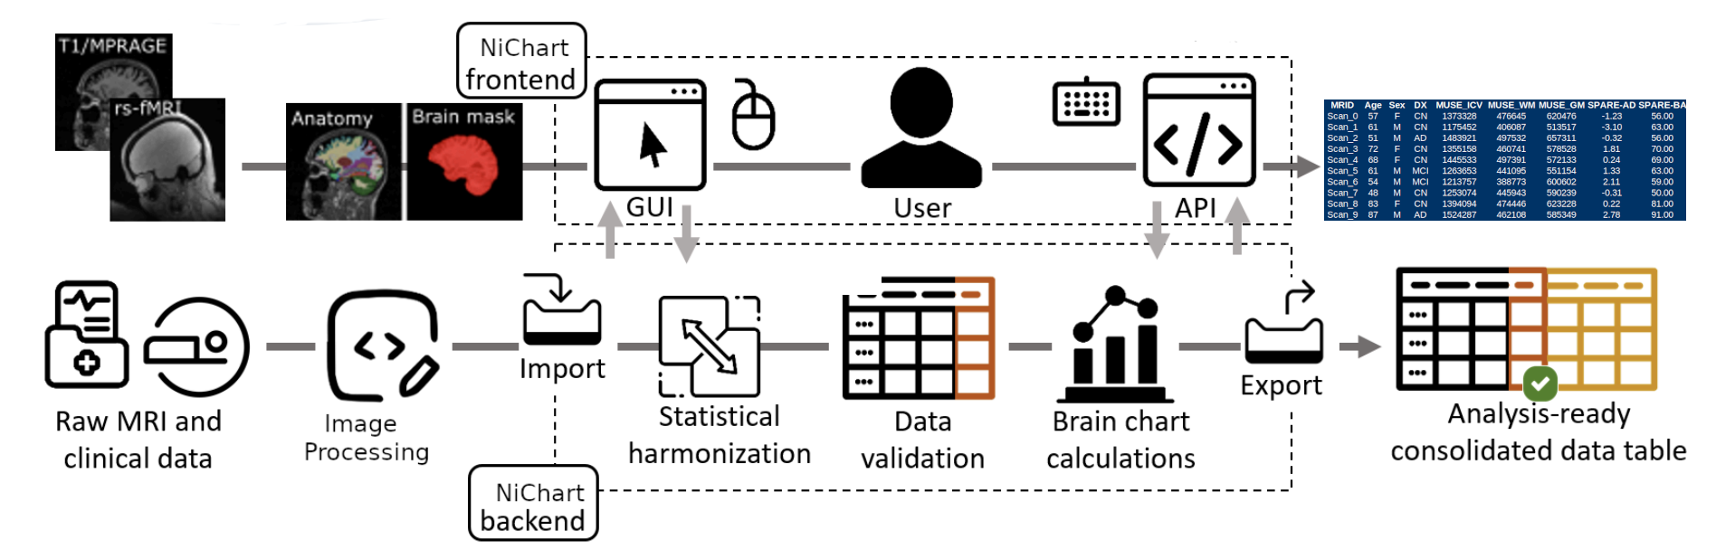
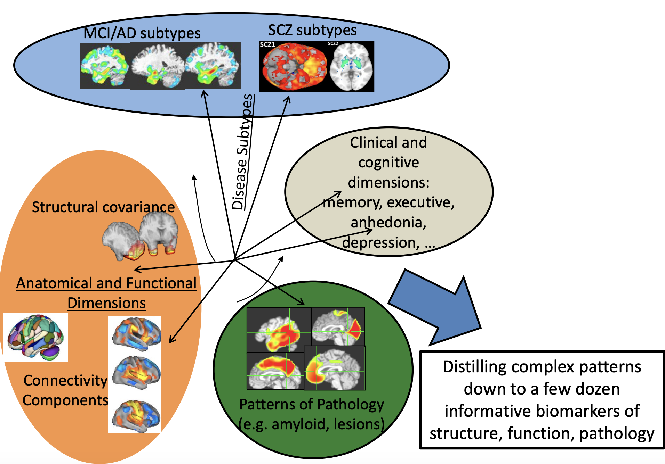
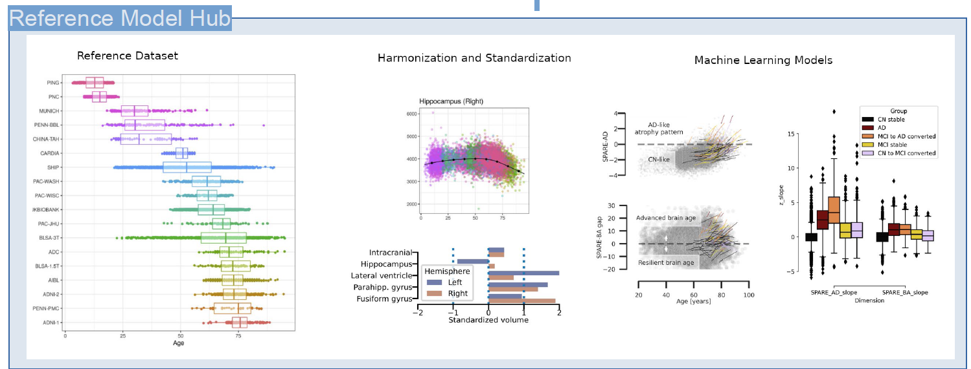
NiCHART: From Neuroimaging Big Data to Individualized Imaging Signatures of Disease and Aging
A framework to process multi-modal MRI and extract rich and accurate imaging descriptors, harmonize to a large reference set, and apply machine learning models trained on the reference set to derive individualized “NeuroImaging Chart” values

