Slide 1

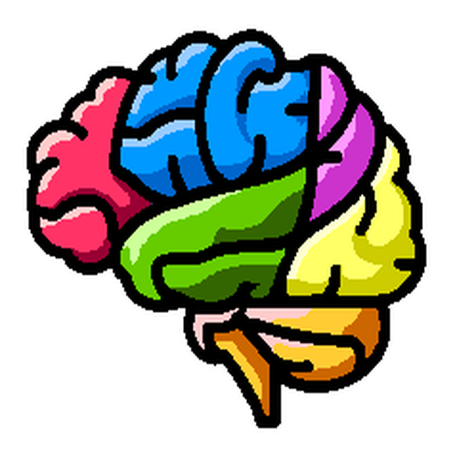
Artificial Intelligence in Biomedical Imaging Lab
(AIBIL – CBICA - UPenn)
NiChart: Neuro Imaging Chart of AI-based Imaging Biomarkers
Meeting title
NiChart Meeting, MM/DD/YYYY

Slide 2
Artificial Intelligence in Biomedical Imaging Lab
(AIBIL – CBICA - UPenn)

