Slide 1

SCARF MODEL The Impact of Perceived Threat

Slide 2



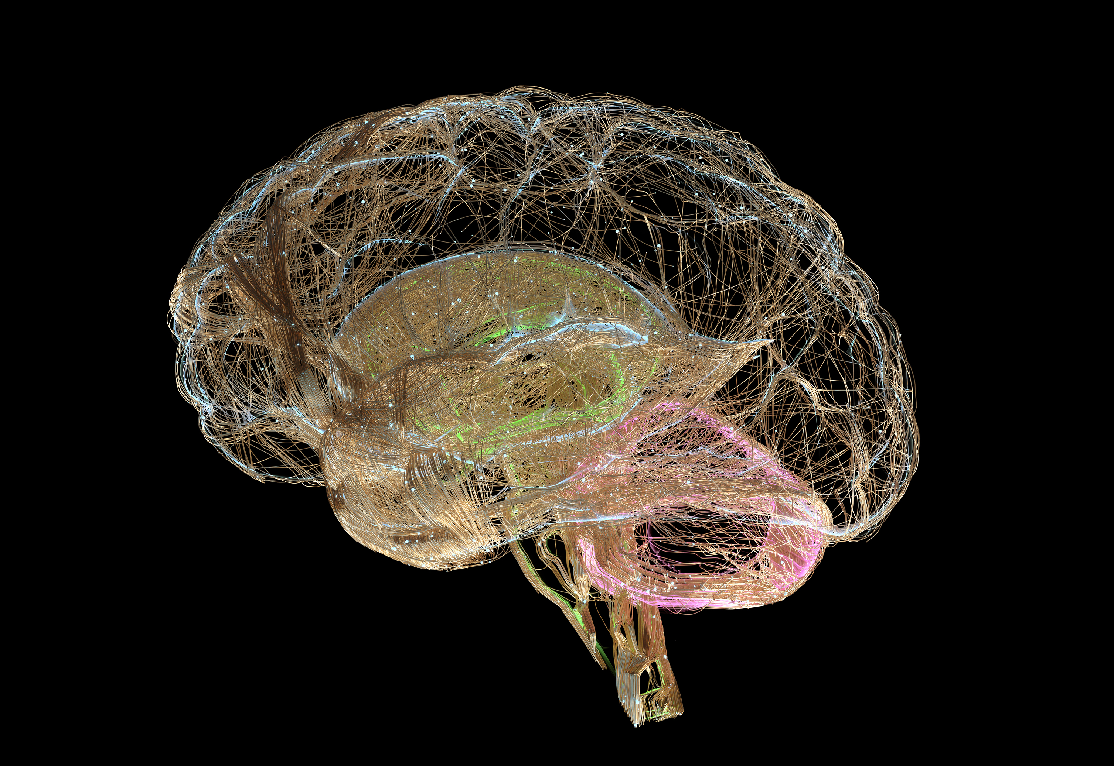
Understanding Human Responses to Perceived Threat
Social interactions perceived as threats or rewards
Our brain reacts to social threats similarly to physical threats
Perceived Threat - Decrease trust, engagement, innovation and belonging
Perceived Reward = Increased collaboration, engagement and innovation

Slide 3
What is the SCARF Model?
The SCARF model, created by David Rock (2008), explains how social experiences trigger threat or reward responses in the brain. It highlights five domains that significantly impact behavior, motivation, and collaboration in the workplace:
Status – Our relative importance to others
Certainty – The ability to predict the future
Autonomy – The sense of control over events
Relatedness – The feeling of safety with others
Fairness – The perception of fair exchanges and outcomes
By understanding and managing these domains, leaders can create environments that reduce threat responses and foster trust, engagement, and innovation.

Slide 4

Leadership Tips for Applying SCARF
z
Status: Relative importance to others.
Recognize and celebrate individual and team contributions.
Provide opportunities for people to demonstrate their expertise.
Offer constructive feedback in private settings.

Slide 5
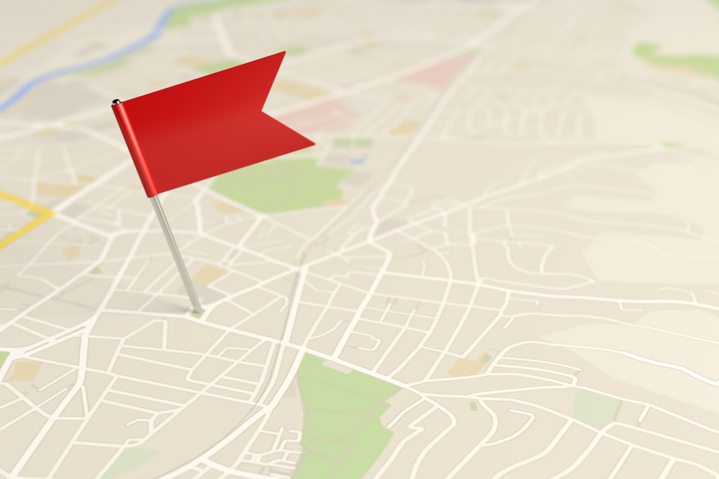
Leadership Tips for Applying SCARF
z
Certainty: Ability to predict the future
Communicate clearly and consistently, especially during change.
Set clear expectations and provide regular updates.
Be transparent about what is known and unknown.
Establish clear goals and priorities.

Slide 6

Leadership Tips for Applying SCARF
z
Autonomy: Sense of control over events
Involve employees in decision-making where possible.
Provide choices in how work is completed.
Encourage self-directed learning and growth.
Notes:
Tell story about why drivers don’t get car sick

Slide 7

Leadership Tips for Applying SCARF
z
Relatedness: Sense of belonging and trust
Foster team connection through regular check-ins and team-building.
Demonstrate empathy and active listening.
Encourage collaboration and mentorship.

Slide 8

Leadership Tips for Applying SCARF
Fairness: Perception of fair treatment
Be transparent about decision-making processes.
Ensure consistency in policies and treatment.
Address perceived inequities openly and constructively.

Slide 9
Team Exercise – Part 1
Small Group Discussion (10 min)
✅ Which SCARF domains feel most important for YOU personally? ✅ What do you think our team does well? ✅ Where do you think we could do better to support safety and belonging?
Pairs or trios (2-3 people)
Encourage personal reflection + ideas for the team

Slide 10
Team Exercise – Part 2
Read out – Each group shares 1-2 insights and suggestions for the team (avoid duplicating) (15 min)
Close & Commit (5 min)
✅ What is one thing YOU can personally do this week to contribute to team psychological safety?
Everyone shares 1 action aloud (round-robin or popcorn)
Notes:
3️⃣ Team Share & Idea Capture (10 min)
Facilitator brings team back together:
Ask groups to share one insight + one suggestion (keep it moving fast).
Capture on flipchart or virtual board under 5 headings:
| Status | Certainty | Autonomy | Relatedness | Fairness |

Slide 11
Personal Reflection
Step 1: Self
Which SCARF domain(s) are most important to me?
When do I feel most "threatened" in my work? What domain is likely triggered?
When do I feel most "rewarded"? What domain is likely supported?
Step 2: Team
Which SCARF domains might be most important to each team member?
How might recent changes or events be impacting each domain for the team?
Step 3: Action Planning
What actions can I take to reduce threats in each SCARF domain for my team?
What actions can I take to increase rewards in each domain?
How will I know if my actions are having the desired impact?

Slide 12
Final Thoughts
Using the SCARF model helps leaders and coaches foster environments where people feel safe, valued, and motivated. By intentionally supporting the five domains, we can enhance engagement, collaboration, and performance across our organizations.

