Slide 1
Grid-characteristic method on unstructured meshes:
problems and applications
Alexander Kazakov
Department of control and applied mathematics
Moscow Institute of Physics and Technology
alexanderkazak@yandex.ru

Slide 2
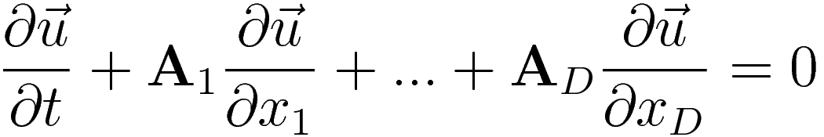

Equation system

Slide 3
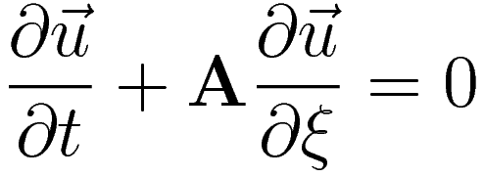

1D approach

Slide 4

1D approach

Slide 5

1D approach

Slide 6
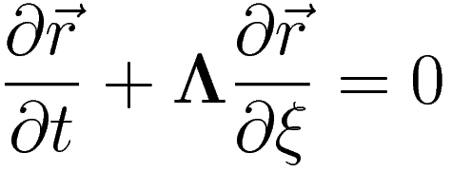
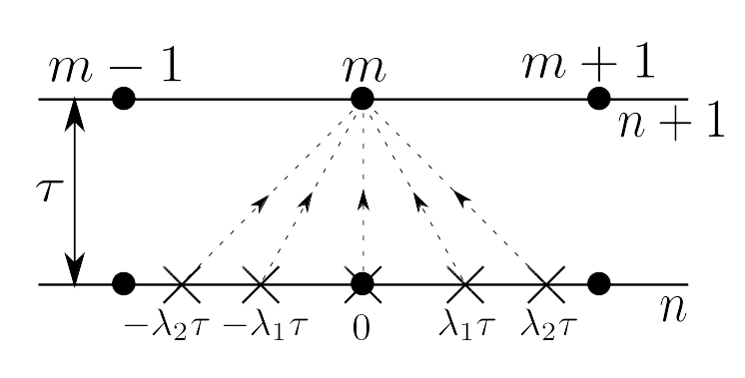
1D approach

Slide 7
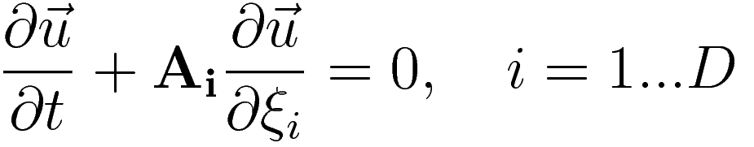
Splitting by dimensions

Slide 8
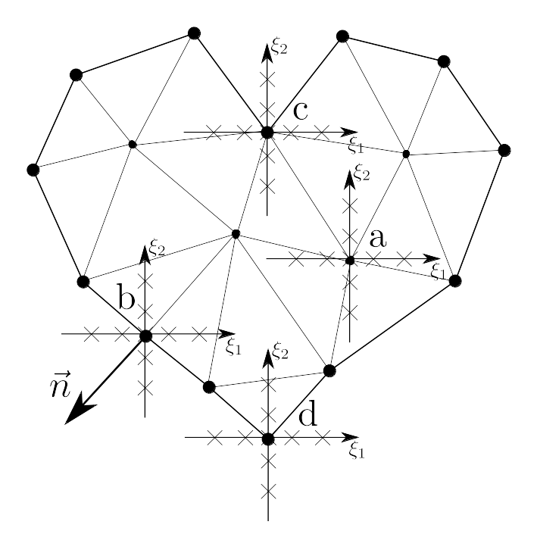
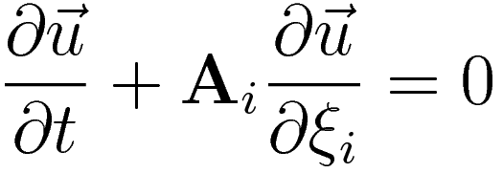
Unstructured grid

Slide 9

Boundary conditions

Slide 10
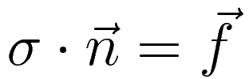
Boundary conditions

Slide 11
Boundary conditions

Slide 12
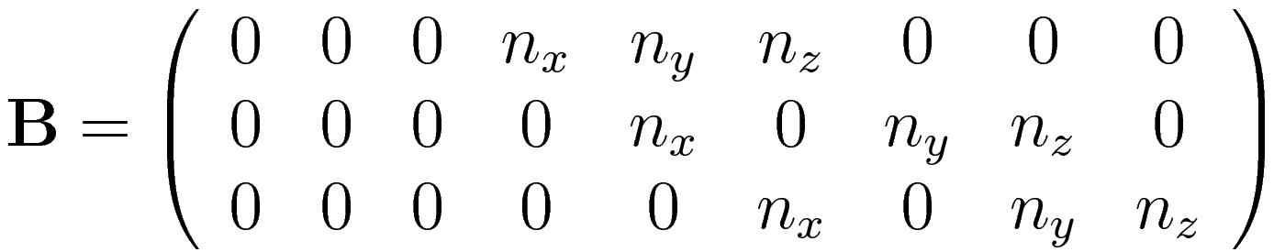
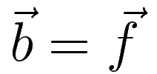
Boundary conditions

Slide 13
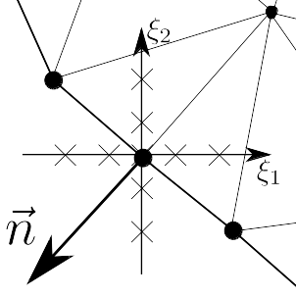
Boundary node calculation

Slide 14
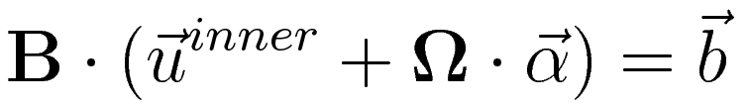
Boundary node calculation

Slide 15
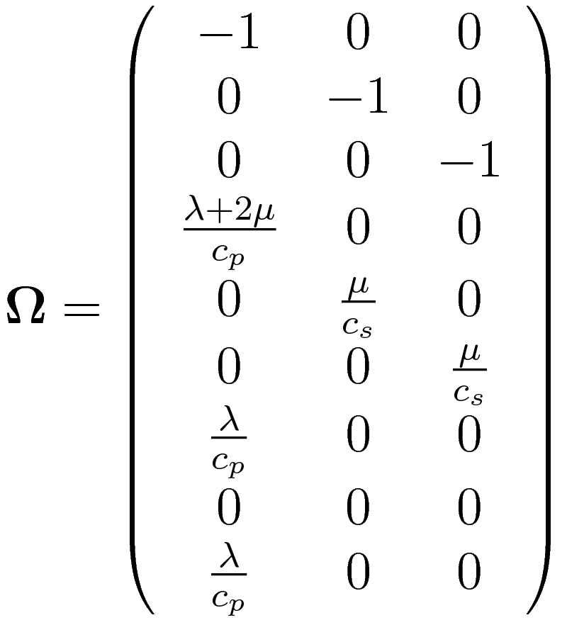
Matrix of outer waves (in columns)

Slide 16

Boundary node calculation

Slide 17

Boundary node calculation

Slide 18
Boundary and contact nodes calculation
Boundary – SLE of size M*M:

Slide 19
Boundary and contact nodes calculation
Boundary – SLE of size M*M:
Contact:
– invertion of matrix M*M
– SLE of size M*M

Slide 20

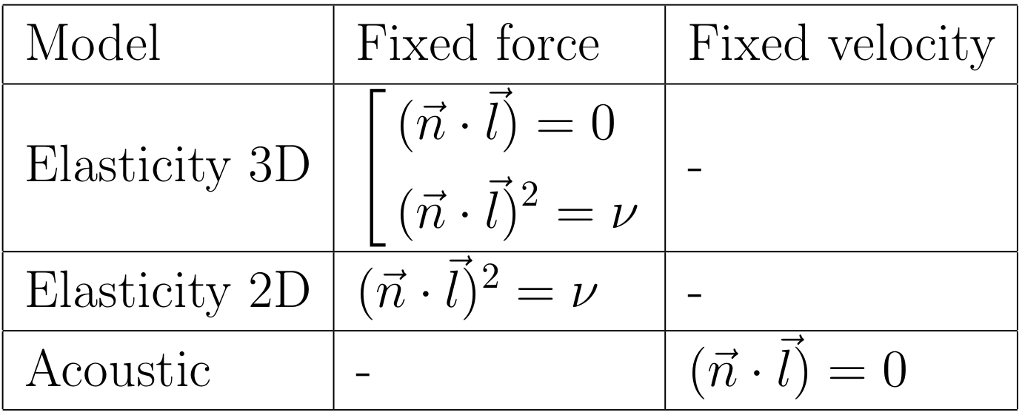
Degeneration of SLE matrices

Slide 21
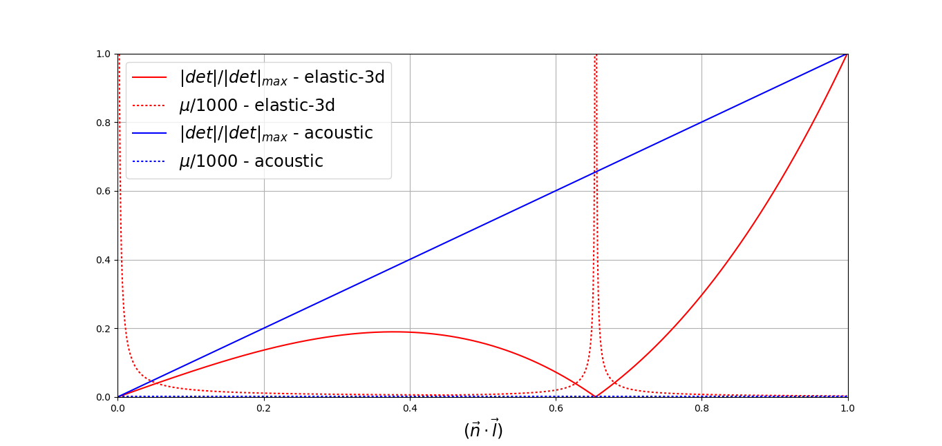
Degeneration of SLE matrices

Slide 22
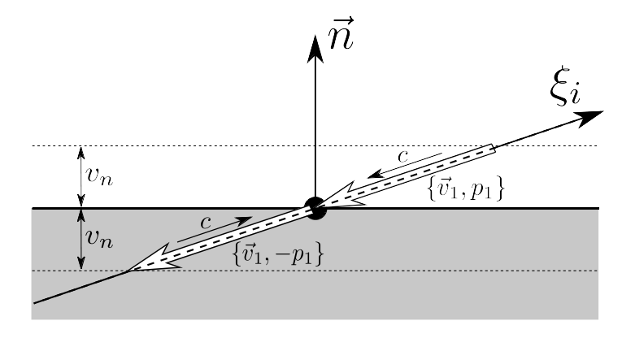
Degeneration of SLE matrices

Slide 23
Bad border cases

Slide 24
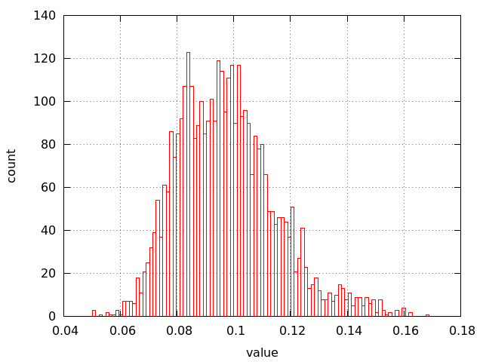
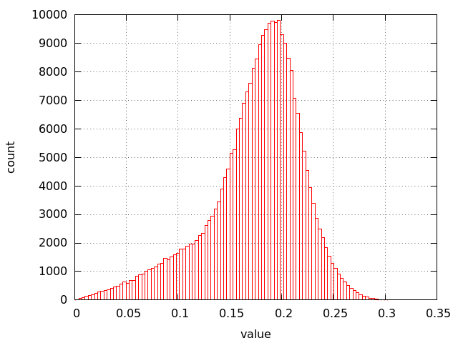
Hystograms of cells heights in typical grids
2D
3D

Slide 25
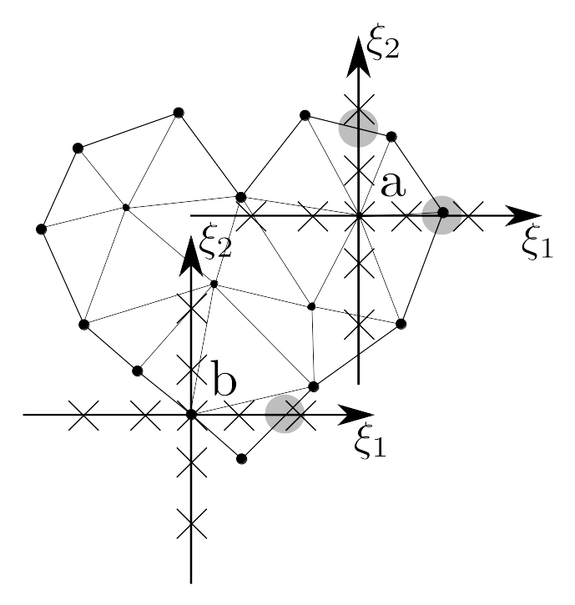
Non-Courant time step

Slide 26
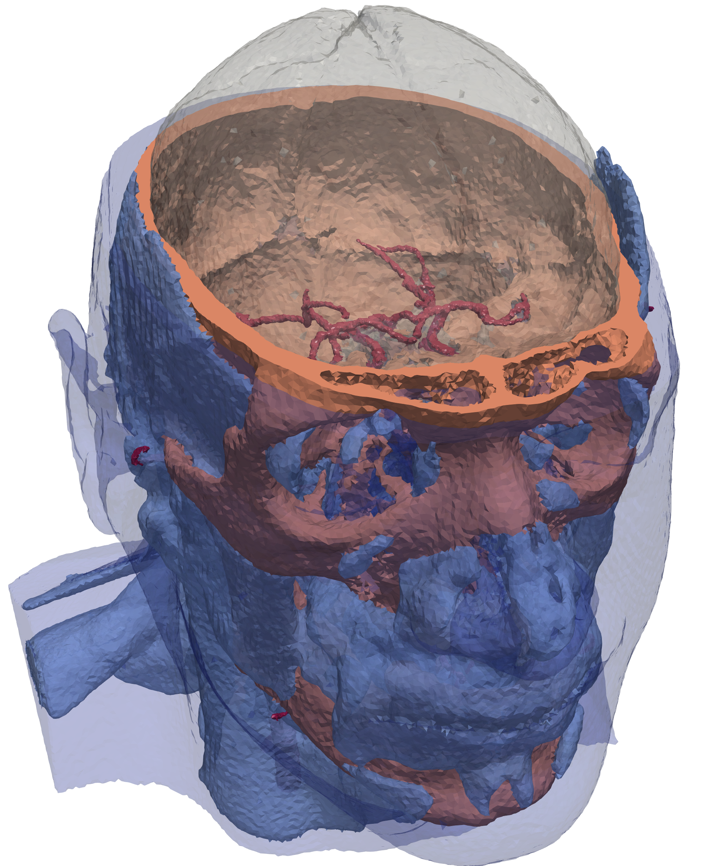
Computational example

Slide 27
Computational example

Slide 28
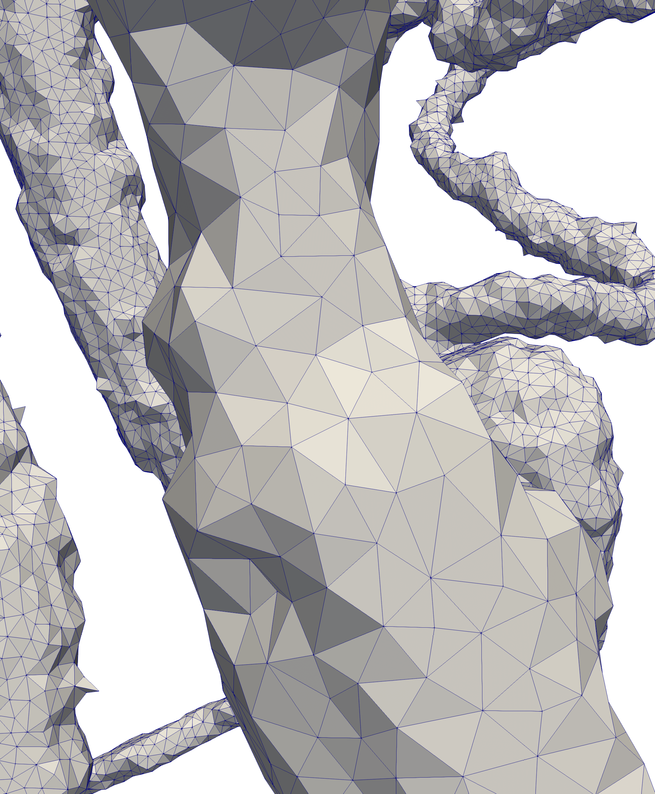
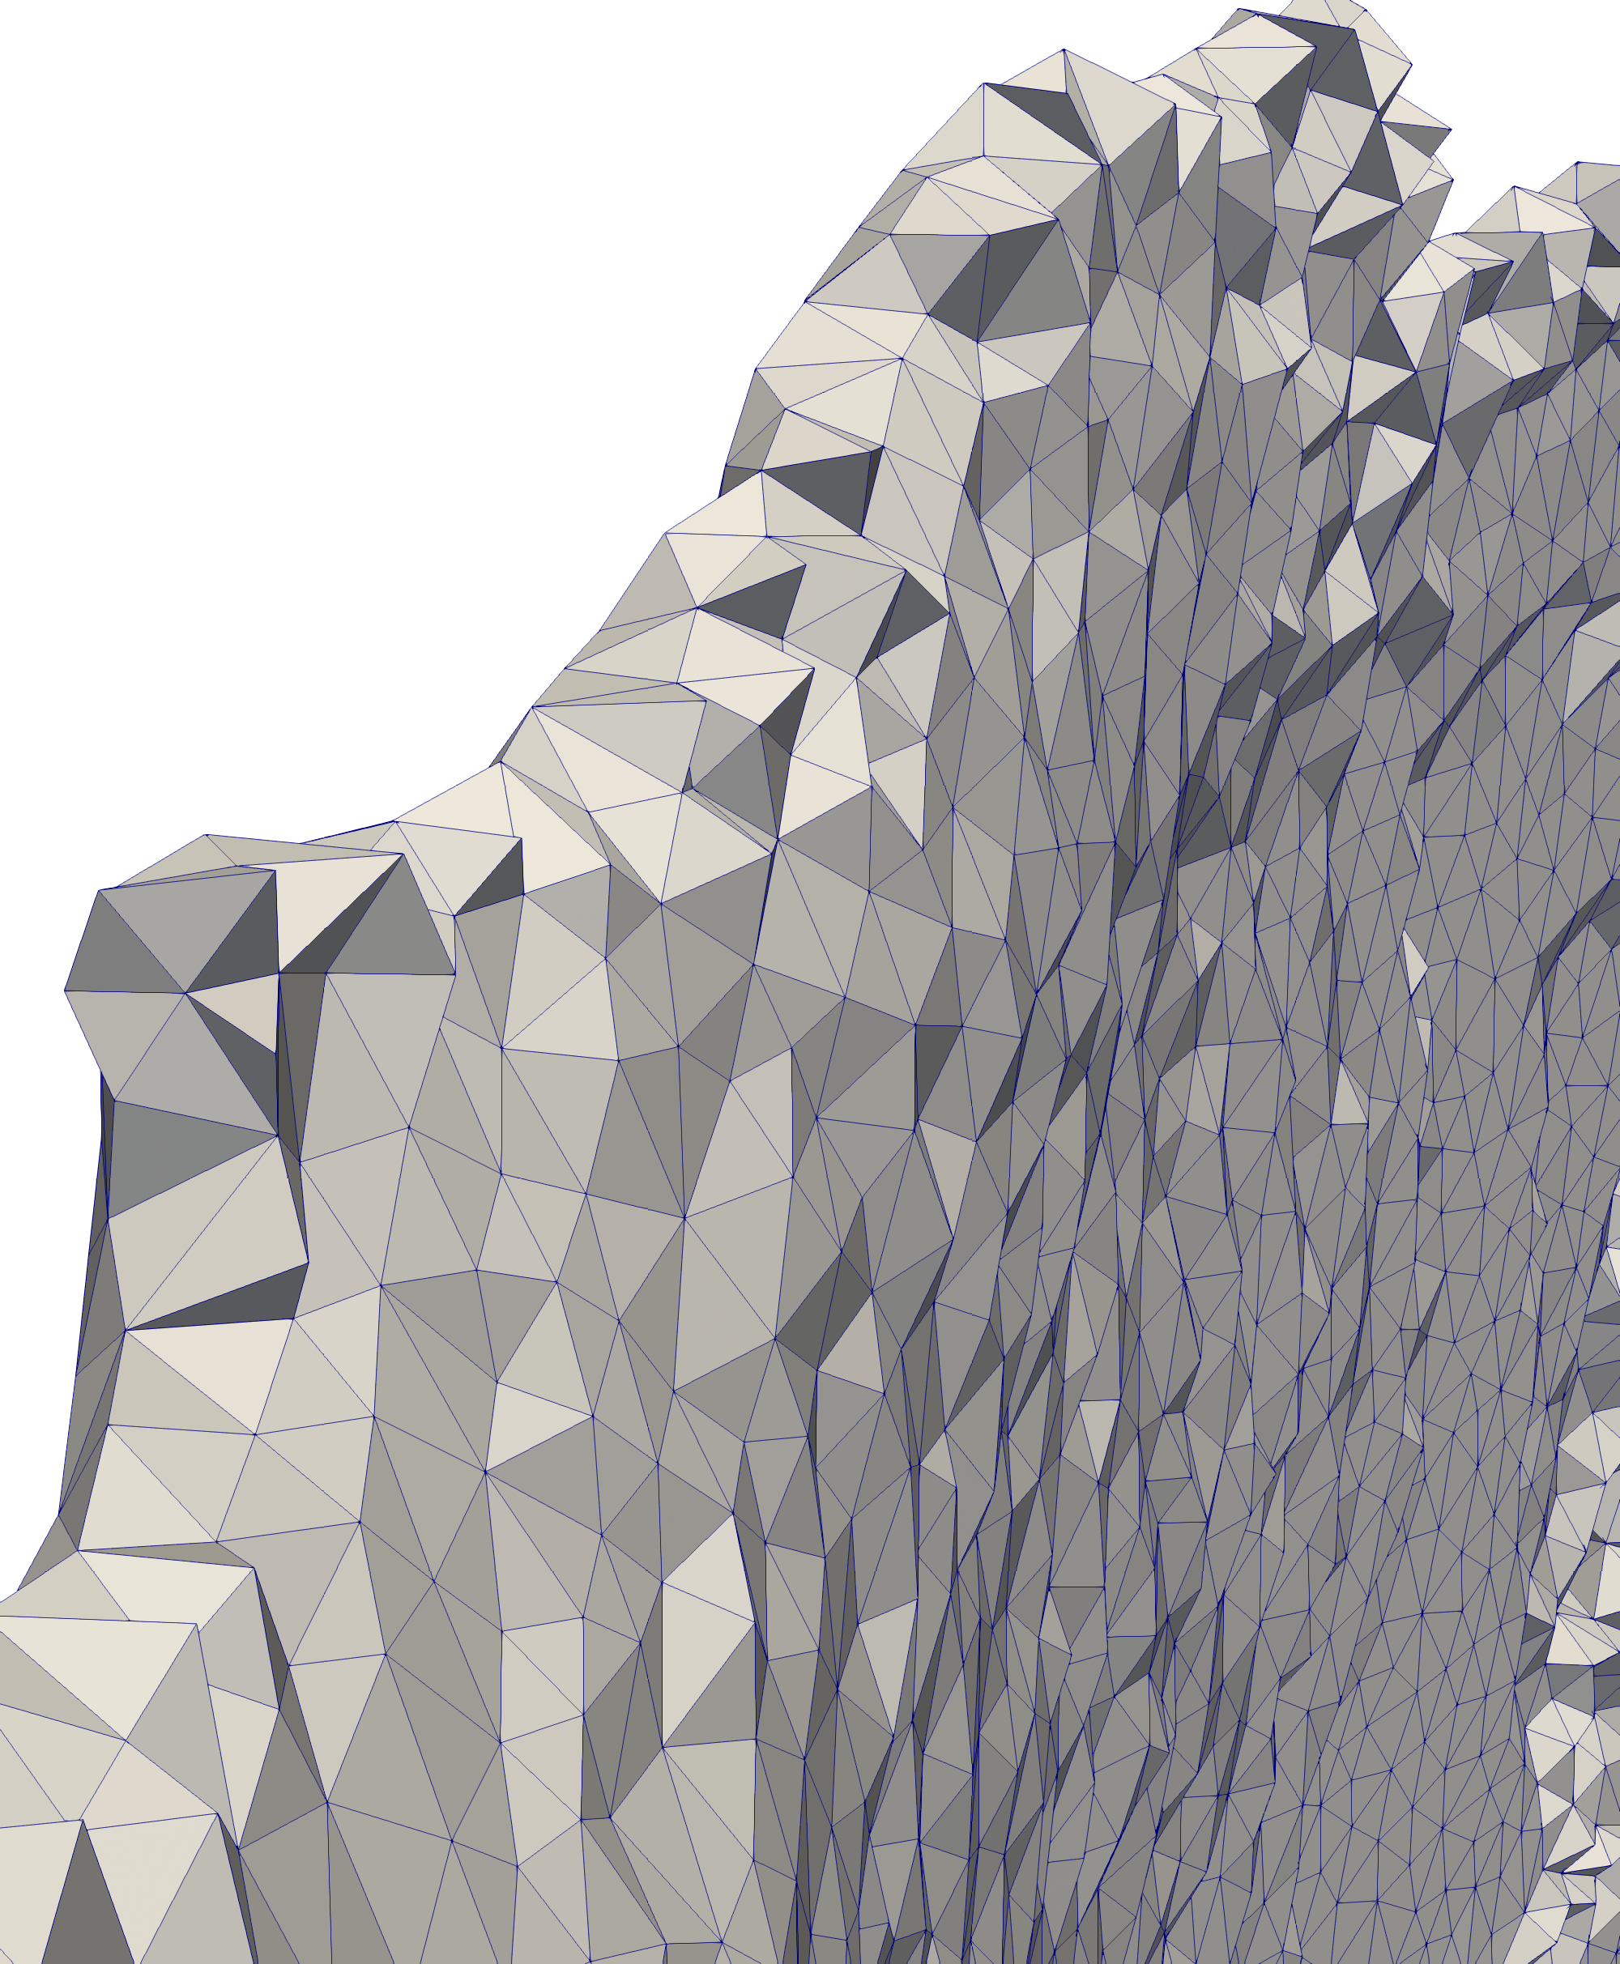
The grid
1.4 mln. nodes, 8.5 mln. cells

Slide 29
Horysontal slice, pressure

Slide 30
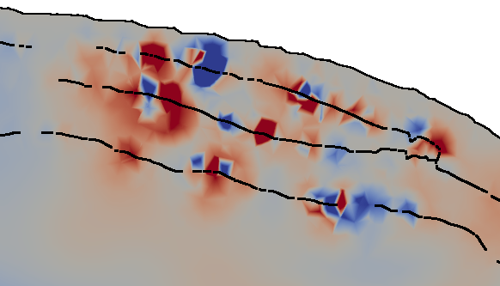
Oscillations on border

Slide 31
Conclusion
Basics of the grid-characteristic method:
  Splitting by dimensions
  Store values in nodes, not in cells
Results:
  Big number of outer characteristics
  Oscillations on curvilinear borders

Slide 32
Thank you for your attention!

Slide 33
Addition
Interpolation in triangle
Point search in triangulation

Slide 34
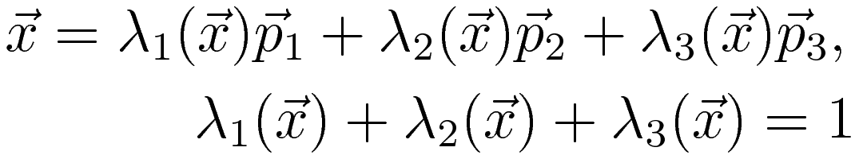
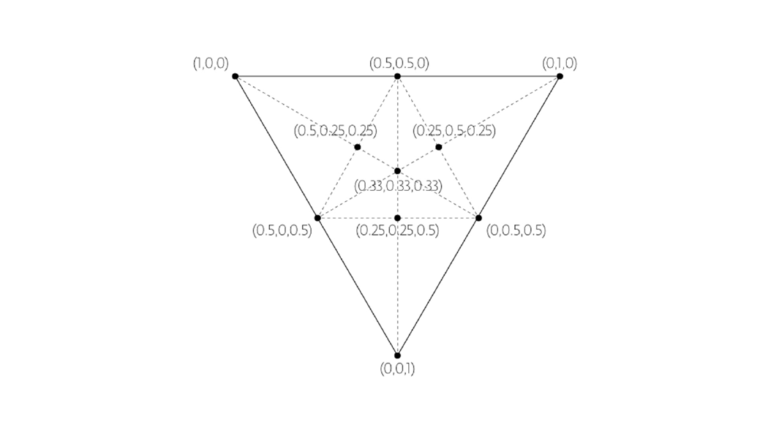
Barycentric coordinates

Slide 35
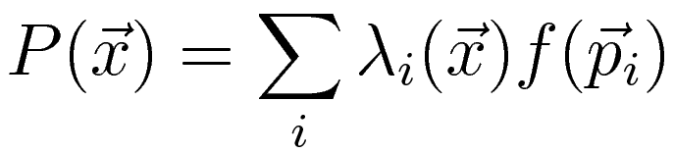
Interpolation in triangle
First order of accuracy:

Slide 36
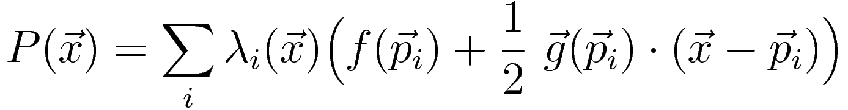
Interpolation in triangle
First order of accuracy:
Second order:

Slide 37
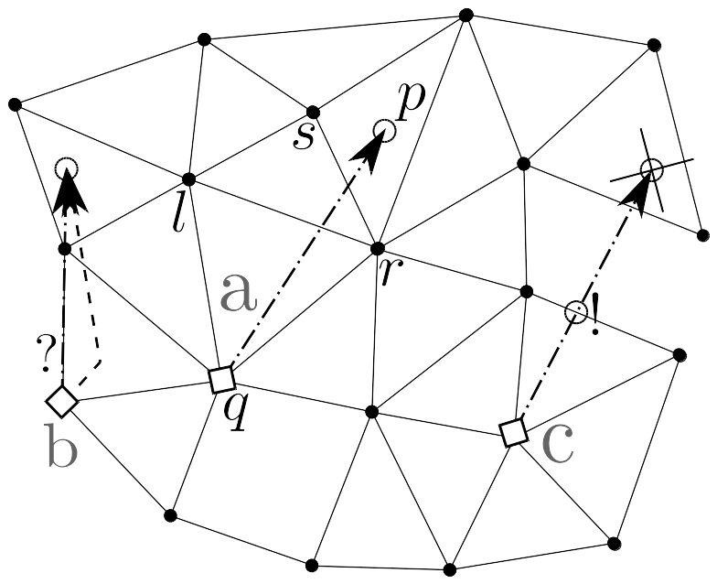
Point search in triangulation

Slide 38
Thank you for your attention!

