Slide 1
Bookdown and Forcats
Von Benjamin Haberkorn und Alexander Kleine

Slide 2

Contents
What is blogdown?
How is blogdown structured?
Example and operations of Blogdown
Open Weather Map
What are facotors?
Examples with Forcats

Slide 3

What is blogdown?
Provides an ecosystem for creating complex websites and blogs
Uses only html, css and javascript and works without any other scripting languages like php
Individual websites or blog entries can be generated via an RMarkdown document

Slide 4
What is blogdown?
Offers simplified setting options via YAML metadata
There are many ready-made themes for every application
Easy publication through plugins for Github Pages or other platforms

Slide 5
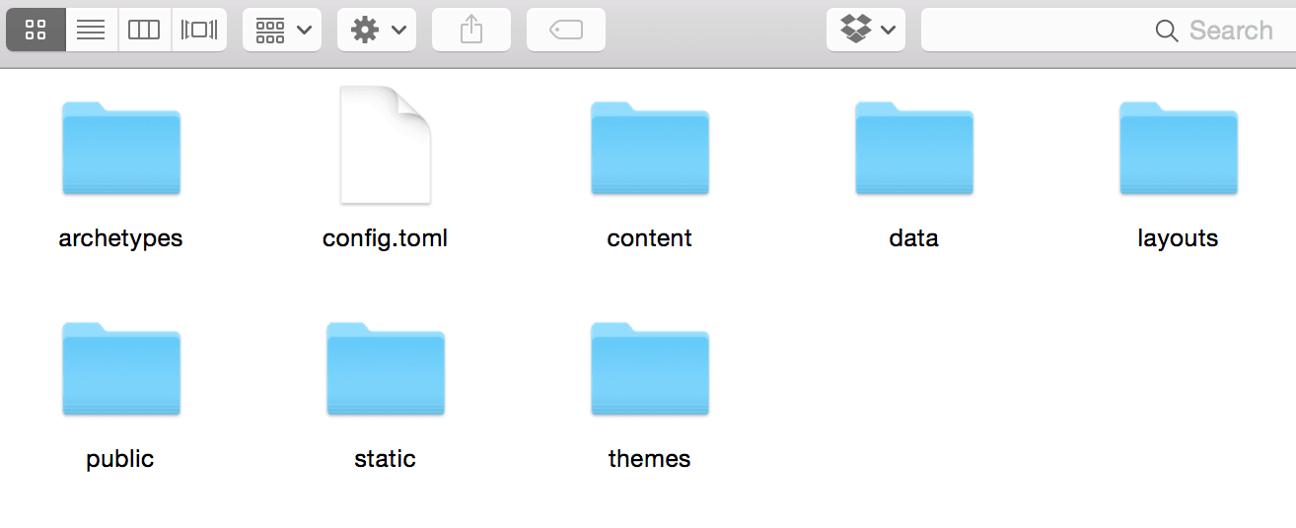
How is blogdown structured?
When a new project is created, a special folder and file structure is created.
config.toml is the configuration file for the generated website.
On content folders the Rmarkdown
files are saved and converted
Public is the target directory
for the upcoming website ecosystem.
Possible project structure:

Slide 6

Example and operations of Blogdown

Slide 7

Open weather map is a freely usable api for weather forecast, current and historical weather data
For the use a free api key is needed
there is a wrapper package for r that makes the functions available in r (owmr)

Slide 8
What are factors?
https://r4ds.had.co.nz/factors.html

Slide 9
What are factors?
https://r4ds.had.co.nz/factors.html

Slide 10
Examples with Forcats
The forcats package includes utility functions for working with factors

Slide 11

Thanks for the attention
All content under:
https://t1p.de/cbk2

