Slide 1


BOOKDOWN Data communication
FORCATS
Data
Wrangling
Tools and Programming Languages Benjamin Haberkorn und Alexander Kleine

Slide 2
Content
What is blogdown?
How is blogdown structured?
Example and operations of Blogdown
How to use forcats?
Data Source : OpenWeather
Examples with Forcats

Slide 3
What is blogdown?
Provides an ecosystem for creating complex websites
Uses only html, css and javascript and works without any other scripting languages like php
Individual websites or blog entries can be generated via an RMarkdown document

Slide 4
What is blogdown?
There are many ready-made themes for every application
Offers simplified setting options via YAML metadata
Easy publication through plugins for Github Pages or other platforms

Slide 5
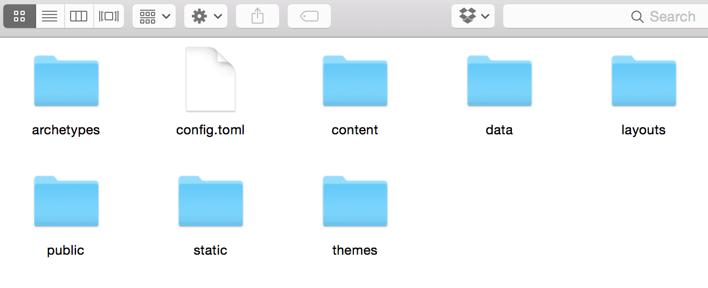
How is blogdown structured?
“config.toml” is the configuration file for the generated website.
Your Rmd files are saved and converted at the folder “content”
For the upcoming website ecosystem you use “public”
Default file structure:

Slide 6
How is blogdown structured?
-> continuous deployment ->
Rmd
Rendering via Blogdown
Locale
Website
Github
„netlify.io“
„github.io“

Slide 7
Only a Few Commands
Installation of the particular package as a setup
install:packages (“blogdown”)
Two steps to render you Rmd file
blogdown::(build_site)
blogdown::(serve_site)

Slide 8

Example and operations of Blogdown

Slide 9
How to use Forcats?
Provides tools to solve common problems with factors
Factors are used for categorical variables
Fixed set of possible values
Blue, Green, Yellow II 1, 2, 3
S < M < L II 1 < 2 < 3

Slide 10

Data Source
A free API for weather forecasting
Current and historical weather data
API-key is needed to use the data
Wrapper package for r that makes the functions available
owmr

Slide 11
Example and operations of Forcats
Published via blogdown:
https://bit.ly/2ppe3pC

Slide 12

Thanks for the attention
github:
https://t1p.de/u4gm
Published blogdown:
https://bit.ly/2ppe3pC

Slide 13
Quellen
https://bookdown.org/yihui/blogdown/
https://forcats.tidyverse.org/
https://r4ds.had.co.nz/factors.html
https://cran.r-project.org/web/packages/owmr/owmr.pdf

