Slide 1
sag-mg-recruit
Recruitment of metagenomic reads to SAGs
Determines representation of SAGs within environmental metagenomes
Comparison of SAG abundance across environments
Github

Slide 2
Usage: sag-mg-recruit [OPTIONS] INPUT_MG_TABLE INPUT_SAG_TABLE
Options:
--outdir TEXT directory location to place output files
--cores INTEGER number of cores to run on [default: 8]
--mmd FLOAT for join step: mismatch density [default: 0.05]
--mino INTEGER for join step: minimum overlap [default: 35]
--maxo INTEGER for join step: maximum overlap [default: 150]
--minlen INTEGER for alignment: minimum alignment length to include
[default: 150]
--pctid INTEGER for alignment: minimum percent identity to keep within
overlapping region [default: 95]
--overlap INTEGER for alignment: percent read that must overlap with
reference sequence to keep [default: 0]
--log TEXT name of log file, else, log sent to standard out
-h, --help Show this message and exit.

Slide 3
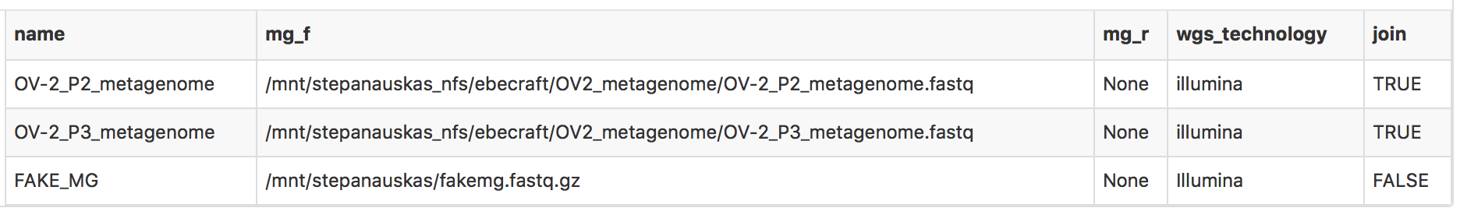
Metagenome Processing
Input file:
Join paired reads?
Output metagenome table:
/mgs/multi_mg_qc.txt
Adds:
to_recruit column that designates paths to metagenomes used for recruitment
read_count column of total reads within metagenome
TRUE
FALSE
Only joined reads used for recruitment
flash
Joined reads and join statistics written to mgs directory
Use mg_f for recruitment

Slide 4
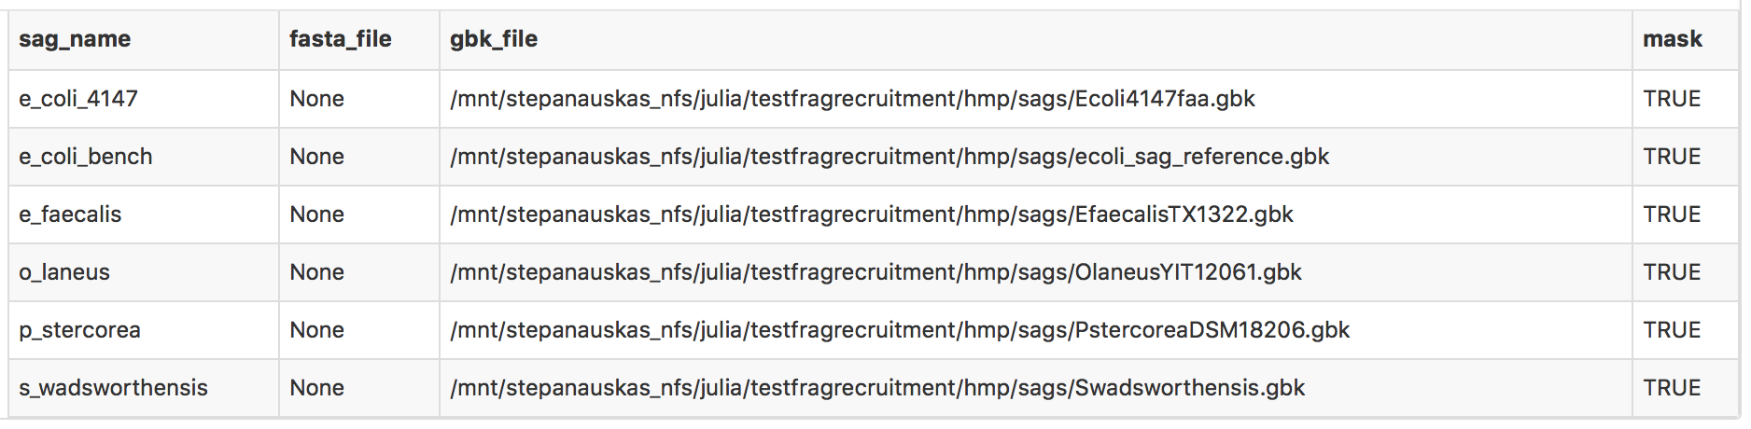
SAG Processing
Input file:
Mask SAG?
Is input a gbk file?
yes
Concatenated SAGs
After processing of SAGs, combine SAG fasta files into one called “concatenated_sags.fasta” to be processed from here on as its own SAG.
TRUE
no
FALSE
Regions of type “rRNA” or “RNA” with qualifiers “16S”, “23S”, “Subunit Ribosomal RNA” or “suRNA” are masked by ‘N’.
fasta file named {sag_name}.fasta written to “sags” working directory
Fasta file named {sag_name}.masked.fasta written to “sags” working directory.
checkm
SAG completeness statistics written to
/sags/sag_completeness.txt

Slide 5
Recruitment
sag-metagenome pair
bwa-mem
Collect:
Percent scaffolds with any coverage
Percent of reference bases covered
Average coverage
# mg reads aligned
/coverage/{mg_name}_vs_{sag_name}.bam
Sort through read alignments, extract only those that match:
minimum percent identity
minimum read length
minimum overlap (default 0)
/coverage/coverage_info_pctid{#}_minlen{#}_overlap{#}.txt
{mg_name}_vs_{sag_name}.pctid{#}.overlap{#}.minlen{#}.bam
{mg_name}_vs_{sag_name}.pctid{#}.overlap{#}.minlen{#}.aln_count
bedtools genomecov
{mg_name}_vs_{sag_name}.pctid{#}.overlap{#}.minlen{#}.genome_coverage

Slide 6
Summary Table
Merge tables
/mgs/multi_mg_qc.txt
Metagenome name
Sequencing technology
Metagenome read count
/sags/sag_completeness.txt
SAG name
SAG completeness (% complete)
SAG length
/coverage/coverage_info_pctid{#}_minlen{#}_overlap{#}.txt
SAG name
Metagenome name
Percent scaffolds with any coverage
Percent reference bases covered
Average coverage (depth of coverage)
Total reads recruited
Calculate:
sag_size_mbp: sag size in megabasepairs
reads_per_mbp: metagenome reads recruited per sag mbp
prop_mgreads_per_mbp: reads_per_mbp/total_mg_reads
/summary_table_pctid{#}_minlen{#}_overlap{#}.txt

Slide 7
Final Table info
sag
metagenome
Percent_scaffolds_with_any_coverage
Percent_of_reference_bases_covered
Average_coverage total_reads_recruited
mg_wgs_technology
mg_read_count
sag_completeness
sag_total_bp
sag_size_mbp
reads_per_mbp
prop_mgreads_per_mbp

Slide 8
Re-analysis:
Re-run sag-mg-recruit using the same input tables and output directory, but change the alignment parameters
Collect:
Percent scaffolds with any coverage
Percent of reference bases covered
Average coverage
# mg reads aligned
/coverage/{mg_name}_vs_{sag_name}.bam
Sort through read alignments, extract only those that match:
minimum percent identity
minimum read length
minimum overlap (default 0)
/coverage/coverage_info_pctid{#}_minlen{#}_overlap{#}.txt
{mg_name}_vs_{sag_name}.pctid{#}.overlap{#}.minlen{#}.bam
{mg_name}_vs_{sag_name}.pctid{#}.overlap{#}.minlen{#}.aln_count
bedtools genomecov
{mg_name}_vs_{sag_name}.pctid{#}.overlap{#}.minlen{#}.genome_coverage

Slide 9
Gaming the Pipeline:
Time intensive processes:
Joining (flash)
SAG completeness (checkm)
Recruitment (bwa)
sag-mg-recruit will not re-run a step if file it is about to create already exists.
For example:
If you are comparing a new set of metagenomes to the same SAGs, you can copy over the “sags” directory from a previous run into your designated run directory and sag-mg-recruit will use the files in the old sag directory rather than re-run checkm.
Same is true for the join step, but you can also provide the path to joined reads from a previous smr run in a new run, and put “FALSE” in the join column.

Slide 10
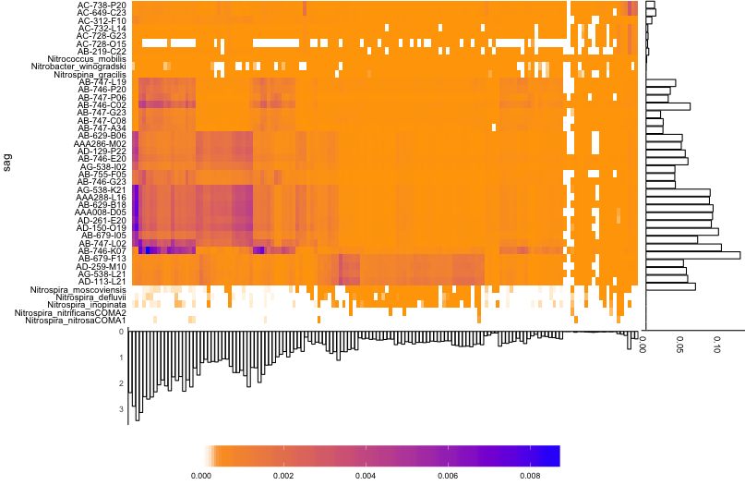
Plotting Results:
y-axis plot :
mean (metagenomic reads recruited /metagenome size) *100
x-axis plot: % metagenomic reads recruited to concatenated SAGs

Slide 11
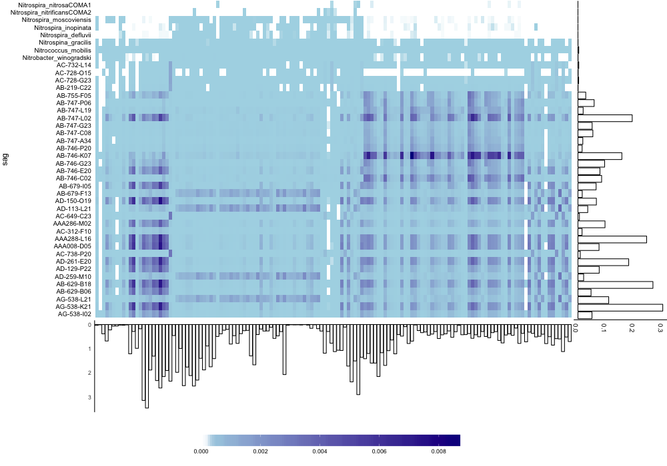
Plotting options:
Alignment:
sag_ax_aln
hm_aln
mg_ax_aln
Heirarchical clustering:
Heirarchical clustering of bray-curtis distance matrix
hclust_mgs, hclust_sags
Input order that SAGs and MGs appear
Provide path to input files with a list of order that you want SAGs/metagenomes to appear, one per line
sag_order, mg_order
Heatmap colors
lowcolor: color of near-zero and zero values
midcolor: mid-range color
highcolor: high-range color

Slide 12
Next
Putting together R plotting package
New github repo for this: here
Functions can be loaded into Rstudio (or your favorite R GUI) and run on outputs
In the process of figuring out how to make it its own independent package
In the future, I hope to work with python plotting functions instead

