Slide 1
PULSE
Profit Pool Simulation Engine
CEO Strategy Briefing | Henkel Consumer Brands | March 2026
Prepared by Bain & Company
CONFIDENTIAL
1

Slide 2





WHY PROFIT POOL THINKING?
Market share alone no longer predicts value creation in FMCG
THE PROBLEM
THE ANSWER: PULSE
Revenue growth masks margin erosion
See where profit migrates — before the P&L shows it
Private label captures 2-3pp of profit pool annually in core European markets
Probabilistic simulation gives 2-3 year lead time on structural shifts
Forces interact causally, not independently
▶
Causal propagation models real-world interdependencies
Regulation drives reformulation cost, which shifts shelf price, which changes consumer behavior
A regulatory shock cascades through technology, cost, and consumer behavior
Static models miss structural shifts
Allocate resources to highest-value pools
Annual Excel-based assessment lacks probabilistic rigor and causal propagation
Optimizer recommends where to invest, defend, or harvest across 12 categories
CONFIDENTIAL
2

Slide 3

WHAT THE PROFIT POOL ENGINE DELIVERS
A living decision platform, not a static report
Simulates
Connects
Recommends
10,000+
16
12
Monte Carlo iterations
causal DAG edges
categories optimized
Bayesian hierarchical model with copula dependencies produces probability distributions — not point estimates
Forces propagate through directed causal paths with lag structures — a regulatory shock ripples through the entire system
Resource allocation optimizer produces invest / defend / harvest recommendations based on expected pool shifts
CONFIDENTIAL
3

Slide 4






SIX FORCES RESHAPING PROFIT POOLS
Each force is causally linked — a shock in one propagates through the system
Consumer
Customer
Technology
Clean beauty, premiumization,
sustainability consciousness
Retail consolidation, private label,
e-commerce channel shift
AI personalization, biotech ingredients,
Digital Product Passport
Government
Environment
Competitive
EU Green Deal, REACH/CLP,
CSRD, microplastics ban
Climate regulation, water scarcity,
circular economy mandates
P&G premiumization, Unilever M&A,
indie brand disruption
Forces are connected via a Causal DAG — 16 directed edges with propagation weights and lag structures
CONFIDENTIAL
4

Slide 5



TWO LENSES, ONE TRUTH
Same Shift Matrix, two purpose-built interfaces
PULSE War Room
Executive Reporting
Interactive web dashboard for the strategy team
PowerPoint + Power BI for ExCo and Finance
Real-time re-simulation on score changes
Auto-generated executive narrative deck
Interactive heatmap with drill-down panels
Power BI dashboard with actual €M financials
Causal DAG flow visualization
Shift Matrix applied to GP1 (absolute terms)
Monte Carlo distributions + tornado charts
Board-ready scenario comparison
Scenario comparison engine
Backtesting accuracy report
AI trend scanner + chat interface
One-click export from War Room
Format: Relative % | Audience: Strategy Team
Format: Absolute €M | Audience: ExCo / Finance
CONFIDENTIAL
5

Slide 6





HOW THE MODEL WORKS
Four-step methodology from trend identification to profit pool impact
▸
▸
▸
01
02
03
04
AI Trend
Scanning
Delphi Expert
Rating
Monte Carlo
Simulation
Profit Pool
Impact
19 free data APIs
Round 1: Blind scoring
Bayesian hierarchical
Shift Matrix output
Regulatory + news + patents
Round 2: Calibrated re-score
Copula dependencies
5-year continuous paths
Weekly signal digest
Round 3: Consensus
Causal DAG propagation
Allocation optimizer
CONFIDENTIAL
6

Slide 7




FOUR DIMENSIONS OF IMPACT ASSESSMENT
Every trend is scored across multiple axes to capture the full economic picture
12
3+
8
2-25%
categories
regions
VC steps
GP1 cap
Category Impact
Regional Lens
Value Chain
% of GP1 Affected
Color, Care, Styling, Body, FCN, FCA, FFI, LAD, HDW, ADW, HSC, IC — each scored 0-5 per trend
Europe, North America, Emerging Markets — tailored force weightings by market context
Raw Materials through After-Sales — where in the chain does each trend hit hardest?
Economic anchor: each trend can only touch a bounded fraction of a category’s profit pool
CONFIDENTIAL
7

Slide 8
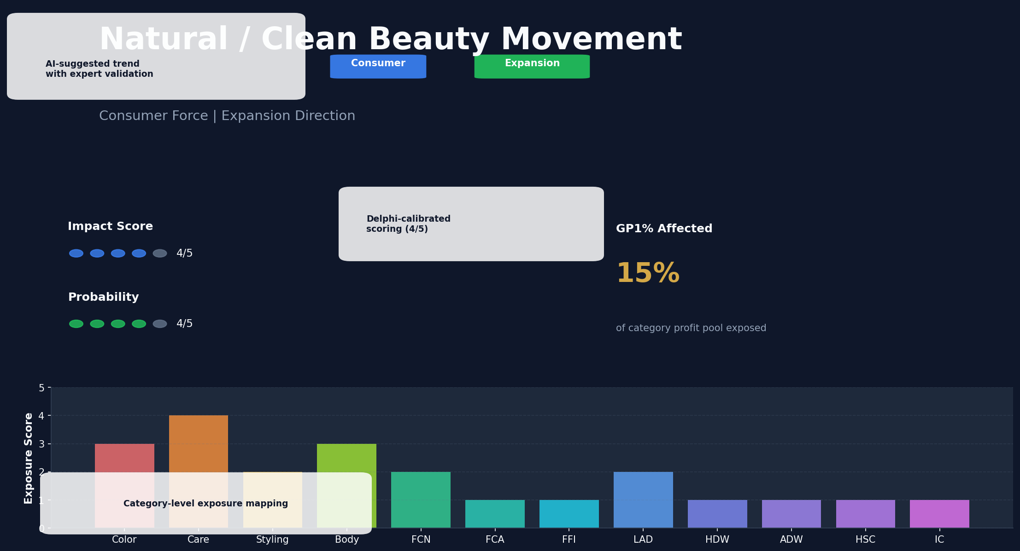
TREND DETAIL VIEW
Every trend is scored, validated, and mapped to categories with full transparency
CONFIDENTIAL
8

Slide 9
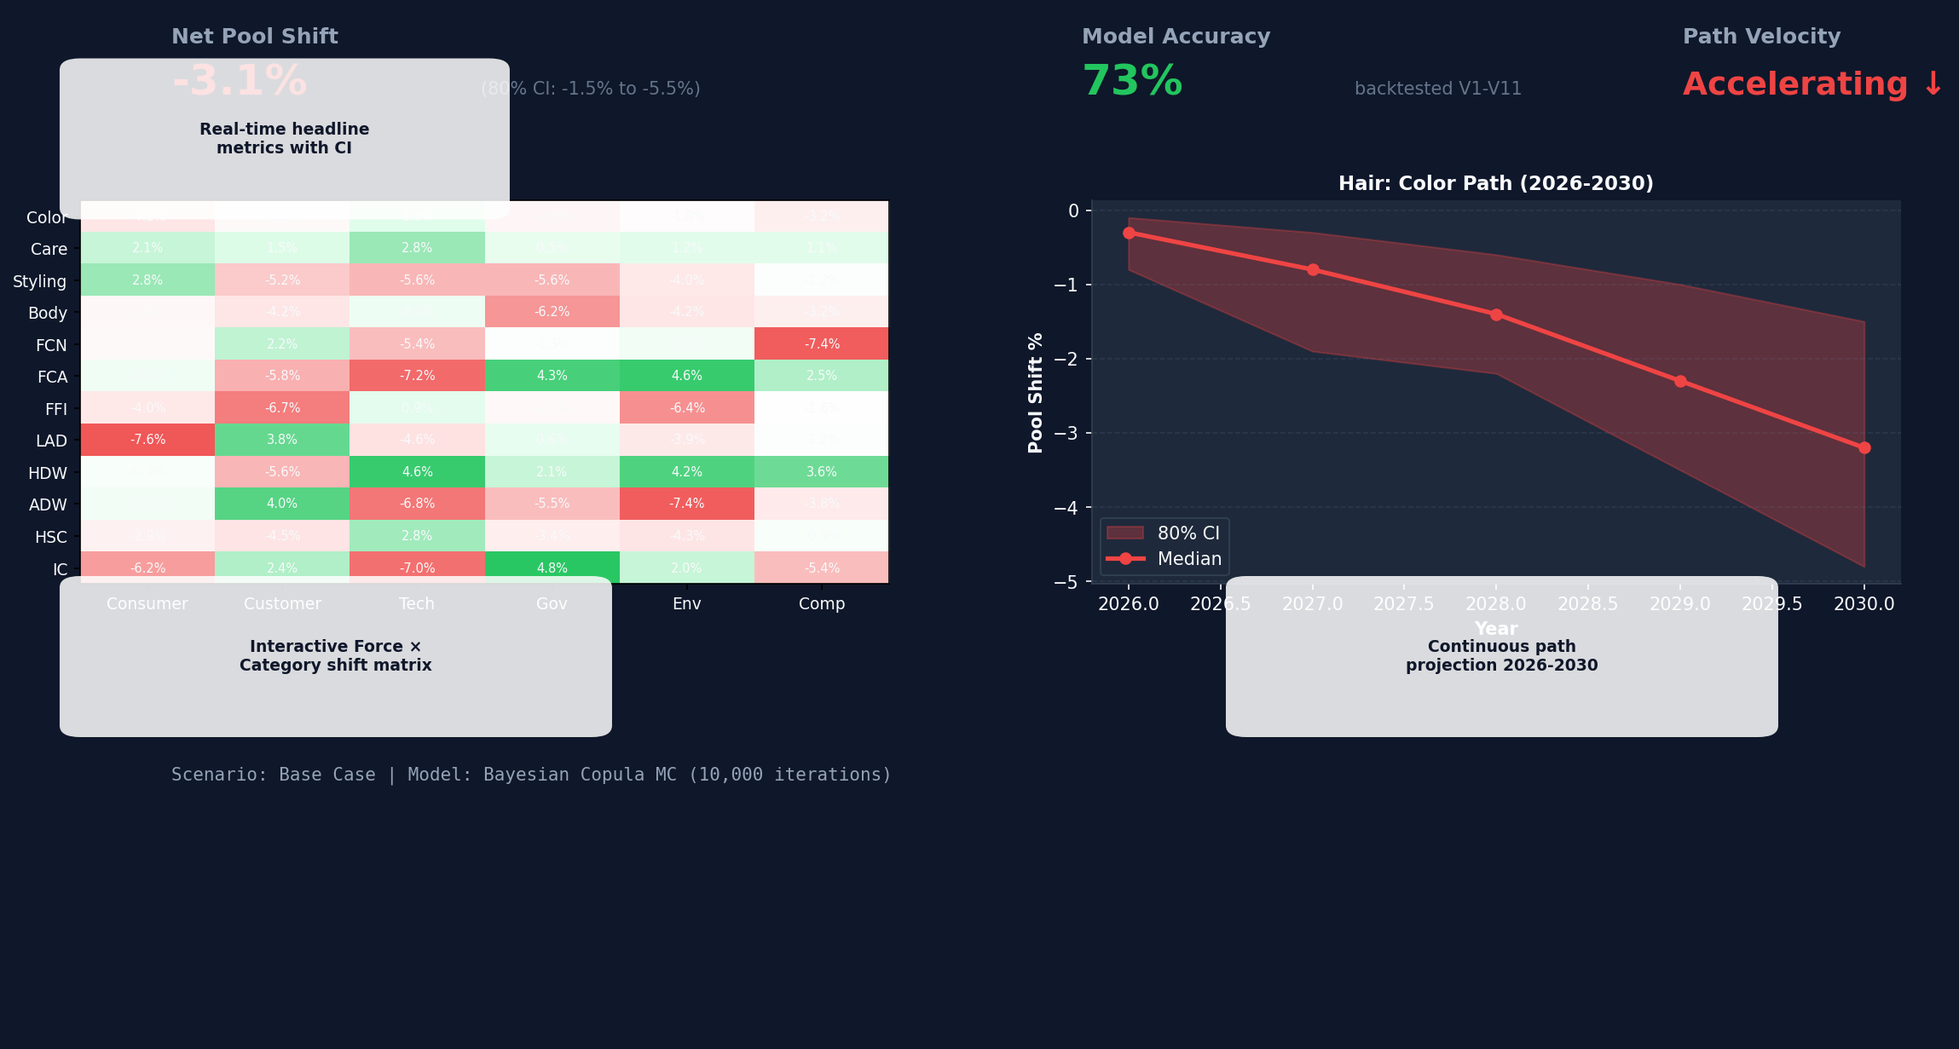
WAR ROOM — UNIFIED COMMAND VIEW
One screen tells the complete story: KPIs, heatmap, path projections, and causal flow
CONFIDENTIAL
9

Slide 10
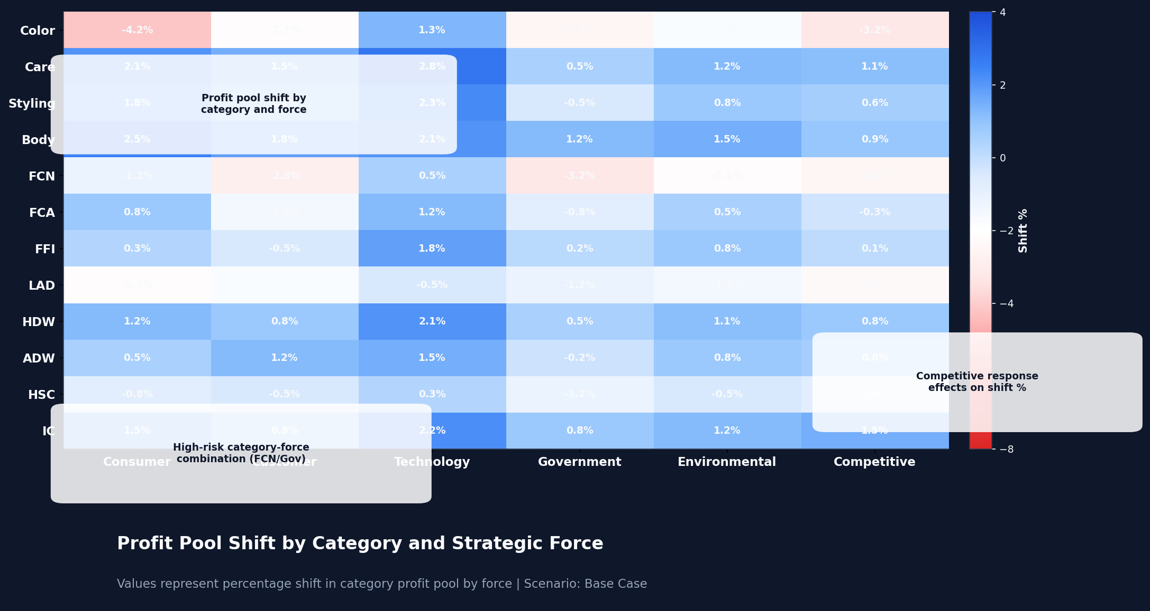
CATEGORY × FORCE SHIFT MATRIX
Percentage shift in category profit pool by strategic force — the core analytical output
CONFIDENTIAL
10

Slide 11



TECHNOLOGY ARCHITECTURE
Enterprise-grade, deployed within Henkel cloud — zero running cost
Simulation Engine
War Room Dashboard
AI & Integration
Python 3.11+
React 18 + Vite
Provider-agnostic
FastAPI REST server
D3.js / Recharts visualization
Claude API → Azure OpenAI
Bayesian MC (SciPy/NumPy)
TailwindCSS dark mode
19 free external data APIs
NetworkX Causal DAG
Framer Motion animations
Power BI Shift Matrix export
SQLite local data store
Zustand + TanStack Query
Excel bidirectional bridge
Copula dependency model
60fps Apple-grade UX
€0/year running cost
CONFIDENTIAL
11

Slide 12



ROADMAP — MVP TO ENTERPRISE
Three phases, each delivering standalone value
Q2 2026
Q3 2026
Q4 2026
Bayesian Engine
War Room Dashboard
AI + Power BI
In Progress
Planned
Planned
CLI reads V12 Excel
React SPA with heatmap
AI trend scanner
Bayesian MC + causal DAG
Causal flow animation
Delphi workflow integration
Continuous-path Shift Matrix
Scenario comparison
NL chat interface
V12 parity validation
Export center (PPT/PDF/XLS)
Auto Power BI sync
CONFIDENTIAL
12

Slide 13





OPERATING RHYTHM
PULSE embeds into the existing annual planning cycle
ANNUAL DEEP DIVES (1-2x PER YEAR)
Q1
Q2
Q2
Q2-Q4
Full Trend
Update
Delphi
Scoring
Full MC
Simulation
Impact
Report
AI scanner refreshes
trend database
3-round expert
rating protocol
50,000 iterations
with causal DAG
Shift Matrix
to ExCo + Power BI
+
CONTINUOUS MONITORING (ALWAYS ON)
AI Trend Scanner
Early-Warning Triggers
Velocity Tracking
Quick Refresh
Weekly signal digest
Threshold alerts
Shift speed monitoring
10K iter. on demand
CONFIDENTIAL
13

Slide 14

FROM STATIC EXCEL TO LIVING SIMULATION
Why the current V12 model cannot capture structural profit pool shifts
Current: V12 Excel Model
New: PULSE Simulation Engine
Point estimates only
Single best-guess scores — no probability distributions or confidence intervals
Bayesian Monte Carlo
10,000+ iterations with probability distributions and confidence bands per category
Independent forces
Each force scored in isolation — no causal links between regulation, tech, and consumer shifts
Causal DAG propagation
16 directed edges model how a regulatory shock cascades through all 6 forces
▶
Two time horizons
Mid-term and long-term snapshots only — no path velocity or early-warning triggers
5-year continuous paths
Annual granularity 2026–2030 with velocity tracking, acceleration, and trigger alerts
Manual, annual refresh
Requires weeks of manual scoring — no AI trend scanning or continuous monitoring
AI-augmented, always-on
19 free APIs scan trends continuously — weekly signal digest with Delphi calibration
No optimization
Shows shifts but doesn’t recommend where to invest, defend, or harvest
Allocation optimizer
Invest / defend / harvest recommendations based on risk-adjusted expected pool shifts
CONFIDENTIAL
14

Slide 15


DELPHI EXPERT ELICITATION PROCESS
Structured 3-round protocol eliminates bias and builds calibrated consensus
▸
▸
ROUND 1
ROUND 2
ROUND 3
Blind
Scoring
Calibrated
Re-Score
Consensus
& Sign-Off
Independent probability rating (1–5)
Anonymized score distribution shared
Outlier discussion (top/bottom 10%)
Written rationale per trend
AI suggests adjustments (human review)
Weighted median = final score
No visibility into others’ scores
Anchoring & optimism bias flagged
Scorer calibration accuracy tracked
Calibration exercise to detect bias
Scorers re-rate with group context
Inter-rater reliability (α > 0.67)
Eliminates anchoring bias
Builds auditable consensus
Tracks scorer accuracy over time
AI-assisted, never AI-decided
CONFIDENTIAL
15

Slide 16



TREND ANALYSIS & DATA SOURCE VALIDATION
AI-powered scanning with 9-tier credibility system ensures evidence-based scoring
AI SCANNING PIPELINE
SOURCE CREDIBILITY TIERS
Multi-Source Ingestion
S
Official regulatory/legislative
19 free APIs: GDELT, GNews, ECHA, EUR-Lex, patents, RSS feeds
▼
A
Tier-1 consulting (primary data)
Relevance Filtering
A–
Investment bank / Big-4 analyst
FMCG category mapping — Hair, LHC, cross-category signals
▼
B+
Specialist industry analyst
AI Scoring Suggestion
B
Trade press / industry media
Probability (1–5) + GP1% affected — always flagged for human review
▼
B–
Company / PR source
Source Credibility Check
Every source rated S through E — weak signals require B-tier corroboration
C
General press
▼
D
Aggregator / blog
Human Review Queue
Expert accepts, rejects, or adjusts — AI never auto-applied
E
Unverified (weak signal only)
55 trends · 220 sources · All rated · Color-coded in War Room
CONFIDENTIAL
16

Slide 17
TREND RESEARCH METHODOLOGY
Repeatable 6-step process from strategic question to validated trend database
01
Strategic
Questions
02
Multi-Source
Intelligence
03
Source
Validation
Define force-specific
research questions —
not keyword searches
▸
19 free APIs + AI
research engine +
manual deep dives
▸
9-tier credibility
system (S through E)
with corroboration
▼
04
Scoring &
Anchoring
05
Category
Mapping
06
Delphi
Validation
Probability (1–5)
× GP1% affected
= normalized score
▸
12 categories ×
8 VC steps ×
4 regions scored
▸
3-round expert
consensus with
bias correction
55 trends validated
220 sources rated
6 forces × 12 categories
Repeatable annually
CONFIDENTIAL
17

Slide 18
KEY BENEFITS & HOW TO GET STARTED
A clear path from today’s Excel model to an enterprise-grade simulation platform
KEY BENEFITS
2–3 yr
10,000+
16
€0
lead time
simulations
causal links
running cost
See structural profit pool shifts before they appear in the P&L
Replace point estimates with full probability distributions and confidence intervals
Understand how a regulatory shock cascades through all 6 forces to every category
Enterprise-grade platform built on free APIs with zero annual licensing fees
HOW TO GET STARTED
April 2026
May 2026
May 2026
Approve Phase 1
Designate Delphi Panel
Provide Historical Data
Bayesian engine build with V12 integration
5–8 category experts for scoring rounds
V1–V11 enables backtesting & calibration
CONFIDENTIAL
18

Slide 19
EXECUTIVE SUMMARY
1
Profit pools are shifting structurally — static Excel cannot capture the causal interdependencies between the 6 forces reshaping our 12 categories
2
PULSE transforms the V12 assessment into a living, probabilistic simulation engine with Bayesian Monte Carlo, causal propagation, and a 5-year continuous path
3
Every AI suggestion requires human review, every score change is audited, and the Delphi protocol ensures calibrated expert consensus — enterprise-grade governance
4
Three-phase rollout delivers standalone value at each stage: Bayesian engine (Q2), War Room dashboard (Q3), AI intelligence layer (Q4) — all at zero running cost
5
Shift Matrix integrates seamlessly with Excel and Power BI — strategy teams see relative %, ExCo sees absolute €M impact. Same truth, two lenses
CONFIDENTIAL
19

Slide 20

WHAT’S NEXT
Four sequential workstreams to deliver a living profit pool simulation
1
2
3
4
▸
▸
▸
Model
Infrastructure
Trend
Analysis
Delphi
Scoring
Profit Pool
Analysis
Determine functionality scope
Review existing 55 trends
3-round expert elicitation
Run Bayesian Monte Carlo
Set up technology architecture
Update with latest market data
Approx. 1 day of expert time
Generate Shift Matrix output
Build together with Henkel DX
Validate with CMI team
AI-assisted bias correction
Category allocation insights
Test & validate model outputs
Consult domain experts
Calibrated consensus scores
Deliver to ExCo & Finance
CONFIDENTIAL
20

