Slide 1
PULSE
Profit Pool Unified Landscape Simulation Engine
CEO Strategy Briefing
Henkel Consumer Brands | March 2026
Prepared by Bain & Company
1

Slide 2
WHY PROFIT POOL THINKING?
Market share alone no longer predicts value creation
THE CHALLENGE
PROFIT POOL THINKING
Revenue growth masks margin erosion
Private label captures 2-3pp of profit pool annually in key European markets
Category dynamics shift faster than planning cycles
6 structural forces reshape profit pools simultaneously — regulation, technology, consumer behavior, competition, environment, retail
Static Excel models can’t capture interdependencies
V12 treats forces as independent — missing cascading effects like regulation → technology → cost
See where value is created — and where it’s migrating
Shift from “how big is the market?” to “where is the profit?”
Anticipate shifts before they appear in the P&L
Probabilistic modeling with causal propagation gives 2-3 year lead time on structural changes
Allocate resources to highest-value opportunities
Optimizer recommends where to invest, defend, or harvest based on expected pool shifts
CONFIDENTIAL — Henkel Consumer Brands
2

Slide 3
WHAT PULSE DOES
A living simulation engine that transforms static assessments into decision intelligence
01
02
03
Simulates
Connects
Recommends
Runs 10,000+ probabilistic scenarios across 12 categories, 6 forces, and 5 years to model profit pool shifts with Bayesian confidence intervals
Causal DAG links forces together — a regulatory shock propagates to technology costs, shelf prices, and consumer behavior automatically
Optimizer produces resource allocation recommendations: where to invest more, where to defend, where to harvest — all in relative terms
CONFIDENTIAL — Henkel Consumer Brands
3

Slide 4
SIX FORCES RESHAPING PROFIT POOLS
Each force is causally linked — a shock in one propagates through the system
CONSUMER
CUSTOMER
TECHNOLOGY
Clean beauty, premiumization, sustainability consciousness, aging demographics
Retail consolidation, private label power, e-commerce channel shift, discounter growth
AI-driven personalization, biotech ingredients, smart packaging, digital shelf
Natural ingredients demand, DTC growth
Aldi/Lidl expansion, Amazon share
Reformulation tech, DPP compliance
GOVERNMENT
ENVIRONMENTAL
COMPETITIVE
EU Green Deal, REACH/CLP, Digital Product Passport, sustainability reporting
Climate regulation, water scarcity, raw material volatility, circular economy
P&G premiumization, Unilever sustainability, private label sophistication
CSRD, PPWR, microplastics ban
Palm oil pressure, refill systems
Competitor M&A, Indie brand disruption
4

Slide 5
TWO LENSES, ONE TRUTH
PULSE serves both the strategy team and ExCo through purpose-built interfaces
PULSE WAR ROOM
EXECUTIVE REPORTING
Interactive Web Dashboard
PowerPoint + Power BI
Real-time simulation re-run on score changes
Interactive heatmap with drill-down panels
Causal DAG visualization with animations
Monte Carlo distributions and tornado charts
Scenario comparison (Base, Green Squeeze, etc.)
AI-powered trend scanner and chat interface
Export to Excel, PowerPoint, PDF
Auto-generated executive narrative deck
Power BI dashboard with actual financials
Shift Matrix applied to GP1 in absolute terms
Scenario comparison in board-ready format
Backtesting accuracy for credibility
Causal decomposition waterfall charts
One-click export from War Room
For: Strategy Team | Format: Relative %
For: ExCo / Finance | Format: Absolute €M
CONFIDENTIAL — Henkel Consumer Brands
5

Slide 6
HOW PULSE WORKS
Four-step methodology from trend identification to profit pool impact
1
2
3
4
AI Trend
Scanning
Delphi Expert
Rating
Monte Carlo
Simulation
Profit Pool
Impact
Multi-source intelligence waterfall scans regulatory databases, news feeds, patent filings, and consumer signals to identify emerging trends
Structured 3-round scoring protocol:
Round 1: Independent blind scoring
Round 2: Calibrated re-scoring
Round 3: Outlier discussion + consensus
Bayesian hierarchical model with copula dependencies runs 10,000 iterations across the causal DAG to produce probabilistic shift distributions
Shift Matrix output: % change by category × force × year with confidence intervals. Optimizer recommends resource allocation
CONFIDENTIAL — Henkel Consumer Brands
6

Slide 7
PROFIT POOL MODEL — FOUR IMPACT DIMENSIONS
Every trend is assessed across multiple dimensions to capture the full economic picture
12
3+
8
2-25%
categories
regions
VC steps
GP1 cap
CATEGORY IMPACT
REGIONAL IMPACT
VALUE CHAIN IMPACT
% OF GP1 AFFECTED
12 categories scored
Market-specific factors
8 value chain steps
Economic anchoring
Each trend receives an exposure score (0-5) for every category: Color, Care, Styling, Body, FCN, FCA, FFI, LAD, HDW, ADW, HSC, IC
Regional configuration via EM_Input sheet captures market-level dynamics: Europe, NA, Emerging Markets with tailored force weightings
Trends impact different parts of the value chain: Raw Materials, Formulation, Production, Packaging, Logistics, Marketing, Sales, After-Sales
Each trend carries a ‘GP1% affected’ parameter (2-25%) capping the maximum fraction of a category’s profit pool that this trend can realistically touch
CONFIDENTIAL — Henkel Consumer Brands
7

Slide 8
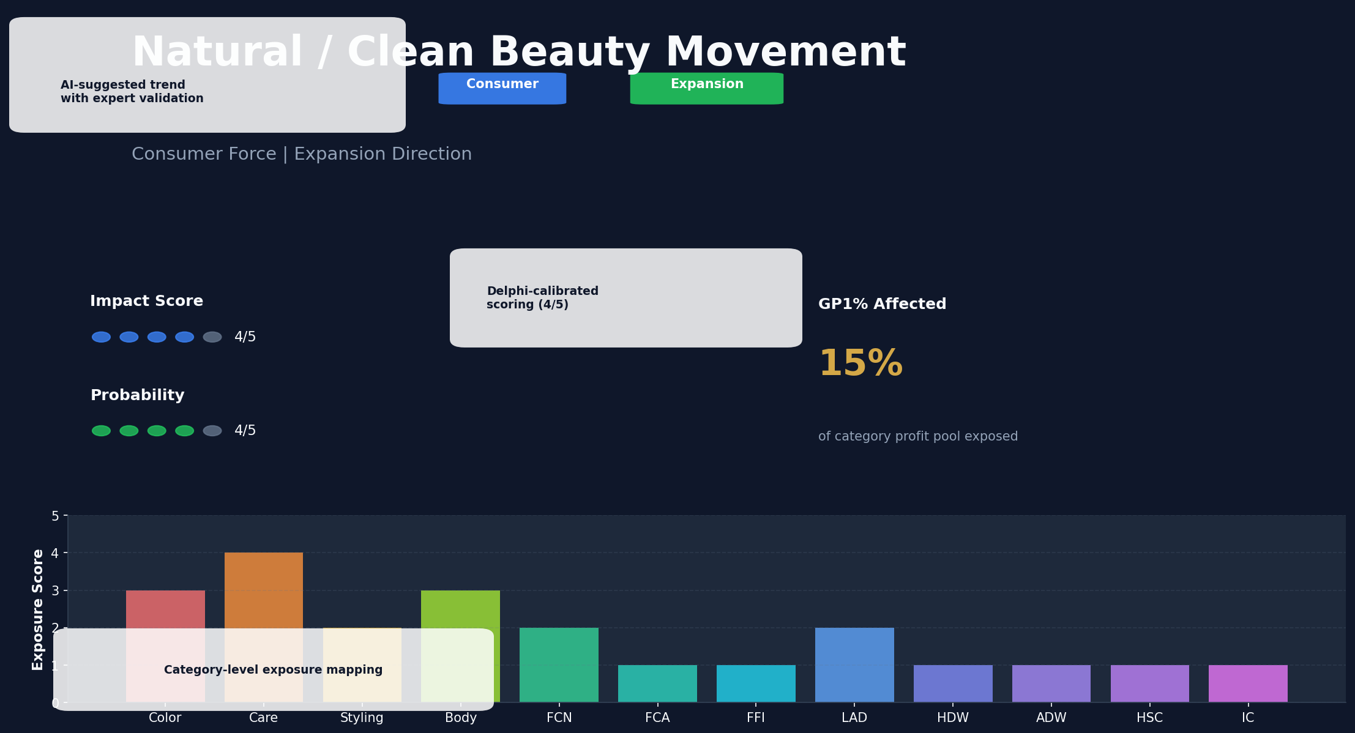
TREND DETAIL VIEW
Each trend is scored, validated, and mapped to categories with full transparency
8

Slide 9
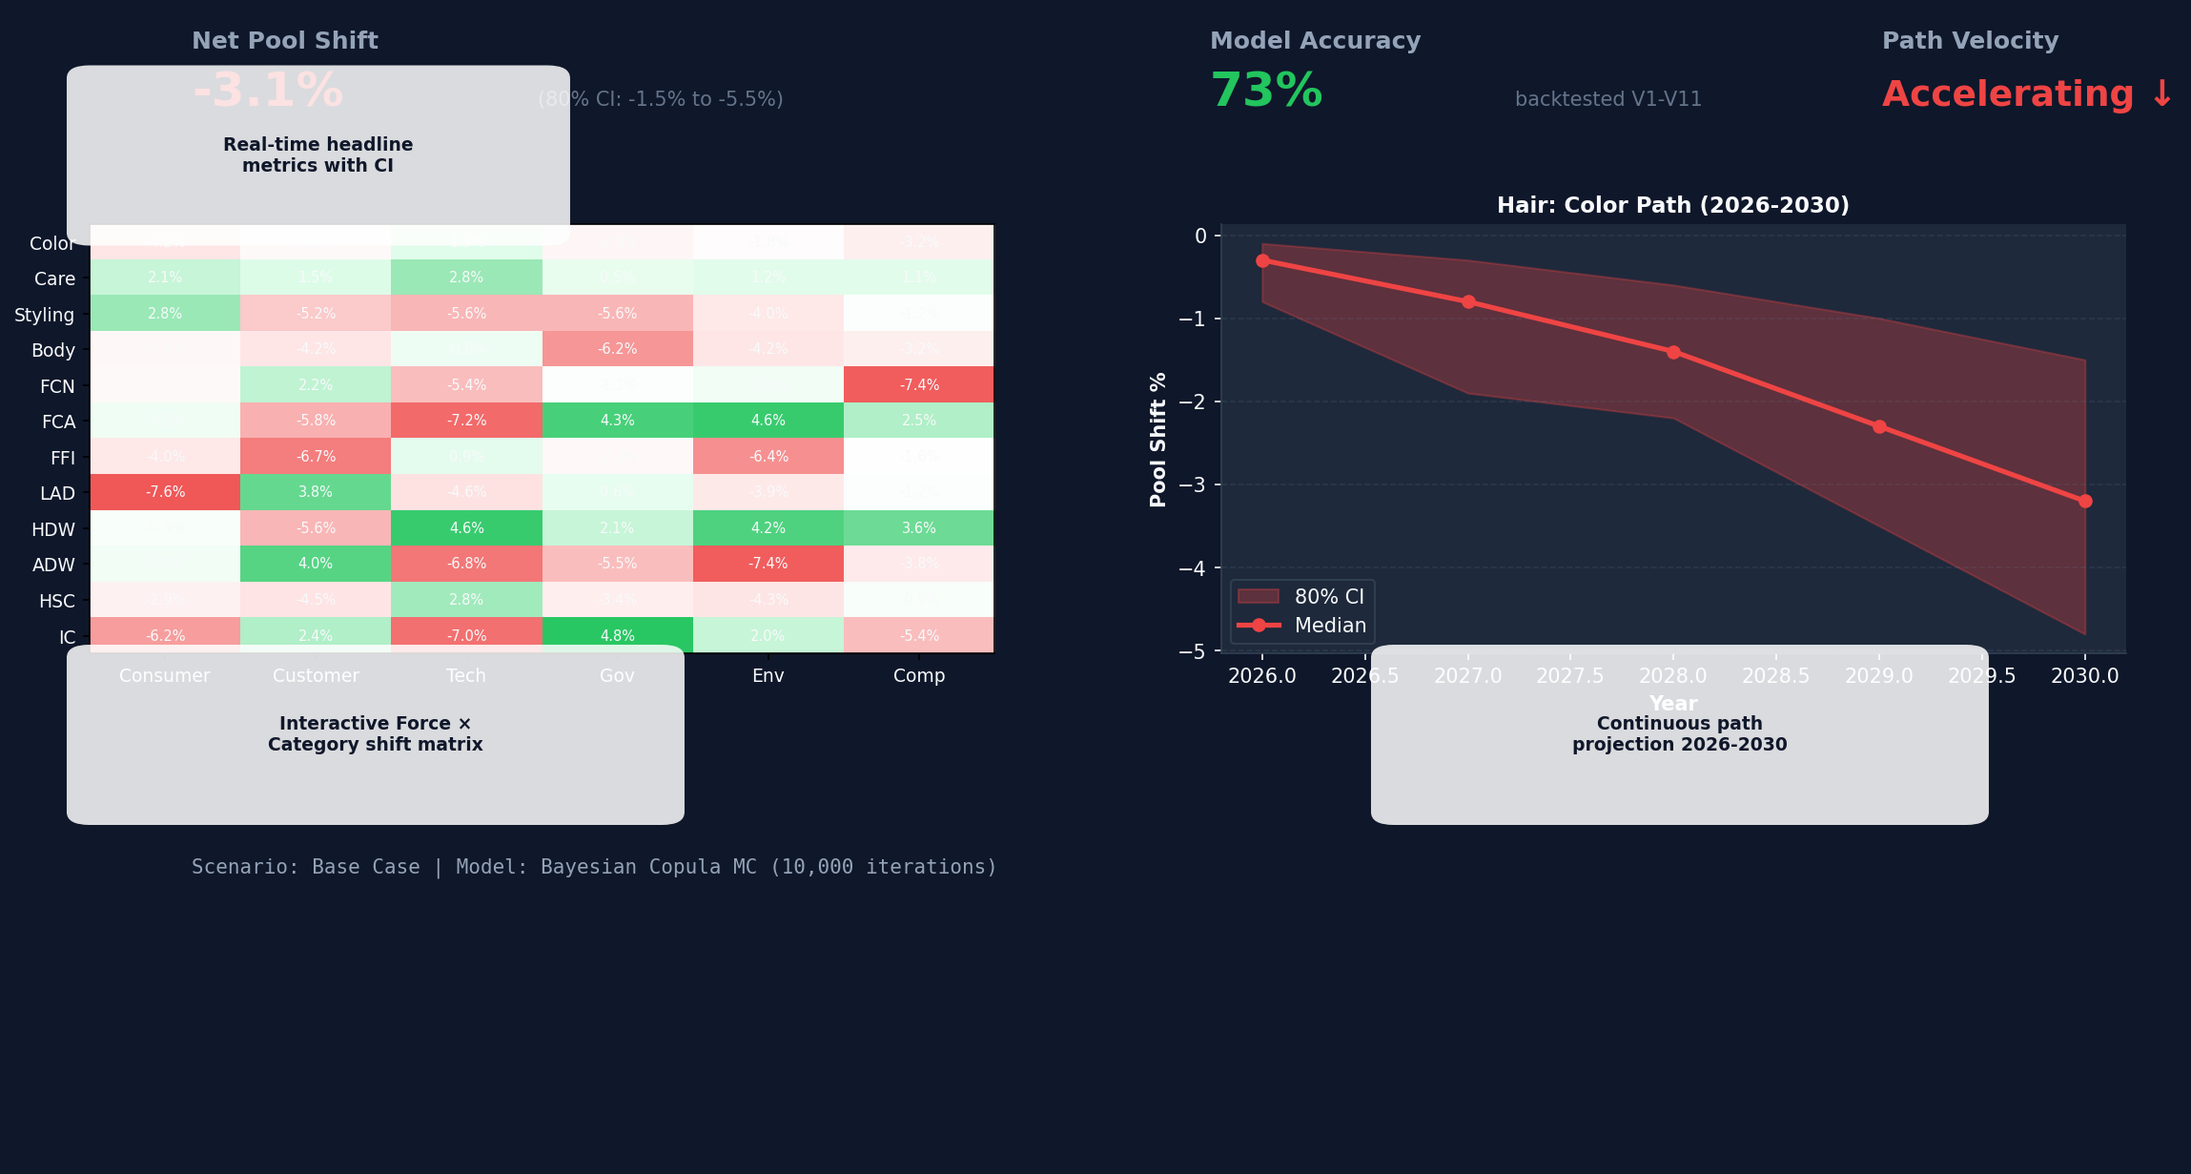
WAR ROOM — UNIFIED COMMAND VIEW
One screen tells the complete story — headline KPIs, heatmap, and path projections
9

Slide 10
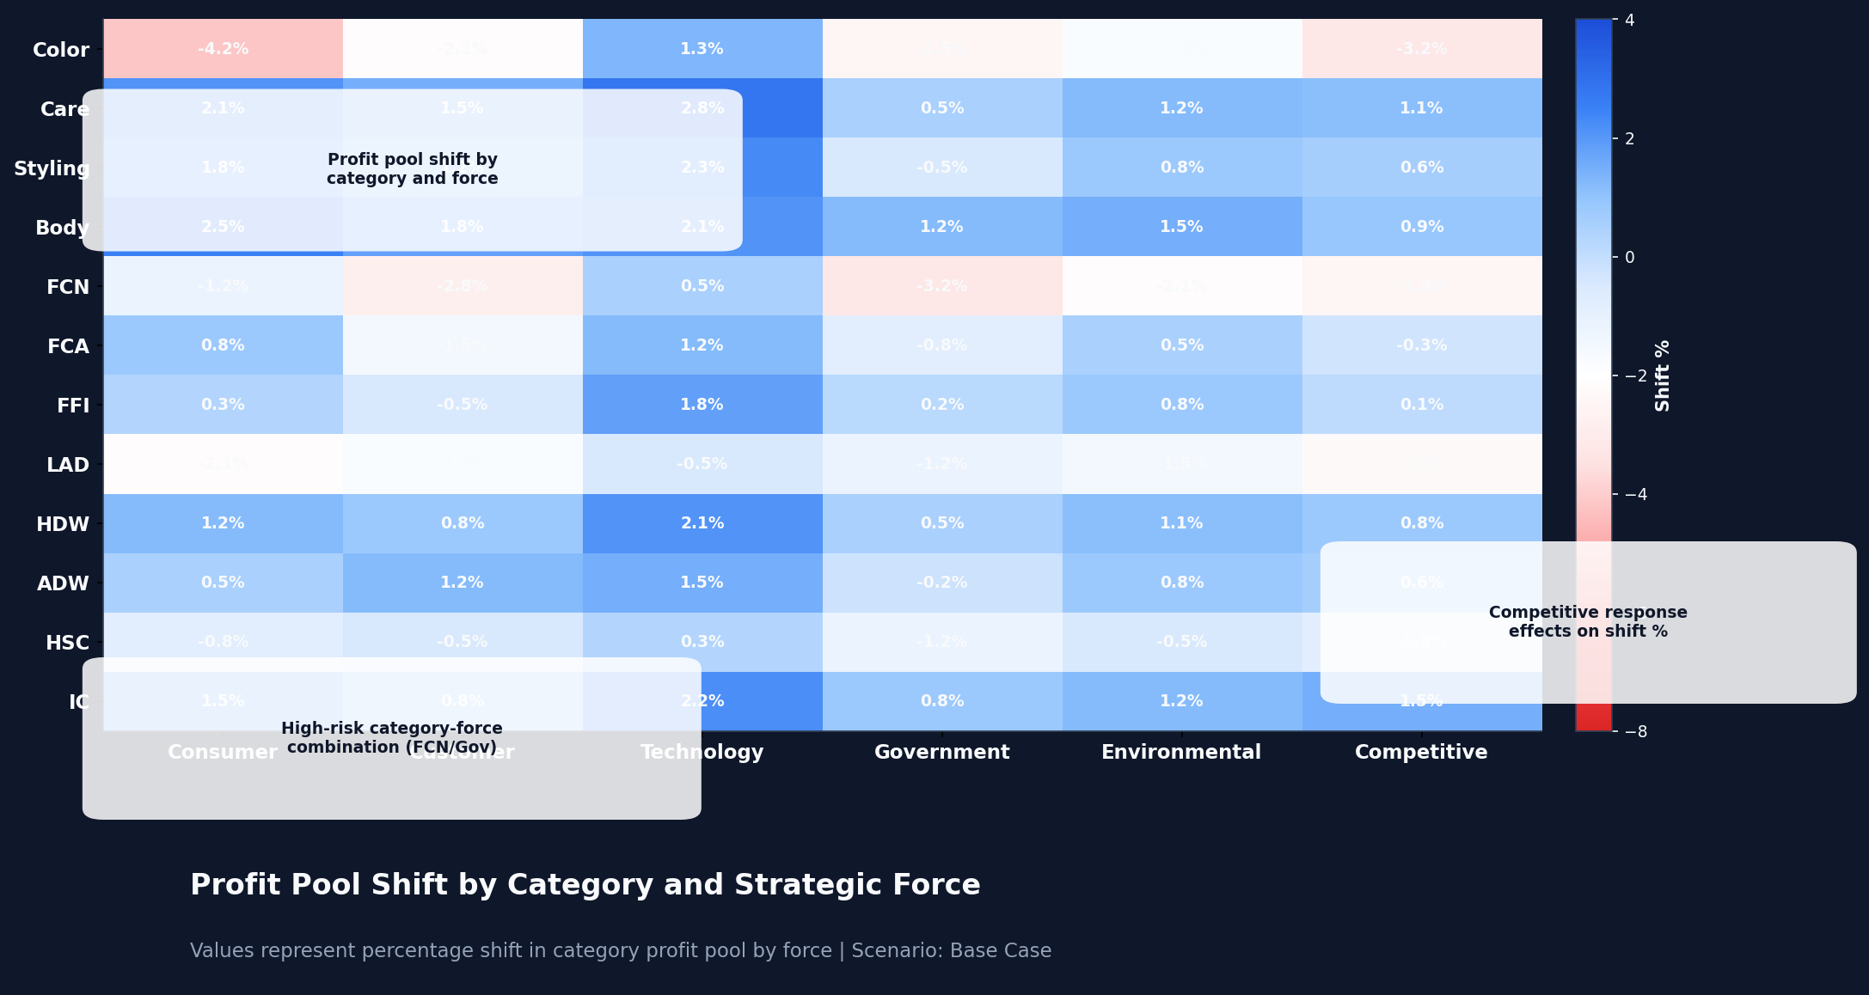
CATEGORY × FORCE SHIFT MATRIX
Percentage shift in category profit pool by strategic force — the core analytical output
10

Slide 11
TECHNOLOGY ARCHITECTURE
Enterprise-grade, deployed within Henkel’s cloud environment
SIMULATION ENGINE
WAR ROOM DASHBOARD
AI & INTEGRATION
Python Backend
React Frontend
Provider-Agnostic
Python 3.11+ with FastAPI
Bayesian MC with SciPy/NumPy
NetworkX for Causal DAG
SQLite local data store
Copula dependency modeling
React 18 + Vite + TailwindCSS
D3.js / Recharts for visualizations
Framer Motion for animations
Zustand + TanStack Query
Apple-grade dark mode UX
Claude API (MVP) or Azure OpenAI
19 free external data APIs
Power BI Shift Matrix export
Excel bidirectional bridge
Zero running cost (€0/year)
CONFIDENTIAL — Henkel Consumer Brands
11

Slide 12
ROADMAP — FROM MVP TO ENTERPRISE
Three-phase approach delivers standalone value at each stage
Q2 2026
Q3 2026
Q4 2026
PHASE 1
In Progress
PHASE 2
Planned
PHASE 3
Planned
Bayesian Engine
War Room Dashboard
AI + Power BI
CLI tool reads V12 Excel, runs Bayesian MC with causal DAG, outputs continuous-path Shift Matrix. Deterministic mode validates against V12.
React War Room with unified view, interactive heatmap, causal flow animation, scenario comparison, and export center. Apple-grade UX.
AI trend scanner, Delphi workflow, natural language chat, automated Power BI export. Provider swap to Azure OpenAI in Henkel tenant.
CONFIDENTIAL — Henkel Consumer Brands
12

Slide 13
OPERATING RHYTHM
PULSE embeds into the existing annual planning cycle
ANNUAL DEEP DIVES (1-2x / YEAR)
Q1
Q2
Q2
Q2-Q4
Full Trend
Update
Delphi
Scoring Round
Full MC
Simulation
Profit Pool
Impact Report
AI scanner identifies new trends, retired trends flagged. Complete trend database refresh.
3-round expert scoring with calibration. Debiasing protocols applied. Consensus scores locked.
50,000 iterations. Full causal propagation. Scenario analysis for strategy week.
Shift Matrix to ExCo. Category allocation recommendations. Power BI dashboard update.
+
CONTINUOUS MONITORING (ALWAYS ON)
AI Trend Scanner
Early-Warning Triggers
Path Velocity Tracking
Quick Refresh (10K iter.)
Weekly digest of new developments
Alerts when thresholds breached
Are shifts faster or slower than expected?
Mid-year re-simulation on demand
CONFIDENTIAL — Henkel Consumer Brands
13

Slide 14
EXECUTIVE SUMMARY
1
Profit pools are shifting structurally — static Excel assessments cannot capture the causal interdependencies between regulatory, consumer, technology, and competitive forces reshaping our categories
2
PULSE transforms the existing V12 force assessment into a living, probabilistic simulation engine: Bayesian Monte Carlo with causal propagation across 12 categories, 6 forces, and a 5-year continuous path
3
The model is backtestable, transparent, and enterprise-grade: every AI suggestion requires human approval, every score change is audited, and the Delphi protocol ensures calibrated expert consensus
4
Three-phase rollout delivers standalone value at each stage: Phase 1 (CLI engine) in Q2, War Room dashboard in Q3, AI intelligence layer in Q4 2026 — all at zero running cost
5
The Shift Matrix output integrates seamlessly with Excel and Power BI — strategy teams see relative shifts, ExCo sees absolute €M impact. Same truth, two lenses
14

Slide 15
NEXT STEPS
1
Approve Phase 1 development
Bayesian engine build with V12 integration — deliverable in Q2 2026
2
Designate Delphi scoring panel
5-8 category experts for structured scoring rounds during strategy week
3
Provide historical V1-V11 data
Enables backtesting and empirical calibration of model parameters
KEY BENEFITS
10,000+
12
5-year
€0
MC iterations per
scenario run
categories with
causal linking
continuous path
projections
annual running
cost (free APIs)
15

