Slide 1

Diverse Recommendation System
Alexander Lavelle

Slide 2
Problem Statement
Minimize Error
Maximize HitRate
Serve recs quickly

Slide 3
Dataset
The (intended) base dataset is the MovieLens ml-latest-small
This dataset contains ~9800 movies and 610 users
Movies contains title, year, genres, and ID
Ratings contains user, rating, timestamp, and ID
Created tables/metrics include:
Hit Rate @ 10 – with top 10 predictions from each algo for each user, how many predictions were previously rated
Popularity – rankings of movies by implicit count (i.e. was watched / rated regardless of rating)
Diversity – How many genres were represented by the movie recommendation per user per all recs
Coverage – Maximum number of genres represented by any recommendation for any user for any algorithm
Cosine Similarity – similarity in Nth space defined by interior cosine angle
Hamming Similarity – experimental

Slide 4
Final Algorithms Considered
Cosine Similarity
Item Collaborative Filtering
SVD on .5-5 scale AND -1 to 1 scale
SVDpp on .5-5 scale AND -1 to 1 scale
Adam .001 Learning Rate neural network with categorical embeddings
Ada .01 Learning Rate neural network with categorical embeddings

Slide 5
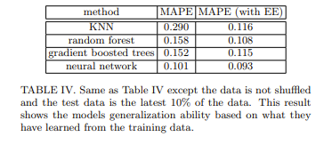
Categorical Embedding Improvements

Slide 6
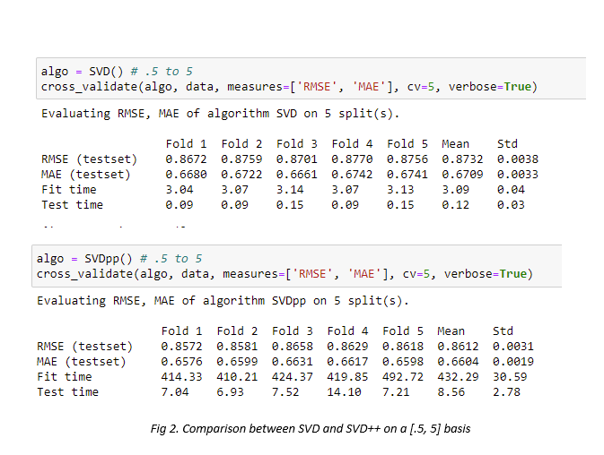
Comparison of SVD and SVD++

Slide 7
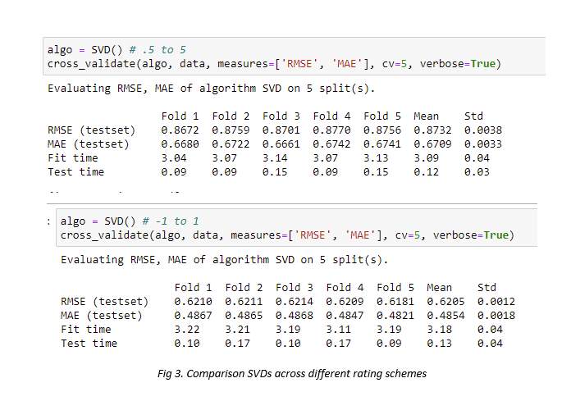
Comparison of SVD .5->5 and SVD -1->1

Slide 8
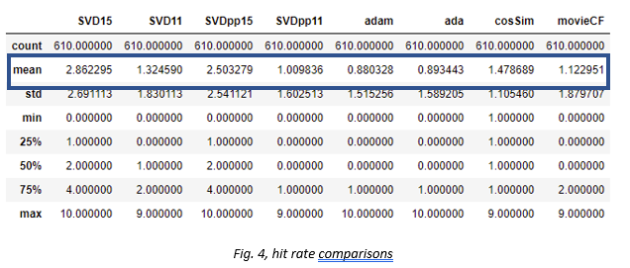
While hitrate is important, is it the whole story? MAE already shows to be inconclusive

Slide 9
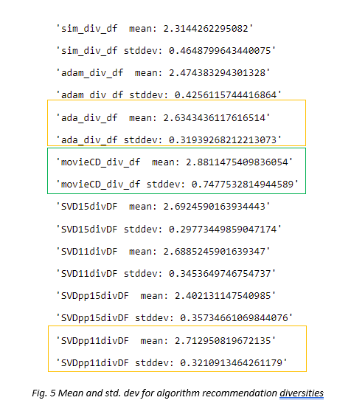
Movie CF (typo) Has the greatest average number of genres recommended, granted with a wide stddev. Ada and SVDpp11 are close behind
Notes:
Need slide above about metrics popularity, etc

Slide 10
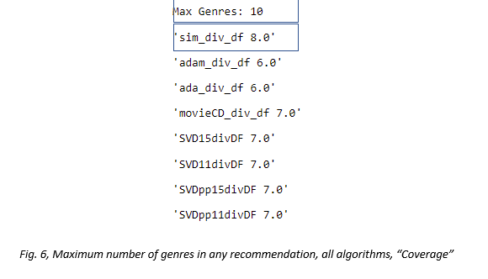
No algorithm recommends (a/the) movie with the greatest number of genres. But most algorithms similarly recommend maximum number of genres

Slide 11
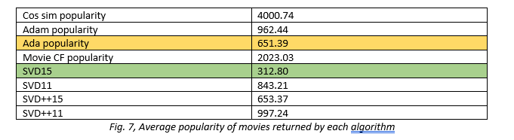
SVD .5->5 provides the most popular items on average

Slide 12
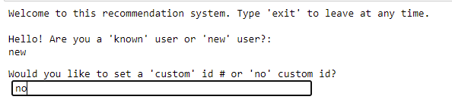

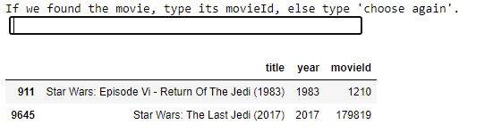
System Start/Welcome

Slide 13
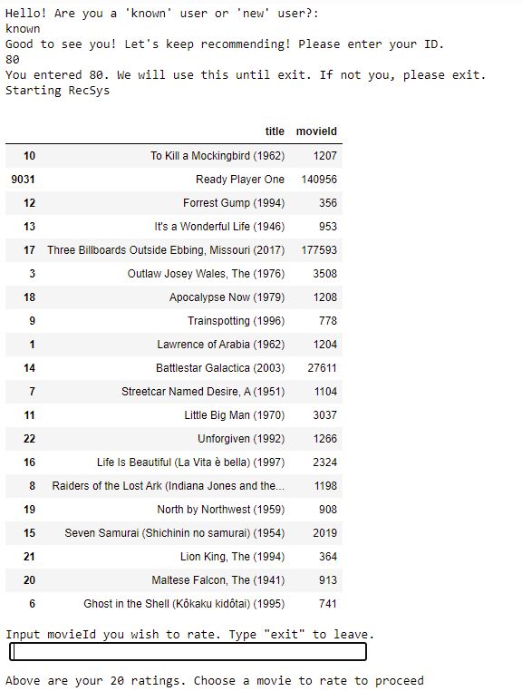
Rec flow
Because it’s a beta, can you find the 2018 “recent” movie?

Slide 14
Conclusions
Interesting MAE vs Hitrate outcomes
System needs to be robust
Requires user input
Interesting one-off applications
Cold-start user problem

