Slide 1
Recitation 2
January 23, 2018

Slide 2
Topics
Node
MVC
Git / GitHub
Continuous Integration / Travis
Docker
Azure
Homework 2

Slide 3
Node

Slide 4
Install
Go to nodejs.org, download and install Node as instructed

Slide 5
What is Node?
JavaScript runtime built on Chrome's V8 JavaScript engine
JavaScript that runs on server
Used to build powerful, fast, scalable web applications
Uses event-driven, non-blocking I/O model

Slide 6
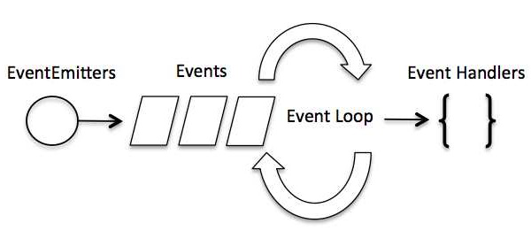
Non-blocking I/O
Single thread
Asynchronous function calls

Slide 7
NPM
Node Package Manager
The largest ecosystem of open source libraries in the world

Slide 9
MVC

Slide 10
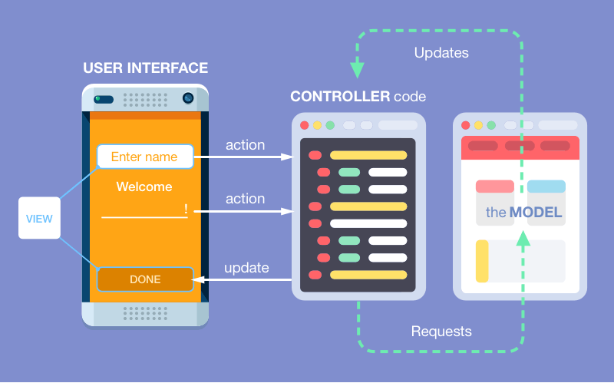
MVC
Model View Controller
Notes:
The model component all the data-related logic that the user works with
The View component is used for all the UI logic of the application
Controllers act as an interface between Model and View components to process all the business logic and incoming requests, manipulate data using the Model component and interact with the Views to render the final output
TV example

Slide 12
Git / GitHub

Slide 13
CI/CT

Slide 14
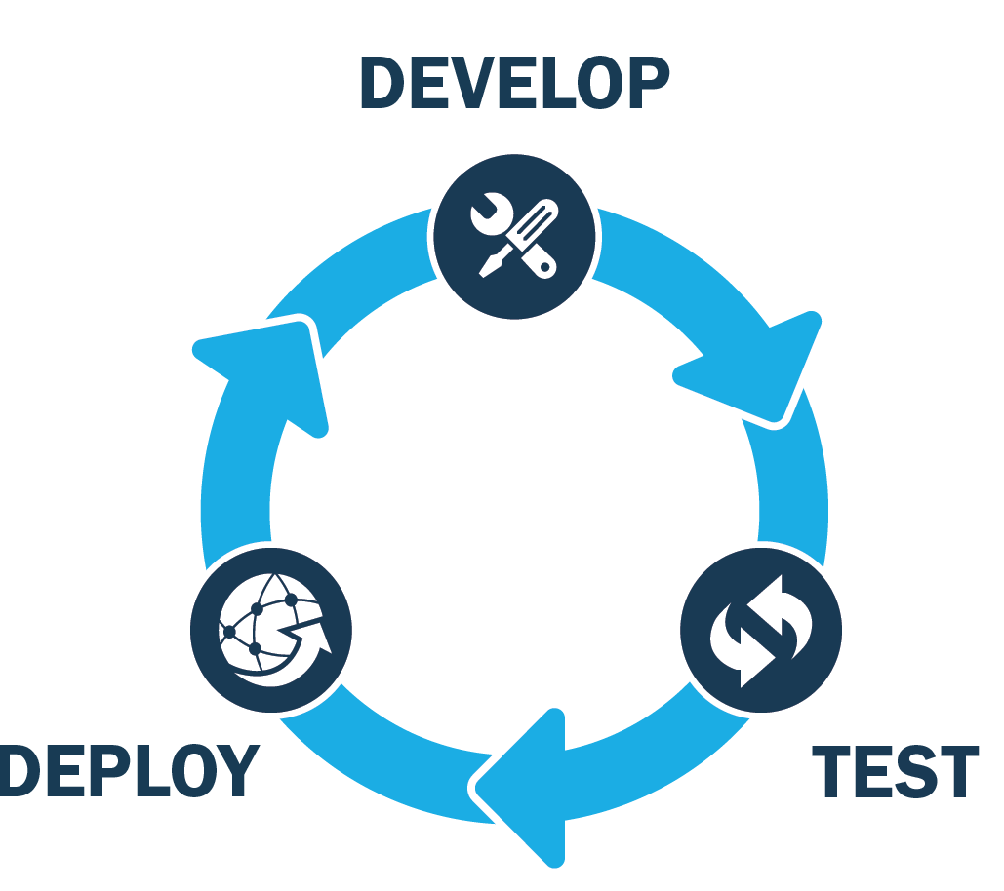

Slide 15
https://travis-ci.com

Slide 17
Docker

Slide 18
What is Docker?
Running applications in an isolated environment
Advantages:
Same environment
Sandbox execution
Using someone else’s code

Slide 19
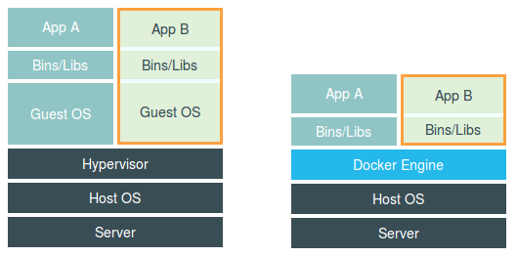
Docker vs. VM

Slide 20
Go to docker.com and install Docker

Slide 21
Azure

Slide 22
Homework 2
Notes:
Make sure everybody has everything set up and running

