Slide 1

Michael Hilton & Claire Le Goues

Slide 2
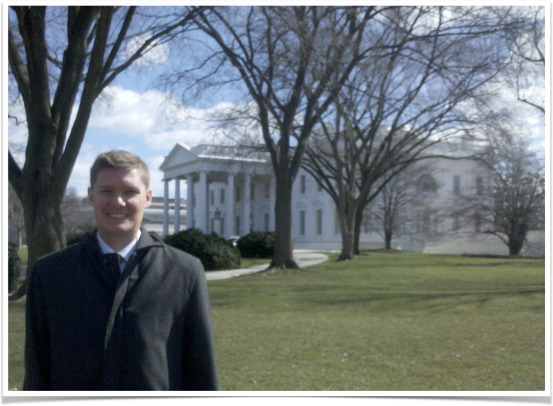

Michael Hilton
Teaching Professor
at CMU
9 years at DoD
9 months as engineer
at startup Squid

Slide 3
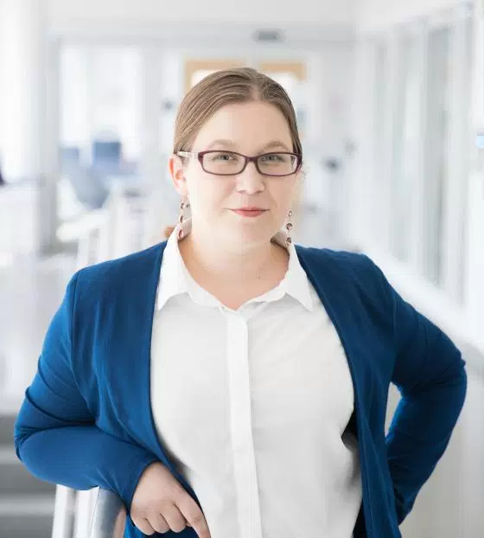
Claire Le Goues
Assistant Professor at CMU
2 years as a SE at IBM
5 years as a Professor...

Slide 4


TAs
Afsoon Afzal afsoona@cs.cmu.edu Office Hours/Location: Th 13:00-15:00, WEH 4113 | Derek Brown derekbro@andrew.cmu.edu Office Hours/Location:TBD

Slide 5
Software Engineering for Startups
Our Startup definition: A company without an empirically validated business plan.

Slide 6
Our Values for this class
Realistic
Useful
Principled
Sustainable
Fun

Slide 7
Expectations
This class is not about the business side of a startup
You don’t need a great startup idea
You will learn technical skills that will be helpful in a startup, or a startup-like environment

Slide 8
This class is a startup
First time a class like this has been offered anywhere
There will be more uncertainty with this class than usual
We will be asking you for feedback along the way

Slide 9
Class Structure
Lectures
Guest Speakers
Recitation
Weekly reports
Midterm
Homeworks
Final Project
Notes:
Overlap with 313

Slide 10


Slide 11
Survey
Help us understand more about you. No startup experiences expected

Slide 12
User Stories
Agile method of doing requirements analysis.
Each user story represents a conversation between a developer and a stakeholder
Lighter weight than other techniques

Slide 13
User Stories
Stakeholders should write them (or at least understand them).
Use the simplest tools (or no tools at all).
Remember non-functional requirements.
Indicate the estimated size and priority.
Break down “epic stories”into smaller user stories

Slide 14
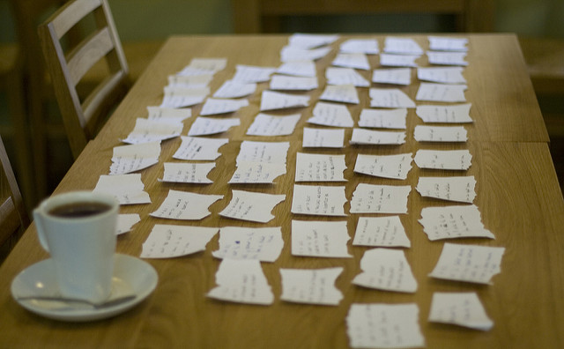
User Stories
Img source: https://flic.kr/p/5a5d3b

Slide 15
The three C’s
Card
“As a <user>, I want <feature>, so that <benefit>”
Conversation
Details needed to implement
Confirmation
How we will know we are done

Slide 16
User Story Benefits
User stories keep the focus on the user
Emphasize delivering value to the user
User stories keep everyone on the same page
Easy to work with

Slide 17
Backlog
List of known tasks of features needed for a project
Collection of user stories

