Slide 1

Michael Hilton & Heather Miller

Slide 2
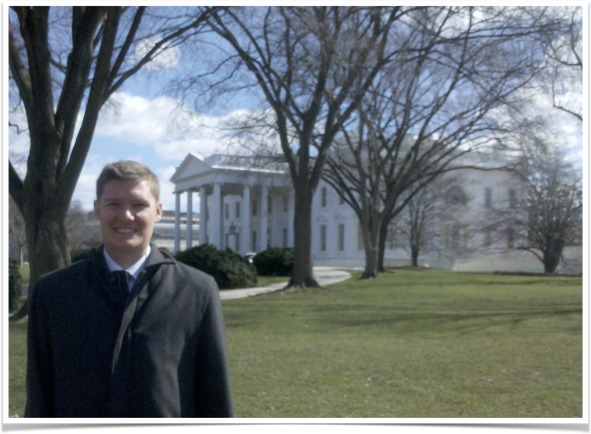

Michael Hilton
Teaching Professor at CMU
9 years at DoD
9 months as engineer at startup Squid
Office: Wean 5122
Twitter: @michaelhilton

Slide 3

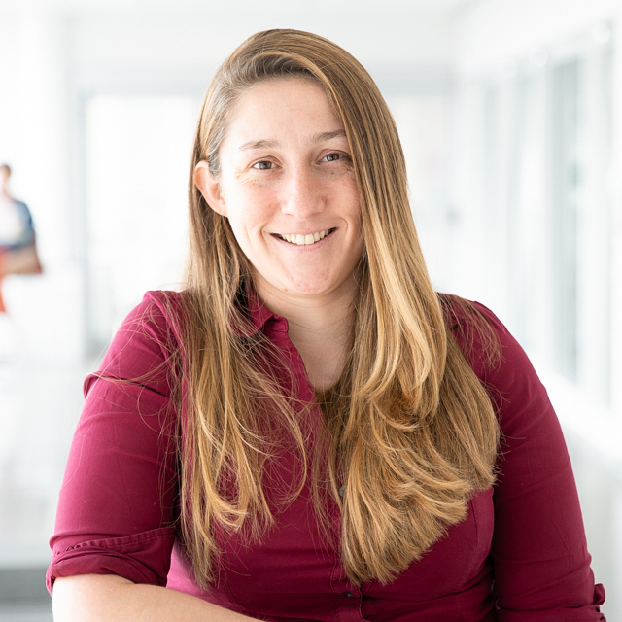
Heather Miller
Assistant Professor at CMU
2 years as the founder of a startup-ey non-profit focused on sustaining open source Scala
4 months at Databricks
years contracting for various startups

Slide 4
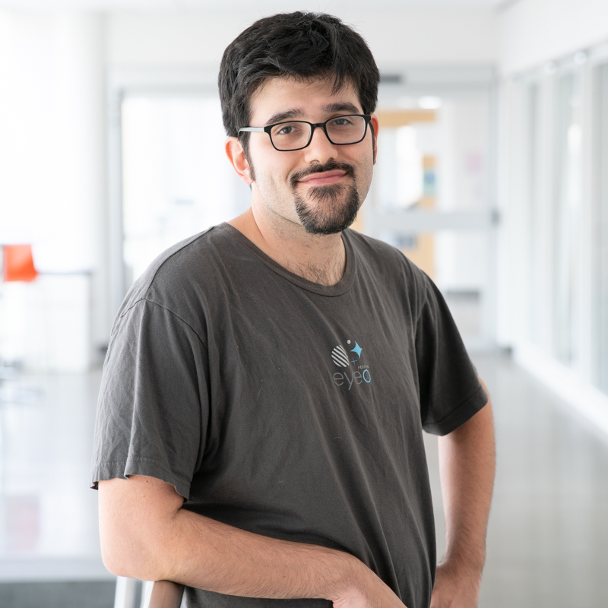
TA
Zeeshan Lakhani
zlakhani@cs.cmu.edu
Office Hours/Location: TBA

Slide 5

No Smoking

Slide 6
Software Engineering for Startups
Our Startup definition: A company without an empirically validated business plan.

Slide 7
Our Values for this class
Realistic
Useful
Principled
Sustainable
Fun

Slide 8
This class is a startup
One of the only classes of its kind (2nd time we’ve run it)
There will be more uncertainty with this class than usual
We will be asking you for feedback along the way

Slide 9
Class Structure
Lectures
Guest Speakers
Recitation
Midterm
Homeworks
Final Project
Weekly reports
Notes:
Overlap with 313

Slide 10


Slide 11
Survey
Help us understand more about you. Please fill out teamwork survey in the teamwork section of the syllabus.

Slide 12
User Stories
Agile method doing requirements analysis.
Each user story represents a conversation between a developer and a stakeholder
Lighter weight than other techniques

Slide 13
User Stories
Stakeholders should write them (or at least understand them).
User the simplest tools (or no tools at all).
Remember non-functional requirements.
Indicate the estimated size.
Indicate the priority.
Break down “epic stories”into smaller user stories

Slide 14
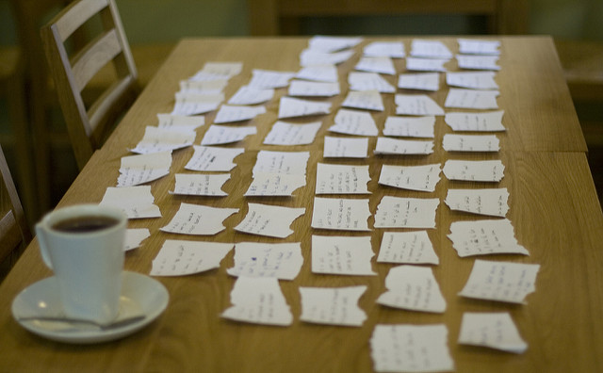
User Stories
Img source: https://flic.kr/p/5a5d3b

Slide 15
The three C’s
Card
“As a <user>, I want <feature>, so that <benefit>”
Conversation
Details needed to implement
Confirmation
How we will know we are done

Slide 16
User Story Benefits
User stories keep the focus on the user
Emphasize delivering value to the user
User stories keep everyone on the same page
Easy to work with

Slide 17
Backlog
List of known tasks of features needed for a project
Collection of user stories

