Slide 1
Viable
Putting the “V” in MVP
Michael Hilton
Assistant Professor
Carnegie Mellon University

Slide 2
Administrivia
“Offline Standup” due today
Feedback from last week:
More class schedule info
Recitation code posted
https://cmu-17-356.github.io/
Sprint 1 due today
Notes:
https://cmu-17-356.github.io/

Slide 3
What does it mean for an idea to be viable?
Notes:
Ask the class for ways which we might prove that a product is viable. Answers we are looking for:
Do people want it?
User Studies
User Metrics (Daily active users, registered users, waiting lists)
Business Partnerships (Client agreements, etc)
Market Capitalization
Can you build it?
Demonstrate your team has done similar things before.
MVP.
Outside estimates / analysis.
Regulatory Approval
Patents
Can you make money doing it?
Sales
Potential ad opportunities
Value of similar competitors
User studies / surveys

Slide 4
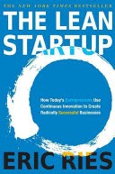
Minimum Viable Product
Inspired by presentation from
Eric Reis, author or “The Lean Startup”

Slide 5
What is an MVP?
“The minimum viable product is that version of a new product which allows a team to collect the maximum amount of validated learning about customers with the least effort.” -Eric Reis, author of The Lean Startup

Slide 6
Why do we build products?
Delight customers?
Sign lots of users up?
Make a lot of Money?
Realize a big vision; change the world?
Learn to predict the future?
Notes:
Ask the class

Slide 7
Traditional delivery approaches
“Maximize chance of success”
Build a great product that people will want.
Problem: no feedback till the end, might be too late to adjust
“Release early, release often”
Get as much feedback as possible, as soon as possible
Run in circles, chasing what customers think they want
Notes:
Waterfall works good when problem is known, solution in known
Agile works great when the problem is known, soln is not
Lean startup is when problem and soln are unknown

Slide 8
MVP
The minimum set of features needed to learn from visionary early adopters.
Avoid building a product no one wants
Maximize the learning per dollar spent
Probably more minimal than you think.
Visionary customers can “fill in the gaps” on missing features, if the product solves a real problem for them.
Show them a real product, get them to react
Charge them money, if they pay, they really want it
Pivot to a new MVP if not getting a positive signal from customers

Slide 9
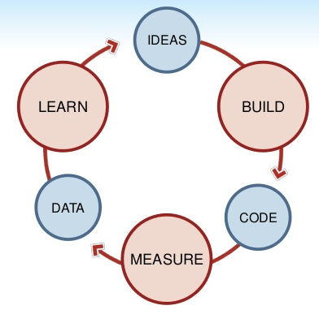
Minimize time in the MVP loop
Img source: https://www.slideshare.net/startuplessonslearned/minimum-viable-product/6-Minimize_TOTAL_time_through_the

Slide 10
The Lean Startup suggested techniques
Smoke Test with landing pages, AdWords
$5 on Search Engine Marketing a day. How will you convert these to customers?
In-product split testing
Paper prototypes
Customer discovery/validation
Remove features

Slide 11
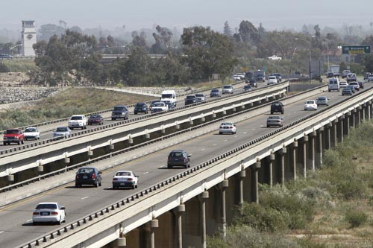
Fears
False Negative: “customers would have liked the full product, but the MVP sucks, so we abandoned the vision”
Visionary complex: “but customers don’t know what they want!”
Too busy to learn: “it would be faster to just build it right, all the measuring distracts from delighting customers”
Notes:
No one cares is the worst outcome.
Test if they actually want it, not just tell you they want it.

Slide 12
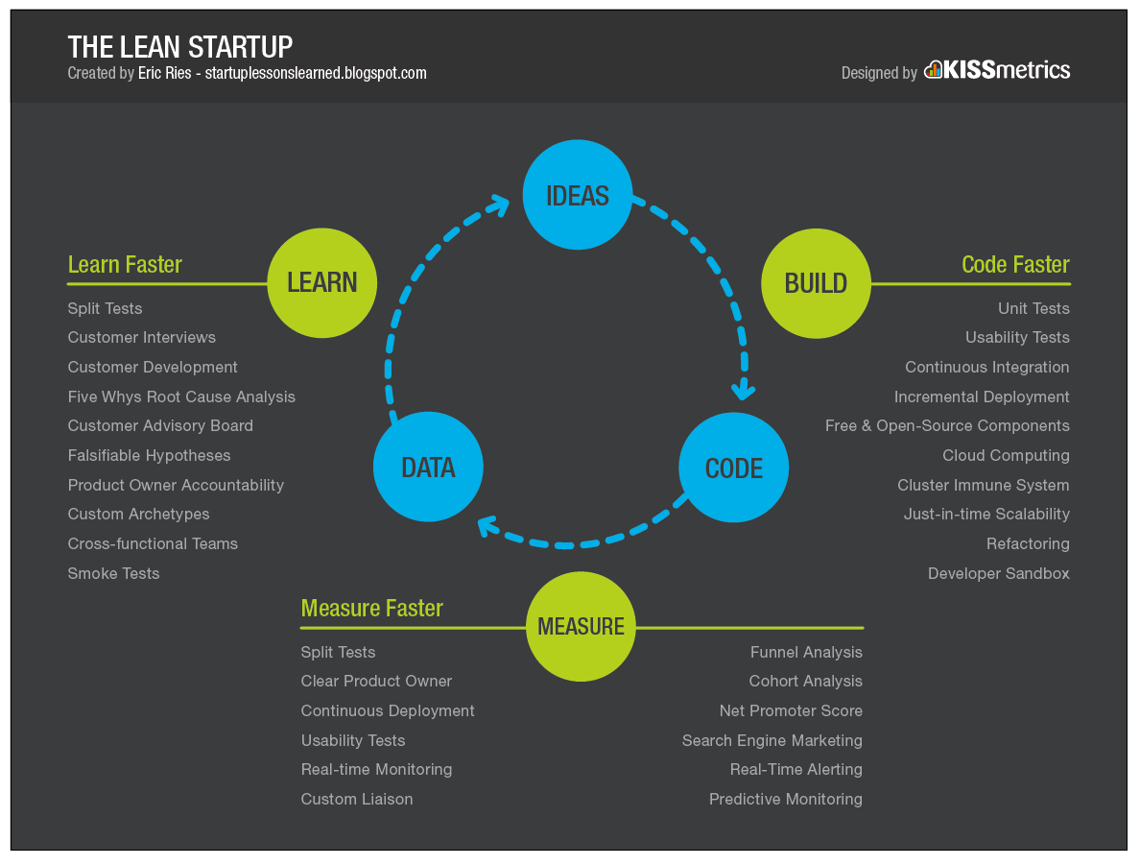
https://speckycdn-sdm.netdna-ssl.com/wp-content/uploads/2014/09/building_minimum_viable_products_spotify_02.png

Slide 13
Early Iterations of MVP
Smokescreen MVP
Concierge MVP

Slide 14
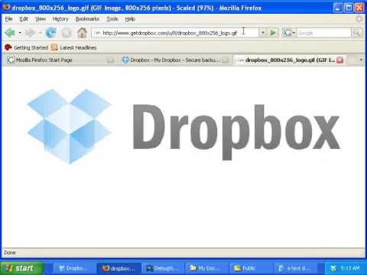
Example MVP Video (smokescreen)

Slide 15
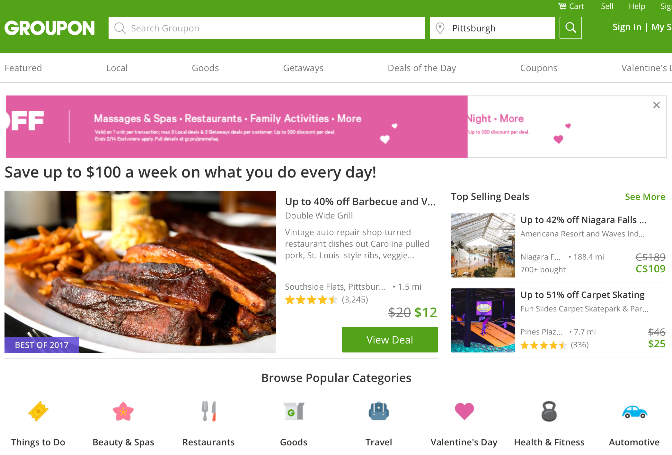
Concierge MVP

Slide 16
The Lean Startup startup definition:
“A startup’s job is to
(1) rigorously measure where it is right now, confronting the hard truths the assessment reveals, and then
(2) devise experiments to learn how to move the real number closer to the ideal reflected in the business plan.
Notes:
Remember our definition of a startup: a company without an empirically validated business plan...

Slide 17
Proving Viability: Three Questions
Do people want It?
Can You build It?
Can you make money doing it?
Notes:
Do people want It?
Market Demand
User Testing
Can You build It?
Technology Challenges
Team Ability to Deliver
Ethical/Regulatory Concerns
Can you make money doing it?
Monetization
Selling Out
Costs/Risks

Slide 18
What are some ways that software companies make money?

