Slide 1

Michael Hilton & Claire Le Goues

Slide 2
Continued Prioritization and Estimation

Slide 3
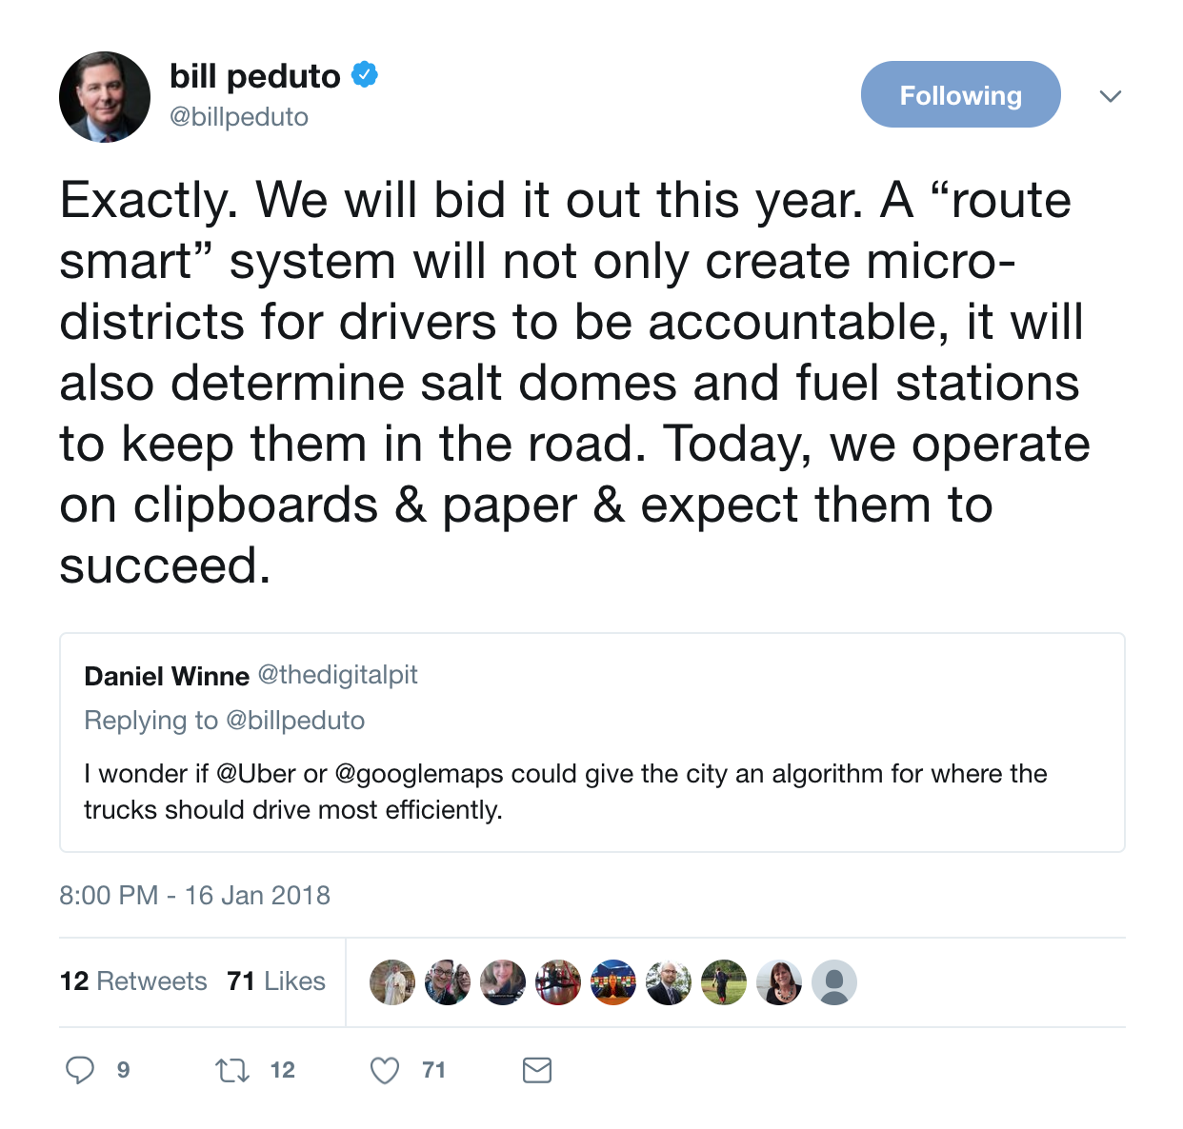
Activity

Slide 4
How should we prioritize features?
HiPPO - Highest Paid Person’s opinion?
MoSCoW -
Must have
Should have
Could have
Won’t have?
Minimum Viable Product

Slide 5
Activity:
Prioritize features to be developed

Slide 6
Estimating
Estimate one user story, feature, and tasks

Slide 7
Design Considerations
Many of these taken from “Getting Real” by 37signals.com

Slide 8
Build Less
Focus, focus, focus
Less today means:
Less Time
Less Maintenance
Less Support
Less Testing

Slide 9
Lower your cost of change
If you can easily change, you don’t have to get it right the first time.
Small modifications are easier than 100% correct guesses on the first attempt.
Even if you are correct, the world around you might change

Slide 10
Embrace Constraints
Constraints breed creativity

Slide 11
What is the Big Idea
You should have a single sentence description of what you are building
What is your product’s reason for existing?
What makes your product different than others?

Slide 12
Ignore details early on
“Perfect is the enemy of done”
Deciding details upfront leads to sunk cost fallacy
Use representations that abstract away details early in the design process, more details later in process

Slide 13
Don’t worry about tomorrow
It’s not a problem till it is a problem
Don’t waste time on problems you don’t have
Worry about getting today right, worry about tomorrow tomorrow
Don’t worry about scale before you have users
Notes:
Secondary emotions are unhelpful- CLG

Slide 14
Half, not Half-baked
Only build what is essential
Start with half the features you think you need
What you do implement, implement well
Notes:
My grandpas packing technique

Slide 15
Learn to say “NO”
Say NO to new features by default
“Innovation is not about saying yes to everything. It’s about saying NO to all but the most crucial features.” -Steve Jobs

Slide 16
Think about hidden costs
With each new feature you need to:
-Gather Requirements
-Manage in backlog
-Design UI
-Design backend
-Code it
-Test it
-Document it
-Deploy it
- ...

Slide 17
Design your interface first
This is how users will interface with your application
All features in the back-end should support the interface somehow
As soon as you have your interface you can start “hallway usability testing”

Slide 18
Epicenter Design
Start by designing the core
Design the most important part first (page, UI element, etc)
If something is “below the line” of features that make the cut, it should be less important than everything above it

Slide 19
Activity
What is the minimal feature set for snow removal application?
What features should we say NO to?
How can we design it using “epicenter design”?

