Slide 1
Recitation 2: Development
January 22, 2018

Slide 2
Topics
Node
MVC and MVVM
Git / GitHub
Continuous Integration / Travis
Docker
Azure / VMs
Homework 2

Slide 3
Node.js

Slide 4
What is Node?
JavaScript runtime built on the open source V8 JavaScript engine, which also powers Chrome
JavaScript that runs on server
Used to build “somewhat” powerful, fast, scalable web applications
Uses event-driven, non-blocking I/O model --- built to handle async Javascript via a callback system (classically)

Slide 5
Non-blocking I/O
Single threaded
Asynchronous function calls
Concurrency (in node) refers to the Event Loop’s capacity to execute Javascript “callback” functions after completing other work
Dangers of mixing blocking and non-blocking code

Slide 6
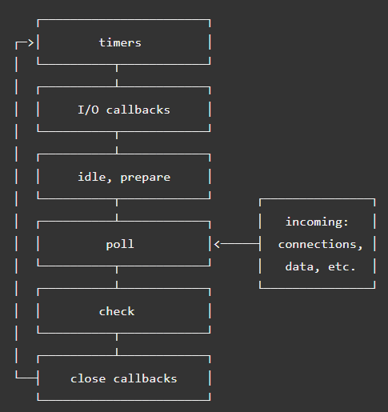
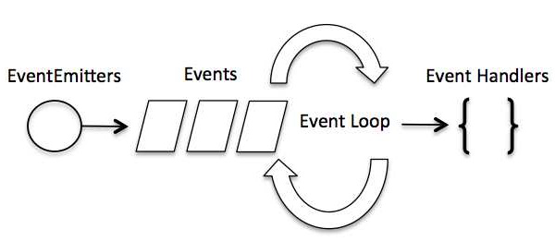

Slide 7
Async Options?
Callbacks: functions passed to another functions ~ CALLBACK HELL!
Promises (and promise chains): structured callbacks
Generators: functions which can be exited/paused and later re-entered
Async/Await: combining generators and promises ~ async code ”made” imperative

Slide 8
NPM
Node Package Manager
The largest ecosystem of open source libraries in the world ~ *probably*

Slide 9
MVC and MVVM

Slide 10
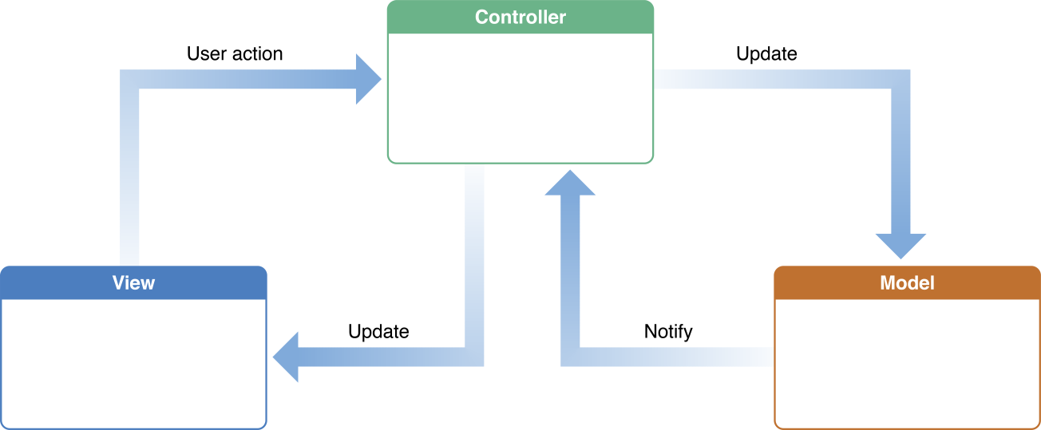
MVC

Slide 11
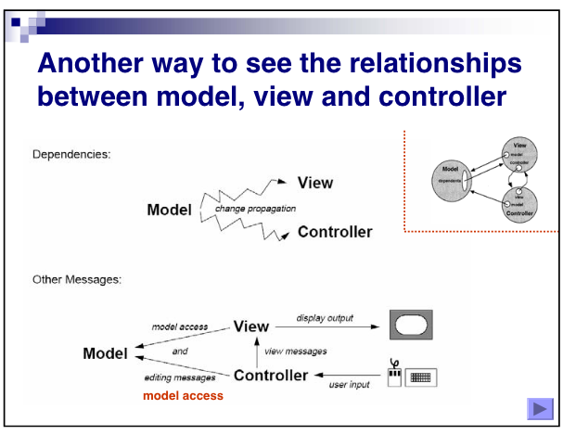

Slide 12

MVVM

Slide 13
Git / GitHub

Slide 14
Continuous Integration

Slide 15
Docker

Slide 16
What is Docker?
Running applications in an isolated, sandboxed environment, executing only necessary applications
Lightweight and faster start times
“Run Anywhere”
A daemon and a cli
docker-machine
a tool that lets you install Docker Engine on virtual hosts

Slide 17
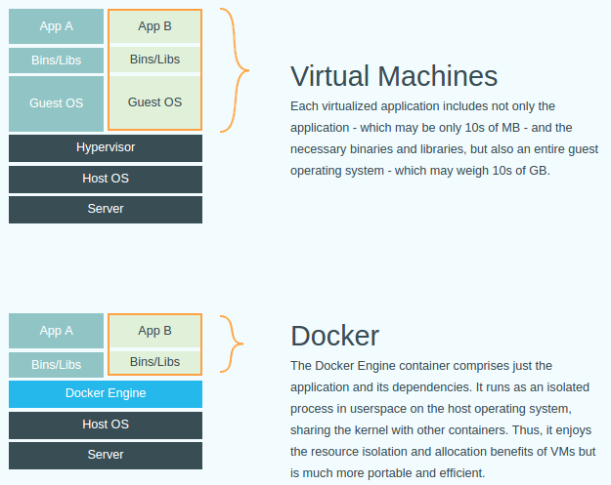
Docker vs. VM

Slide 18
Azure or AWS or GCE

