Slide 1
QA: Testing, testability, and code review
SE for Startups
February 8, 2018

Slide 2
Testability: Discuss
What is testability?
What makes software testable?

Slide 3
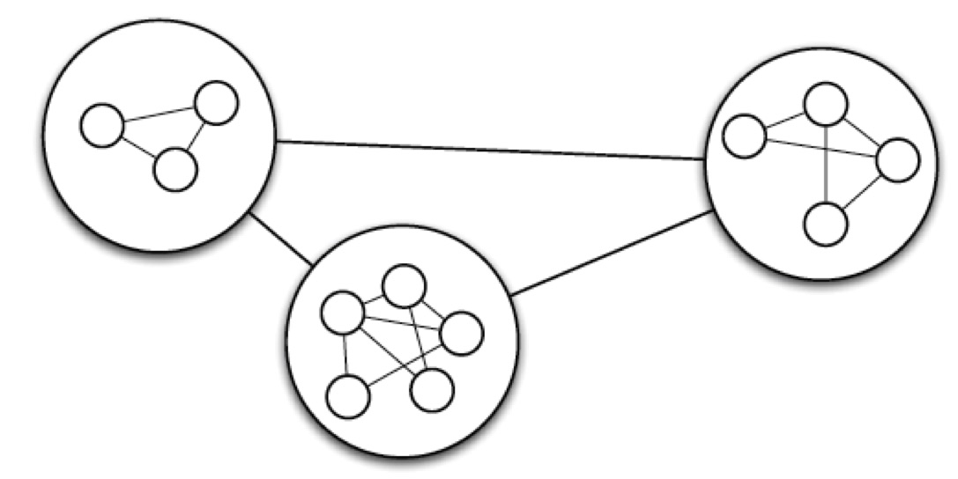
Design principle: Modularity
Partitioning software into separate components in such a way that dependencies among components are minimized while dependencies within components are maximized

Slide 4
Design principle: SOLID
Single Responsibility Principle (SRP)
Open-Closed Principle (OCP)
Liskov Substitution Principle (LSP)
Interface Segregation Principle (ISP)
Dependency Inversion Principle (DIP)
Notes:
Applies to OO software in particular... but generalizable...
LSP: Subclasses should be substitutable for their base classes
If B inherits from A, then code that uses an instance of class A should continue to function properly if passed an instance of class B

Slide 5
Single Responsibility Principle (SRP)
Classes should be
Small
Focused
Cohesive
Methods should be
Small
Focused
Simple
Classes should have only one reason to change

Slide 6
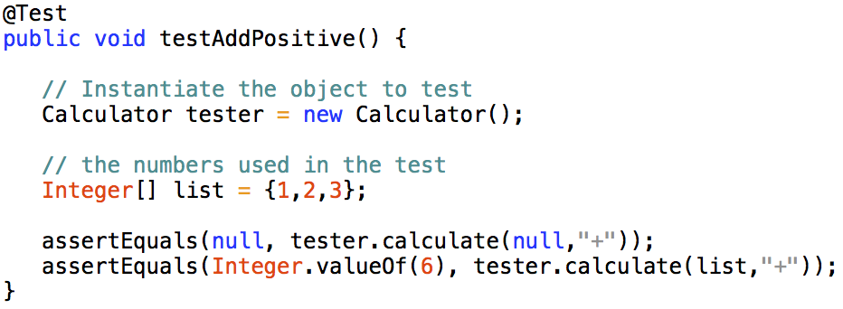
Implication: Tests should have a single reason to fail.
Notes:
How can you tell what caused the fault?

Slide 7
Open-Closed Principle (OCP)
Designs should be open for extension but, closed for modification.
Extend what a class does without changing its source code:
E.g., reuse through inheritance or composition by swapping in or adding an alternative strategy, or through delegation by injecting a dependency
Some people say: prefer composition over inheritance (unless going full dep inj).

Slide 8
Classic OCP example
Bad Example
Good Example
class GraphicEditor { public void drawShape(Shape s) { if (s.m_type==1) drawRectangle(s); else if (s.m_type==2) drawCircle(s); } public void drawCircle(Circle r) {....} public void drawRectangle(Rectangle r)
{....} } class Shape { int m_type; } class Rectangle extends Shape { Rectangle() { super.m_type=1; } } class Circle extends Shape { Circle() { super.m_type=2; } }
class GraphicEditor { public void drawShape(Shape s)
{ s.draw(); } } class Shape { abstract void draw(); } class Rectangle extends Shape { public void draw() {...} }
http://www.oodesign.com/open-close-principle.html
Notes:
Adding a shape to draw in the bad example requires editing to GraphicsEditor. And then circle extends shape

Slide 9
How does OCP inform testing?
Test doubles: Elements on which the unit we’re really interested in testing depends (i.e. collaborators), but need to be approximated for various reasons.
OCP—can use test doubles for the code/class under test without having to change the code.
Notes:
Test doubles:
isolate the code under test
focus our tests on real objects of interest
speed up test execution
make execution deterministic
simulate special conditions
gain access to hidden information
Consider a Route class that uses a complex search algorithm to find shortest path between two GPS locations
The algorithm is slow
We’re not interested in testing whether this algorithm is correct; we’re really interested performance, so we just need some directions to give to a Car object
From internet, simulate special conditions
Expose hidden information
Route relies on real-time information to return directions (time of day, traffic conditions, etc.)
We can have a Route class double return canned directions for testing Car

Slide 10
Types of test doubles
Stubs: A dummy stand-in for the real collaborator for testing purposes
Fakes: An optimized, thinned-down version of the real thing that replicates the behavior of the real thing, but without the side effects and other –[undesirable] consequences of using the real thing.
Spies: Use a spy when the state of a collaborator is a secret, and you need to access that state to test an object
Mocks: Object configured at runtime to behave in a certain way under certain circumstances
For javascript: sinon.js (among others)
Notes:
Mock if you care about certain interactions between two objects
Spy if mocks turn out to be too complex or if object internals inaccessible
Stub if you just want collaborators to be there and feed canned responses to tests
Fake if you test a complex scenario that relies on a service or component that’s unavailable or unusable for your test’s purposes, and stubbing does not do the job

Slide 11
Liskov’s Substitution Principle (LSP)
Subclasses should be substitutable for their base classes
If B inherits from A, then code that uses an instance of class A should continue to function properly if passed an instance of class B
Notes:
Functions that use pointers or references to base classes must be able to use objects of derived classes without knowing it.”
This basically means that anything you use as a dependency should have similar behavior as seen by the dependent class.
Bottom line – easy to substitute
Discuss test doubles example
As a short example, say you have an IWriter interface that exposes Write(string), which is implemented by ConsoleWriter. Now you have to write to a file instead, so you create FileWriter. In doing so, you must make sure that FileWriter can be used the same way ConsoleWriter did (meaning that the only way the dependent can interact with it is by calling Write(string)), and so additional information that FileWriter may need to do that job (like the path and file to write to) must be provided from somewhere else than the dependent.

Slide 12
LSP testing implications
If production code obeys LSP, tests should not have nasty surprises resulting from abuse of inheritance
Test doubles are created using LSP
If the test double and real class implement or extend the same superclass; they can be substituted for superclass in any context that expects the superclass
Class hierarchies that follow LSP contribute to testability by enabling the use of contract tests
tests written for an interface can be executed against all implementations of that interface

Slide 13
Interface Segregation Principle (ISP)
Small interfaces improve testability by making it easier to write and use test doubles
Example:
One test might want to stub collaborator A, fake collaborator B, and substitute a spy for collaborator C
With each collaborator having its own small interface, it’s straightforward to implement the test doubles
Otherwise we many need many test doubles
Notes:
Bloated, fat, or polluted interfaces

Slide 14
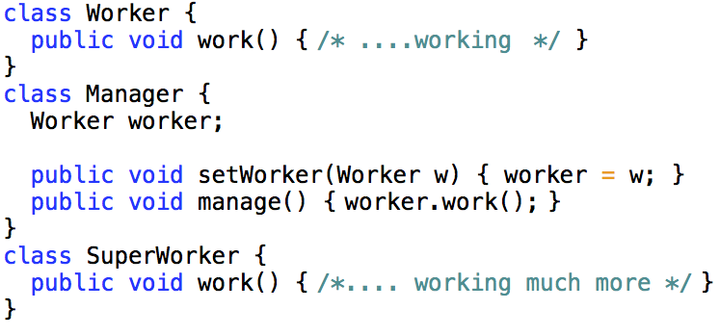
Dependency Inversion Principle (DIP)
Complex high-level elements should not directly depend on low-level elements that are likely to change: instead both should depend on abstractions.
Abstractions should not depend on details; details should depend on abstractions.
An object should not have to know what it is; is should instead care about what it does.
Introducing SuperWorker may require changes to Manager and/or rewrite of unit tests
Example from: http://www.oodesign.com/dependency-inversion-principle.html
Notes:
As to why it is important, in short: changes are risky, and by depending on a concept instead of on an implementation, you reduce the need for change at call sites.
Reduces coupling

Slide 15
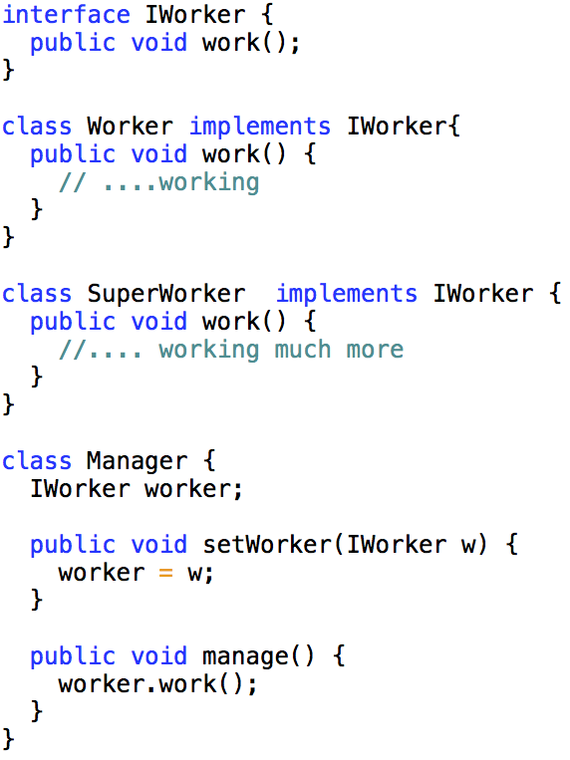
Improved design
New IWorker interface adds a layer of abstraction between Manager and worker types
Manager class no longer needs changes when adding SuperWorkers.

Slide 16
Testability Inhibitors
Restrictions on
Instantiation (especially reliance on environment)
Invocation (private methods)
Observation (methods with no return values)
Substitution (hard coded collaborators)
Overriding (complicates doubles)

Slide 17
Final guidelines
Carefully consider the use of …
Private methods
Final methods
Static methods
Instantiation/Reflection
Logic in constructors
Singletons
Composition/delegation vs. inheritance
Wrapping

Slide 18
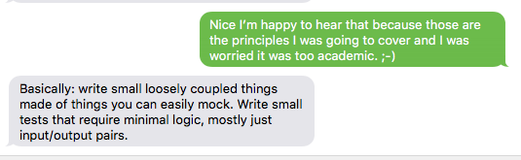
Or, resident developer says:

Slide 19
Testability principles in javascript.
Use constructors.
Support configurability.
Keep methods simple.
Keep state inspectable.
Don’t intermingle responsibilities.
http://alistapart.com/article/writing-testable-javascript

Slide 20
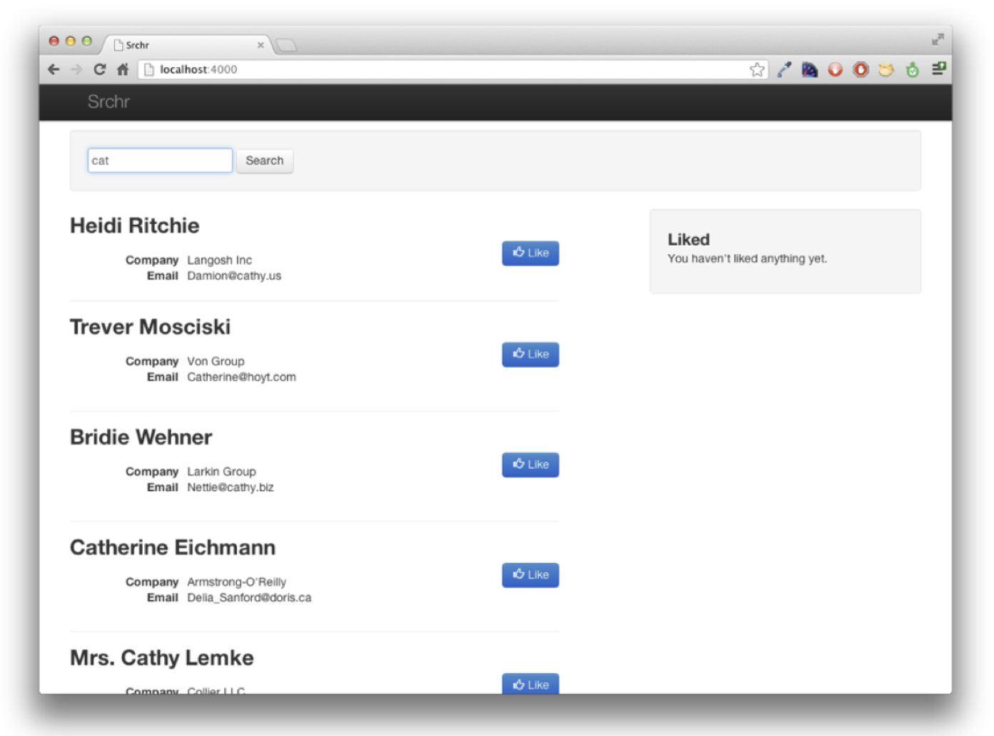

Slide 21
<look at code we just handed out>

Slide 22
Aside: integration tests
Unit test: “given input x, is the output y?”
Integration test: do the pieces work together as expected?
This code is relatively integration-testable.

Slide 23
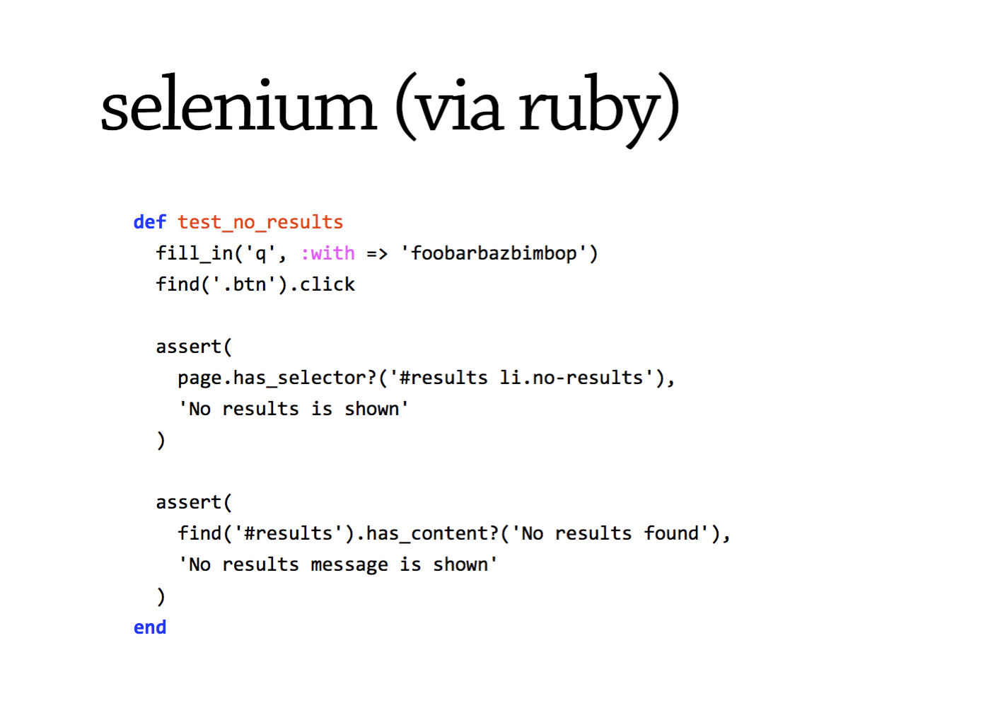

Slide 24
<back to unit tests>

Slide 25
This code has problems.
Lack of structure: almost everything happens in a single callback.
Complex functions. Rule of thumb: if it’s more than 10 lines, it’s doing too much.
Hidden or shared state.
Tight coupling.
Lack of configurability.
Notes:
Identify each! 1: document.ready() callback, anonymous functions; submit handler; pending (in a closure), $.ajax success handler has direct access to the DOM

Slide 26
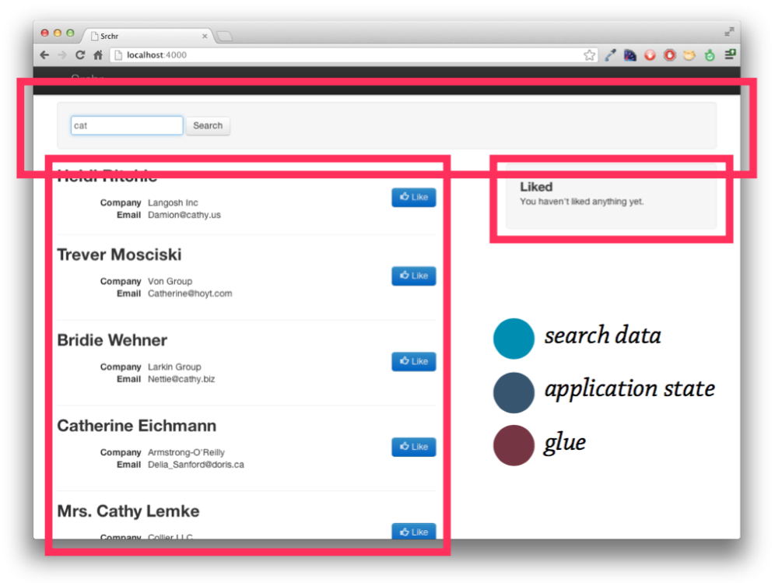

Slide 27
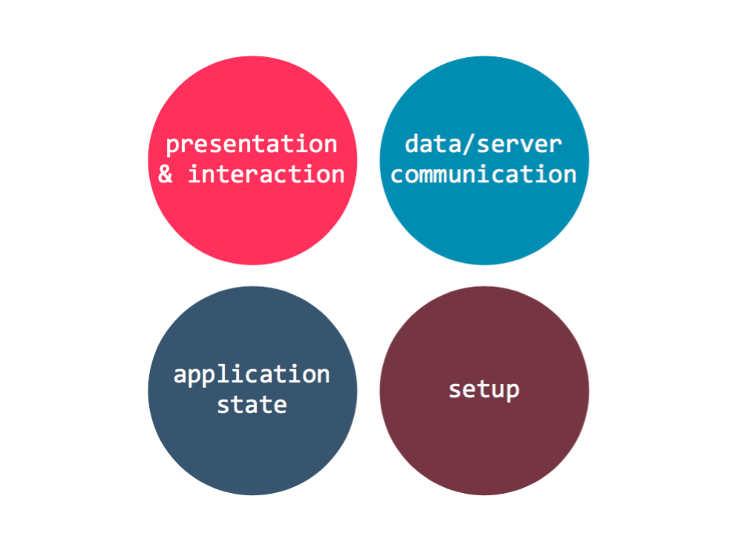
Notes:
Annotate your code

Slide 28
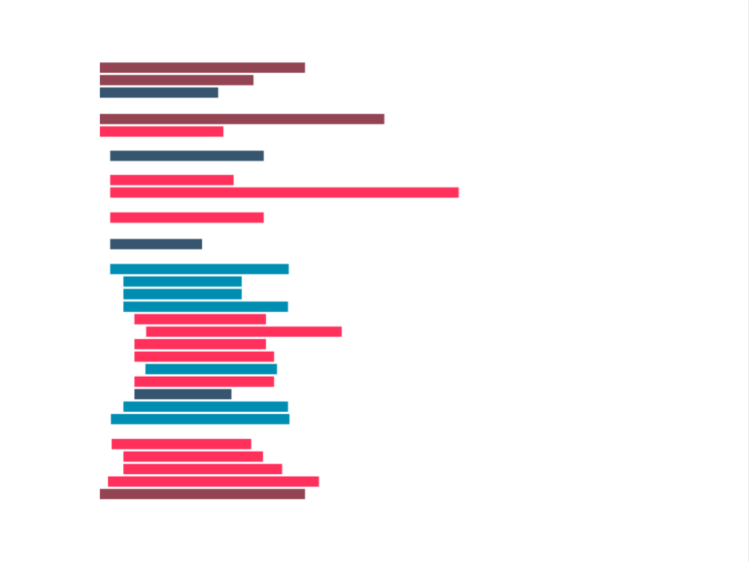

Slide 29
Let’s reorganize:
Represent each piece of behavior as a separate object that falls into one of the four areas of responsibility and doesn’t need to know about other objects.
Support configurability, so we don’t have to replicate the entire HTML environment to write tests.
Keep objects’ methods simple and brief.
Use constructor functions to create instances of objects.

Slide 30
Rewrite the code!
Notes:
Hints:
Separate object for likes and search results
Use document as a global message bus.

Slide 31
<secretly we just did code review>

Slide 32
What are Code Reviews?

Slide 33
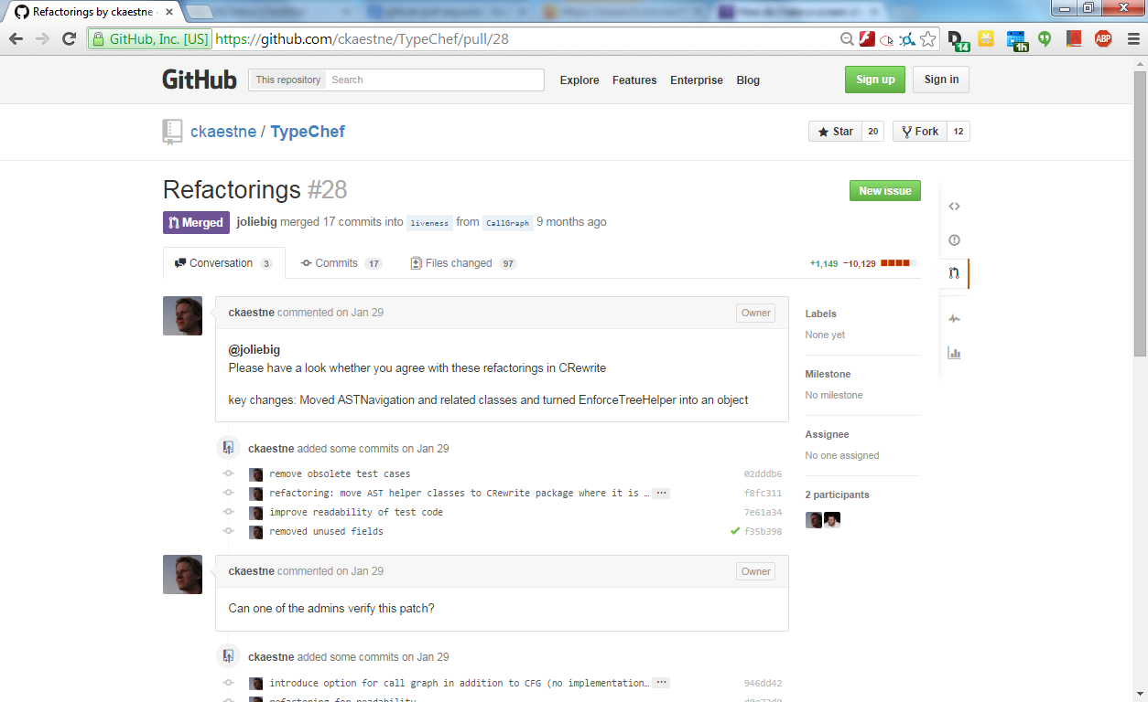
https://help.github.com/articles/using-pull-requests/
Notes:
Show examples https://github.com/twbs/bootstrap/pulls

Slide 34
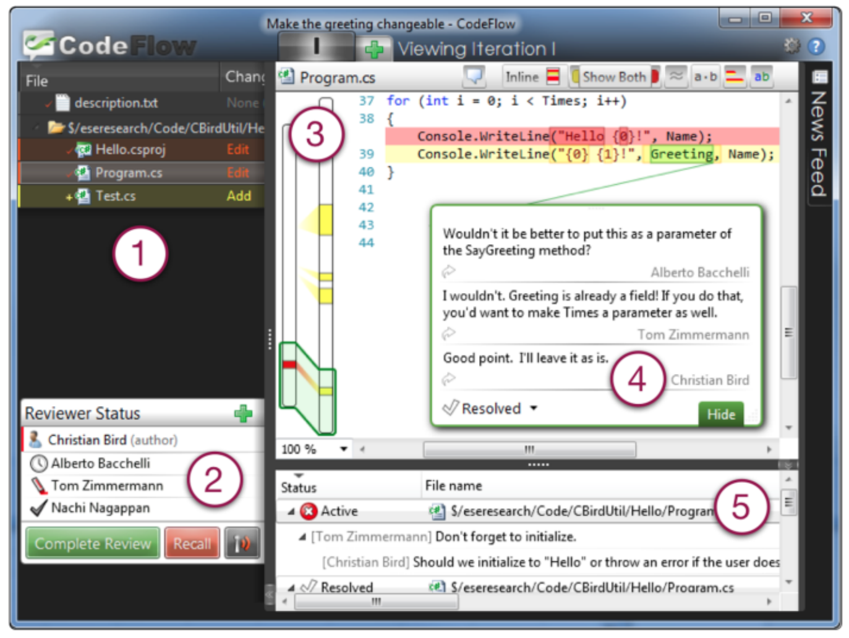
Notes:
ask which students know this or one of the next tools.
let them explain the workflow
afterward collect why companies may use this

Slide 35
Google's Code Review Policy
All change lists must be reviewed. Period.
Any CL can be reviewed by any engineer at Google.
Each directory has a list of owners. At least one reviewer or the author must be an owner for each file that was touched in the commit. If the author is not in the owners file, the reviewer is expected to pay extra attention to how the code fits in to the overall codebase.
[… readability review …] If the author does not have readability review, the reviewer is expected to pay extra attention to coding style (both the syntax and the proper use of libraries in that language).
One can enforce that any CLs to that directory are CC'd to a team mailing list.
Reviews are conducted either by email, or using a web interface called Mondrian
In general, the review must have a positive outcome before the change can be submitted (enforced by perforce hooks). However, if the author of the changelist meets the readability and owners checks, they can submit the change TBR, and have a post-hoc review. There is a process which will harass reviewers with very annoying emails if they do not promptly review the change.
source: https://www.quora.com/What-is-Googles-internal-code-review-policy-process, 2010

Slide 36
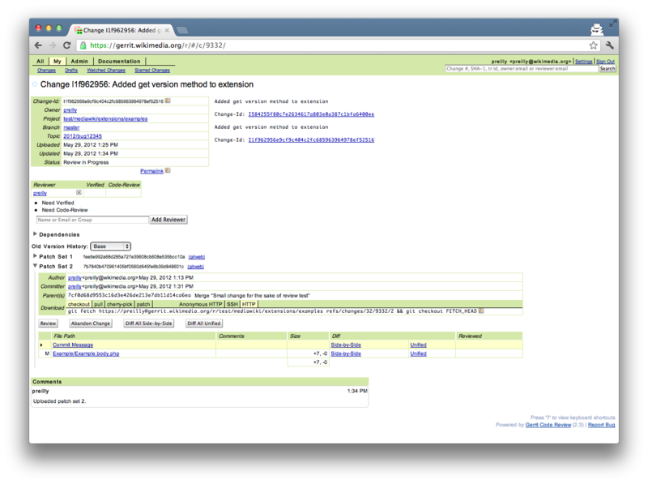
Gerrit
(open source)
Notes:
named after Gerrit Rietveld when froking the tool Rietveld (another dutch artist known for furniture and architecture; Rietveld named by the same guy who developed Mondrian)

Slide 37
https://help.github.com/articles/using-pull-requests/
Notes:
coming back to pull request discuss differences

Slide 38
“Many eyes make all bugs shallow”
Standard Refrain in Open Source
“Have peers, rather than customers, find defects”
Karl Wiegers

Slide 39
A second pair of eyes
Different background, different experience
No preconceived idea of correctness
Not biased by “what was intended”

Slide 40
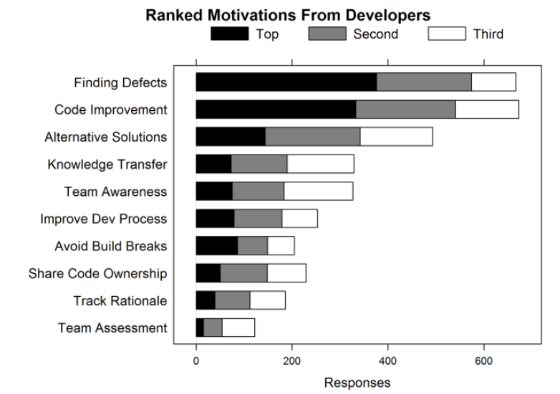
Bacchelli, Alberto, and Christian Bird. "Expectations, outcomes, and challenges of modern code review." Proceedings of the 2013 International Conference on Software Engineering. IEEE Press, 2013.

Slide 41
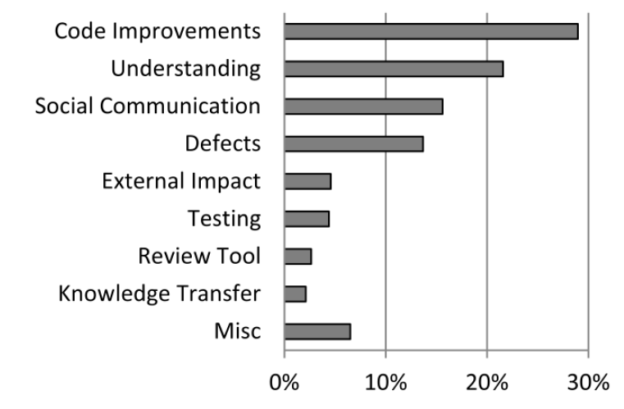
Outcomes (Analyzing Reviews)
Bacchelli, Alberto, and Christian Bird. "Expectations, outcomes, and challenges of modern code review." Proceedings of the 2013 International Conference on Software Engineering. IEEE Press, 2013.

Slide 42
Mismatch of Expectations and Outcomes
Low quality of code reviews
Reviewers look for easy errors, as formatting issues
Miss serious errors
Understanding is the main challenge
Understanding the reason for a change
Understanding the code and its context
Feedback channels to ask questions often needed
No quality assurance on the outcome
Bacchelli, Alberto, and Christian Bird. "Expectations, outcomes, and challenges of modern code review." Proceedings of the 2013 International Conference on Software Engineering. IEEE Press, 2013.

Slide 43
Checklists
Reminder what to look for
Include issues detected in the past
Preferably focus on few important items
Examples:
Are all variables initialized before use?
Are all variables used?
Is the condition of each if/while statement correct?
Does each loop terminate?
Do function parameters have the right types and appear in the right order?
Are linked lists efficiently traversed?
Is dynamically allocated memory released?
Can unexpected inputs cause corruption?
Have all possible error conditions been handled?
Are strings correctly sanitized?

Slide 44
What would a good checklist be for your startup? A bad one?

Slide 45
Code review summary
Actually not great at finding bugs, but great at many other things:
knowledge sharing
improving design/testability
conforming to coding standards
mentorship
Turn them on for merging pull requests for your group!
Develop a checklist?

