Slide 1
Viable
Putting the “V” in MVP
Michael Hilton
Assistant Professor
Carnegie Mellon University

Slide 2
Administrivia
Homework 4: Sprint 2 posted today
Dropbox MVP Explainer
Notes:
https://cmu-17-356.github.io/

Slide 3
What does it mean for an idea to be viable?
Notes:
Ask the class for ways which we might prove that a product is viable. Answers we are looking for:
Do people want it?
User Studies
User Metrics (Daily active users, registered users, waiting lists)
Business Partnerships (Client agreements, etc)
Market Capitalization
Can you build it?
Demonstrate your team has done similar things before.
MVP.
Outside estimates / analysis.
Regulatory Approval
Patents
Can you make money doing it?
Sales
Potential ad opportunities
Value of similar competitors
User studies / surveys

Slide 4
What is an MVP?
“The minimum viable product is that version of a new product which allows a team to collect the maximum amount of validated learning about customers with the least effort.” -Eric Reis, author of The Lean Startup

Slide 5
Proving Viability: Three Questions
Do people want It?
Can You build It?
Can you make money doing it?
Notes:
Do people want It?
Market Demand
User Testing
Can You build It?
Technology Challenges
Team Ability to Deliver
Ethical/Regulatory Concerns
Can you make money doing it?
Monetization
Selling Out
Costs/Risks

Slide 6
What are some ways that software companies make money?

Slide 7
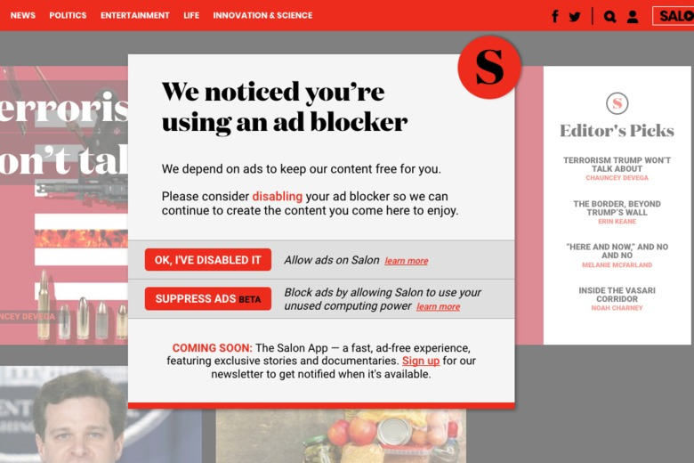

Slide 8
How do we prove viability?
Notes:
Ask the class for ways which we might prove that a product is viable. Answers we are looking for:
Do people want it?
User Studies
User Metrics (Daily active users, registered users, waiting lists)
Business Partnerships (Client agreements, etc)
Market Capitalization
Can you build it?
Demonstrate your team has done similar things before.
MVP.
Outside estimates / analysis.
Regulatory Approval
Patents
Can you make money doing it?
Sales
Potential ad opportunities
Value of similar competitors
User studies / surveys

Slide 9
Do people want it?
User Studies
User Metrics (Daily active users, registered users, waiting lists)
Business Partnerships (Client agreements, etc)
Market Capitalization

Slide 10
Can you build it?
Demonstrate your team has done similar things before.
MVP.
Outside estimates / analysis.
Regulatory Approval
Patents

Slide 11
Can you make money?
Sales
Potential ad opportunities
Value of similar competitors
User studies / surveys

Slide 12
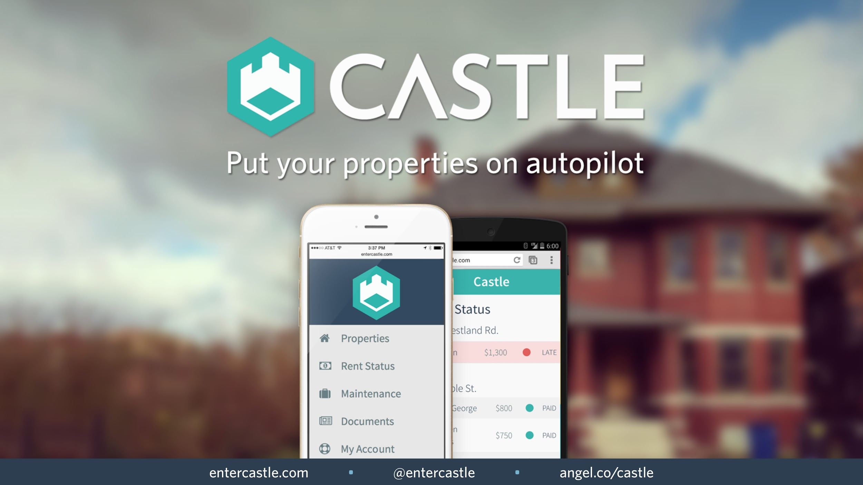
Case Study: Castle
Source: 500 Startups

Slide 13
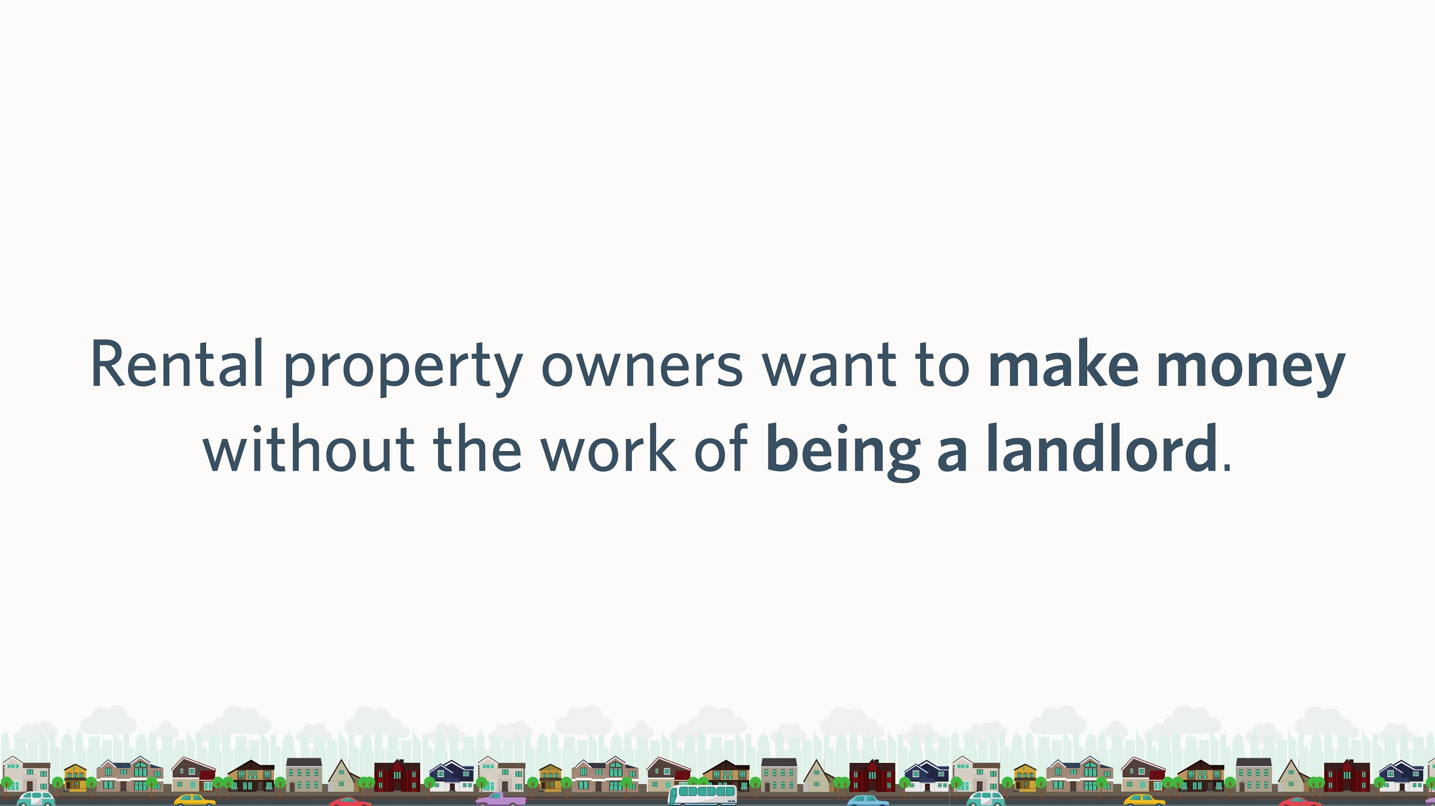
Case Study: Castle
Source: 500 Startups

Slide 14
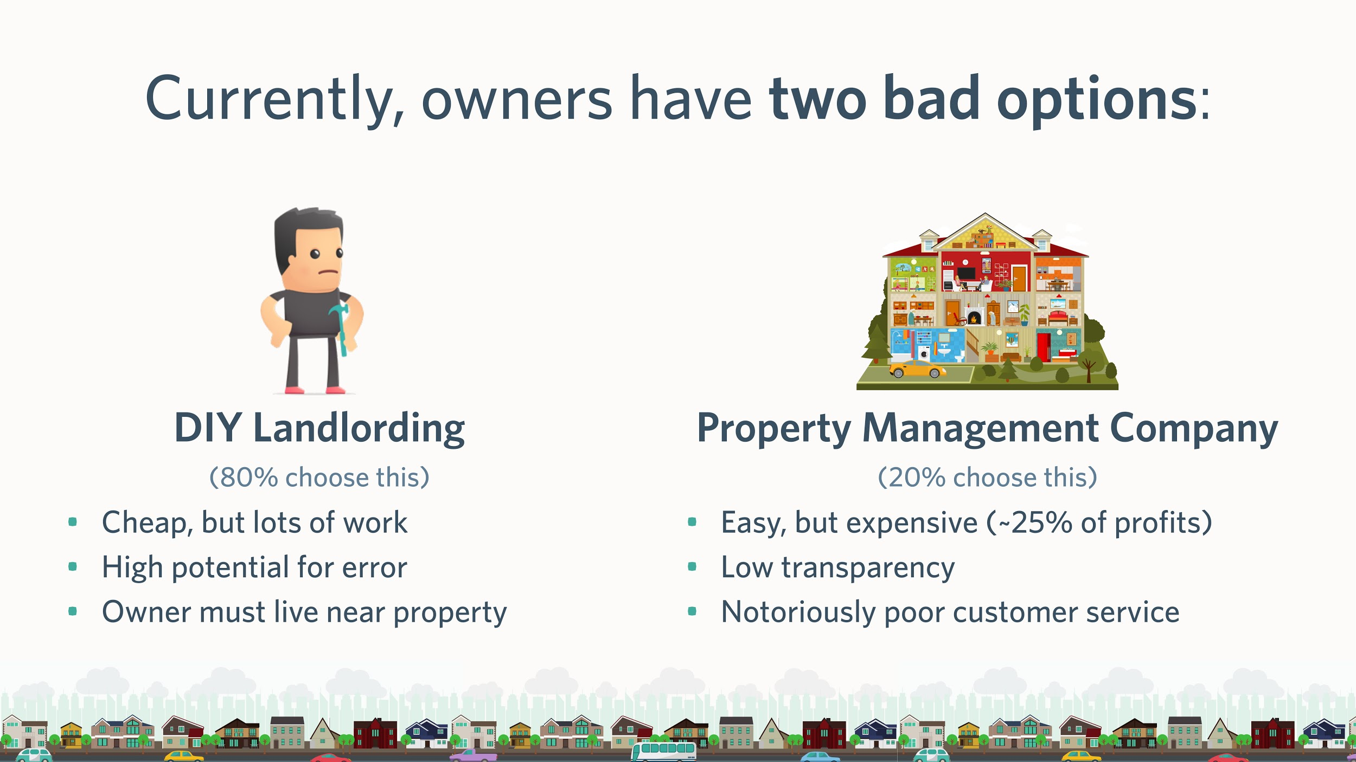
Case Study: Castle
Source: 500 Startups

Slide 15
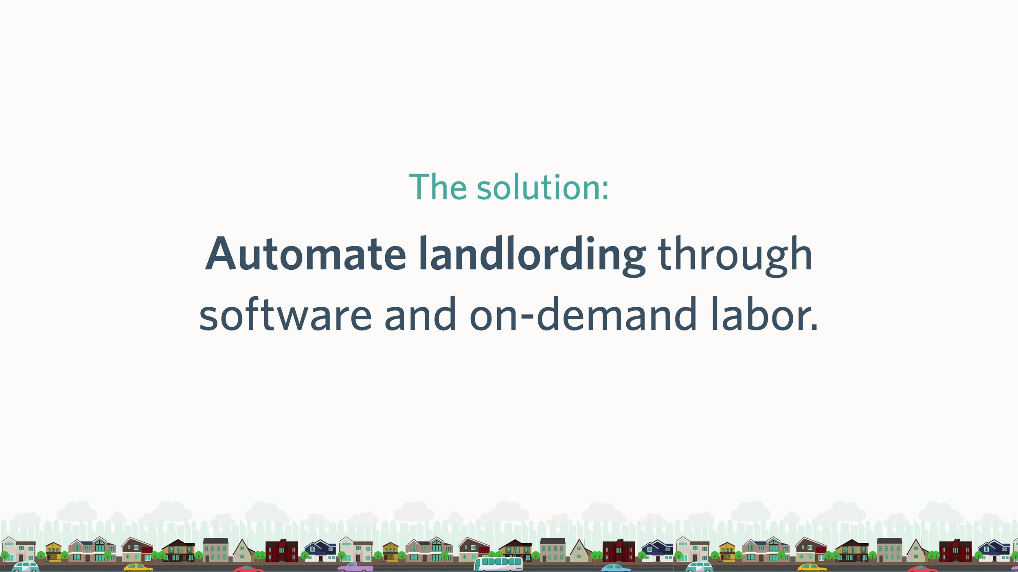
Case Study: Castle
Source: 500 Startups

Slide 16
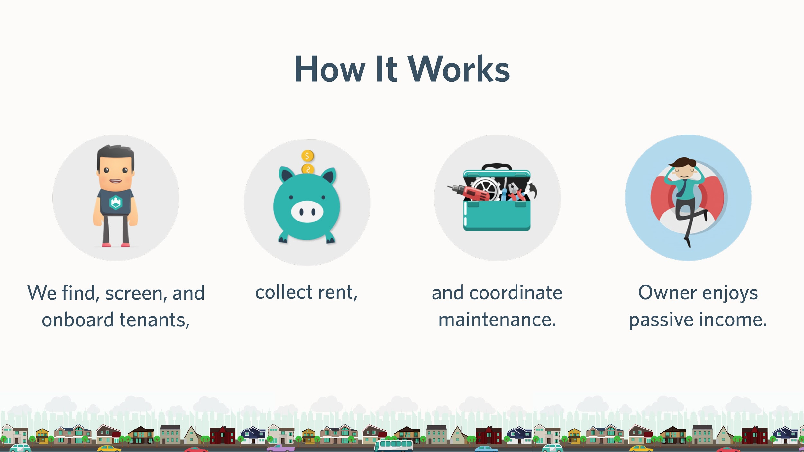
Case Study: Castle
Source: 500 Startups

Slide 17
Case Study: Castle
Do people want it?
Invite-only Beta Customers
Create a Waiting List
Present at a conference for Landlords
Can you build it?
Hire an experienced team.
Can we make money doing it?
User study: how much are people willing to pay?
What is the market capitalization now?

Slide 18
Class Activity : Viability Analysis - Part 1
As a group, answer the following:
How can you demonstrate people want it?
How can you demonstrate your ability to build it?
How can you monetize it? How can you demonstrate you can monetize it?

Slide 19



Class Activity : Viability Analysis
Croma
Mint
Foursquare
Notes:
Handouts are in the corresponding folder.

