Slide 1
Lecture 2: Process, Estimation, and Agile
SE for Startups
1/18/2018

Slide 2
Administrivia
Fill out the schedule quiz, linked from Canvas, so we can assign teams.
Apologies for the out-of-cycle deadline; we need to assign the teams by Tuesday, so we need the info before then.
Have you confirmed Canvas access yet?

Slide 3
Learning Goals

Slide 4
Software Process
“The set of activities and associated results that produce a software product”
Sommerville, SE, ed. 8
Notes:
examples:
Writing down all requirements
Require approval for all changes to requirements
Use version control for all changes
Track all reported bugs
Review requirements and code
Break down development into smaller tasks and schedule and monitor them
Planning and conducting quality assurance
Have daily status meetings
Use Docker containers to push code between developers and operation

Slide 5
100%
Percent
of
Effort
0%
Project
beginning
Time
Project
end
Notes:
if left to their own devices programmers tend to start coding immediately
do this chart on the white/board

Slide 6
100%
Trashing / Rework
Percent
of
Effort
Productive Coding
0%
Project
beginning
Time
Project
end
Notes:
idea: spent most of the time on coding, accept a little rework

Slide 7
100%
Trashing / Rework
Percent
of
Effort
Productive Coding
Too Much Process: Cost and Time estimates, Writing Requirements, Design,
Change Management, Quality Assurance Plan,
Development and Integration Plan
0%
Project
beginning
Time
Project
end
Notes:
negative view of process. pure overhead, reduces productive work, limits creativity

Slide 8
Trashing / Rework
100%
Percent
of
Effort
Productive Coding
Process
0%
Project
beginning
Time
Project
end
Notes:
real experience if little attention is paid to process
increasingly complicated, increasing rework
attempts to rescue by introducing process
collect examples of what could go wrong!
Change Control: Mid-project informal agreement to changes suggested by customer or manager. Project scope expands 25-50%
Quality Assurance: Late detection of requirements and design issues. Test-debug-reimplement cycle limits development of new features. Release with known defects.
Defect Tracking: Bug reports collected informally, forgotten
System Integration: Integration of independently developed components at the very end of the project. Interfaces out of sync.
Source Code Control: Accidentally overwritten changes, lost work.
Scheduling: When project is behind, developers are asked weekly for new estimates.

Slide 9
100%
Trashing / Rework
Percent
of
Effort
Productive Coding
Process
0%
Project
beginning
Time
Project
end
Notes:
ideal setting of little process investment upfront

Slide 10
STARTUP-SPECIFIC PROPERTIES OR CONCERNS?
Notes:
Small teams
No time
everyone does everything

Slide 11
Process Costs
n(n − 1) / 2
communication links
Notes:
Small teams are better anyway

Slide 12
“Agile” Software Development Is …
Both:
a set of software engineering principles and best practices (allowing for rapid delivery of high quality software)
a business approach (aligning development with customer needs and goals)
Caveat about Agile’s suitability in general…

Slide 13
Agile in a nutshell
A project management approach that seeks to respond to change and unpredictability, primarily using incremental, iterative work sequences (often called “sprints”).
Also: a collection of practices to facility that approach.
All predicated on the principles outlined in “The Manifesto for Agile Software Development.”

Slide 14
Agile principles are well-suited for startup context.
Our highest priority is to satisfy the customer through early and continuous delivery of valuable software.
Welcome changing requirements, even late in development. Agile processes harness change for the customer's competitive advantage.
Deliver working software frequently, from a couple of weeks to a couple of months, with a preference to the shorter timescale.
Notes:
Discussion here about matching of Agile assumptions and startup context; maybe not discussion per principle, but at least some.

Slide 15
Agile principles are well-suited for startup context.
Business people and developers must work together daily throughout the project.
Build projects around motivated individuals. Give them the environment and support they need, and trust them to get the job done.
The most efficient and effective method of conveying information to and within a development team is face-to-face conversation.

Slide 16
Agile principles are well-suited for startup context.
Working software is the primary measure of progress.
Agile processes promote sustainable development. The sponsors, developers, and users should be able to maintain a constant pace indefinitely.
Continuous attention to technical excellence and good design enhances agility.

Slide 17
Agile principles are well-suited for startup context.
Simplicity—the art of maximizing the amount of work not done—is essential.
The best architectures, requirements, and designs emerge from self-organizing teams.
At regular intervals, the team reflects on how to become more effective, then tunes and adjusts its behavior accordingly.

Slide 18
PRINCIPLES ARE NICE, BUT A BIT HIGH-LEVEL…

Slide 19
Agile Practices
Backlogs (Product and Sprint)
Behavior-driven development (BDD)
Cross-functional team
Continuous
integration (CI)
Domain-driven design (DDD)
Information radiators (Kanban board, Task board, Burndown chart)
Acceptance test-driven development (ATDD)
Iterative and incremental development (IID)
Pair programming
Planning poker
Refactoring
Scrum meetings (Sprint planning, Daily scrum, Sprint review and retrospective)
Small releases
Simple design
Test-driven development (TDD)
Agile testing
Timeboxing
Use case
User story
Story-driven modeling
Retrospective
On-site customer
Agile Modeling
40-hour weeks
Short development cycles
Collective ownership
Open workspace
Velocity tracking
Etc.

Slide 20
PROCESS INTERVENTIONS ARE USEFUL INASMUCH AS THEY PREVENT PROBLEMS.

Slide 21
Collective Ownership
Every programmer improves any code anywhere in the system at any time if they see the opportunity.

Slide 22
Test-driven development
Programmers write unit tests minute by minute. These tests are collected and they must all run correctly. Customers write functional tests for the stories in an iteration.

Slide 23
Short development cycle
The software development process is organized in a way in which the full software development cycle—from design phase to implementation phase to test and deployment phase—is performed within a short timespan, usually several months or even weeks.

Slide 24
Continuous Integration (CI)
New code is integrated with the current system after no more than a few hours. When integrating, the system is built from scratch and all tests must pass or the changes are discarded.

Slide 25
Small Releases
The system is put into production in a few months, before solving the whole problem. New releases are made often—anywhere from daily to monthly.

Slide 26
Continuous Delivery (CD)
New releases are deployed automatically (not necessarily to production, but in a production-like environment) for early adopters to use and assess.

Slide 27
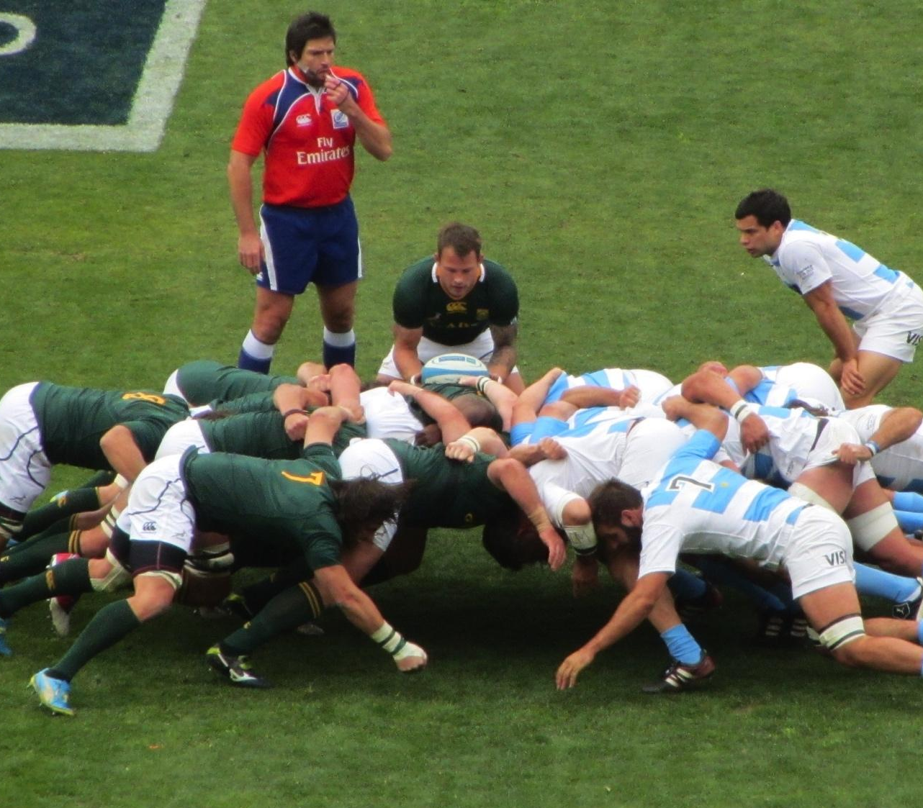
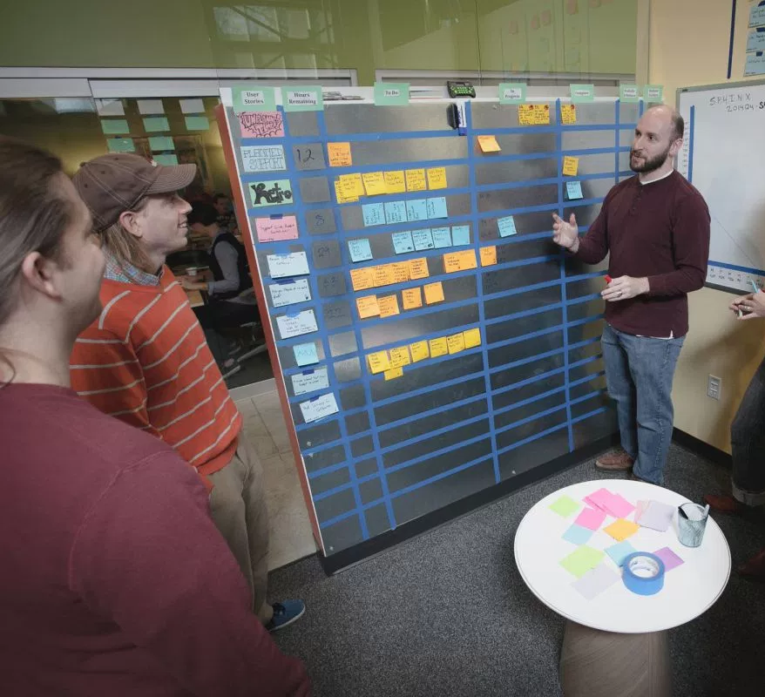
Scrum: Structure and Communication

Slide 28
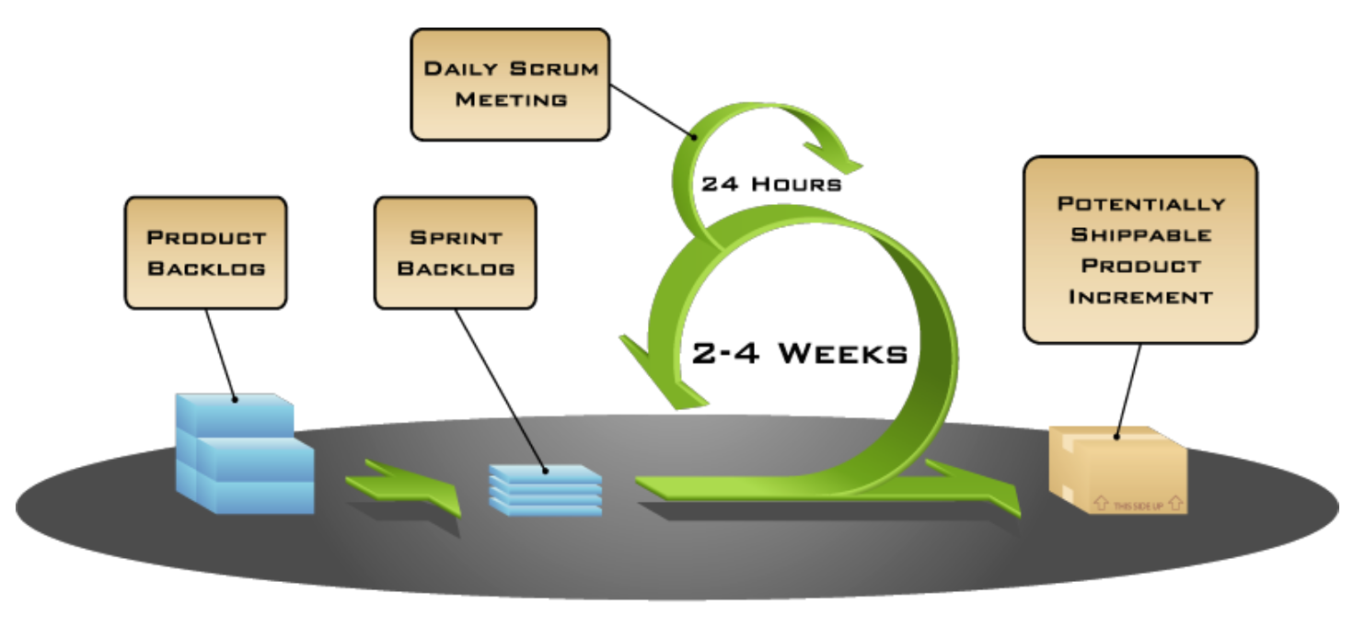
Scrum Process

Slide 29

Sprint planning: estimation

Slide 30
Question: Why is this so hard?
Notes:
Small teams
No time
everyone does everything

Slide 31
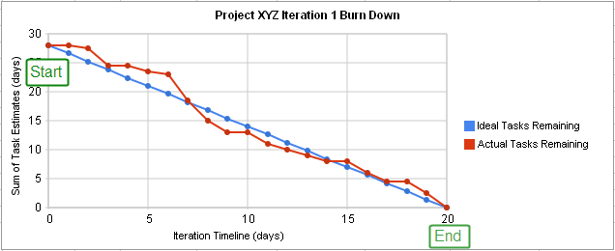
Burndown charts: now you’ve seen one

Slide 32

More realistic...

Slide 33

Roles: product owner, team, scrum master

Slide 34
Sprint planning
Product Backlog
List of user stories for the product
All entries should add value
It is a living document (should be groomed)
No low level tasks
Backlog is ordered

Slide 35
Sprint planning
Sprint Backlog
Tasks to be done that sprint.
Features (user stories, broken into features and tasks)
Bugs
Technical work
Knowledge acquisition

Slide 36
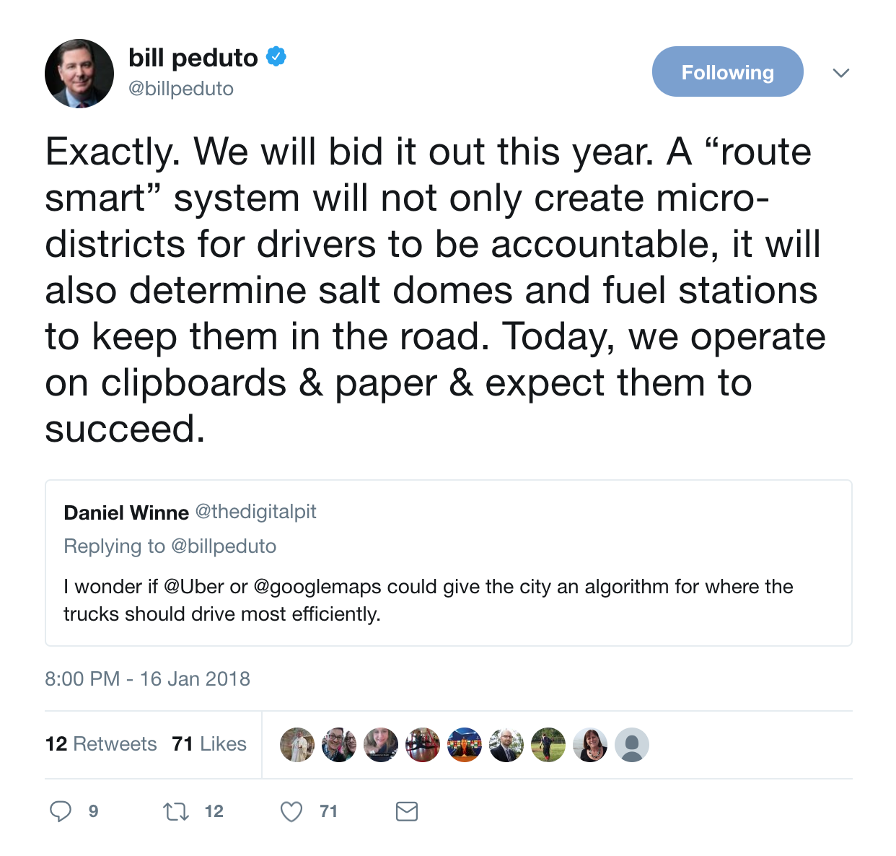
Activity

Slide 37
Sprint review and retrospective
Sprint Review: End of sprint meeting: inspect increment, adapt the backlog. Based on changes to backlog, attendees decide what could be done next to optimize value.
Discuss what has been done, effect on backlog; team demonstrates what has been done.
Discusses what went well and what problems were solved, and how.
Discussion of what to do next (including potential changes in the product use case or market).
Sprint retrospective: team inspects itself and creates a plan for self-improvement for the next Sprint.
Occurs after the review, before planning.
Team discusses:
What went well in the Sprint
What could be improved
What will we commit to improve in the next Sprint
The Scrum Master encourages the Scrum Team to improve its development process and practices to make it more effective and enjoyable for the next Sprint.

Slide 38
Scrum meetings
Daily “stand-ups”, strictly time-boxed to 15 minutes, where each team member answers three questions:
What did you do yesterday?
What will you do today?
Are there any impediments in your way?

Slide 39
Question: Why? And how can you simulate that in your teams?
Notes:
Small teams
No time
everyone does everything

