Slide 1
Design and prototyping
Software Engineering for Startups
January 25, 2018

Slide 2
A comment on 40 hours

Slide 3
Requirements
Miracle /
genius developers
Architecture
Implementation

Slide 4
Software Architecture
The software architecture of a program or computing system is the structure or structures of the system, which comprise software elements, the externally visible properties of those elements, and the relationships among them.
[Bass et al. 2003]
Notes:
First, architecture defines software elements and embodies information about how they relate to each other; omits info about elements that does not pertain to their interaction.
An architecture is foremost an abstraction of a system that suppresses details of elements that do not affect how they use, are used by, relate to, or interact with other elements.
In nearly all modern systems, elements interact with each other by means of interfaces that partition details about an element into public and private parts. Architecture is concerned with the public side of this division; private details-those having to do solely with internal implementation-are not architectural.
"Externally visible" properties are those assumptions other elements can make of an element, such as its provided services, performance characteristics, fault handling, shared resource usage, and so on. Let's look at some of the implications of this definition in more detail.
The behavior of each element is part of the architecture insofar as that behavior can be observed or discerned from the point of view of another element. Such behavior is what allows elements to interact with each other, which is clearly part of the architecture.
(This is another reason that the box-and-line drawings that are passed off as architectures are not architectures at all.)
One set of structures used to describe a system is its implementation modules or units.
Static: focuses on the way the system's functionality is divided up and (often) assigned to implementation teams.
Another set of structures describe the way elements interact more explicitly.
E.g., consider a set of parallel processes that is described in terms of sequential behavior, interactions, and synchronization mechanisms.
Both convey architectural information, do not necessarily describe all interesting relationships/elements in the system.

Slide 5
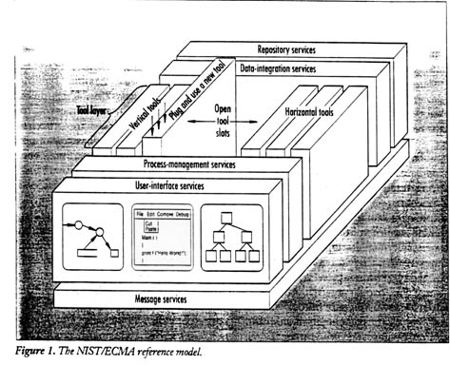
Examples of Architecture Descriptions

Slide 6
In practice, in modern development, especially web apps, very little of that matters.

Slide 7
Web application development crash course

Slide 8
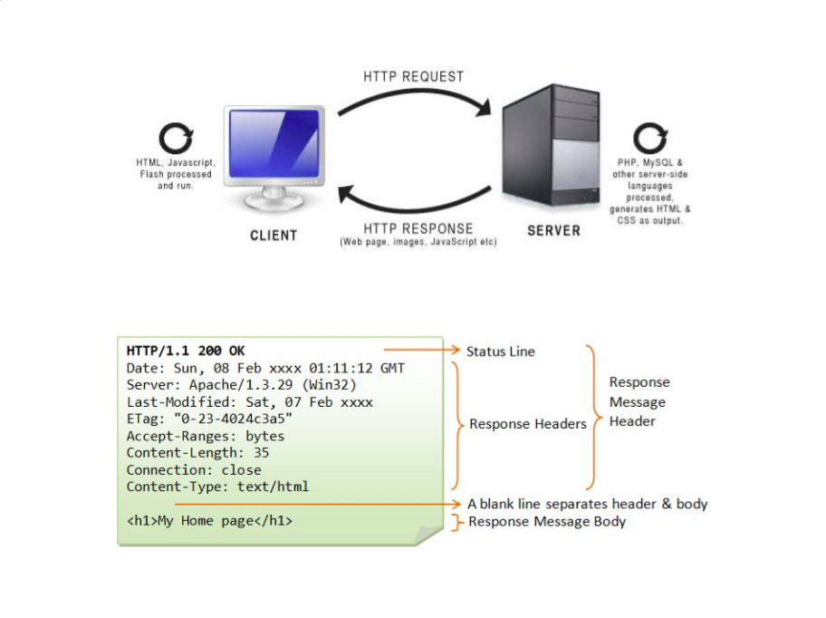
Slides borrowed wholesale and liberally from Alexey Zagalsky, Uvic
https://speakerdeck.com/alexeyza/web-development-overview-2016

Slide 9
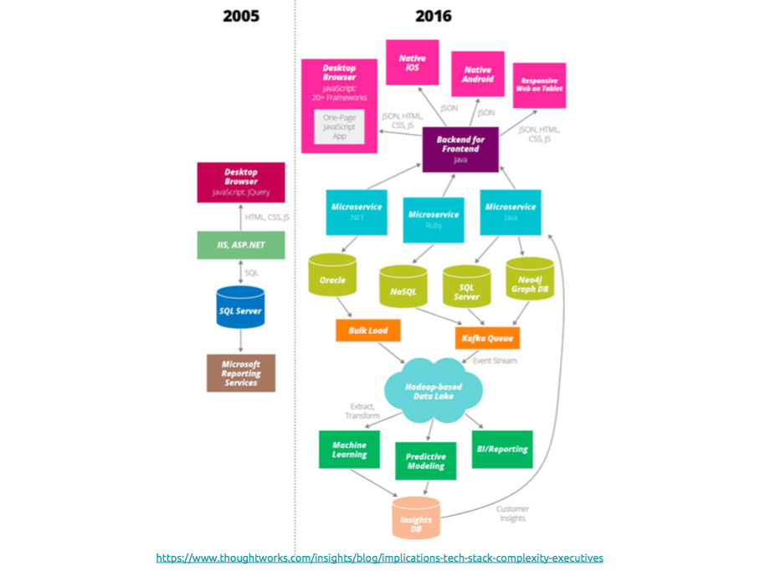

Slide 10
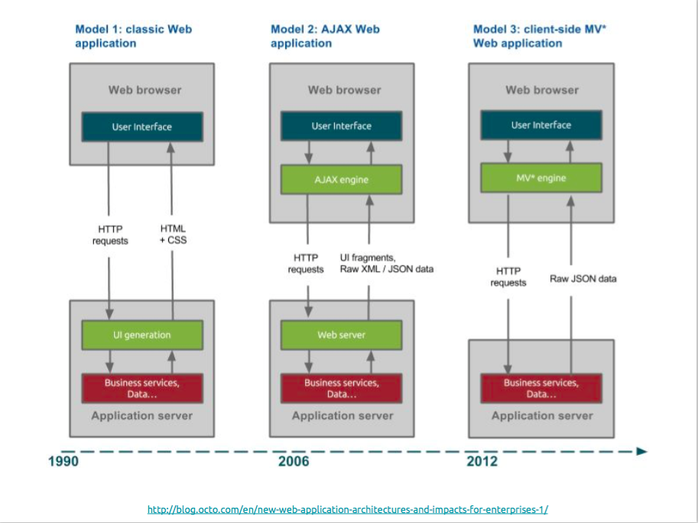

Slide 11
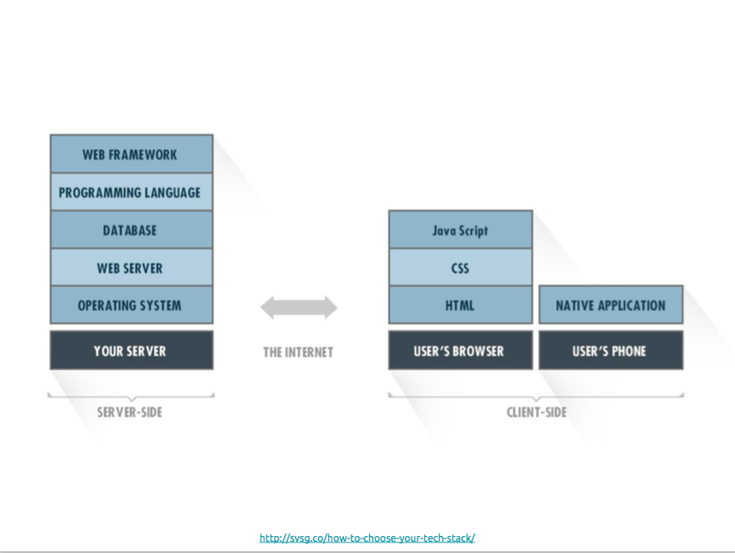
Notes:
A tech stack is a combination of software products and programming languages used to create a web or mobile application. Applications have two software components: client-side and server-side, also known as front-end and back-end.
The back-end contains the business logic that works behind the scenes to drive your application. Users will never directly engage with the back-end, all information is passed back and forth through the front-end. The most well known example of a back-end tech stack is the LAMP stack (Linux, Apache, MySQL, PHP). More recent variations of this stack include Ruby or Python as the programming language instead of PHP. A programming language is selected along with a web framework written in that language. Frameworks are incredibly useful because they provide developers with vetted implementations of common web application features like user authentication and data access, saving them from re-inventing the wheel. Popular framework choices include:

Slide 12
Client Side
Web browser, native/iOS/Android/etc

Slide 13
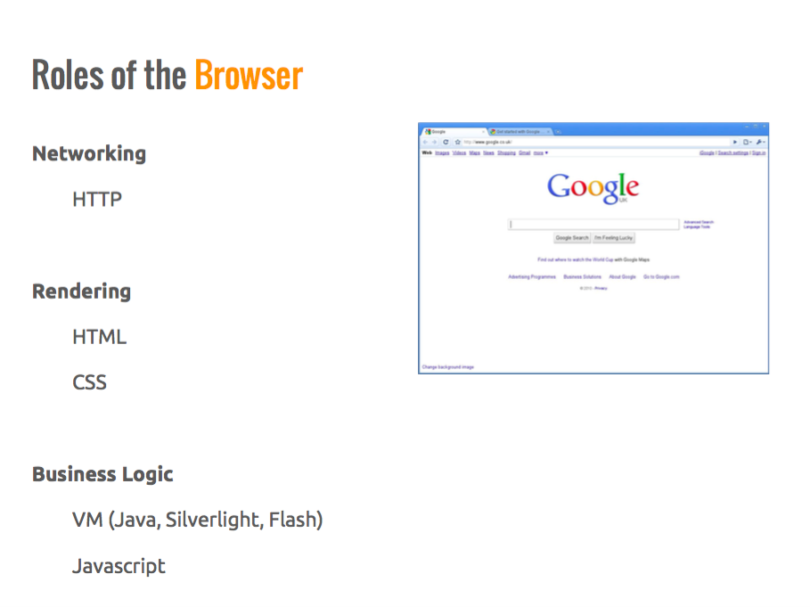

Slide 14
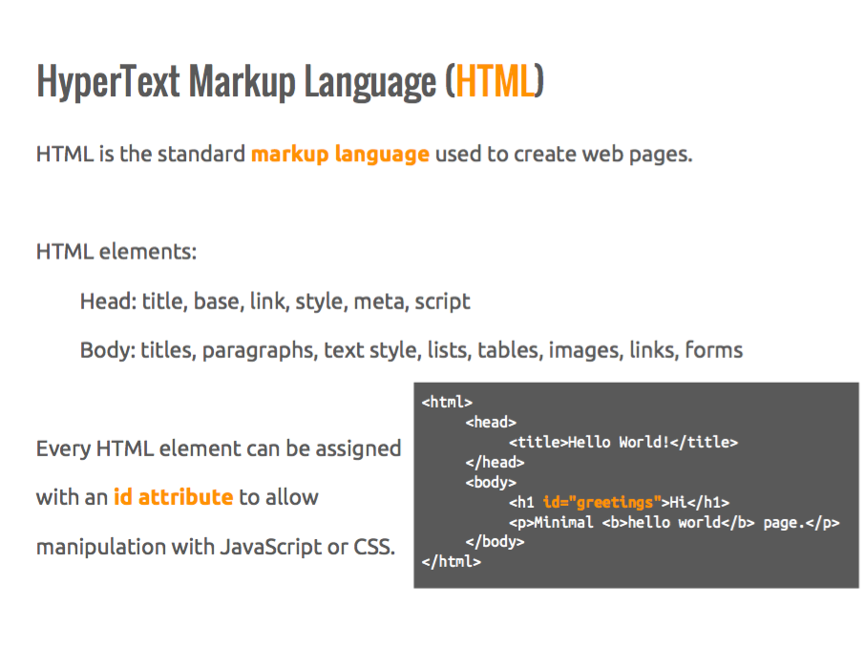

Slide 15
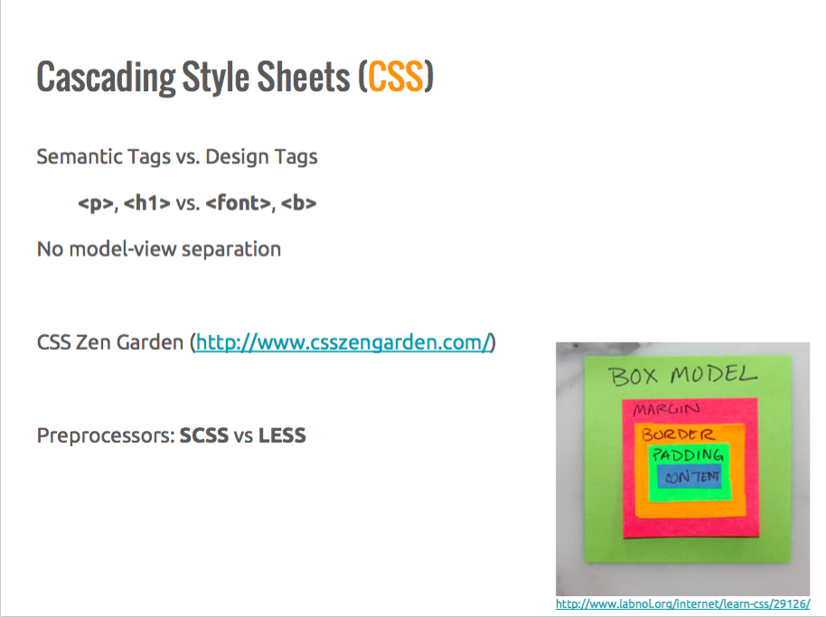

Slide 16
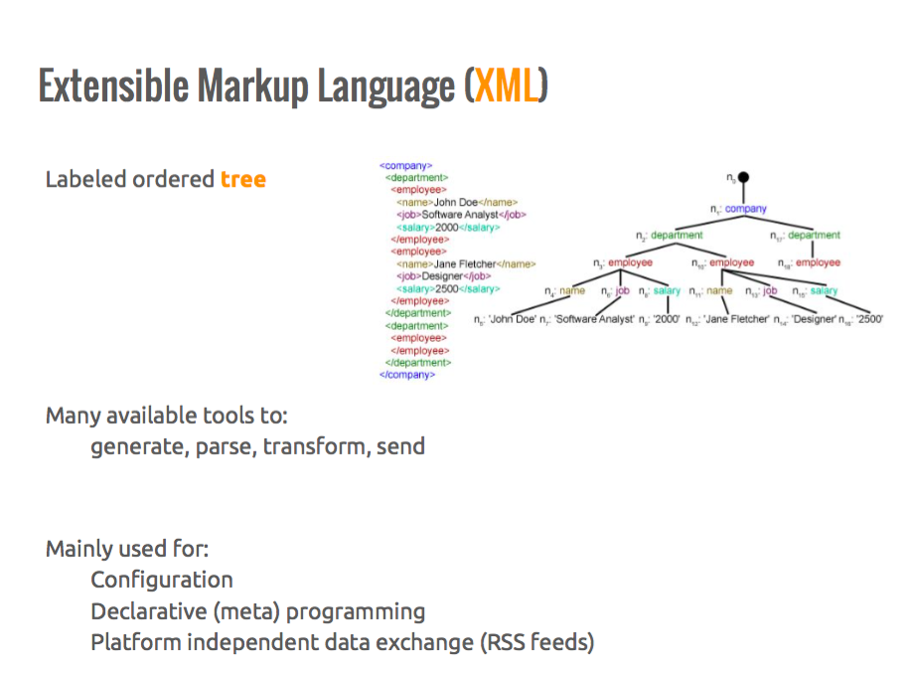

Slide 17
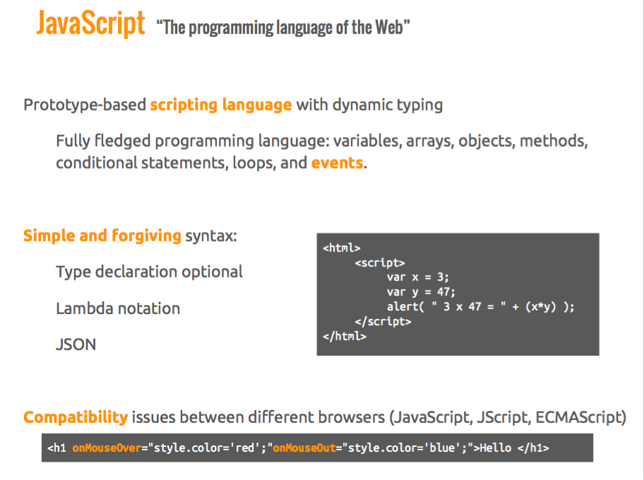

Slide 18
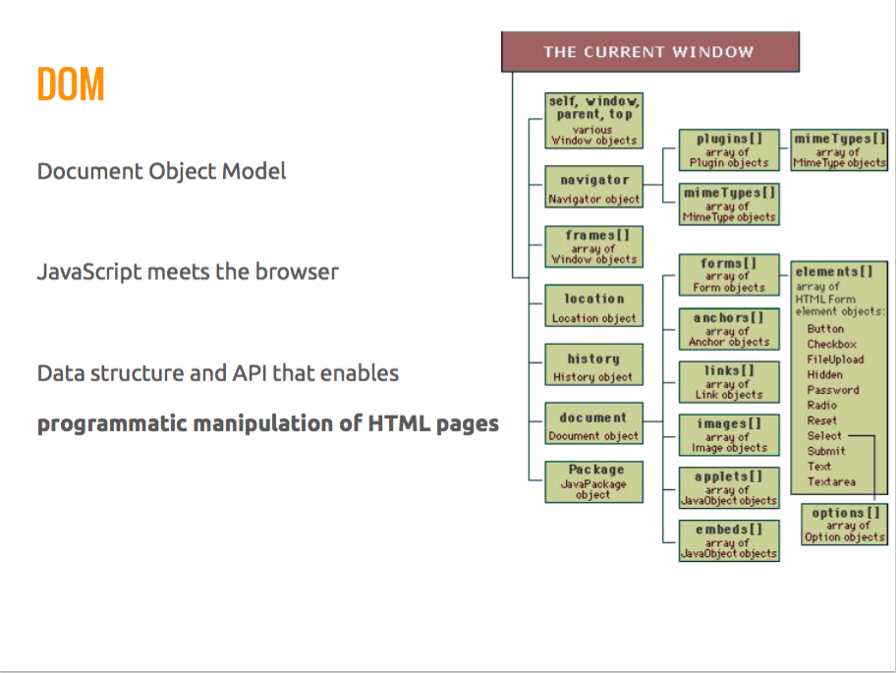

Slide 19
Server Side
Web server, databases, authentication, etc…

Slide 20
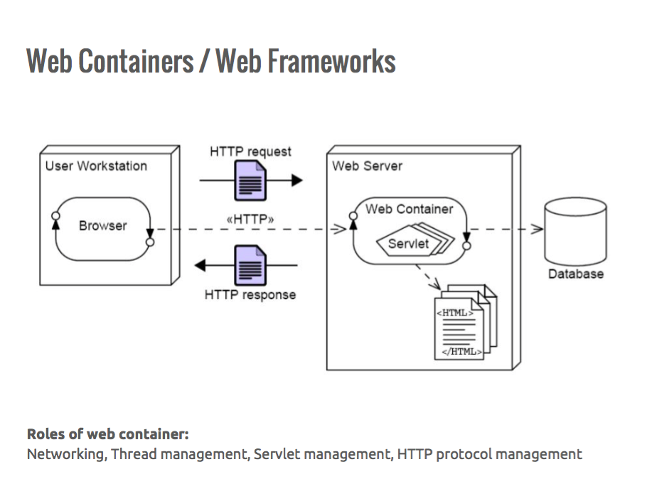

Slide 21
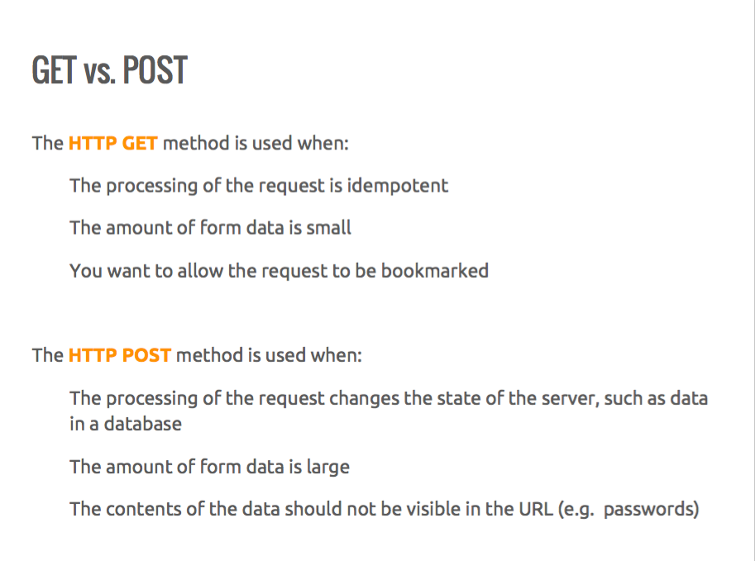

Slide 22
Two core issues.
How do we map a requested URL to the code that is meant to handle it?
How do we create the requested HTML dynamically, injecting calculated values or information retrieved from a database?
https://jeffknupp.com/blog/2014/03/03/what-is-a-web-framework/

Slide 23
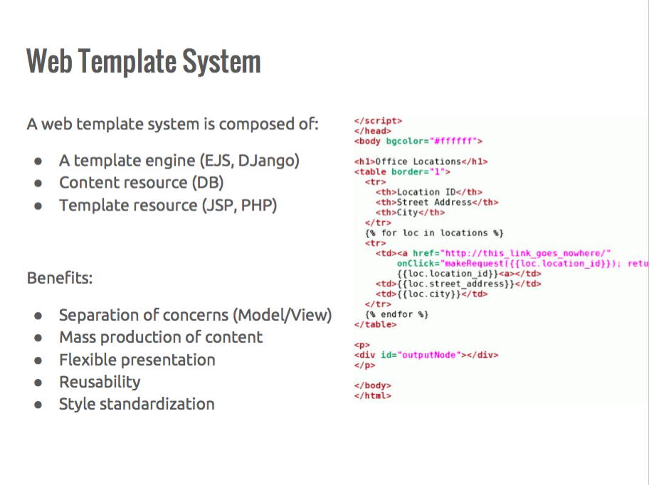

Slide 24

Notes:
So this question about architecture is basically moot….

Slide 25
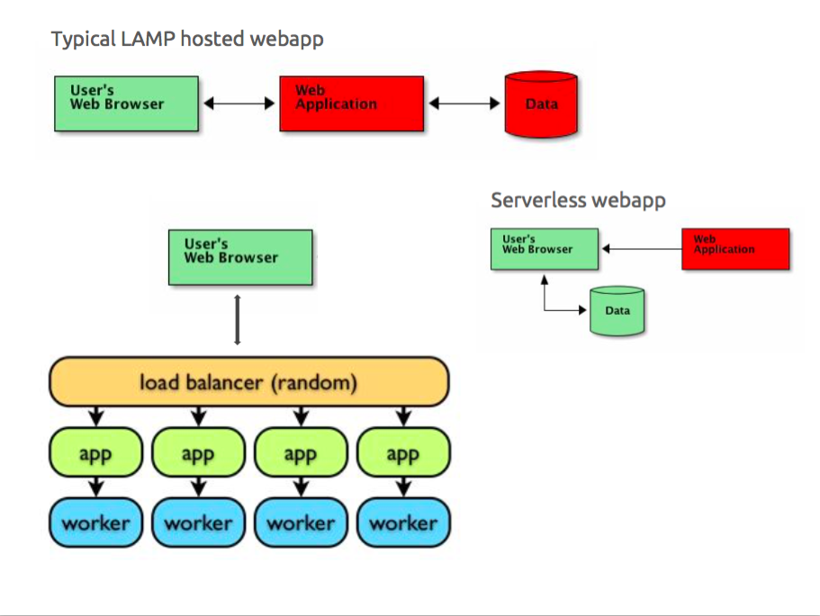

Slide 27
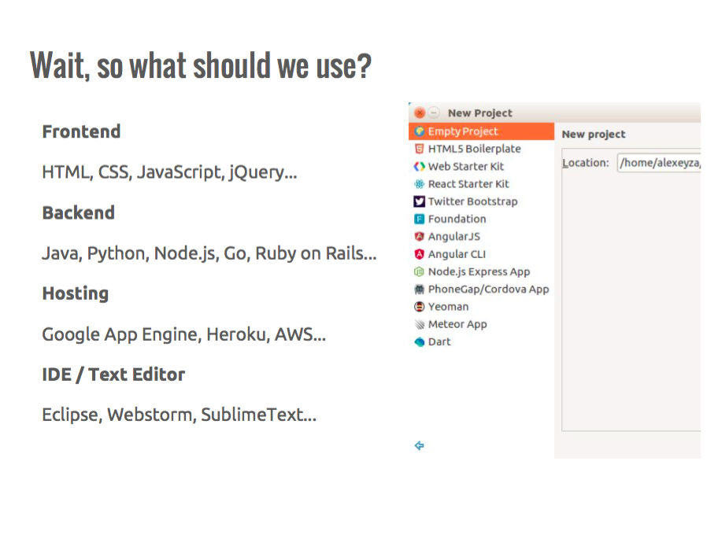

Slide 28
What is a framework?
“A starting architecture, with supporting libraries, to support a general programming goal, typically using inverted control.”

Slide 29
Examples? And how do we choose between them?
<I’d have made a list, but I bet we can just name a bunch, eh?>

Slide 30
Honesty Time: we’re boxing you in
Sorry/Not Sorry

Slide 31
Path to prototypes

Slide 32
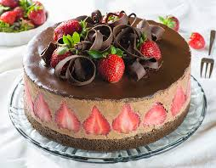

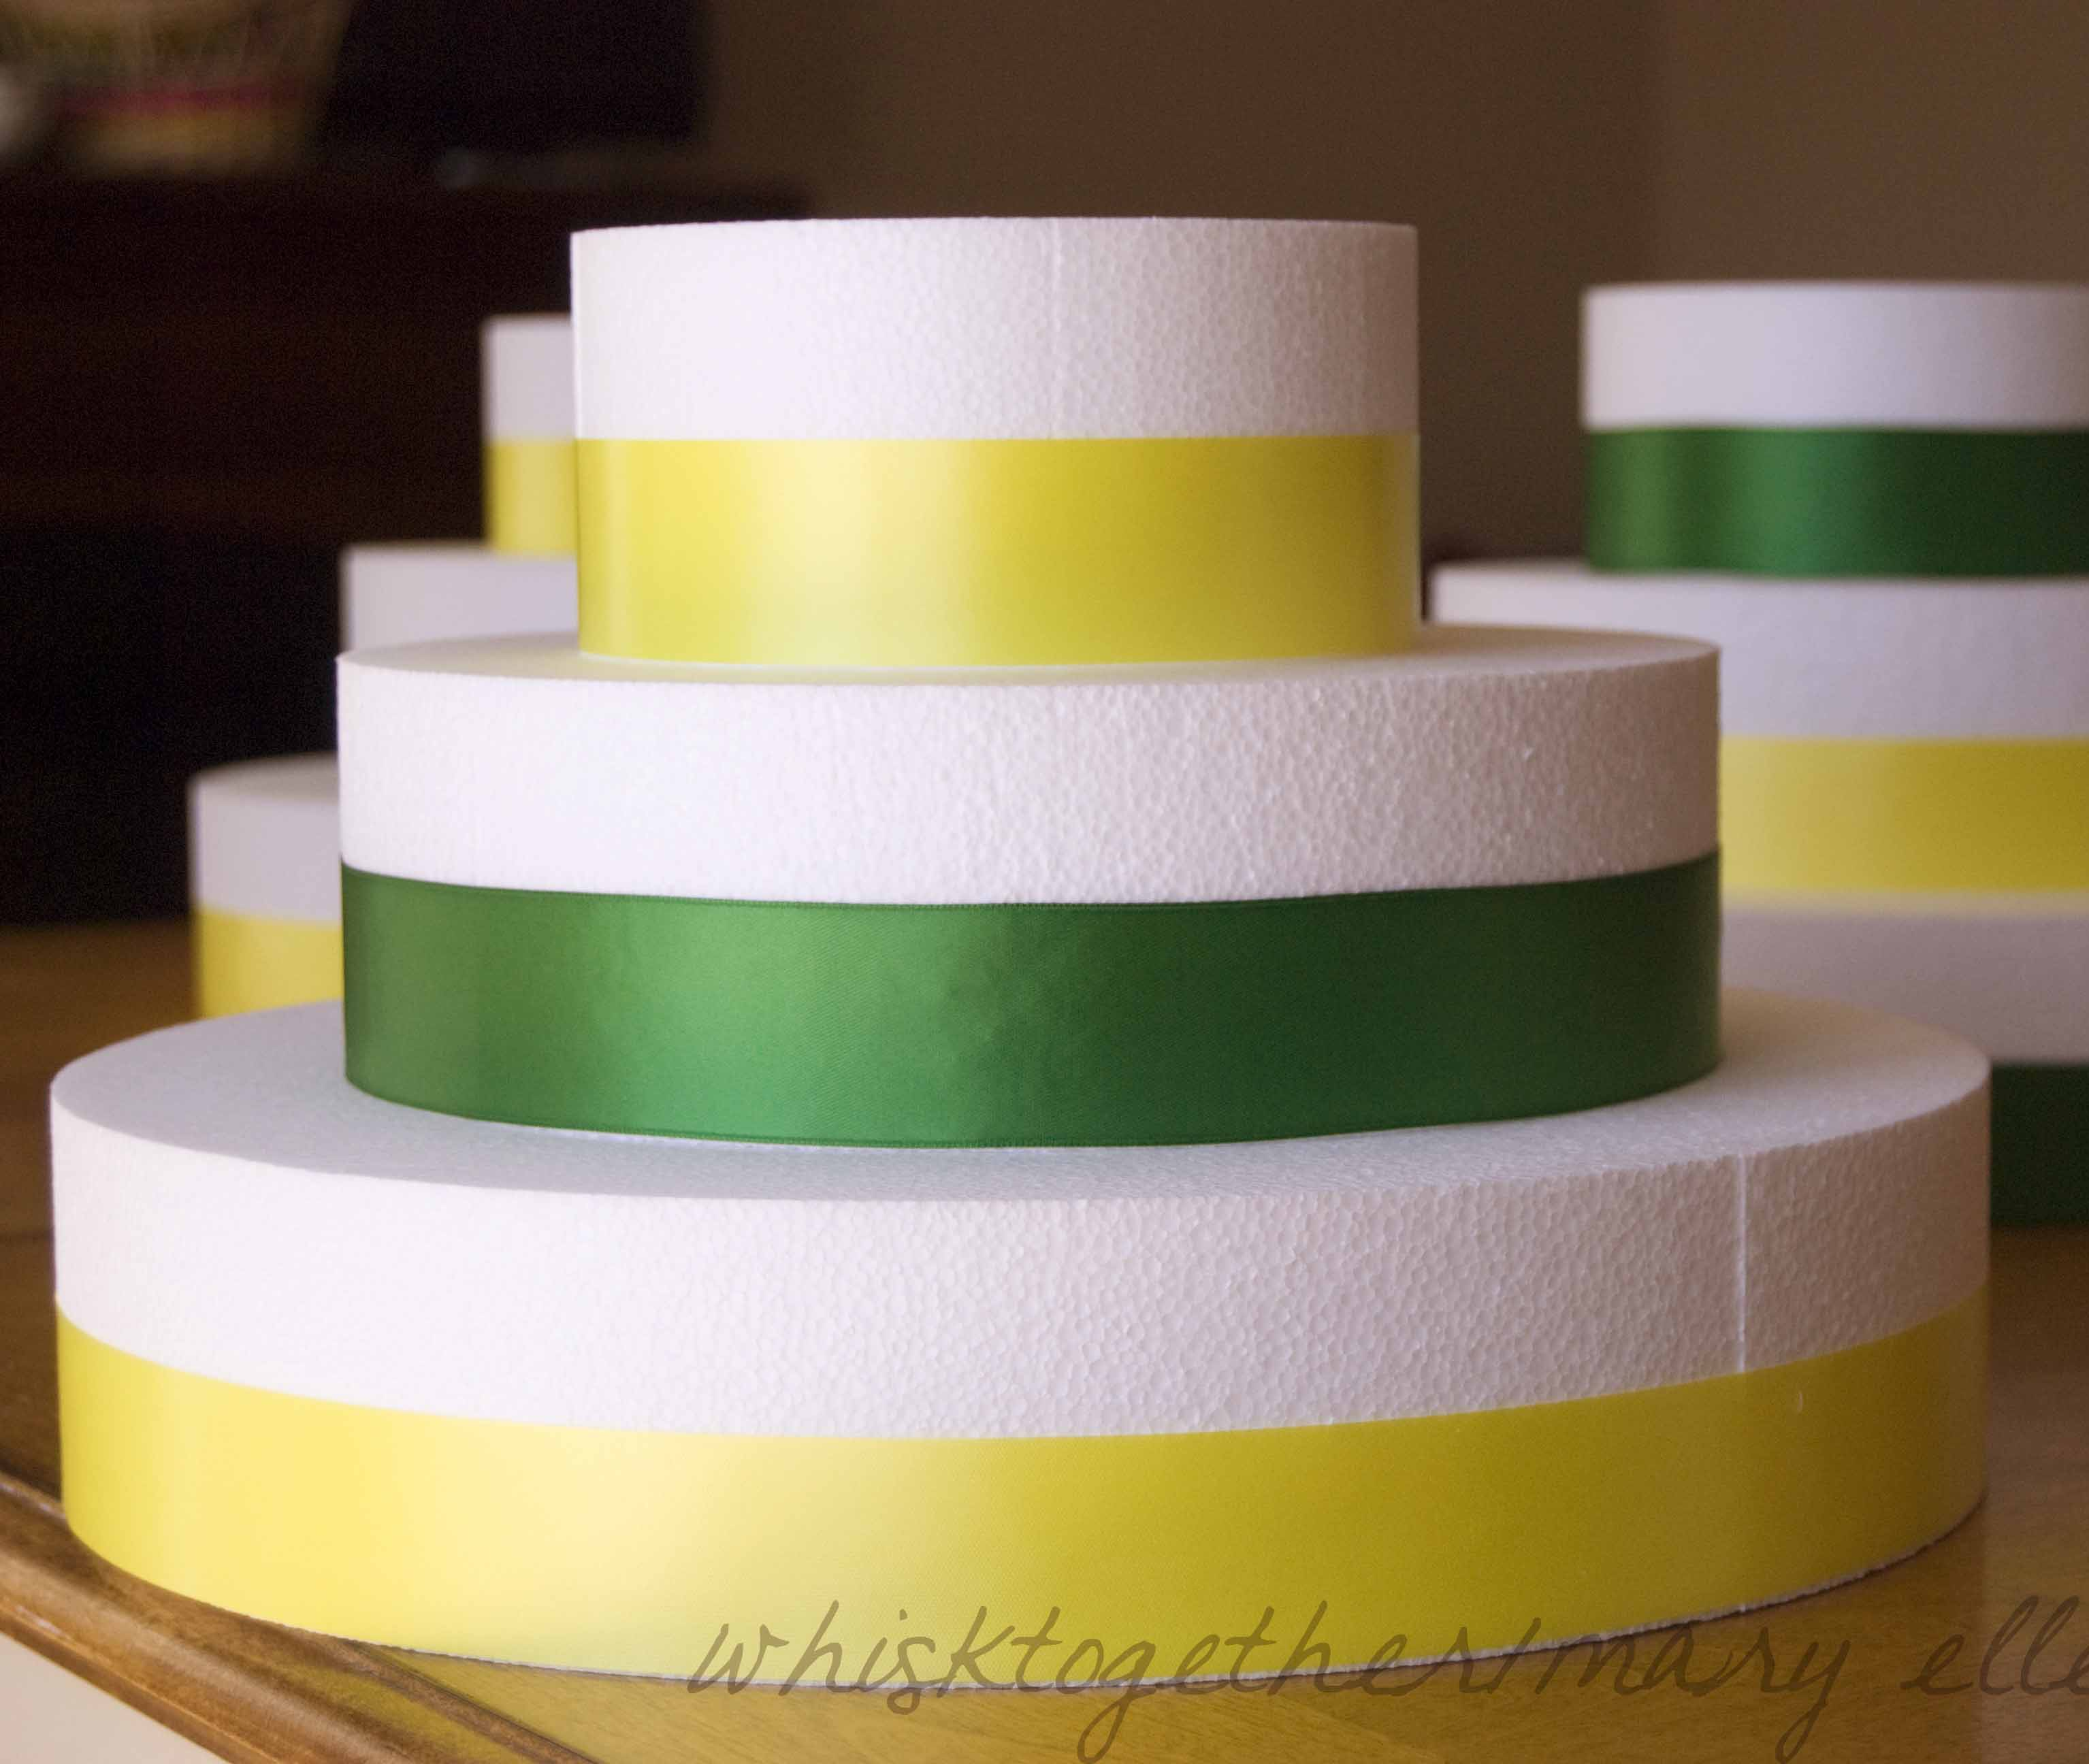
Product
MVP
Prototype
Notes:
What is the purpose of a prototype?
Iterate over multiple ideas quickly.

Slide 33
Prototyping a web app
Front end (View): Paper prototypes
Back end (Database): Data Model
“Middle end”: API, endpoints

Slide 34
Prototype to iterate over and refine ideas…so where do ideas come from?

Slide 35
tl;dr: Geniuses don’t have better ideas, they have more of them.
Creativity can be cultivated through practice.
Creativity style (innovative versus adaptive) doesn’t correlate with how many ideas people generate.
We are most creative when we turn off evaluations and restrictions.
Warning re: startup!
Alternate between exploring problems in depth versus laterally.
Accept bad ideas – “yes and” them – point out the good point of an idea if you can find one and mention how it could be improved with the and statement.
Guidelines:
Defer judgment
Generate as many options as possible (more is better)– ask what else
Seek novelty
Then, converge on the best ideas (spend about as much time on this as generating ideas)
Notes:
Get more specific about the problem or choose a level and come up with multiple ways to solve that level of the problem abstraction
Keep novelty alive late in the process
Ensure options meet the needs of the problem, stay focused on the problem
Convergent tools:
Hits – go through the list of options and mark the best ones, or those that could be best in specific context (limit marks to ten percent of the options). Be aware of groupthink!
Clustering –group the hits into clusters and label the theme of each group
Blue sky voting – separate the hit results into two groups: the easy to implement ideas, and the highly novel ideas that have a big payoff but may be difficult to achieve. Give about 70% to the easy to implement ideas and the rest to the highly novel ideas to keep the group from quickly removing the ideas that may just need to be thought about a little more.
The steps for creative problem solving
oClarify: Specify the problem, the different subsections of the problem, and possible alternative formulations of the problem (use things like the 5Ws and H, webbing, and storyboarding)
o Ideate: Diverge on possible ideas; generate a large number of possible options for the problem/problems (brainstorm, brainwriting, try to apply conflicting terms to your idea (strong/fragile), create a list of possible options for multiple categories and try to combine them, go through three pictures of nature with your problem while generating lists how the problem relates to nature, pick two different two and come up with as many ways as possible the terms are related. Try to pick a process or product used in another area for a relatively similar problem and come up with how to relate that process/technique to the problem, po statements – described earlier)
o Develop: Converge on the best idea/ideas; try to think through the most promising ideas and try to improve them (evaluation matrix, solution mapping)
o Implement: test the idea/ideas (how-how diagram, performance dashboard)

Slide 36
Activity: brainstorm snow plowing

