Slide 1
Pitch Decks
February 20, 2018

Slide 2
What is a pitch deck?
A brief presentation
10 to 12 slides
4 (really 5) to 10 minutes
A quick overview of your business plan
Usually during a meeting with potential investors, customers, partners, co-founders

Slide 3
Important points
The goal: Mitigate risk perception
Audience’s attention

Slide 4
12-slide Format
https://pitchdeck.improvepresentation.com/what-is-a-pitch-deck

Slide 5
1. Introduction
Who are you and why you're here?
Keep it short and sweet
Maybe just a logo and name of the company

Slide 6
2. Team
Show the people behind the idea and briefly describe their role
What the audience is looking for?
Experience
How well you work together
You are the best team
As cross-functional as possible

Slide 7
3. Problem
What problem are you trying to solve? Is it really a problem?
Explain as they are a customer
Convince them the problem exists

Slide 8
4. Advantages
What makes your solution special? How are you different from others?
Show that you’re better than X.

Slide 9
5. Solution
Describe how are you planning to solve the problem
Why are you the best solution?

Slide 10
6. Product
How does your product or service actually work?
Show some example

Slide 11
7. Traction
Traction means having a measurable set of customers that serves to prove a potential
Is this the right company to invest in?
Key Performance Indicator (KPI)
Focus on features that you already mentioned as your advantage

Slide 12
8. Market
Know, or at least attempt to predict, the size of your target market

Slide 13
9. Competition
What are the alternative solutions to the problem you are trying to solve
Show competitors with their differences
Show you understand the need of customer and going to take the market
If no competitor, use similar companies to show the market exists
Notes:
genius vs. no market

Slide 14
10. Business Model
How are you planning to make money? Show a schedule when you expect revenues to pour in
Keep in mind that you have to show you’re going to make money, now and in future

Slide 15
11. Investing
What is your planned budget? What kind of money are you looking for?
How are you going to spend the money?
Plan for 18 months up to 3 years
Keep KPIs in mind
Notes:
Never say 100k to finish

Slide 16
12. Contact
Leave your contact details and let people know how to reach you quickly
Only put 1 person’s contact

Slide 17
Pitch Deck Do’s

Slide 18

Tell a story & engage people emotionally
Everyone loves to hear stories, even the investors. So tell an exciting story about your startup

Slide 19

Limit each slide to expressing one idea
You want to keep your entire audience on the same page

Slide 20

Prepare to make a great first impression
First impressions are powerful. Believe it.
The first 2-3 minutes are the most important

Slide 21

Show the people behind your idea
Focus on a significant, relevant accomplishment for each person in a team that identifies that person as a winner

Slide 22

Keep a consistent look in presentation
Use the same font, size, color and capitalization format across all slides of your investment pitch deck

Slide 23

Know your metrics better than anyone
Traction speaks louder than words

Slide 24
Pitch Deck Dont’s

Slide 25

Don't use too many bullet Points
Limit the bullets. Too many bullet points will kill a presentation

Slide 26

Don't make it too long
Average entrepreneur pitch: 38 slides. Average VC attention span/cranial capacity: 10 slides. Do the math.

Slide 27
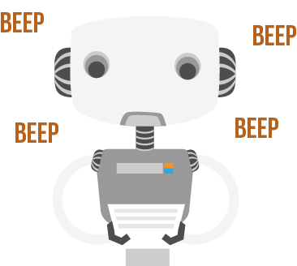
Don't read word by word from your script
You will sound like a robot and miss the all-important eye contact with the audience

Slide 28
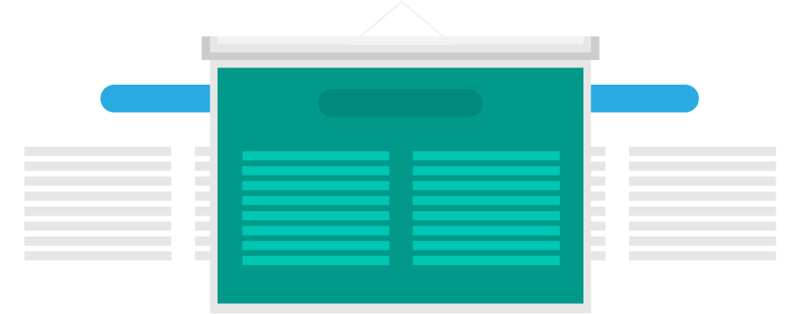
Don't create a text-rich, picture-poor presentation
People cannot read and listen at the same time. Great visual inspire and engage people emotionally

Slide 29

Don't Come unprepared
Try to anticipate the kinds of questions they might have and be prepared with answers

Slide 30

Don't use small fonts
Always use a font large enough to be seen by all audience members. Use 32- to 44-point for titles and no smaller than 28-point for the text or bulleted items

Slide 31

Example
https://www.slideshare.net/Bufferapp/buffer-seedrounddeck

