Slide 1

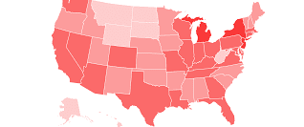
Impact of COVID-19 in US
Python Project by: MKFG
Contributors: Rudy Duvnjak, Joby Augustine, Karla Robles, Alex Lorin

Slide 2
Project Description: Analysis of the mortality rate due to covid-19 and to project the number of deaths while categorizing the data across US.

Slide 3
Data for analysis
CDC’s Covid-19 mortality data (https://data.cdc.gov/resource/9bhg-hcku)
API (https://data.cdc.gov/resource/9bhg-hcku.json?)
Development Tools used
Python
Dependencies used: pandas, numpy, matplotlib, stats, json, requests

Slide 4
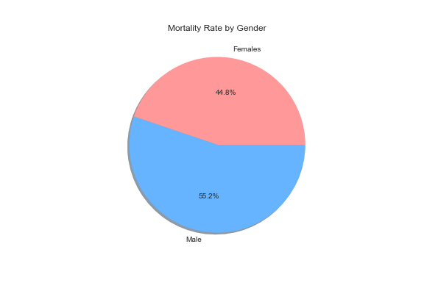
Pie chart for number of deaths by gender
 | covid_19_deaths | total_deaths
sex
Female | 313830 | 2535160
Male | 386773 | 2809640

Slide 5
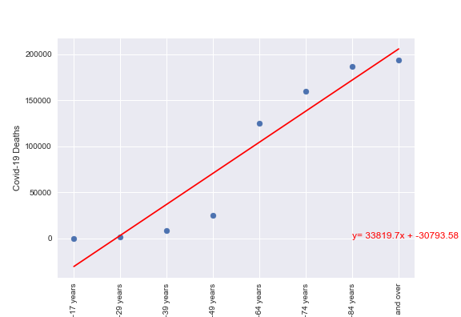
Scatter plot for Number of deaths by age group
 | age_group | sum
0 | 0-17 years | 0
1 | 18-29 years | 1673
2 | 30-39 years | 7921
3 | 40-49 years | 24726
4 | 50-64 years | 125340
5 | 65-74 years | 160076
6 | 75-84 years | 186964
7 | 85 years and over | 193903

Slide 6
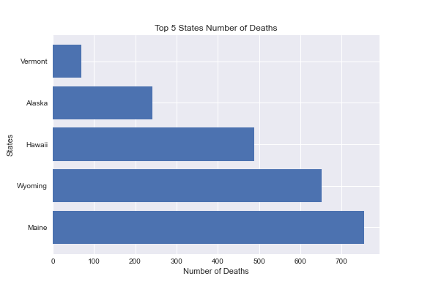
Horizontal bar graph for number of deaths by state
 | covid_19_deaths | total_deaths
state
Alabama | 14375 | 102035
Alaska | 242 | 3645
Arizona | 17973 | 126092
Arkansas | 7852 | 56184
California | 73272 | 553310

Slide 7
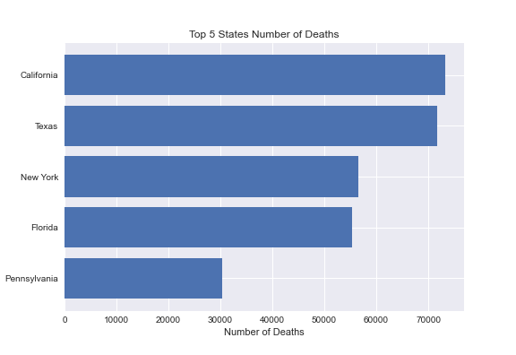
Top 5 states with highest Mortality rate

Slide 8
Mortality by State counts sorted in Ascending order

Slide 9
Data and Stacked bar graph for Number of deaths by Gender types for different age groups
 |  | covid_19_deaths | total_deaths
sex | age_group
Female | 0-17 years | 0 | 15804
 | 18-29 years | 589 | 13275
 | 30-39 years | 2657 | 23575
 | 40-49 years | 8367 | 54497
 | 50-64 years | 45992 | 339439
 | 65-74 years | 63572 | 464811
 | 75-84 years | 81811 | 641122
 | 85 years and over | 110842 | 982637
Male | 0-17 years | 0 | 22581
 | 18-29 years | 1084 | 35594
 | 30-39 years | 5264 | 56712
 | 40-49 years | 16359 | 111050
 | 50-64 years | 79348 | 580369
 | 65-74 years | 96504 | 663306
 | 75-84 years | 105153 | 712593
 | 85 years and over | 83061 | 627435

Slide 10
