Slide 1
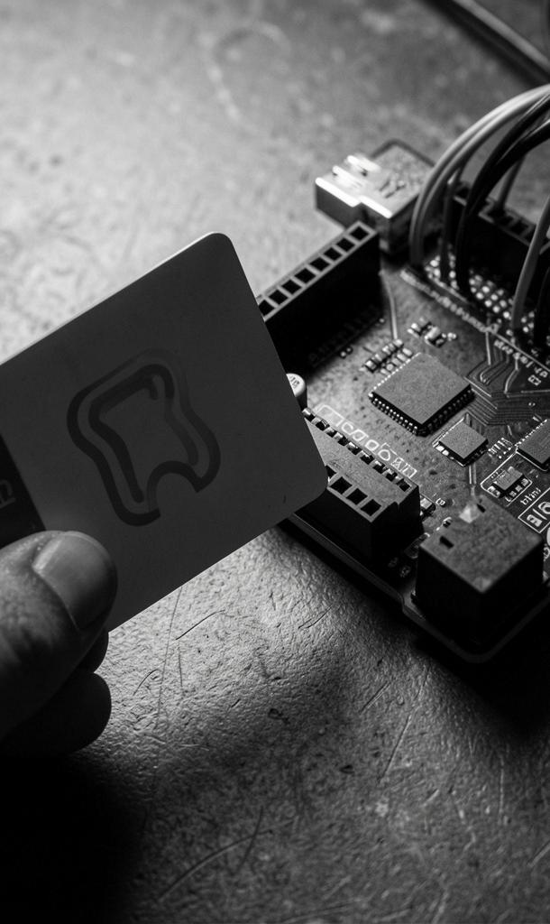
AttendX
Smart Attendance System using Arduino, RFID, Firebase & Flutter

Slide 2
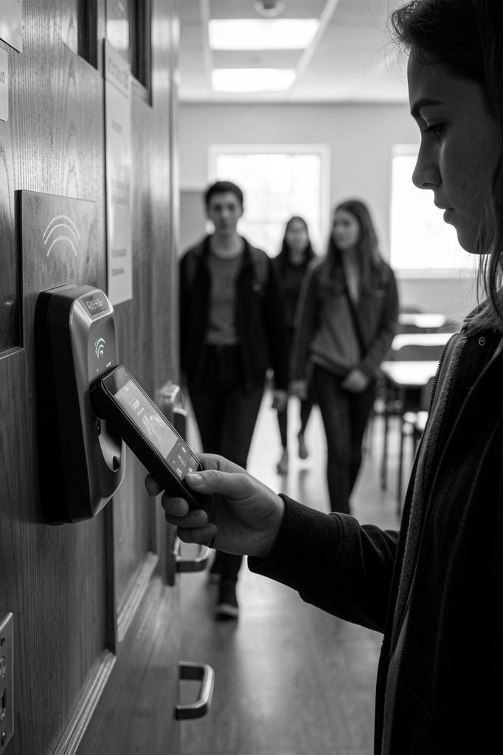
Introduction
AttendX is a professional, end-to-end solution to automate attendance using RFID hardware, cloud storage, and a mobile dashboard.
The system delivers real-time attendance capture and centralized management for colleges, improving accuracy and reducing administrative overhead.

Slide 3


01
System Overview

Slide 4

Problem Statement
Manual attendance is time-consuming and prone to errors.
Proxy marking and delayed record updates prevent real-time tracking and reliable analytics, increasing administrative workload and reducing accountability.

Slide 5
Objectives
Automate attendance capture using RFID cards and Arduino hardware.
Store and sync records to Firebase for instant access and analytics.
Provide a Flutter mobile app for dashboards, profiles, and reports, ensuring accuracy and speed.

Slide 6
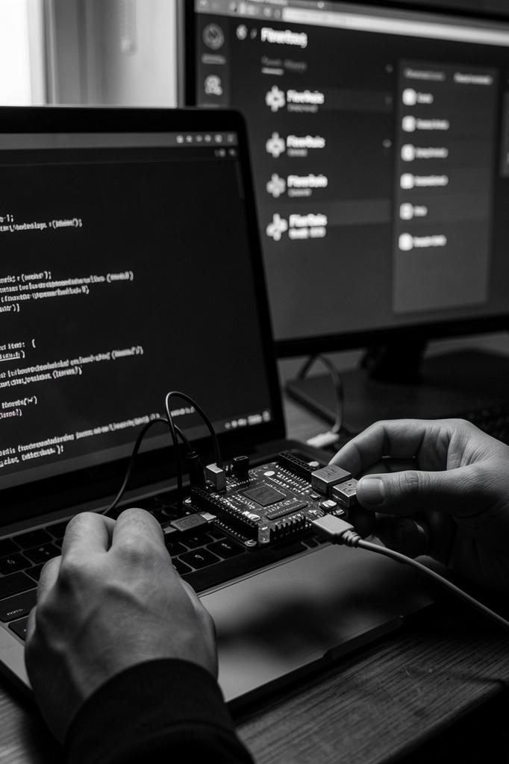
Architecture Flow
RFID → Arduino reads UID and sends via serial to a Python middleware.
Python validates and pushes records to Firebase Realtime Database, which syncs instantly with the Flutter app.
The Flutter app displays dashboards and updates attendance in real time for students and admins.

Slide 7
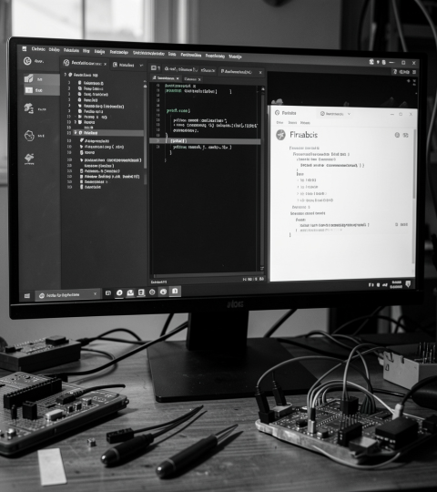
02
Implementation Details

Slide 8
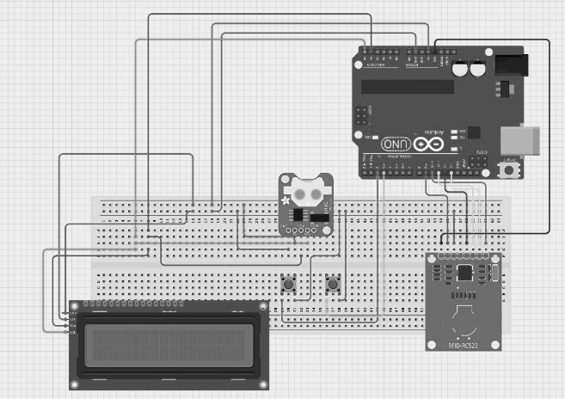
Hardware Components
Arduino Uno controls RFID reader and peripherals.
RFID RC522 reads card UIDs; LCD I2C provides user feedback.
Supporting items: push buttons, breadboard, wiring, and power supply for reliable prototyping.

Slide 9

Software Components
Arduino sketches manage UID capture and serial communication.
Python middleware handles serial parsing, validation, and Firebase API updates.
Flutter app provides UI; Firebase configured for realtime sync and authentication for secure access.

Slide 10
UI & Testing
Design screens: Login, Dashboard, Student Profile, and Attendance Graph.
Test flows: UID scan → database write → app update; validate duplicate prevention and date formatting.

Slide 11

Conclusions
AttendX automates attendance with RFID + Firebase + Flutter, delivering faster, accurate records and administrative efficiency.
The solution is scalable, provides real-time insights, and reduces manual errors, ready for further enhancements like face recognition and admin reports.

Slide 12
Thank you
Please keep this slide for attribution

