Slide 1
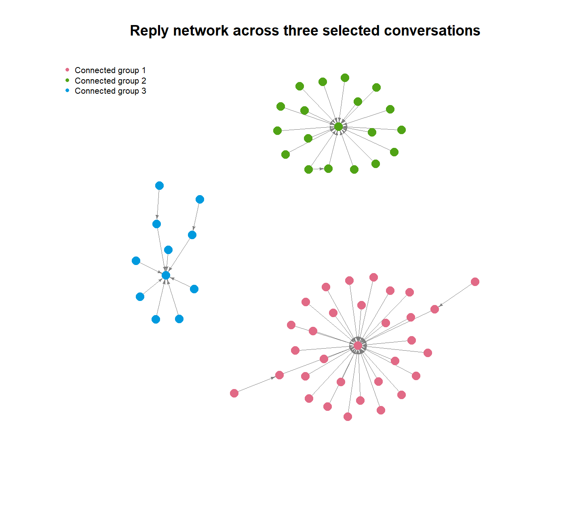
Remote work vs return to office
on Bluesky
Do posts from the two searches differ in sentiment, vocabulary and reply structure?
Group 25: Joshua William Kilpatrick (20146450) | Alexander Manalo (19385596) | Manraj Singh (22117527) COMP3020 Social Web Analytics
Research questions
Data and methods
Sentiment: How do sentiment categories compare between the return-to-office and remote-work search groups?
Vocabulary: What vocabulary characterises the English-labelled RTO and WFH search results?
Clusters: Do the English-labelled search results form distinct vocabulary clusters, and how are the two search groups distributed across them?
Network: How do accounts interact through replies around our three selected posts?
1,137
727
2
cleaned posts
English-labelled
searches
Data: Bluesky search via R (atrrr). “return to office” (RTO) and “remote work” (WFH), latest posts, 25 Aug to 29 Sep 2026.
Methods: Bing-lexicon sentiment with chi-squared test, word frequencies, TF-IDF with k-means, reply network (igraph).
KEY FINDING RTO-search posts were more negative than remote-work-search posts (52.0% vs 26.8% negative, p < .001). But the two searches retrieve different kinds of posts, so this does not show what people prefer.
1
Sentiment differs by search group
2
Different words stand out
Chi-squared test: X² = 36.39, df = 2, p < .001; Cramér’s V = 0.26 (small to moderate)
Search words were removed from the dictionary first. Left in, V = 0.46, because “work” scores as positive.
An association, not a cause.
RTO: policy 7.3%, mandates 6.7%, employees 5.4% of posts
WFH: job 9.3%, jobs 8.1%
Bars show % of posts containing the word (search words excluded).
3
No clear themes, mostly repeats
4
Replies centre on a few authors
Cluster | Posts | RTO / WFH | What it contains
1 | 642 | 327 / 315 | Mixed remainder
2 | 21 | 21 / 0 | Repeated political news
3 | 16 | 0 / 16 | Repeated appeals for help
4 | 11 | 0 / 11 | Remote-job referral adverts
5 | 10 | 10 / 0 | One auto-industry news story
62 accounts, 60 reply links, density 0.016
3 separate groups (32, 19 and 11 accounts)
Most replies go to the 3 authors of the selected posts (in-degree 29, 18 and 8)
642 of 700 posts (91.7%) fall in one mixed cluster. The four small clusters are repeated messages, each from one search group.
k = 5 was an exploratory choice; the elbow plot had no clear bend.
Replies show engagement, not agreement. Only 4 accounts had any betweenness (1 each), so there is little bridging.
Conclusions
Limitations
RTO-search posts were more negative, and the association is statistically significant (V = 0.26).
Part of the gap is content mix: policy and political news for RTO; job adverts, appeals and repeated messages for WFH.
Clusters were weak and replies centred on three authors. Results describe the posts returned, not worker preferences.
Exact-phrase searches of the latest posts; RTO covers 25 Aug to 29 Sep, WFH only 15 to 29 Sep.
Bluesky users are not representative; English filter uses language tags (345 posts had none).
Dictionary sentiment misses sarcasm; the network is three hand-picked threads, two reply levels deep.
Code and data: https://github.com/AlexanderManalo19385596/comp3020-bluesky-rto-wfh

