Slide 1
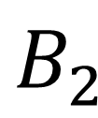



Control $∈\{$ Yes, No}
$$B_{1}$$
$$B_{3}$$
$$B_{2}$$
Target

