Slide 1






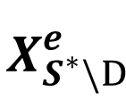


$$E$$
$$n^{e}$$
$$e$$
$$X_{S^{∗}\backslash D}^{e}$$
$$X_{S^{∗}\backslash D}^{e}$$
$$ε$$
$$X_{S^{∗}}^{e}$$
$$β^{e}$$
$$Y^{e}$$

