Slide 1
Predicting Treasury Yields
Using linear regression and decision trees to analyze US Treasury Yields

Slide 2
Background information
US treasuries = “I owe you”
Gov’t needs funding -> auctions -> raise money
14 regularly issued types of treasuries:
Bills: 4/13/26/52 weeks
Nominal Coupons: 2/3/5/7/10/30 years
Treasury Inflation Protected Securities: 5/10/30 years
Floating Rate Notes: 2 year

Slide 3
What is yield?
Return on investment in US gov’t debt
Expressed as %
Interest rate the US pays to borrow money
Investor’s outlook on the economy
Example:
High yield
Higher borrowing cost for the gov’t
Better return for investors
Better economic outlook

Slide 4
Questions
What factors do investors look at when determining yields?
Did the debt ceiling crisis spook investors?

Slide 5
Data
Federal Reserve, White House, and Treasury websites
Treasury yields (bills and nominal coupons)
Unemployment rate
CPI
Debt limit
Deficit
GDP
Amount of debt outstanding
Spreadsheets

Slide 6
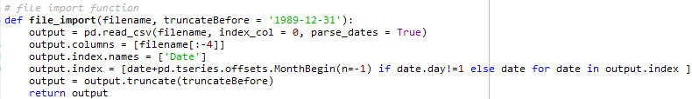
Data Pre-Processing
Convert Excel files to csv files
Header/data fix
Debt limit/CPI/GDP files required special fixes
Import function

Slide 7
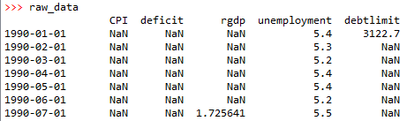
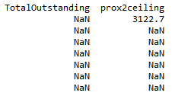
Data Pre-Processing Cont.
Form a dataframe: date index = monthly
Missing values: backfill, pad, interpolate
Calculate prox2ceiling
Time frame: 1990-09-01 to 2014-09-01

Slide 8
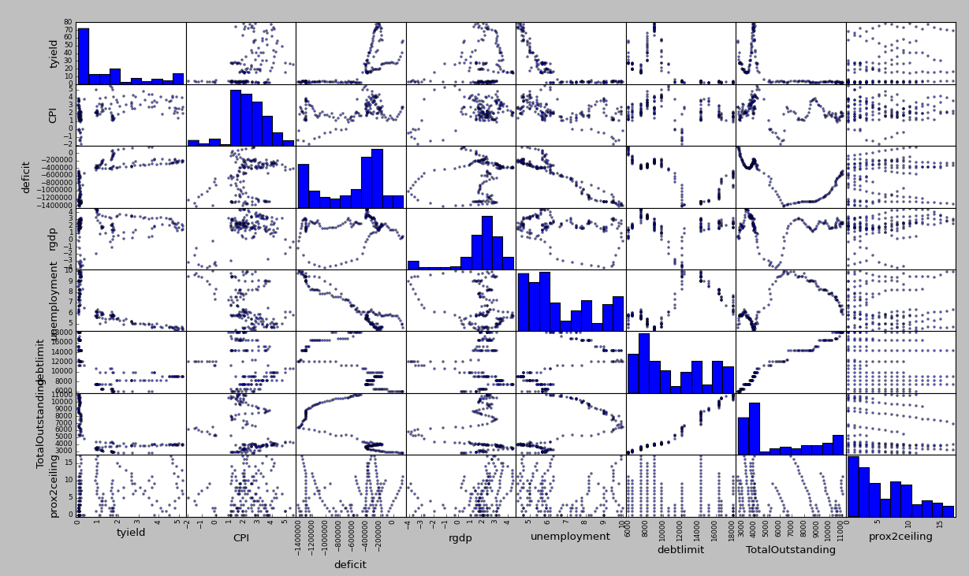
Initial Exploration

Slide 9
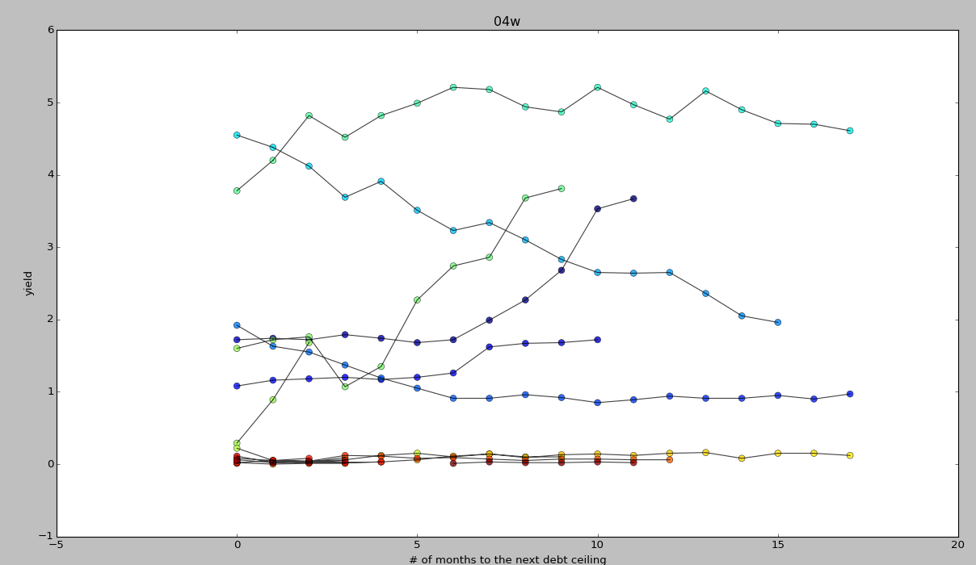
Initial Exploration Cont.
Hypothesis: closer to debt ceiling = more likely US will default = higher yield

Slide 10
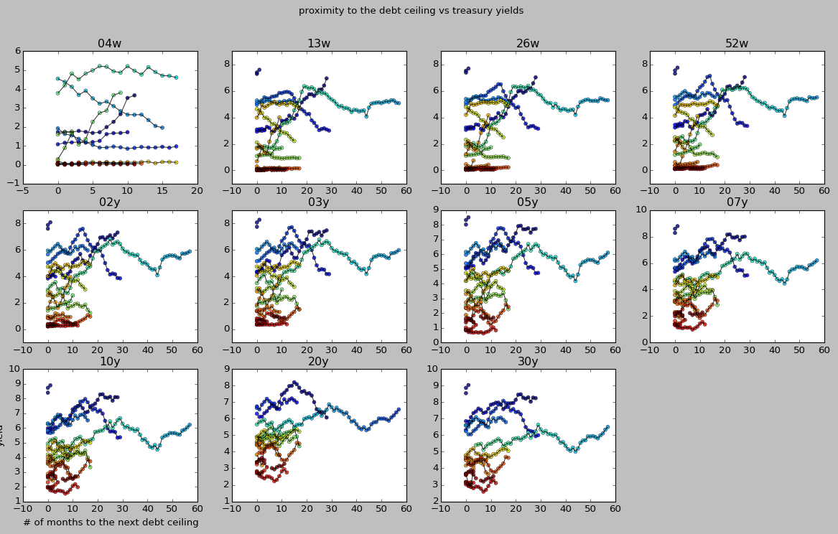

Slide 11
Modeling: Linear Regression
Continuous supervised – use statsmodels
est = smf.ols(formula='tyield ~ CPI + deficit + rgdp + unemployment + TotalOutstanding + prox2ceiling', data=full_data).fit()

Slide 12
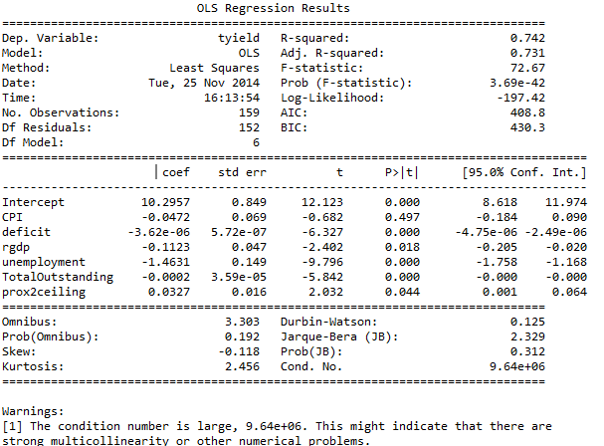
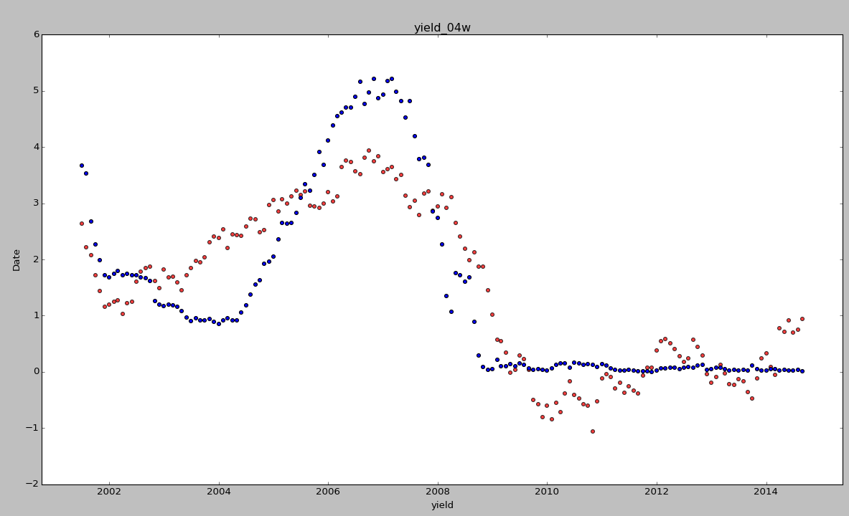

Slide 13
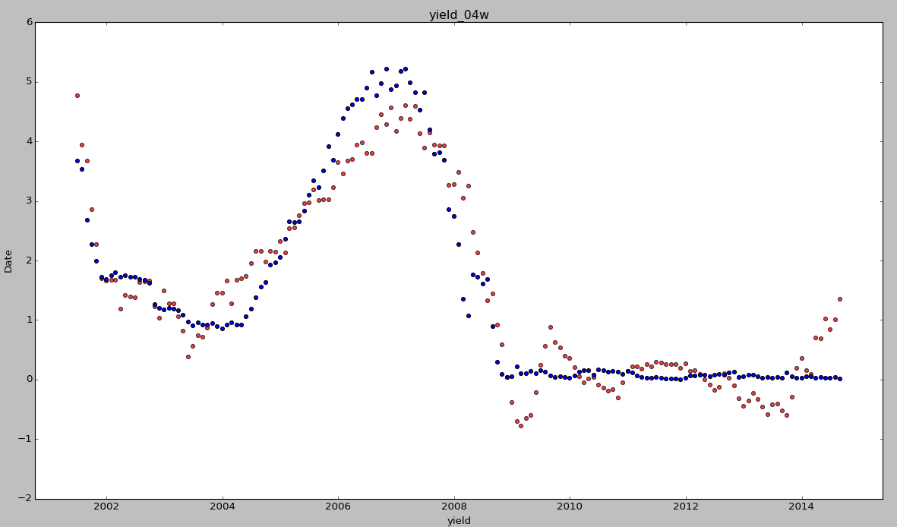
Trial and Error
est = smf.ols(formula='tyield ~ deficit:unemployment + deficit + rgdp + unemployment', data=full_data).fit()

Slide 14
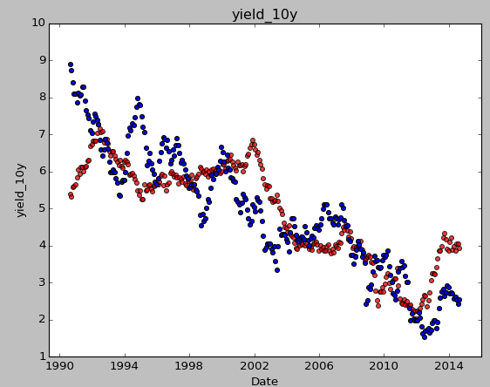
Bad results for 10-Year Yields
est = smf.ols(formula='tyield ~ deficit:unemployment + deficit + rgdp + unemployment', data=full_data).fit()

Slide 15
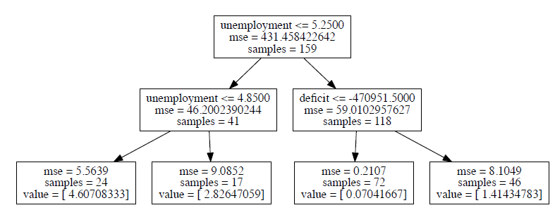
Modeling: Decision Tree
DecisionTreeRegressor, tree, grid_search
Max_depth = 2

Slide 16
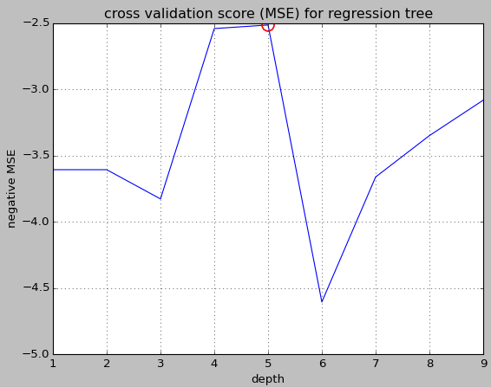
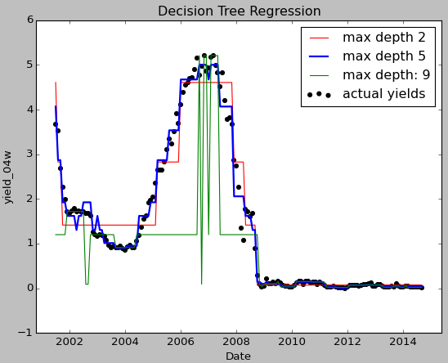
Find the best max_depth

Slide 17
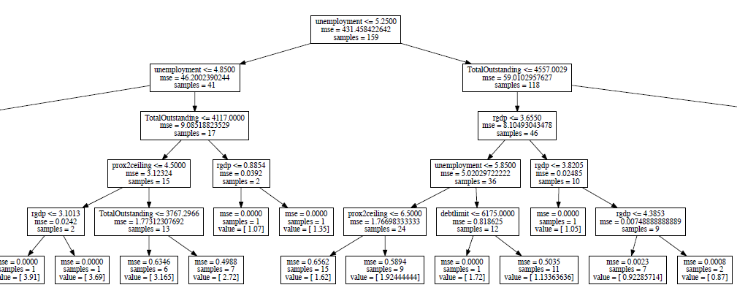
Important features: max_depth = 5
CPI | Deficit | Rgdp | Unemployment | Debtlimit | Outstanding | Prox2ceiling
4.31e-05 | 1.19e-01 | 7.16e-03 | 8.42e-01 | 6.53e-03 | 1.93e-02 | 5.67e-03
7 | 2 | 4 | 1 | 5 | 3 | 6

Slide 18
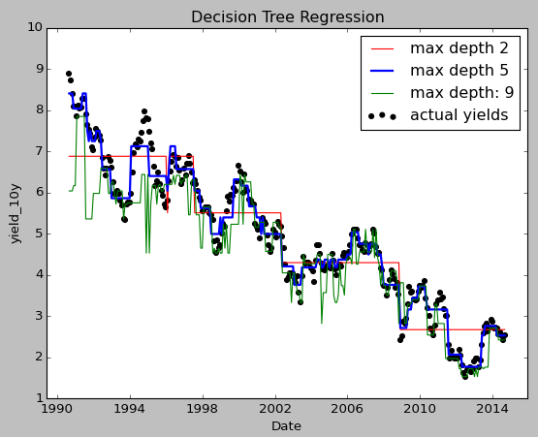
Repeat for 10-Year Yields
CPI | Deficit | Rgdp | Unemployment | Debtlimit | Outstanding | Prox2ceiling
0.00201 | 0.01666 | 0.01285 | 0.01870 | 0.78724 | 0.15852 | 0.00399
7 | 4 | 5 | 3 | 1 | 2 | 6

Slide 19
Conclusions
Debt ceiling threat = not too important
Factors investors consider when looking at yields: unemployment rate and debt outstanding
Deficit and debt limit may be important too depending on the maturity of the security

Slide 20
Possible Extensions
Produce a dataframe with a daily time series
Focus on 2008 and after (after the financial crash)
Factor in other explanatory variables such as the Dow Jones Industrial Average or the federal funds rate
Use more comprehensive linear regression models to tackle multicolinearity
Use k-means clustering to further examine the explanatory variables
Factor in “Time” as an explanatory variable – run time series models (Moving Average?)

Slide 21
Challenges and Successes
Successes
Data concatenation
Visualization
Decision tree modeling
Challenges
Multicolinearity problems
Factor in ‘time’ in the model
Explore more explanatory variables

Slide 22
Key Takeaways
Correlation does not necessarily mean causation!
Use machine learning algorithms to tackle problems
Cross validation
Data cleaning requires a lot of time
Use graphics
Open source materials available

