Slide 1
American Epilepsy Society Seizure Prediction Challenge
Chad Leonard

Slide 2
The Kaggle Competition
The Challenge Question: Is it possible to accurately predict when a subject with epilepsy is going to have a seizure?
Epileptic States: There are two epileptic states of interest for this competition – interictal and preictal
Interictal States: Defined as the state between seizures, or the baseline state.
Preictal States: Defined as the states prior to a seizure.
The Goal: To predict preictal states.

Slide 3
Null & Alternative Hypotheses
Null Hypothesis: It's not possible to accurately classify preictal brain states in dogs and humans.
Alternative Hypothesis: The preictal brain state in dogs and humans does exist and can be accurately classified with naturally occurring epilepsy.

Slide 4
The Raw Data
Raw Input Data
The data from Kaggle comes in Matlab .mat files.
Each file is either an interictal file or a preictal file.
The files cover 10 minutes worth of brain activity.
A measurement is taken every .002 seconds, or about 239,766 measurements in each 10 minute file.
The channels are the names of the electrodes placed on the subject’s body. They are also the predictor variables.
There are 239k measurements per channel.

Slide 5
Data Transformations
Absolute Value Difference:
A first attempt to transform the raw data tried to take the absolute value of differences between measurements, on a per channel basis, and find the channel’s mean and standard deviation.
This attempt was very time consuming and, ultimately, unsuccessful at determining a statistically significant difference between epileptic states.

Slide 6
Data Transformations Con’t.
Fast Fourier Transform (FFT):
What does the Fourier Transform do? Given a smoothie, it finds the recipe.
How? Run the smoothie through filters to extract each ingredient.
Why? Recipes are easier to analyze, compare, and modify than the smoothie itself.
How do we get the smoothie back? Blend the ingredients.

Slide 7
Data Transformations (FFT) Con’t.
Here's the "math English" version of previous definition:
The Fourier Transform takes a time-based pattern, measures every possible cycle, and returns the overall "cycle recipe" (the strength, offset, & rotation speed for every cycle that was found).

Slide 8
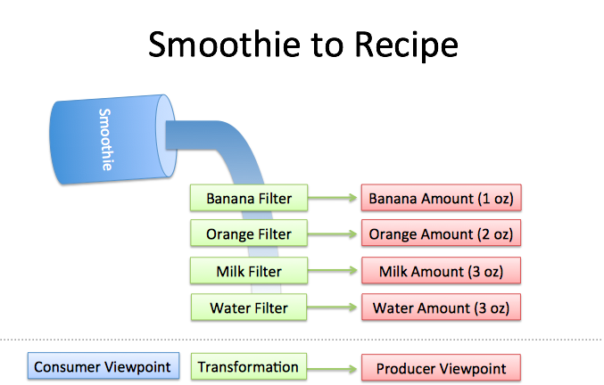
FFT Smoothie to Recipe

Slide 9
Filter Conditions
Filters must be independent. The banana filter needs to capture bananas, and nothing else. Adding more oranges should never affect the banana reading.
Filters must be complete. We won't get the real recipe if we leave out a filter ("There were mangoes too!"). Our collection of filters must catch every last ingredient.
Ingredients must be combine-able. Smoothies can be separated and re-combined without issue (A cookie? Not so much. Who wants crumbs?). The ingredients, when separated and combined in any order, must make the same result.

Slide 10
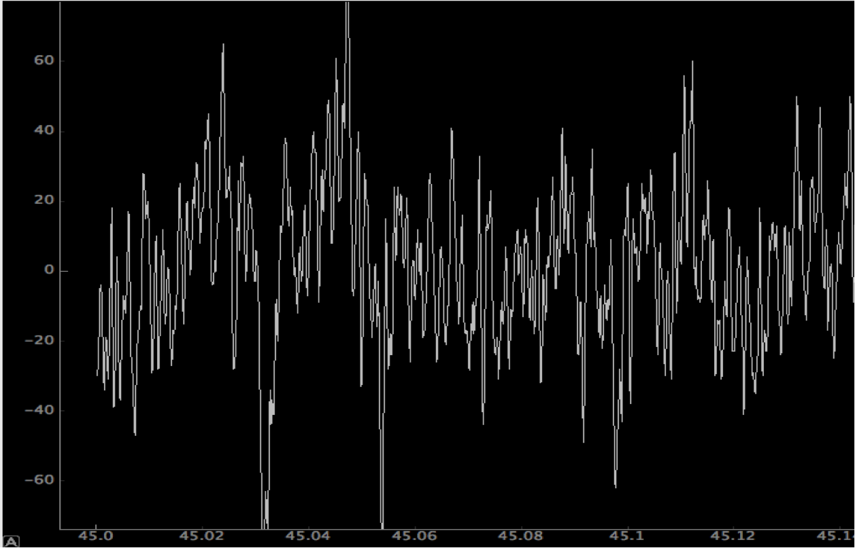
Plot of Raw Data–Channel One

Slide 11
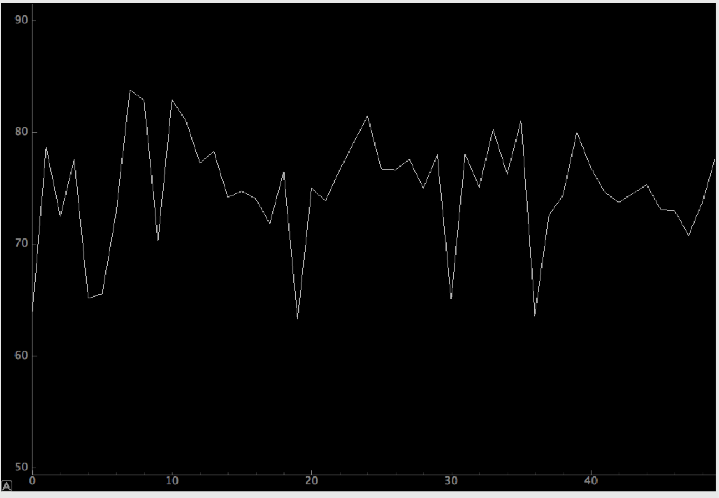
Plot of FFT Data – Channel One

Slide 12
The Methodology
Read Data:
Read Matlab files into DataFrame
Transform Data:
FFT as described above
Each file condensed down to a single record
“ictal_ind” binary variable created with a value of 1 for a preictal file else 0
Subset of the transformed data is used. Of the 239k record only 7200 used.
Those 7200 time intervals are divided into 24 segments of 300 time intervals each per channel.
The 24 segment are then averaged.
Feature Selection:
Logit
Choosing channels with p-values >=.05
Random Forest
Trial and Error from the list created from the Logit Regression logic above.

Slide 13
The Methodology Con’t.
Machine Learning Algorithms:
Logistic Regression
Initially used for prediction but proved unstable
Eventually it was just used for feature selection only
Random Forest
Used sklearn.ensemble’s RandomForestClassifier

Slide 14
Random Forest Code Snippet
Random Forest:
Used sklearn.grid_search’s GridSearchCV to experiment with various numbers of trees
Chose the number of trees that produced the best ROC AUC Curve score on a 5 fold Cross Validation of train/test data
After the number of trees was determined, used train_test_split to divide the data into test and training datasets and ran the models.
This was the model that the Kaggle predictions were based on.

Slide 15
Test Results
Subject | Number of Trees | Random State | ROC AUC Curve
Dog_1 | 60 | 1 | 0.82202
Dog_2 | 30 | 1 | 0.92927
Dog_3 | 50 | 1 | 0.87484
Dog_4 | 40 | 1 | 0.86558
Dog_5 | 30 | 1 | 0.98432
Patient_1 | 40 | 1 | 1.00000
Patient_2 | 40 | 1 | 0.88461

Slide 16
Conclusion
The winning ROC AUC score was circa .84.
My ROC AUC score for the Kaggle competition was only .54.
The ROC AUC values that were recorded for each subject using data from the train/test split were much better.
Not sure what the cause of the discrepancy between my scores on my test data versus my score on the Kaggle’s test data. Possibly too much overfitting or Kaggle’s test data is not representative of their training data.

Slide 17
Lessons Learned
Try to avoid transformations that are not fully understood, i.e. FFT.
Get something modeled early.
If in a Kaggle competition, try and make many submissions and use results as feedback.
Have a better plan for Cross Validation and testing. Incorporate feedback from submissions into testing.

