Slide 1
Epilepsy Seizure Prediction
Chad Leonard

Slide 2
The Kaggle Competition
If it is possible to predict when a patient is about to have an epileptic seizure, then patients with epilepsy have the potential to live lives more similar to people without epilepsy.
For this to be feasible, learning algorithms must be able to reliably identify periods of increased probability of seizure occurrence. If these seizure-permissive brain states can be identified, devices designed to warn patients of impending seizures would be possible. Patients could avoid potentially dangerous activities like driving or swimming, and medications could be administered only when needed to prevent impending seizures, reducing overall side effects.
The primary challenge in seizure forecasting is differentiating between the preictal and interictal states. Interictal are states defined as between seizures, or baseline. Preictal states are defined as states prior to seizure.

Slide 3
Hypotheses
Null Hypothesis: It's not possible to accurately classify preictal brain states in dogs and humans.
Alternative Hypothesis: The preictal brain state in dogs and humans does exist and can be accurately classified with naturally occurring epilepsy.

Slide 4
The Data
Raw Input Data
Each file is either an interictal file or a preictal file.
The channels are the names of the electrodes placed on the patient’s body. They are also the predictor variables.
Tranformations
An “ictal_ind” will be created for each record that will tell what file it came from . 0 if it came from an interictal file. 1 if it came from a preictal file.
Fast Fourier Transformation
Plots

Slide 5
Fast Fourier Transformation
TBD

Slide 6
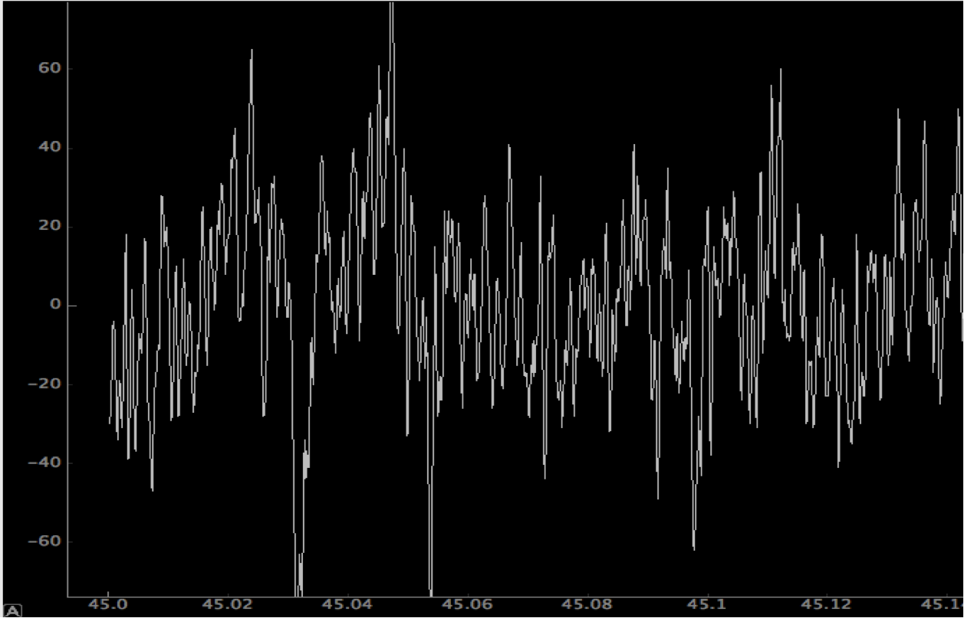
Raw Plot of Data – Channel One

Slide 7
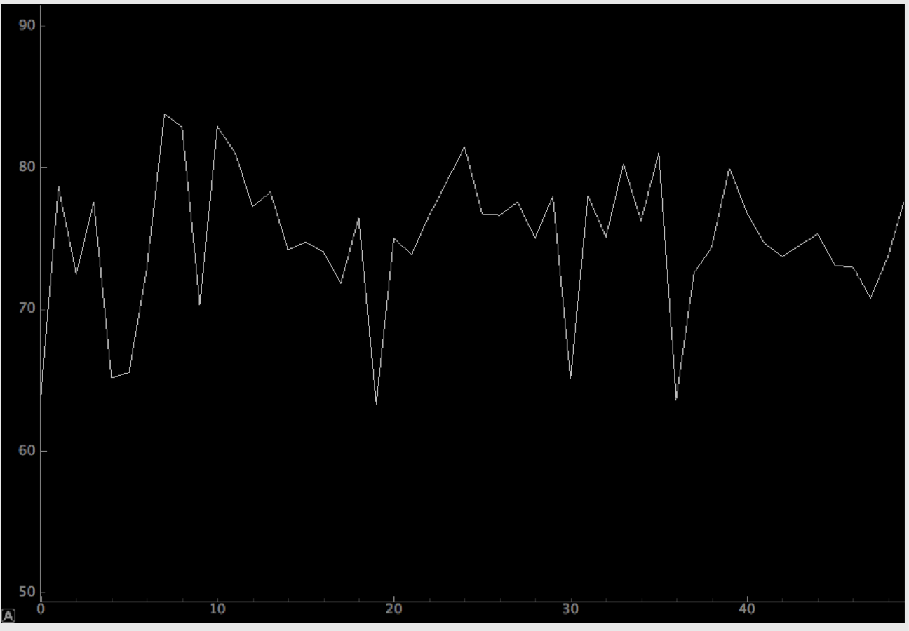
FFT Plot of Data – Channel One

Slide 8
The Methodology
Machine Learning Algorithms
Logit
Random Forest
Feature Selection
Logit
Choosing channels with p-values >=.05
Random Forest
TBD

Slide 9
The Methodology Con’t.
Cross Validation
Scikit-learn’s crossval methods don’t seem appropriate for the type of data used here.
Created code to create crossval directories and randomly place interictal and preictal files into them to be processed.
The ratio of interictal to preictal files, for Dog_1, is about 20 to 1.
Will start out using that ratio but keep decreasing the ratio until low p-values are reached for feature selection.

Slide 10
Machine Learning Algorithm Logistic Regression Classifier
The transformed data with the new ‘ictal_ind’ field is fed to a logit function:
ictal_ind is the response variable and the channels are the predictor variables.
The formula:
ictal_ind ~ channel_one * x₁ + channel_two * x₂ … + channel_N * x_{n}

Slide 11
Machine Learning Algorithm Random Forest
TBD

Slide 12
Results
TBD

Slide 13
Conclusion
TBD

