Slide 1
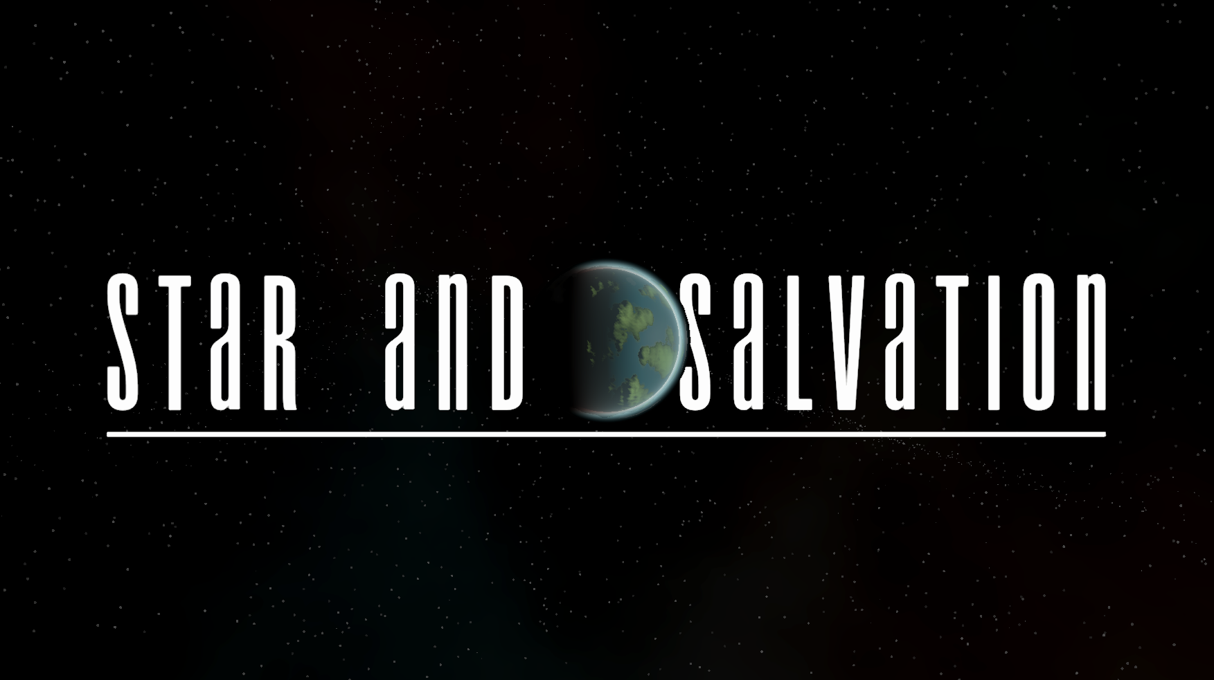
Alexander John Noles (267533)

Slide 2
Simulation and Narrative
My project aimed to explore how simulated systems could create emergent narratives through gameplay.
As an example, combinations of Battle, Territory Transfer, Relationship and Target Decision systems can create a war narrative.

Slide 3
The Result
To achieve this end, I produced something similar to a role-playing game.
My main sources of inspiration involved a mix of standard RPGs (e.g., Disco Elysium) and narrative focused RTS games (e.g., Stellaris).
During the later stages of the project, I drew additional inspiration from the game “Kenshi”.

Slide 4
The Result
The result resembles a mix of the different inspirations but drawing more from Stellaris than anything else.
The project is limited by being a vertical slice, or in a more general sense the production timescale.
I feel it still accurately demonstrates what the final game could look like.

Slide 5
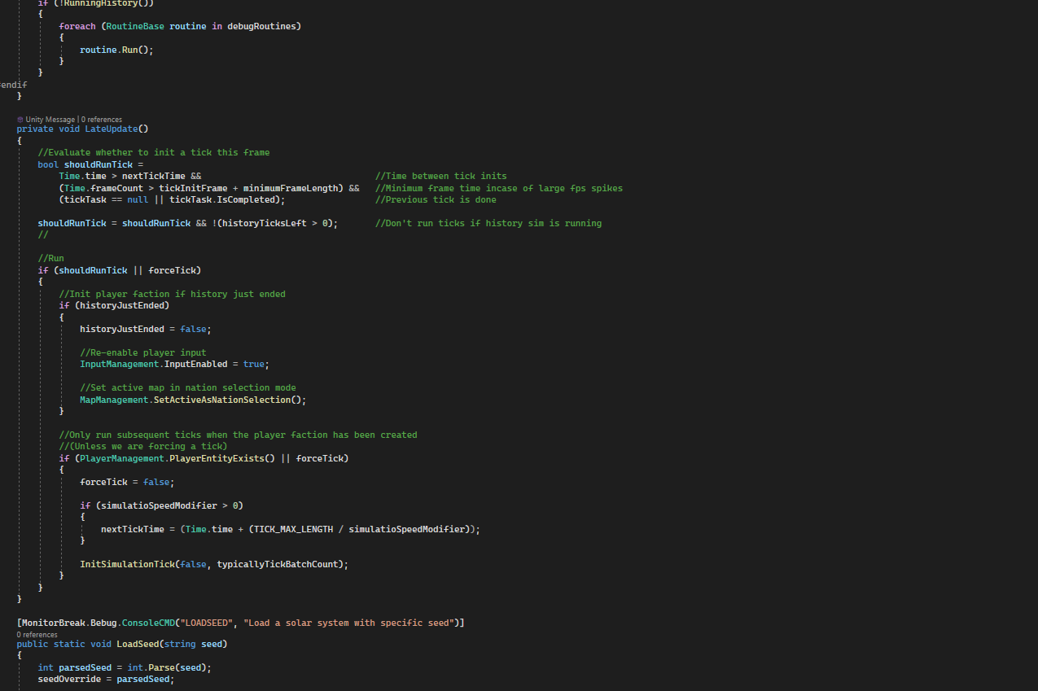
Design And Implementation

Slide 6
General Coding Patterns
My code has a focus on modularity and a “Define as Needed” pattern. Both are efforts to reduce future work.
“Define as Needed” presumes default implementations that should work for most cases. There must be some assumption of intended functionality.
Modularity is particularly important for the Simulation, separating parts of its functionality into distinct systems.

Slide 7
Data Driven Simulation
The focus of my Simulation code is on Data Modules, individual section of data.
A given entity within the Simulation can have any number of Data Modules.
Simulation code acts on the Data Modules directly. This makes it easy to modify and create new entities.

Slide 8
Data Driven Simulation
The approach comes with a few major limitations.
Ultimately inheritance can allow the code to work for slightly more generalized cases (e.g., the Target Acquisition systems).
Code that acts on Data Modules needs to assume a type, not just Data Module. This leads to a large amount of casting, a minor but important performance concern.

Slide 9
Simulation Tick Structure
Simulation updates generally happen on intervals (called ticks) that happen every 3 seconds.
In general, Simulation performance concerns are massively exacerbated by history generation.
This involves running a large quantity of ticks, a standard length of 250 years means 108,000 ticks.
All Simulation ticks are run on a separate thread, in the case of multiple being run at once, they are batched into one task.

Slide 10
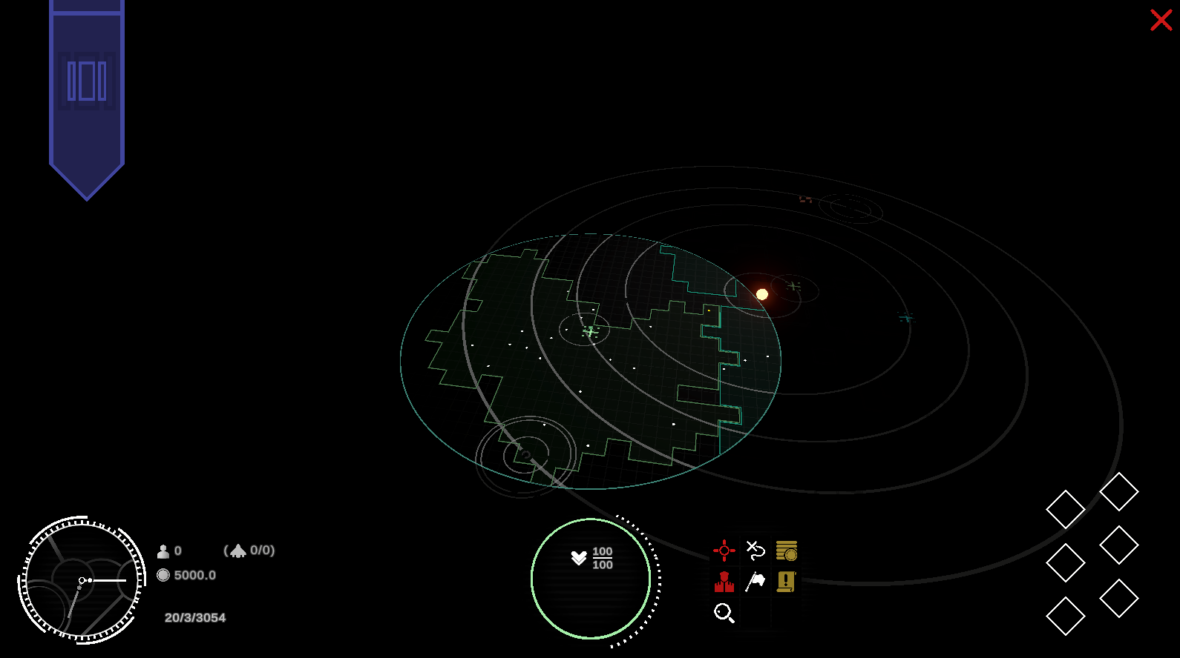
Simulation Visualisation
Each frame the Drawing system, looks through Simulation Data to find nearby locations. Data that wants to be found needs to be spatially stored.
The fundamental base class of all Simulation Objects has draw methods that can be defined as needed. This allows objects to be culled and drawn with relative ease.
The map (and in general UI elements) also acts as a key method to visualize Simulation Data, primarily Territory Data.
The map with the player’s view range shown.

Slide 11
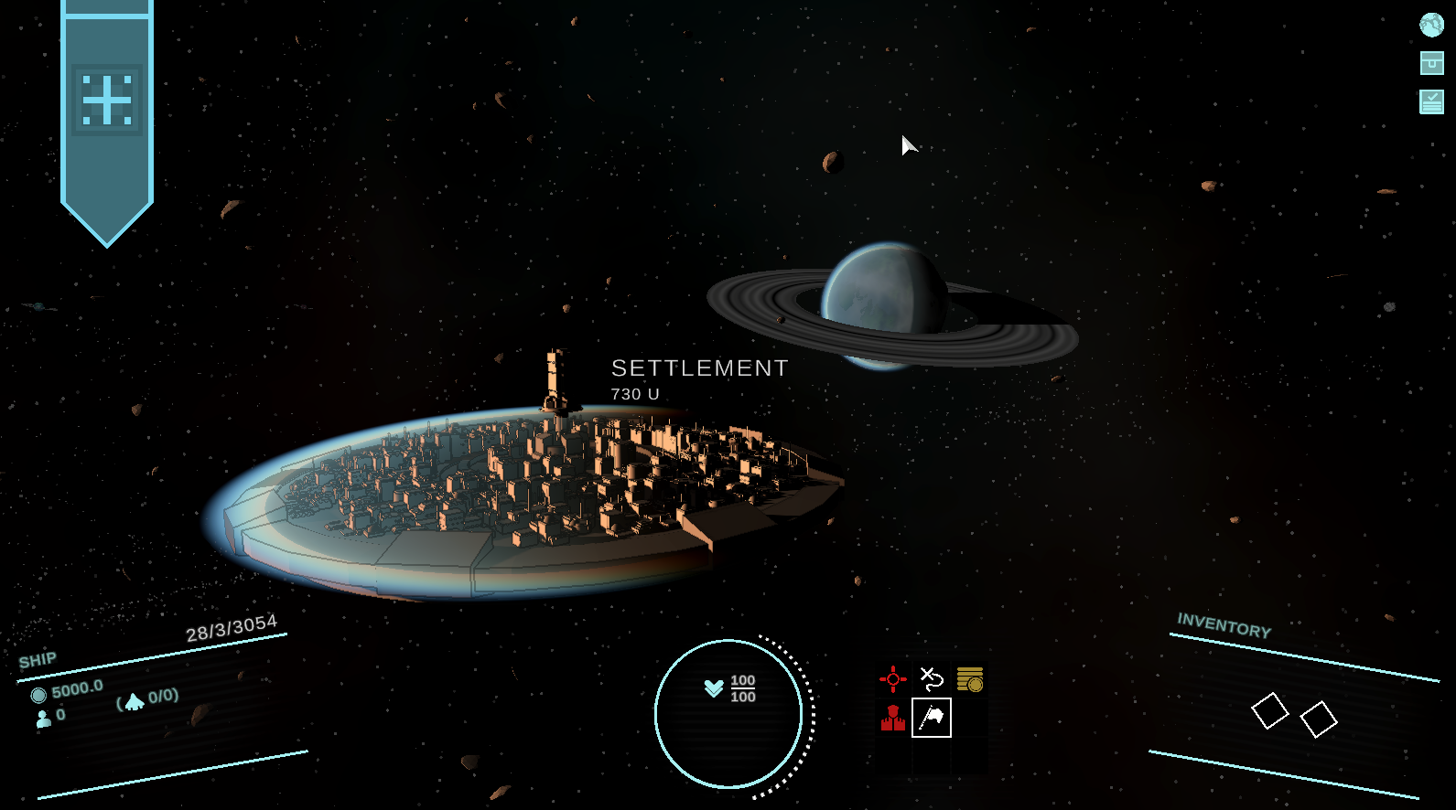
General Visual Design
Immersion is vital to selling the core idea, the world needs to feel real for the player to feel they are having an impact.
There is a focus on larger visual elements that always occupy some visual space (e.g., celestial bodies, the player ship). To achieve their look, I used a large amount of raymarching.
A Settlement and Planet

Slide 12
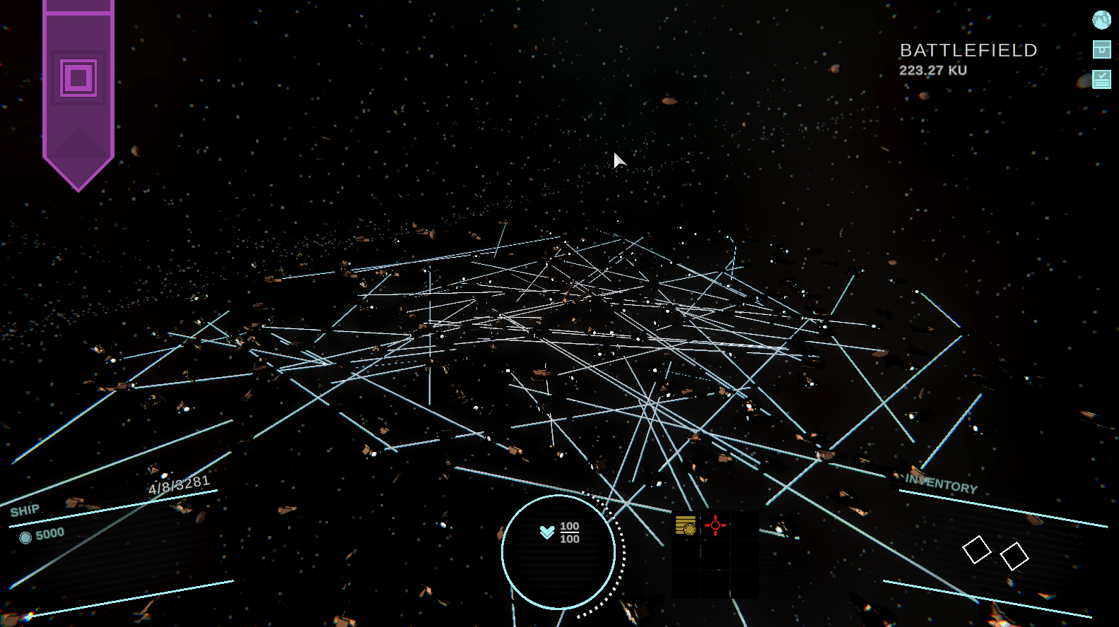
Simulation and Gameplay
Gameplay patterns informed and generated by the Simulation are a key component of my project. These patterns need to recognizable and understandable.
Attacking Settlements is a key case study of a gameplay generated pattern working in tandem with basic gameplay structures (in this case the player battle structure).
An early battle stress test, Settlements battles can reach similar numbers of ships

Slide 13
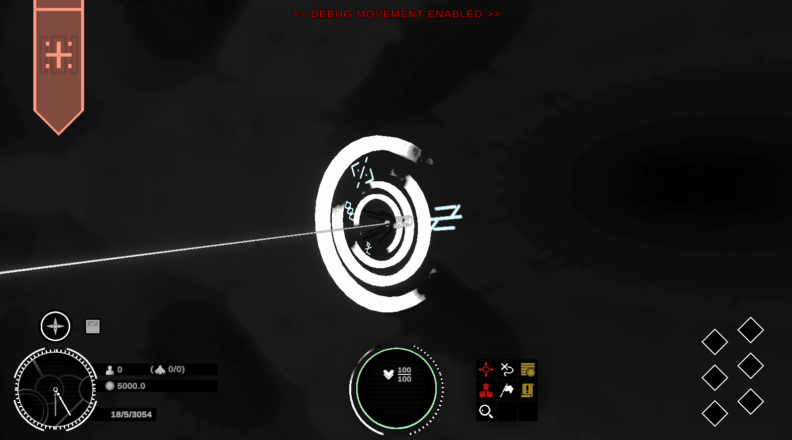
Simulation and Gameplay
Locations are defined places in the game’s world and are created by Simulation Entities.
They are another important aspect of gameplay, acting as a pacing mechanism. Travel between locations serves a similar purpose to loading screens in other games.
Travel itself could be a major point of improvement for the game in my opinion. It is such an important aspect of the game but holds little gameplay value.
The player ship in fast travel.

Slide 14
Additional Gameplay
Some other gameplay elements don’t include direct interaction with the Simulation necessarily. This includes most forms of player progression, which takes two major forms, Items and Statistics.
There are additional sources of soft progression, for example, Player relationships with factions.
In general, player progression tends to affect moment to moment gameplay over having a sweeping Simulation impact. This in part reinforces the player’s place in a larger world.

