Slide 1

Measuring classification models’ performance
Artificial Intelligence
Alexander, Dennis, Hélène

Slide 2
Objectives
Understand the effect of sample size on models performance
Understand the effect of the choice of attributes on models performance
Compare this difference between KNN, LDA and Logistic regression
Understand the importance of data Standardization

Slide 3
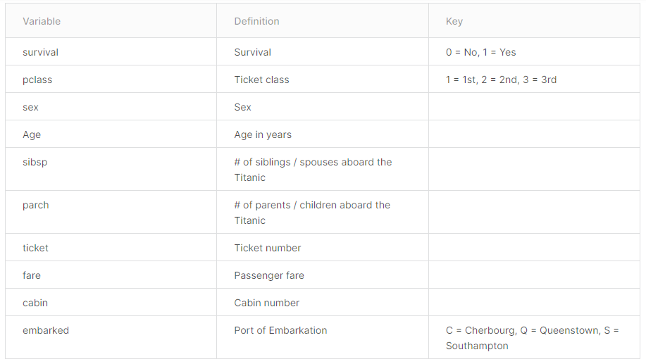
The data
Train.csv file from the Titanic Kaggle competition (891 rows)
After data cleaning and feature engineering, we have 13 attributes: ["Pclass_1","Pclass_2","Pclass_3","SibSp","Parch","Fare","Sexcode","FareCat","FamilyCount","AgeCat","Embarked_C","Embarked_Q","Embarked_S"]

Slide 4
How Accuracy was calculated?
Train
Sample
CV split
Test (actually, validation)
Accuracy calculated here

Slide 5
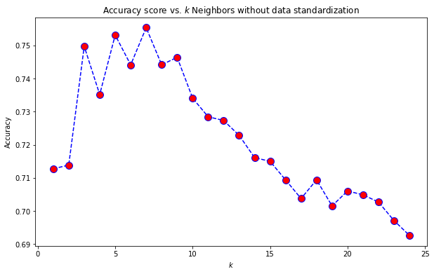
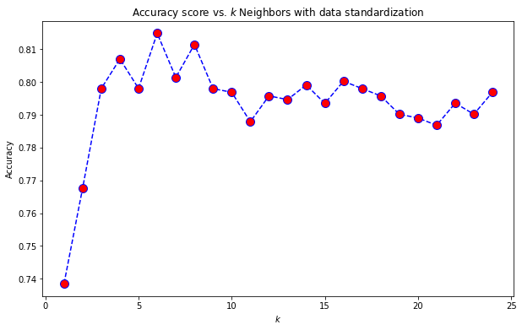
Accuracy for KNN classifier with and without standardization
Mean: 0.722
Standard deviation: 0.019
Mean: 0.793
Standard deviation: 0.014

Slide 6
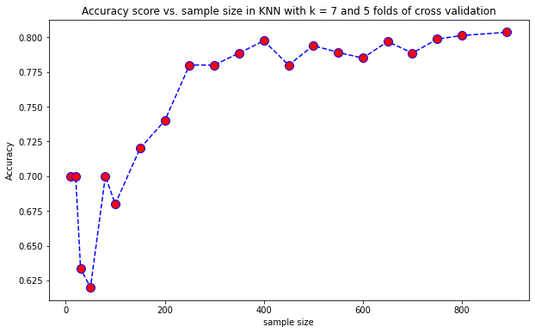
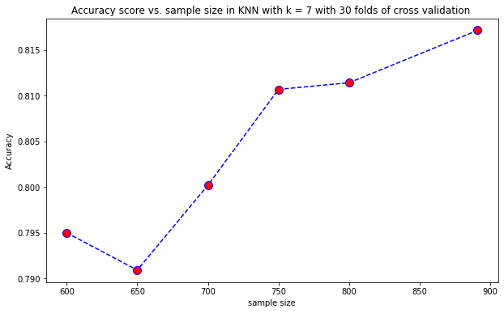
Accuracy for KNN Classifier with different sample size
Mean: 0.754
Standard deviation: 0.062
Mean: 0.804
Standard deviation: 0.009

Slide 7
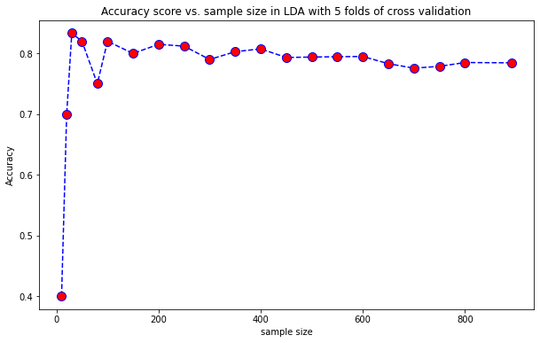
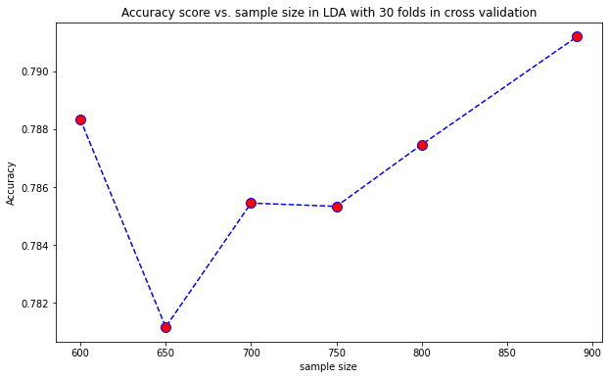
Accuracy for Linear Discriminant Analysis
Mean: 0.773
Standard deviation: 0.088
Mean: 0.786
Standard deviation: 0.003

Slide 8
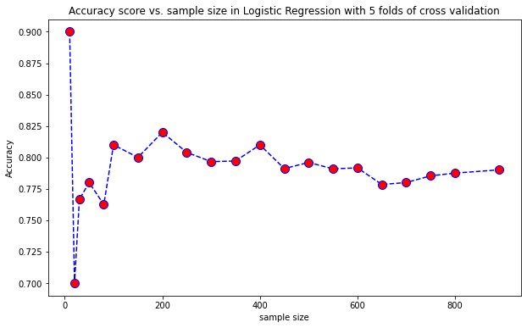
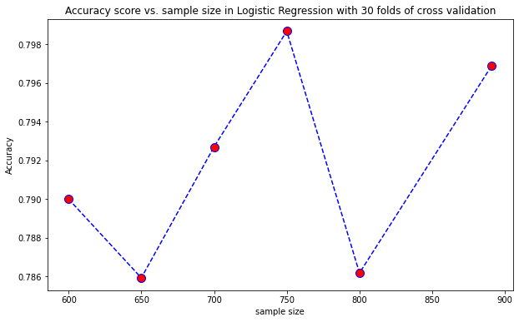
Accuracy for Logistic Regression
Mean: 0.792
Standard deviation: 0.034
Mean: 0.792
Standard deviation: 0.005

Slide 9
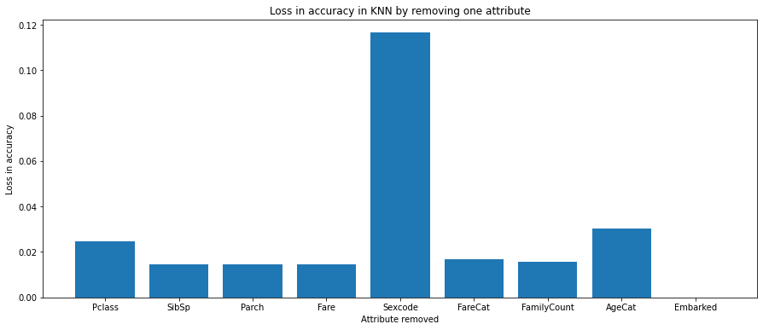
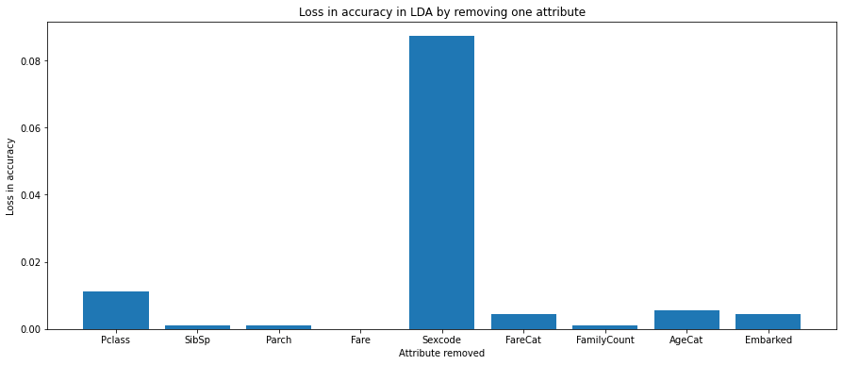
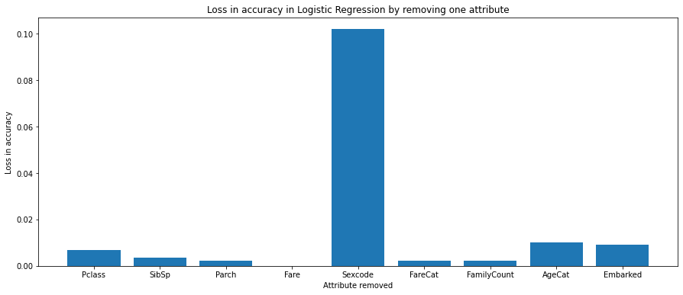
Loss in accuracy by removing one attribute
Sex variable is clearly the most decisive in all cases
KNN uses attributes is the most “balanced” way

Slide 10
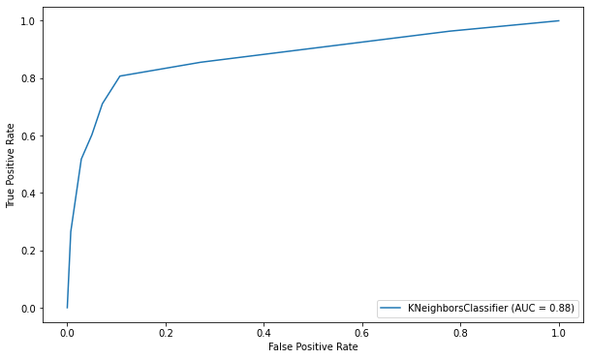
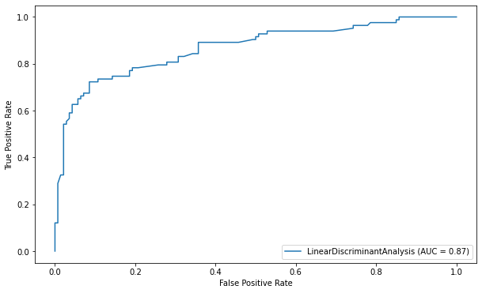
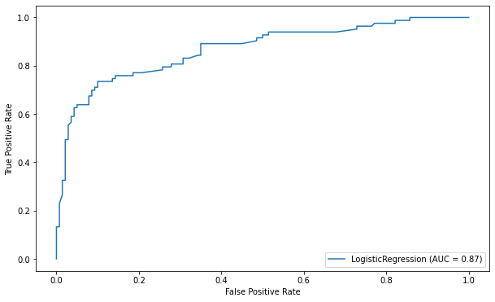
ROC curves
Receiver Operating characteristic curve is the plot of the true positive rate (TPR) against the false positive rate (FPR) at various threshold settings
The ROC for KNN has the largest area under the curve, suggesting it is the best classifier, although the difference is not significant

Slide 11
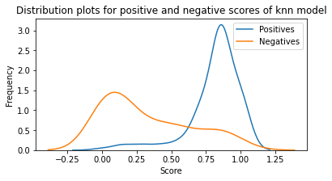
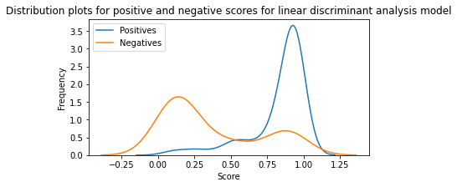
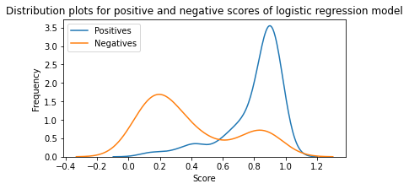
Plotting the confusion matrix
This helps us identify the best threshold s for each model to get the best balance between sensitivity (true positive recognition rate) and best specificity (true negative recognition rate)
The 3 graphs show our models are neither suspiciously perfect nor totally random

Slide 12
Conclusions
The sample size affects the performance of all models in similar proportions
The bigger the sample size, better the performance on the evaluation set
The change in attributes affected in similar ways all the models, but LDA was the one with the least effect after removing each variable

Slide 13
THANK YOU

Slide 14
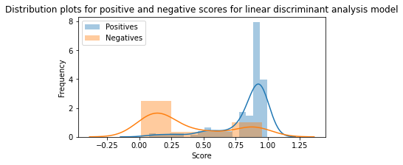
Explanation of graphs on slide 11

