Slide 1

Decision tree and Naive Bayes models exploration
Artificial Intelligence
Alexander, Dennis, Hélène

Slide 2
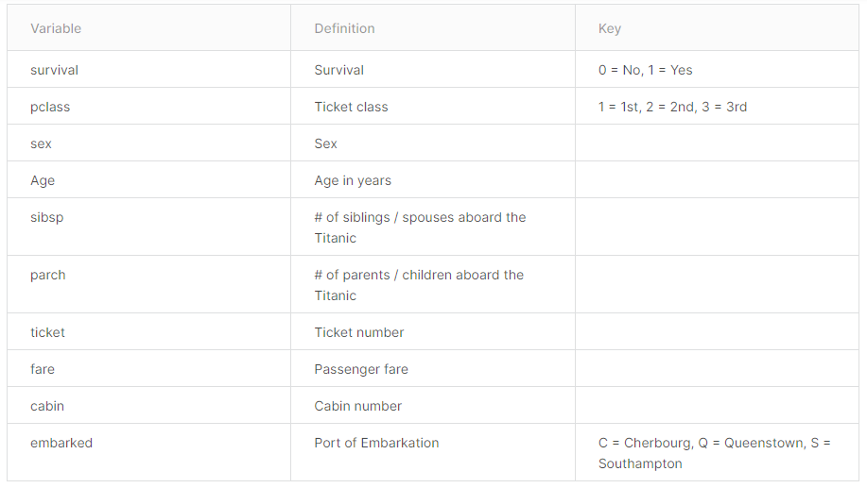
Reminder: the data
Train.csv file from the Titanic Kaggle competition (891 rows)
After data cleaning and feature engineering, we have 13 attributes: ["Pclass_1","Pclass_2","Pclass_3","SibSp","Parch","Fare","Sexcode","FareCat","FamilyCount","AgeCat","Embarked_C","Embarked_Q","Embarked_S"]

Slide 3
PART I: NAIVE BAYES

Slide 4
Objectives
Construct and interpret naive Bayes models in the Titanic competition.
Try different sample size and splits (learn/eval)
Discuss the computing time as a function of the number of variables.

Slide 5
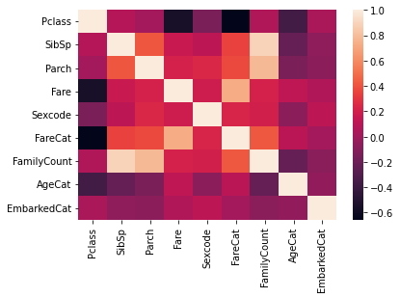
Naive Bayes
Correlation study:

Slide 6
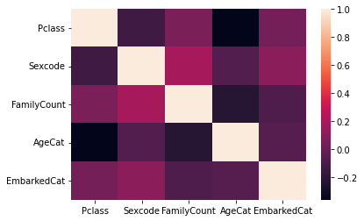
Naive Bayes
Correlation study:
Removed SibSp, Parch due high correlation with FamilyCount
Removed Fare, FareCat due high correlation with Pclass

Slide 7
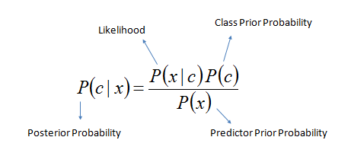


Naive Bayes
Likelihood of the features:
Using the variables: ["Pclass","Sexcode","FamilyCount","AgeCat","EmbarkedCat"]
Using 5 fold cross-validation:
Mean accuracy 0.795
Std accuracy 0.021

Slide 8
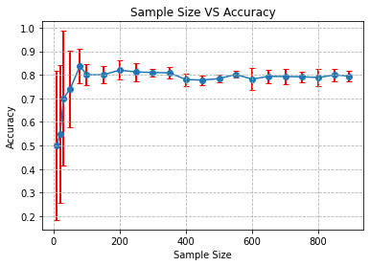
Naive Bayes

Slide 9
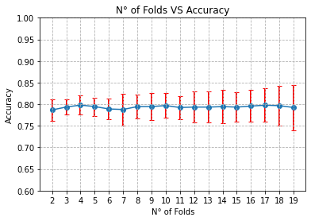
Naive Bayes

Slide 10
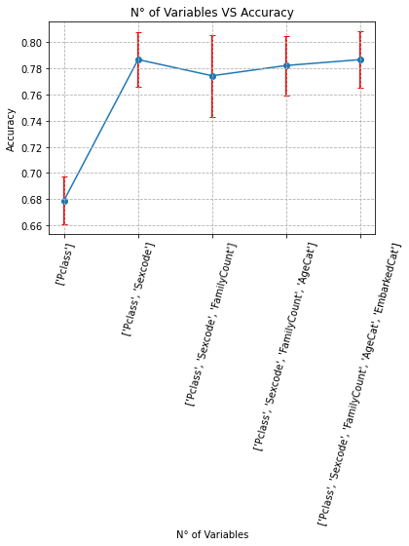
Naive Bayes

Slide 11
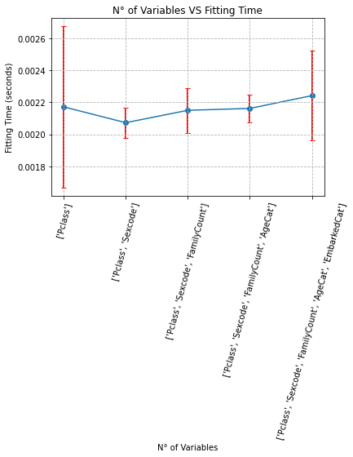
Naive Bayes

Slide 12
PART II: Decision trees

Slide 13
Objectives
Measure and compare learning and validation errors:
On different choices of variables
On different pre-pruning and post-pruning
Discuss the effect of depth, number of nodes on the model generalization

Slide 14
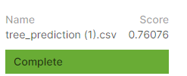
Decision tree performance with default parameters
Decision tree classifier from sklearn scikit-learn (which uses an optimised version of the CART algorithm: it constructs binary trees using the feature and threshold that yield the largest information gain at each node.)
Training accuracy is high but testing accuracy is comparatively low
We can suspect that our decision tree is overfitting on training data and cannot generalize
DecisionTreeClassifier(ccp_alpha=0.0, class_weight=None, criterion='gini',
max_depth=None, max_features=None, max_leaf_nodes=None,
min_impurity_decrease=0.0, min_impurity_split=None,
min_samples_leaf=1, min_samples_split=2,
min_weight_fraction_leaf=0.0, presort='deprecated',
random_state=None, splitter='best')
Training accuracy: 0.95
Validation accuracy: 0.78
Parameters exploration and post-pruning appear to be necessary

Slide 15
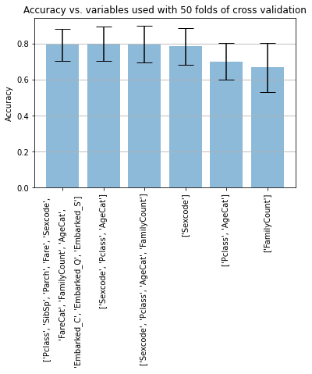
Effect of different variables on accuracy

Slide 16
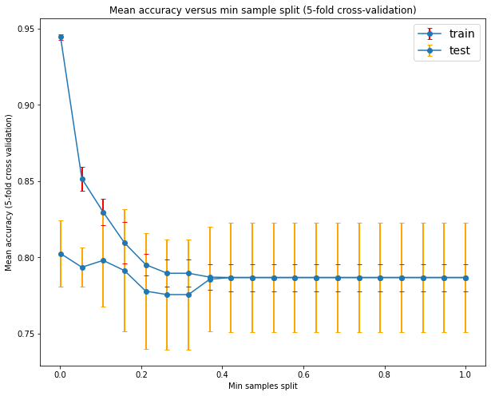
Decision tree - exploring the effects of different parameters: min_sample_split
Minimum number of samples required to split an internal node
Default number is 2

Slide 17
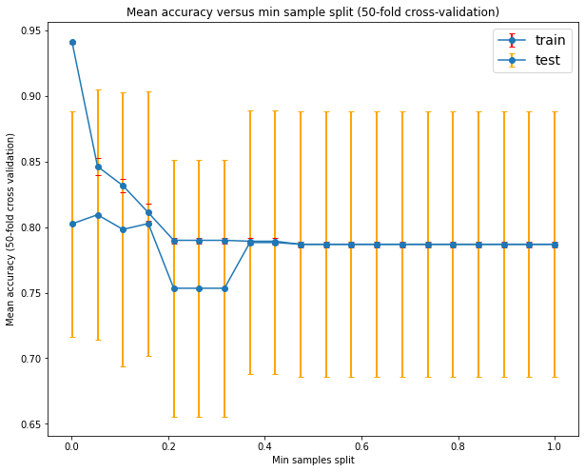
Decision tree - exploring the effects of different parameters: min_sample_split
Minimum number of samples required to split an internal node
Default number is 2

Slide 18
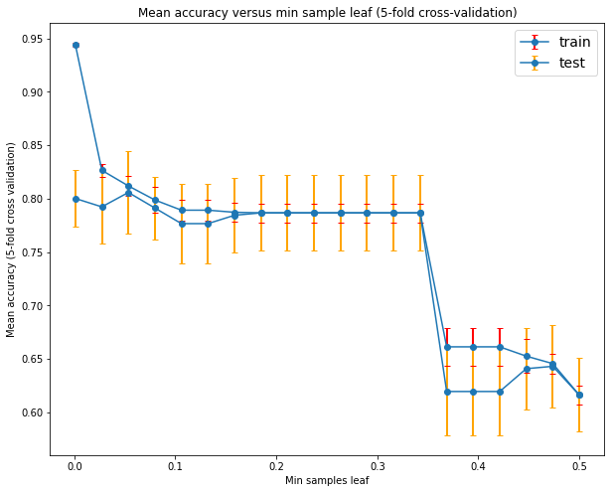
Decision tree - exploring the effects of different parameters: min_sample_leaf
Minimum number of samples required be at a leaf node
Default number is 1

Slide 19
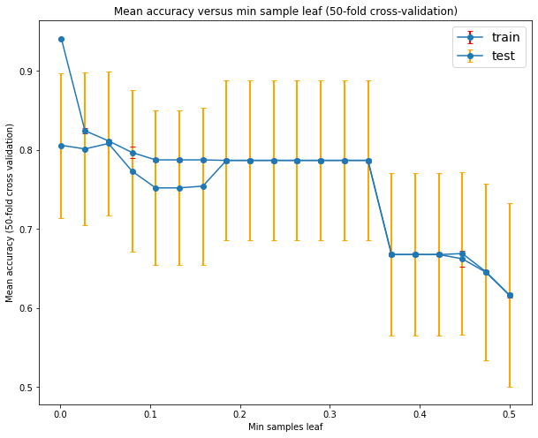
Decision tree - exploring the effects of different parameters: min_sample_leaf
Minimum number of samples required be at a leaf node
Default number is 1

Slide 20
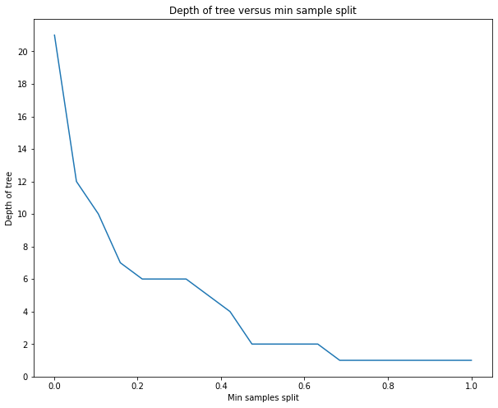
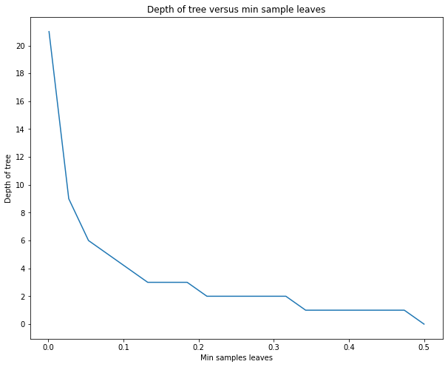
Effect of min sample split and min sample leaf on tree depth

Slide 21
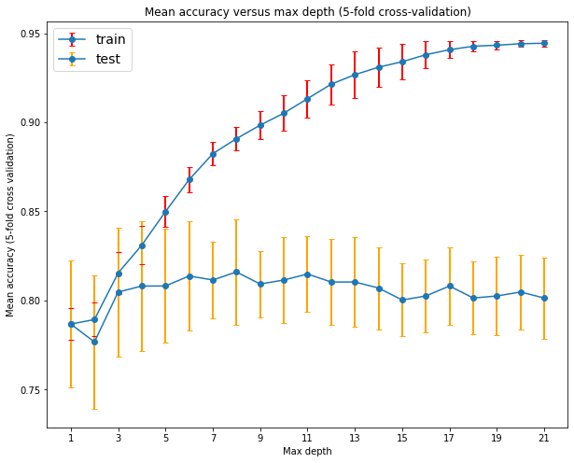
Effect of depth limitation in accuracy

Slide 22
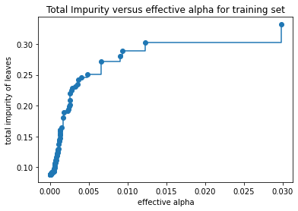
Post pruning with cost complexity
Cost complexity pruning provides another option to control the size of a tree. In DecisionTreeClassifier, this pruning technique is parameterized by the cost complexity parameter, ccp_alpha. Greater values of ccp_alpha increase the number of nodes pruned.
As alpha increases, more of the tree is pruned, which increases the total impurity of its leaves.

Slide 23
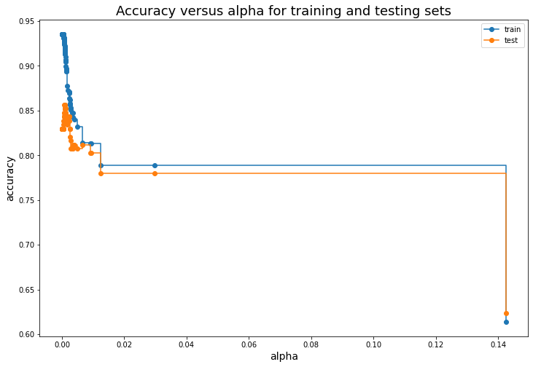
Post pruning
We train decision trees on train and test sets using the effective alphas to choose the right one
When ccp_alpha is set to zero and keeping the other default parameters, the tree overfits, leading to a 94% training accuracy and 83% testing accuracy.
As alpha increases, more of the tree is pruned, thus creating a decision tree that generalizes better. In this example, ccp_alpha should be very low to maximize the testing accuracy.

Slide 24
Conclusions
As we saw before, Sexcode, Pclass and AgeCat are the most important variables
Using only those 3 generate almost the same result in our models
In Naive Bayes, using more variables demands more processing time
In Naive Bayes, it’s enough to have 200 samples to have a stable accuracy
This implies that if we have much more data, we can use only those 3 variables to compute our models really fast
In Decision trees, we can limit the depth of the trees because if we don’t it will cost us more computation time and we will have a lot of overfitting

Slide 25
THANK YOU !

