Slide 1

Choosing the best model
Artificial Intelligence
Alexander, Dennis, Hélène

Slide 2
Data description and objectives
ADA dataset: task of ADA is to discover high revenue people (making more than 50k a year) from 1994 census data. This is a two-class classification problem with sparse binary input variables
48 features: age, workclass, education, marital status, occupation, race, sex, native country, number of hours worked per week...
4147 entries in training set, 415 entries in validation set
Comparison between knn, LDA, logistic regression, naive bayes, decision tree
Based on Area Under Curve, accuracy score and BER

Slide 3
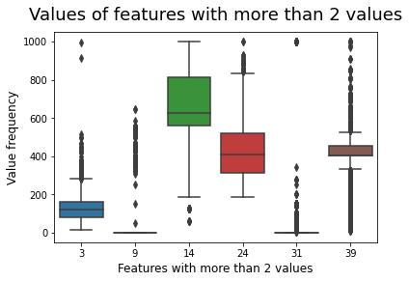
Data exploration & preprocessing
Most features are binary (40 out of 48)
Drop 2 columns containing only 0s
After examination of features with large values, we opt for Standard Scaling (removing the mean and scaling to unit variance)

Slide 4
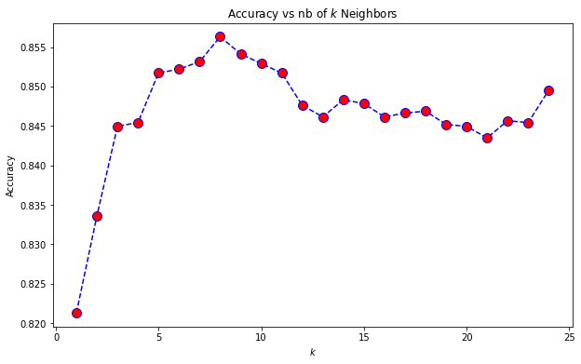
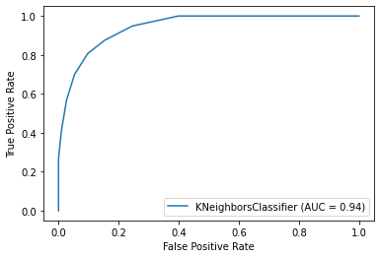
K-nearest neighbour classifier
Best k is 8
AUC of 0.94, accuracy score on validation set of 0.86

Slide 5
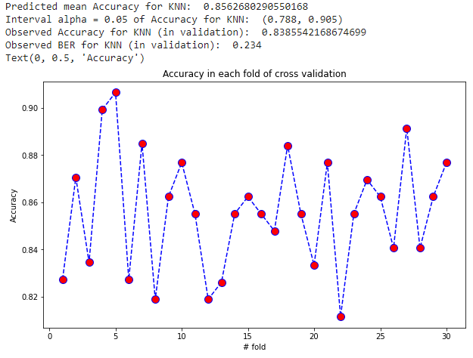
K-nearest neighbour classifier

Slide 6
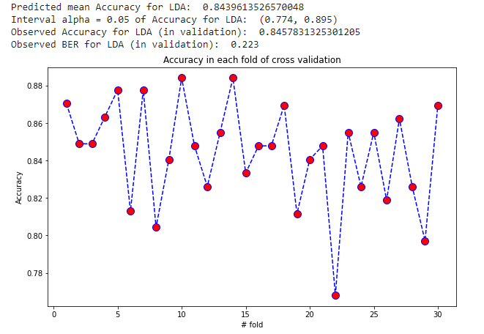
Linear Discriminant Analysis

Slide 7
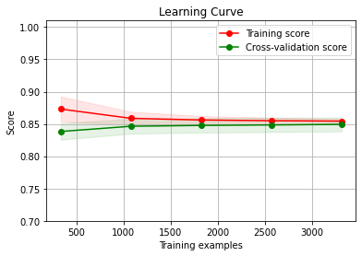
Logistic Regression
Using 5 fold cross validation:
Accuracy average: 0.851
Accuracy std:0.01

Slide 8
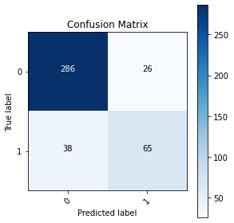
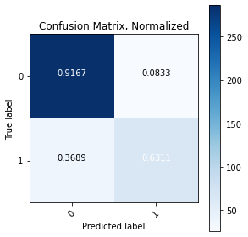
Logistic Regression

Slide 9
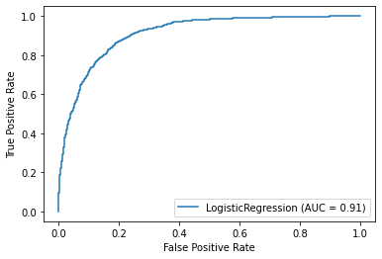
Logistic Regression
BER value: 0.2261

Slide 10
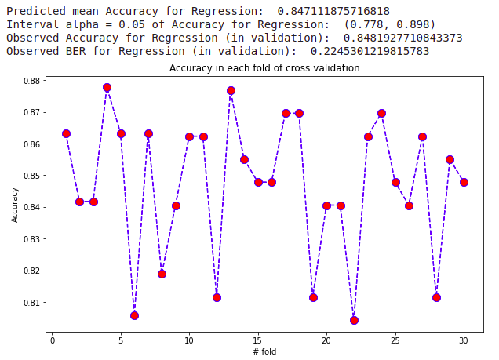
Logistic Regression

Slide 11
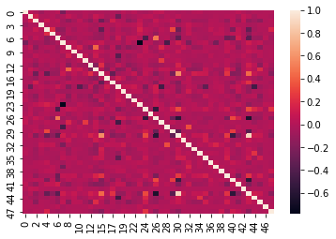
Gaussian Naive Bayes
Correlation study:

Slide 12
Gaussian Naive Bayes
Using 5 fold cross-validation:
Mean accuracy: 0.7702
Std accuracy: 0.0085

Slide 13


Gaussian Naive Bayes

Slide 14
Gaussian Naive Bayes
BER value: 0.2294

Slide 15
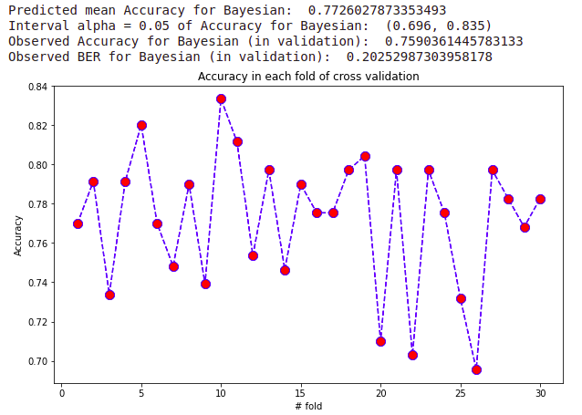
Gaussian Naive Bayes

Slide 16
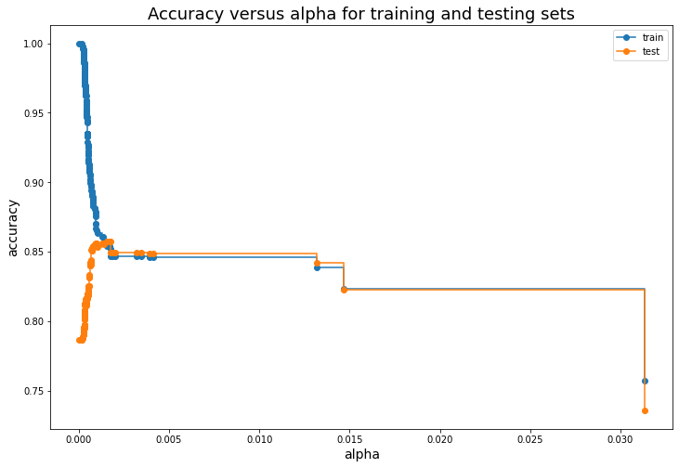
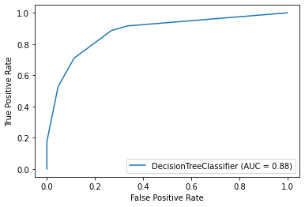
Decision tree classifier
We have seeked best alpha for post pruning in order to avoid overfitting
Area under curve is 0.88, accuracy is 0.87

Slide 17
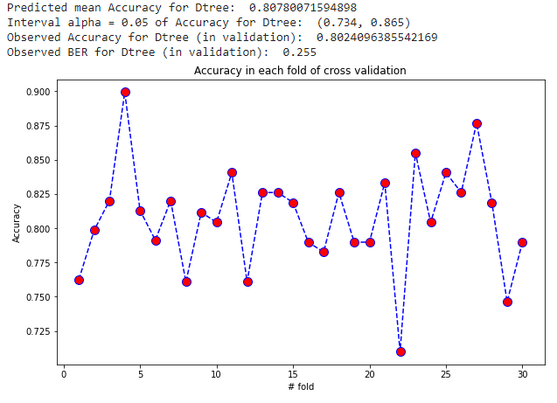
Decision tree classifier

Slide 18
Recap
 | kNN | Logistic regression | Naive Bayes | Decision tree | LDA
Accuracy | (0.788, 0.905) | (0.778, 0.898) | (0.734, 0.865) | (0.734, 0.865) | (0.836, 0.938)
AUC | 0.94 | 0.91 | 0.91 | 0.88 | 0.90
BER | 0.234 | 0.226 | 0.229 | 0.255 | 0.223

Slide 19
THANK YOU

