Slide 1
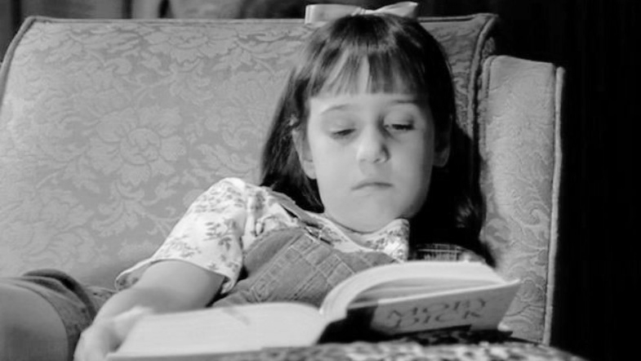
Artificial Intelligence
Book recommendation
Alexander, Dennis, Hélène

Slide 2
Objectives
Build a recommendation system for Books
Apply a memory based collaborative filtering system (Item-based)

Slide 3
The data - Bookcrossing (Kaggle)
Book rating dataset to build a recommendation engine
3 tables: Book ratings, ~270k books and ~92k users
Once tables are merged, we have the following attributes:
ISBN
Book title
Book author
Year of publication
Publisher
User-ID
Location
Age
Book rating
3 image URLs

Slide 4
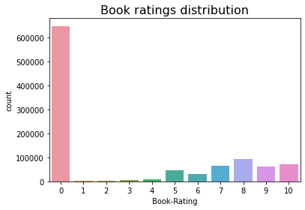
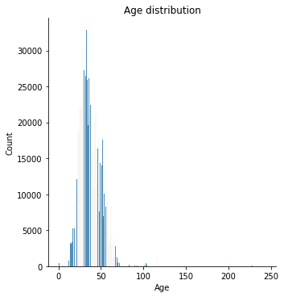
Preprocessing
Dropping image URLs
Dropping ratings of value 0
Replacing ages over 90 by the median
Country feature extracted from location

Slide 5
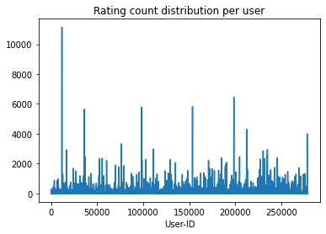
Preprocessing
We only used users that had rated more than 100 books
We only used books that have been rated more than 100 times

Slide 6
Memory-based Collaborative Filtering (item-based)
Recommended books:
Gai-Jin: A Novel of Japan
Hamlet (Bantam Classics)
Name of the Rose-Nla
Glitz
The Electric Kool-Aid Acid Test
Moneyball: The Art of Winning an Unfair Game
One hundred years of solitude
Blanche on the Lam
Decider
Medusa's Child
If a user liked:
GREAT GATSBY

Slide 7
Memory-based Collaborative Filtering (item-based)
Recommended books:
Historia De Una Gaviota Y Del Gato (Andanzas)
Cronica de una muerte anunciada (Vintage Espanol)
Shaman
Where Dreams Begin (Avon Historical Romance)
The Key to Rebecca
The Flame and the Flower
La piel del tambor
La casa de los espÃ­ritus
A House for Mr. Biswas
Morgan'S Run
If a user liked:
Diario de Ana Frank

