Slide 1



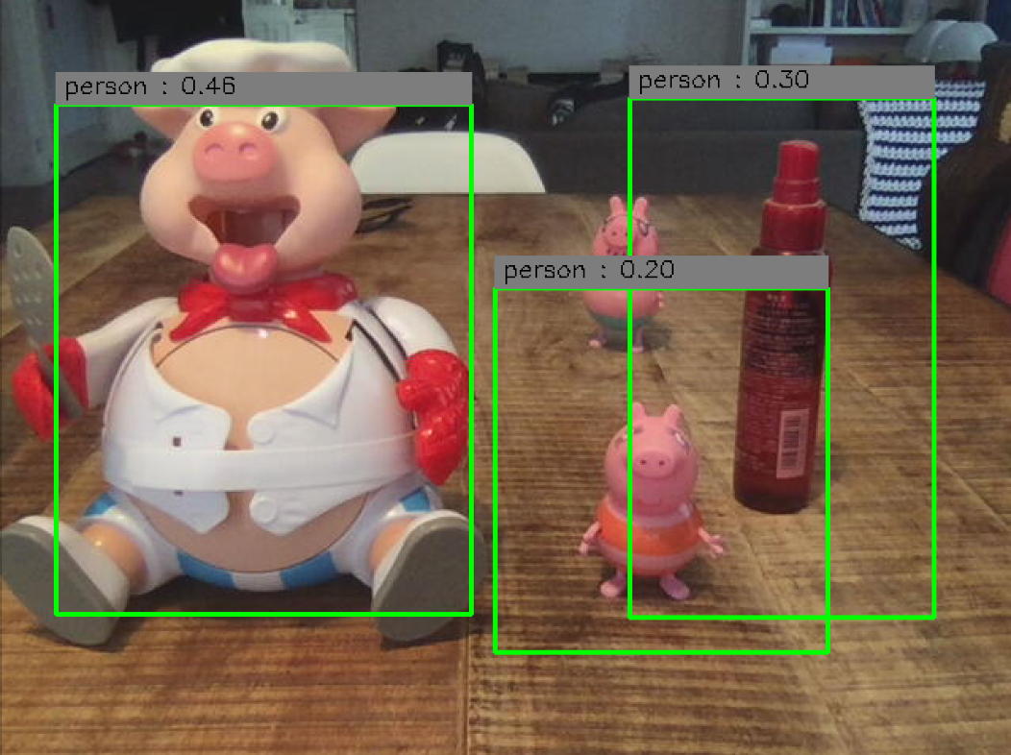


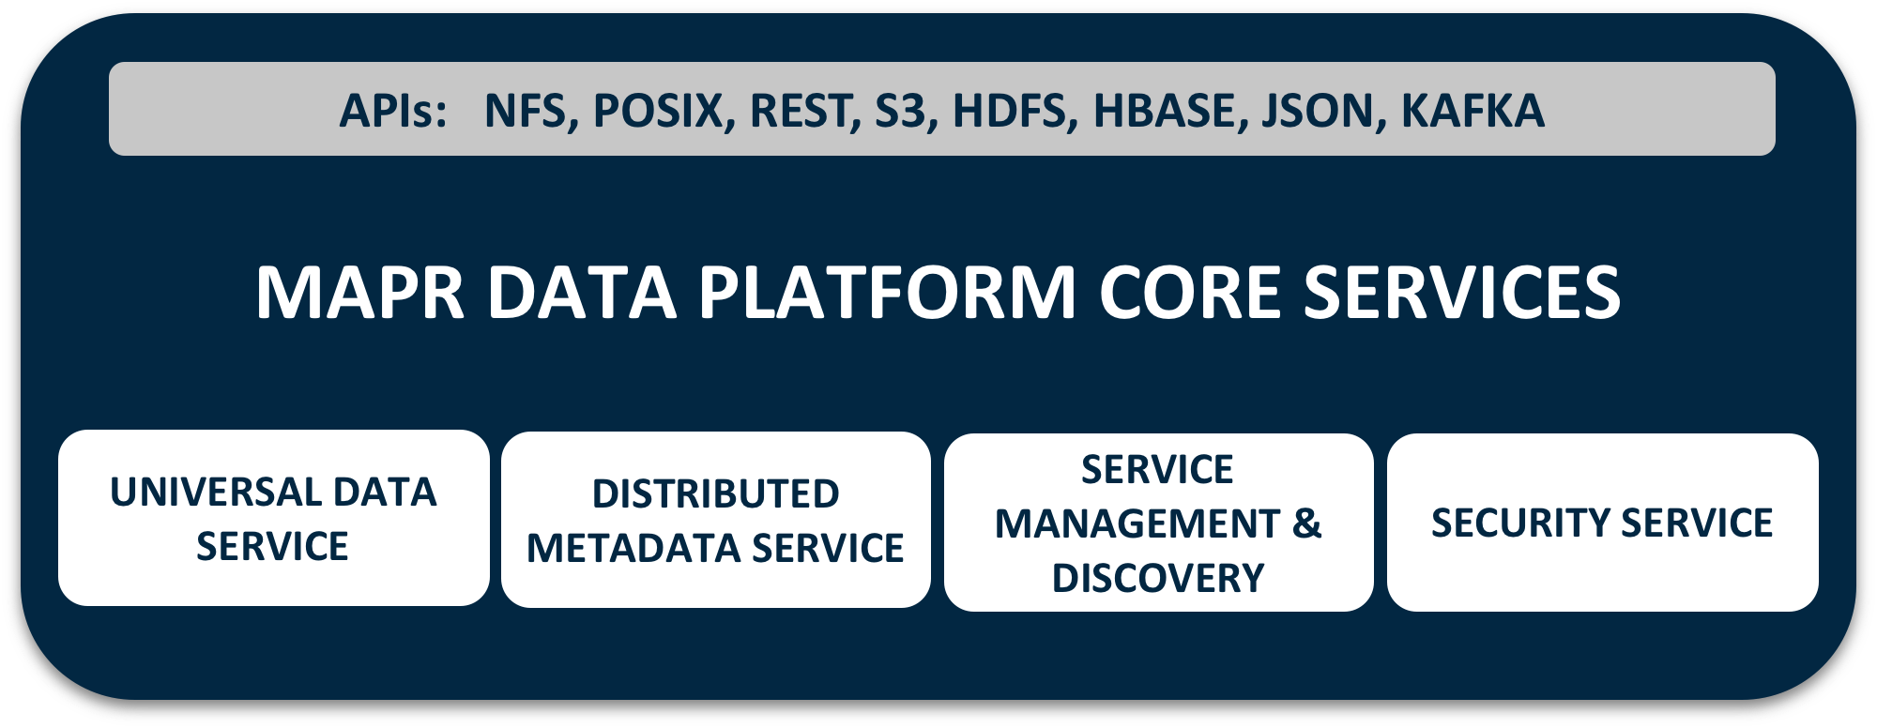

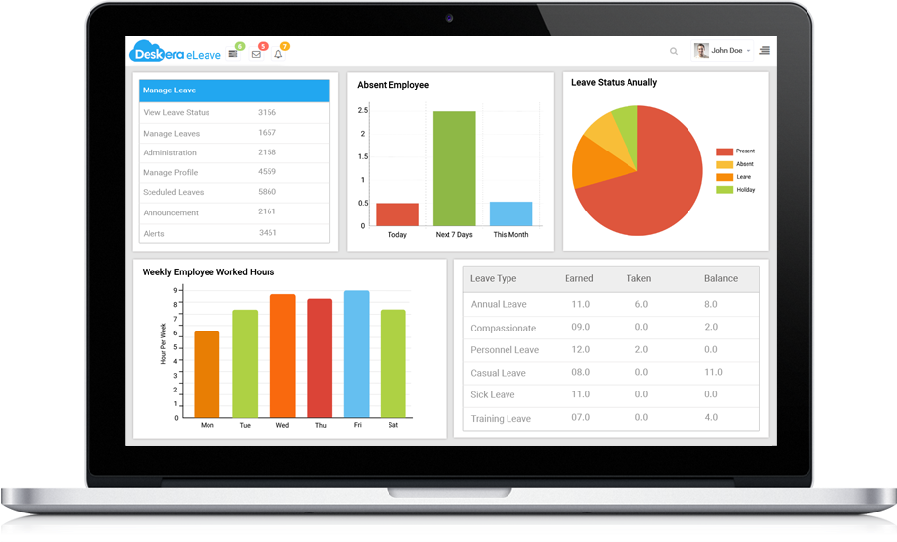

Micro Service Approach To Distributed Image Processing
drone1
DRONE CAPTURE
IMAGE RESIZE
IMAGE OBJECTS DETECTION
Container #1
Drone-client:latest
Container #2
Step1-resize-img:latest
Container #3
Step2-detect:latest
WiFi
DATA SCIENCE
MONITORING
Container #4
MapR
Data Science Refinery
Container #5
Live stream web server
http://localhost:5000

Slide 2
Micro Service Approach To Distributed Image Processing
Image
Process
Pilote
drone1
/frenchpatrol/pilote:images
Meta
/frenchpatrol/pilote:actions
/frenchpatrol/detection_meta
/frenchpatrol/detection:images
WebUI
/frenchpatrol/archive/<files>

