Slide 1
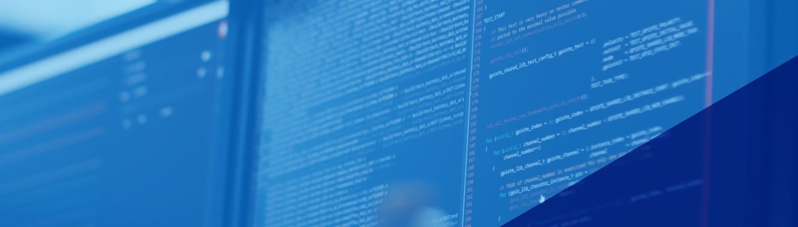
Getting to know the nRF54L15
Feb 2025
Alex Rawstorne
Alexander.rawstorne@nordicsemi.no
Hello World – App core +FLPR
Hello World running on App Core and FLPR nRF54L15
SESSION 1 : 8h30 – 10h00

Slide 2

Prerequisites
nRF Connect for Desktop with all tools installed
nRF SDK 2.9.0 installed with VSCode
Power Profiler 2
3 USB Cables – 2 x Micro USB and 1 x USBC Bring a hub if your laptop doesn’t have enough USB ports
nRF Connect SDK Fundamentals - Nordic Developer Academy
Optional:
Bluetooth Low Energy Fundamentals - Nordic Developer Academy
nRF Connect SDK Intermediate - Nordic Developer Academy
Cellular IoT Fundamentals - Nordic Developer Academy
Notes:
Toolchain manager for easily downloading SDK
Programmer for flashing kits, memory visualization
LTE Link Monitor, send AT commands, see LTE link quality, etc
Trace collector for modem traces
VS Code: easy to use, easy to configure and extend IDE for Nordic developers
nRF Debug, Youtube videos for VS Code
nRF Connect for Mobile, Bluetooth LE
nRF Toolbox

Slide 3
AGENDA
Session | Start | End | Tools
1 | 8h30 | 10h00 | nrf54L15DK | UART working on FLPR and Cortex M33
Break | 10h00 | 10h15
2 | 10h15 | 11h45 | nrf54L15-DK/nRF52840-DK/ PPK2 | Build iBeacon application on 54L15 and 52840 and compare power consumption
Lunch | 11h45 | 12h30
3 | 12h30 | 14h00 | nrf54L15-DK | Get 1.3" OLED Display operating on nrf54L15
Break | 14h00 | 14h15
4 | 14h15 | 15h15 | nRF54L15-DK | Continue session 3 followed by Questions Sam
Q/A Close | 15h15 | 15h30
Notes:
Toolchain manager for easily downloading SDK
Programmer for flashing kits, memory visualization
LTE Link Monitor, send AT commands, see LTE link quality, etc
Trace collector for modem traces
VS Code: easy to use, easy to configure and extend IDE for Nordic developers
nRF Debug, Youtube videos for VS Code
nRF Connect for Mobile, Bluetooth LE
nRF Toolbox

Slide 4
Agenda Session 1 8h30-10h00
NRF Connect
Board Configurator
Direct Test Mode
Power Profiler
Programmer
Bluetooth Low Energy
Hello World on nRF54L15-DK
Hello World on FLPR
2 Hello Worlds running simultaneously on FLPR and App Core

Slide 5
Session1 : Tasks
Board Configurator
Unbox nRF54L15-DK and nRF52840-DK
Plug in nRF54L15-DK and run Board Configurator
Adjust IO Voltage to 3V0
Can you do the same for nRF52840?
Direct Test Mode
Copy sample Direct Test Mode.
Create a Build Configuration for nrf54l15dk/nrf54l15/cpuapp
Flash build – open a serial terminal and run TX test on band 39

Slide 6
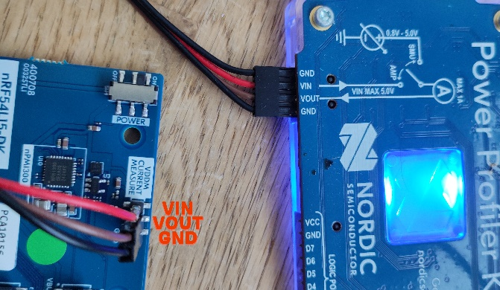
Session1 : Tasks continued
Power Profiler
Turn the DK off
Go into Power Profiler in nrf Connect and connect to the PPK2
Ensure the USB cable is plugged into the “USB Data/Power”
Ensure the Power mode is set to “Ampere Meter” and turn “Enable power output” switch on.
Connect the Power profiler to the nRF54L15DK by removing the jumper.
Measure current draw Ch 17 0dB
ENSURE IT’S THE RIGHT WAY AROUND

Slide 7
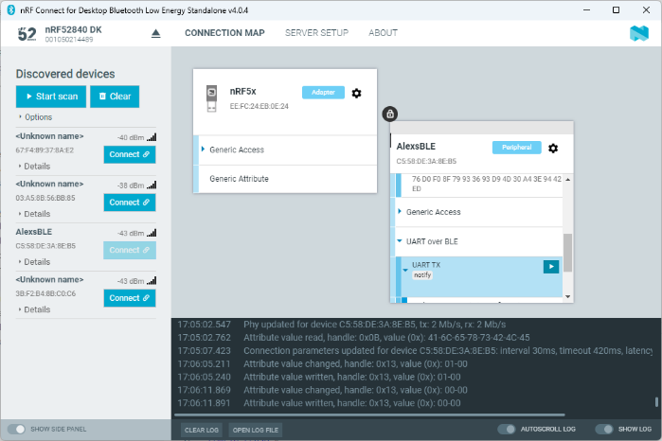
Session1 : Tasks continued
Programmer
Open Programmer
Connect to nRF54L15-DK
Load the hex file in ProjDirectory/build/zephyr/zephyr.hex
Write the hex file to the DK
Bluetooth Low Energy
Open Bluetooth Low Energy in nRFConnect
Connect your nRF52840 and Scan
Search for AlexsBLE
Connect and discover Services

Slide 8
Session1 : Hello World
Create a new application by copying sample hello_world
Create a nrf54l15 build configuration (buildapp directory) and run it
Observe terminal output on Serial console
Save the workspace
Modify the sample to enable Logging
Add to proj.conf
CONFIG_LOG=y
CONFIG_LOG_BACKEND=y
Add to main.c
#include <zephyr/logging/log.h>
LOG_MODULE_REGISTER(main,LOG_LEVEL_DBG);
LOG_INF("Hello World! %s", CONFIG_BOARD_TARGET);
Rebuild and check all is working

Slide 9
Session1 : Hello World contd
Custom config option
Create CONFIG_MY_MESSAGE=“Rutronik’s the best”
Create a Kconfig in the root directory and add
menu “Workshop”
config MY_MESSAGE
string “Nordic's the best”
default “Hello World Custom”
endmenu
menu “Zephyr Kernel”
source “Kconfig.zephyr”
endmenu
Add the string in LOG_INF with CONFIG_MY_MESSAGE and Pristine Build
Create CONFIG_MY_MESSAGE=“Hello Nordicers” in proj.conf and rebuild

Slide 10
Session1 : Hello World contd
Hello World on APP Processor
Observe current consumption on PPK2 (330uA)
Go to the build Configuration and Add Snippet nordic-flpr, Rebuild, FLASH and observe current conumption
Note the flash size difference in 1. and 2.
Note the power consumption increase (1mA vs 330uA)
Hello World on FLPR Processor
Create another build configuration build_flpr
Build for the flpr processor and flash
Open another terminal and observe output on the FLPR core
Hello World on both App and Flpr in One Build System
Create another Directory hw2
Copy hello_world to that directory and delete build directory
Create three files kconfig.sysbuild, sysbuild.conf and sysbuild.cmake (If you want to cheat, you can find these files in C:\ncs\v2.9.0\zephyr\samples\sysbuild\hello_world)

Slide 11
Session1 : Hello World contd
Create sysbuild.conf. Add the lines
SB_CONFIG_REMOTE_BOARD="nrf54l15dk/nrf54l15/cpuflpr"
Add Extra CMAKE options in build configuration
-Dhw2_SNIPPET=nordic-flpr
KConfig.sysbuild
source "${ZEPHYR_BASE}/share/sysbuild/Kconfig“
config REMOTE_BOARD
string "The board used for remote target“

Slide 12
Session1 : Hello World contd
sysbuild.cmake
if("${SB_CONFIG_REMOTE_BOARD}" STREQUAL "") message(FATAL_ERROR "REMOTE_BOARD must be set to a valid board name")
endif()
ExternalZephyrProject_Add(
APPLICATION remote
SOURCE_DIR ${APP_DIR}/remote
BOARD ${SB_CONFIG_REMOTE_BOARD}
)
set_property(GLOBAL APPEND PROPERTY PM_DOMAINS CPUFLPR)
set_property(GLOBAL APPEND PROPERTY PM_CPUFLPR_IMAGES remote)
set_property(GLOBAL PROPERTY DOMAIN_APP_CPUFLPR remote)
set(CPUFLPR_PM_DOMAIN_DYNAMIC_PARTITION remote CACHE INTERNAL "")
add_dependencies(${DEFAULT_IMAGE} remote)
sysbuild_add_dependencies(FLASH ${DEFAULT_IMAGE} remote)
Build the project and flash.
Connect to the other COM Port to see FLPR messages

Slide 13
Session1 : Hello World contd
Remove the LOG Messages in the main.c file and replace with printf
Make sure you see the message on the FLPR
Extra task.
Create your own src directory in remote with another main.c
Modify CMAKELISTS.TXT in the remote to use the remote/src/main.c
Get the Custom Kconfig working on FLPR

Slide 14
Agenda Session 2 10h15-11h45
Power Consumption benefits iBeacon
iBeacon on nRF54L15-DK
Add a scan response with unique name
Observe Current consumption – floor current and 3 advertising channels
Optimise power consumption and reobserve
Deploy the same code to nRF52840-DK

Slide 15
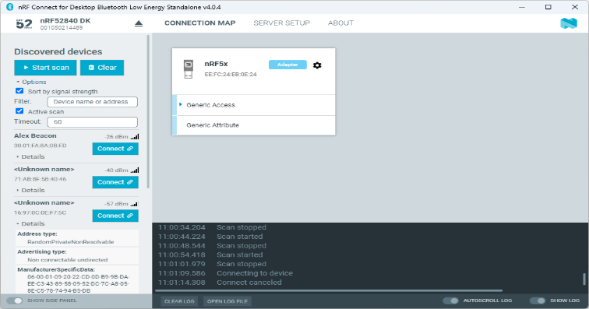
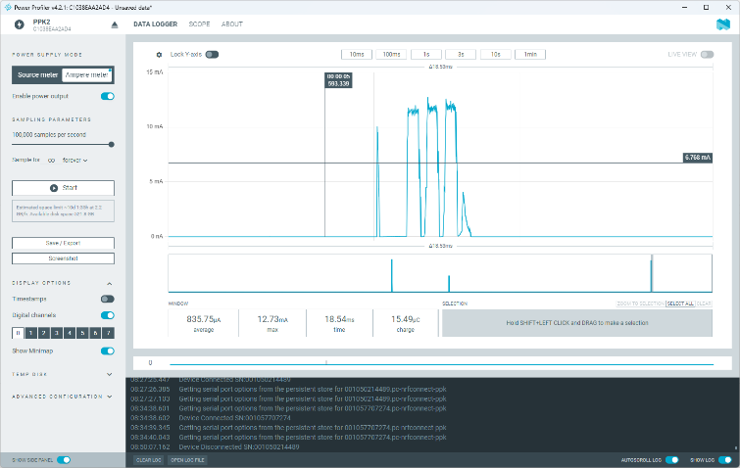
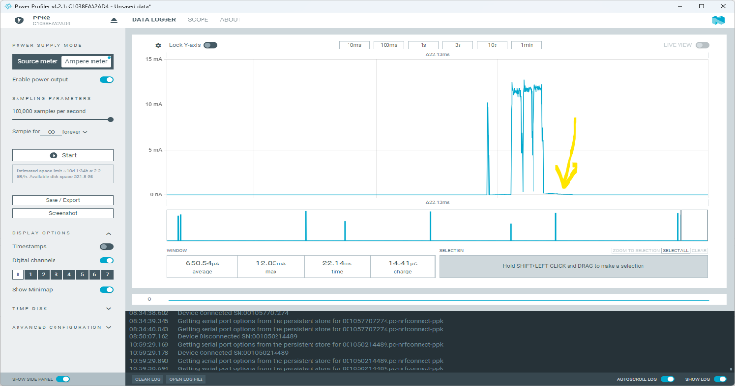
Session 2 Task
Create a New Application
Copy iBeacon Sample
Create a Build Configuration for nrf54L15DK
Add Scan Response data with a Name to advertising
Add your device name CONFIG_BT_DEVICE_NAME="AlexBeacon"
Define an array sd[] (look at beacon sample)
Use the BT_DATA macro (NOT _BYTES) to add a custom name (FIELD,ID),
Add scan response to the adv data () function
Build, flash and find the device on Bluetooth Low energy and COM port
Observe the floor current and Advertising with/without scan response
Change the advertising interval to 1 second
Inspect the variable BT_LE_ADV_NCONN
Create BT_LE_ADV_CUSTOM
Build, flash and then observe your device using Bluetooth Low Energy
Measure current on the PPK2 and record it

Slide 16
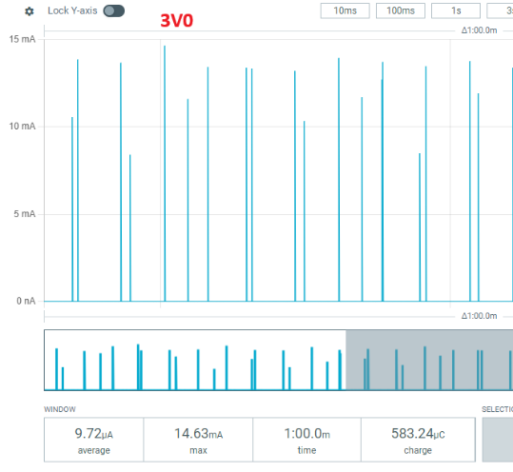
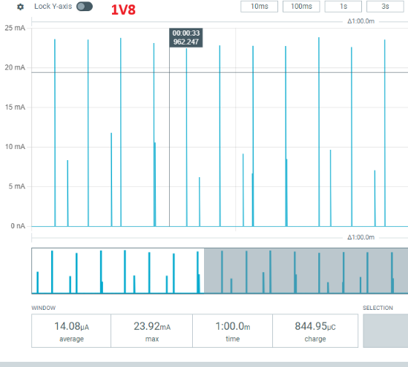
Session 2 Task
Reduce the operational current by disabling LOG and the UART
Hint, change the Settings in Proj.conf (SERIAL ? LOG ?)
Measure the current on PPK2
Reduce the average current to <7uA over a 10 sec interval
Observe floor current
Set transmit power to 8dB
CONFIG_BT_CTLR_TX_PWR_PLUS_8
CONFIG_BT_CTLR_TX_PWR_DYNAMIC_CONTROL
CONFIG_MPSL_CALIBRATION_PERIOD=60000
Record floor current and average over 10 sec at 1V8
Record the same at 3V0
Which is more efficient ?
Notes:
3uA at 3V, 3.6uA at 1V8 floor – Energy of floor is lower at 1v8
Max Tx 43.89uJ at 3V vs 43uJ for the TX current so pretty much the same
Averages – 29.16uJ at 3V vs 25.34uJ at 1.8V

Slide 17
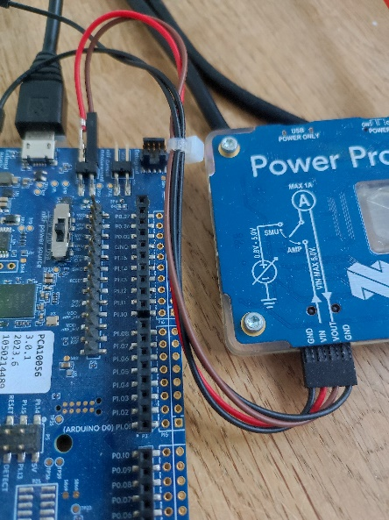
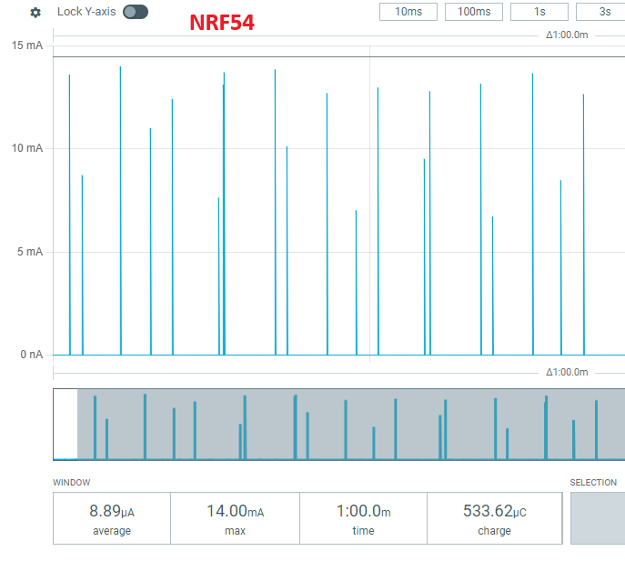
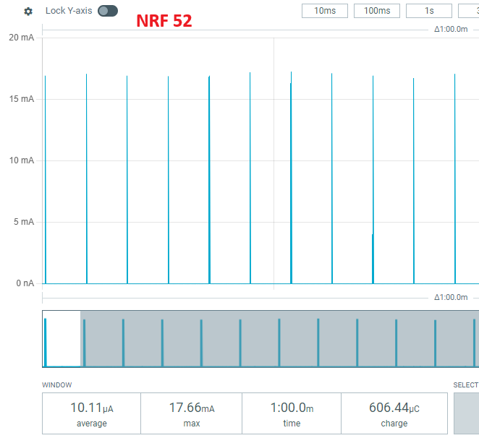
Session 2 Task
Create a build configuration for nrf52840-DK
Program at test it and measure floor and average current over 1min
Compare nRF54L15 to nRF52840
Which device wins the race ? Do it for 1.8V
Notes:
52840, 10.4uA
54L15, 9uA@3V, 13.7uA at 1.8

Slide 18
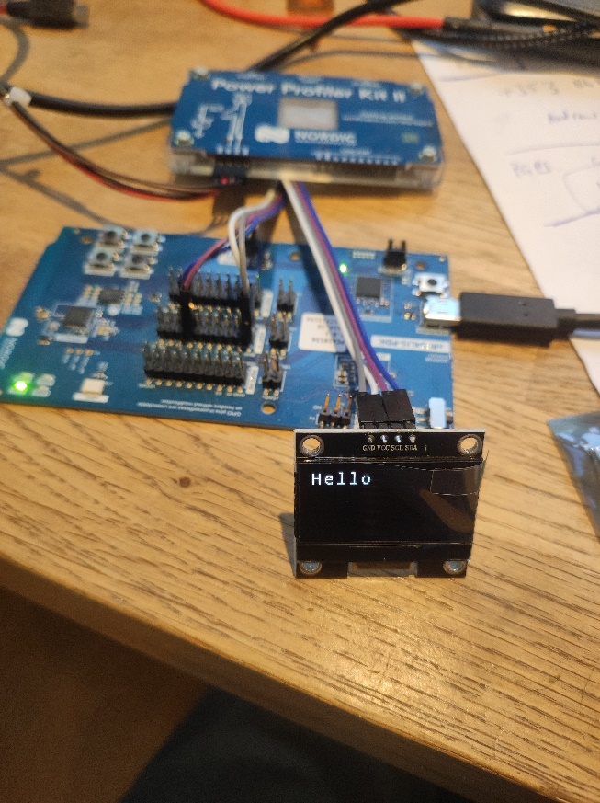
Agenda Session 3 12h30-14h00
Getting an 128 x 64 OLED Display working on nRF54L15-DK
Block Diagram Architectural differences in nRF54L15
Use the Display Driver in Zephyr
Use the Character Frame buffer
Use the LCD Driver for the SSH1106
Setup the Device Tree for the Display
Setup Proj.conf
Use the drivers to display a message on the screen
If there’s time use the LVGL driver library
Get 2.42” display working on the kit

Slide 19
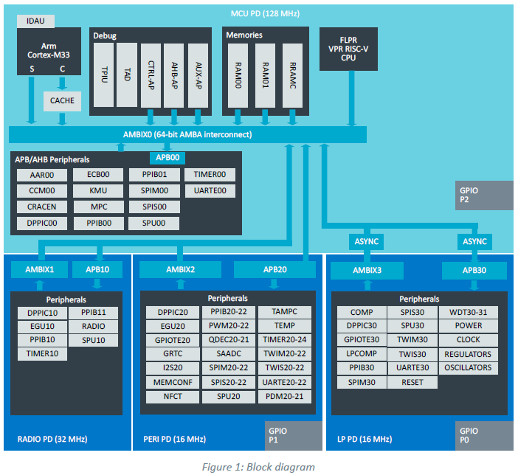
nRF54L15 Block Diagram
To talk between ports you use the peripheral bridges. This takes time

Slide 20
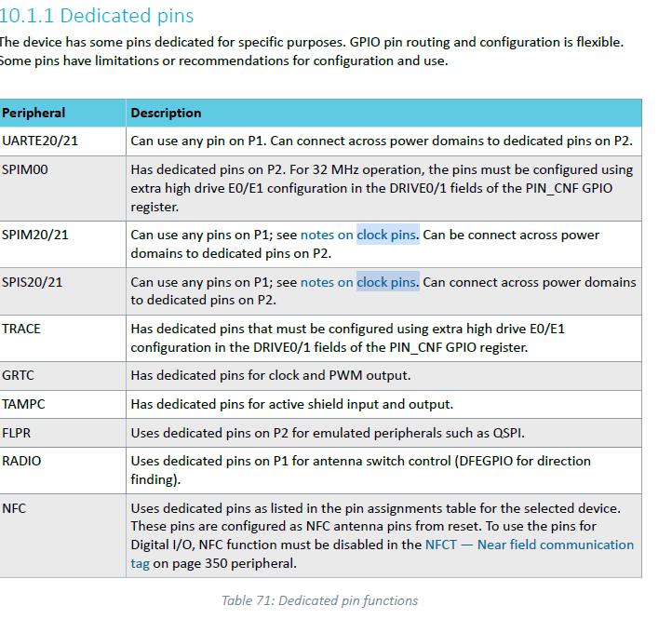
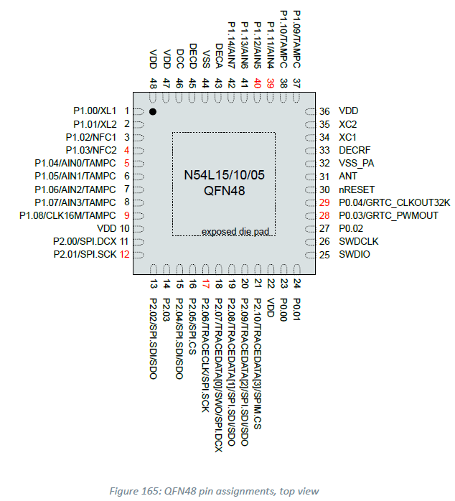
nRF54L15 Dedicated Clock pins

Slide 21
Session3: Task
Start with Beacon Example in Zephyr on nRF54L15-DK
Add I2C OLED 128 x 64 Display
Create an overlay file (disp54l.overlay)
Modify the device tree to include i2c21
Add Device Driver for sinowealth ssh1106
Add Character Frame Buffer to the project
Display “Hello”
Repurpose the demo to the nRF54840-DK

Slide 22
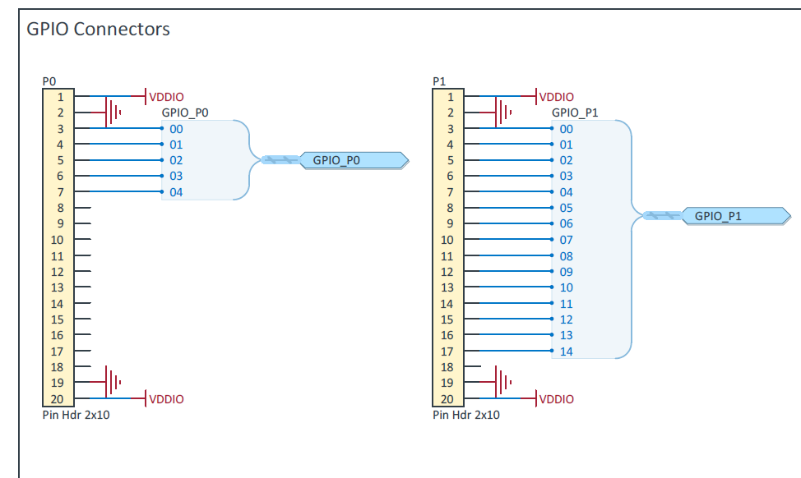
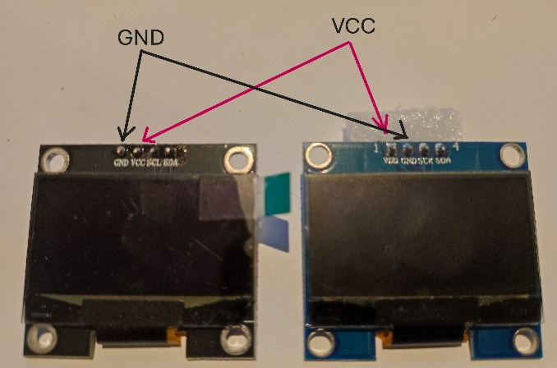
Port Pins on DK to connect Display to
Use P1 for the Connections
Use P11 for SCL
Use P10 for SDA
Connect VDDIO to VCC on the Display
Connect GND TO GND on the Display
Ensure Power and GND are the correct way around as there are two different displays
Use board configurator to set the Voltage to 3V

Slide 23
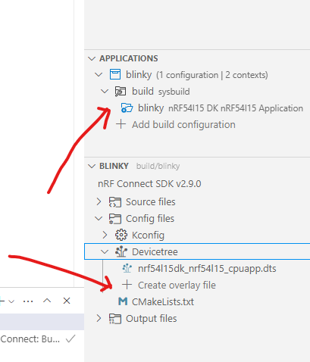
Blinky and create an overlay file
Copy the sample Blinky and create a build configuration for nRF54L15
Create an overlay file – call it disp54l.overlay
Add the i2c1 device
&i2c21 {
status = "okay";
zephyr,concat-buf-size=<1025>;
pinctrl-0 = <&i2c21_default>;
pinctrl-1 = <&i2c21_sleep>;
pinctrl-names = "default", "sleep";
};

Slide 24
Blinky and create an overlay file
Pin Control – Define which pins do what
&pinctrl {
/omit-if-no-ref/ i2c21_default: i2c21_default {
group1 {
psels = <NRF_PSEL(TWIM_SDA, 1, 10)>,
<NRF_PSEL(TWIM_SCL, 1, 11)>;
};
};
/omit-if-no-ref/ i2c21_sleep: i2c21_sleep {
group1 {
psels = <NRF_PSEL(TWIM_SDA, 1, 10)>,
<NRF_PSEL(TWIM_SCL, 1, 11)>;
low-power-enable;
};
};
};

Slide 25
Blinky and create an overlay file
Where do I find drivers ? Bindings index — Zephyr Project Documentation
Add the specifics of the sinowealth, ssh1106 in i2c21
sh1106_sh1106_128x64: ssd1106@3c {
compatible = "sinowealth,sh1106";
reg = <0x3c>;
width = <128>;
height = <64>;
segment-offset = <2>;
page-offset = <0>;
display-offset = <0>;
multiplex-ratio = <63>;
segment-remap;
com-invdir;
prechargep = <0x22>;
};
Unique label that defines the display
i2C Address 0x3C

Slide 26
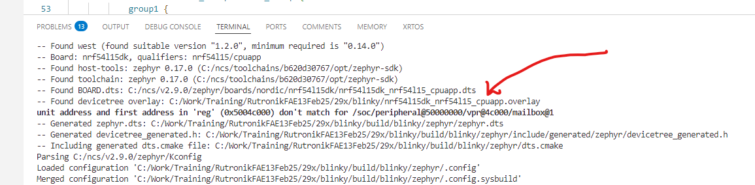
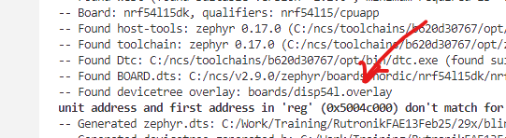
Blinky and create an overlay file
Link the driver to zephyr display and add the uart console
/ {
chosen {
zephyr,display = &sh1106_sh1106_128x64;
zephyr,console = &uart20;
};
};
Build the application and make
sure there are no errors
Optional : Move the overlay to
the boards directory, rename it
to disp54l.overlay and explicitly
add it in the Extra Devicetree overlays section
The label you gave to the display
Link Uart20 to the zephyr console

Slide 27
Blinky : Add drivers proj.conf
Edit proj.conf
Enable the I2C driver
CONFIG_I2C=y
Enable Logging (So we can see if there is an I2C error)
# Logging system
CONFIG_LOG=y
CONFIG_UART_CONSOLE=y
CONFIG_I2C_LOG_LEVEL_DBG=y
Enable I2C Driver
# Display driver
CONFIG_DISPLAY=y #Display driver
CONFIG_HEAP_MEM_POOL_SIZE=4096 #Increase default heap siz
CONFIG_CFB_LOG_LEVEL_DBG=y #Set Debug on for CFB
CONFIG_CHARACTER_FRAMEBUFFER=y #Load CFB driver
CONFIG_CHARACTER_FRAMEBUFFER_USE_DEFAULT_FONTS=y #Load default fonts

Slide 28
Blinky : Add code to main.c
Build and Flash the application
Connect the COMPort so you can see output
Ensure there are no errors
Disconnect SDA or SCK. Reboot and see if you get an error?
Modify main.c
Include the zephyr/display/cfb.h
Initialise the display
struct device *display;
display = (struct device *)DEVICE_DT_GET(DT_CHOSEN(zephyr_display));
if (!device_is_ready(d->dev)) {LOG_ERR("Display not Present");return (1);}
Refer to
Zephyr API: Monochrome Character Framebuffer or
https://docs.nordicsemi.com/bundle/zephyr-apis-2.8.0/page/group_monochrome_character_framebuffer.html

Slide 29
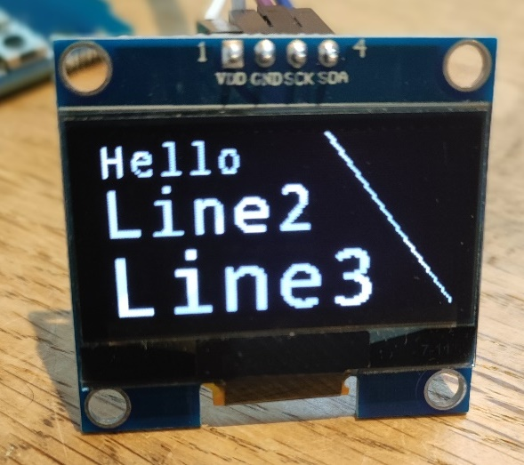
Blinky : Add code to main.c
You need to
Initialise the character frame buffer (init ?)
Clear the CFB
Print Hello on the display
Try finalizing the frame buffer
Read the number of fonts and try another font
Invert the display
Draw a line from 80,0 to 120,64
Include the SHELL and CHARCTER_FRAMEBUFFER_SHELL
Try (NOTE YOUR CODE SIZE DOWN)
cfb scroll vertical 0 0 "Hello“
cfb print 10 2 "Hello"

Slide 30
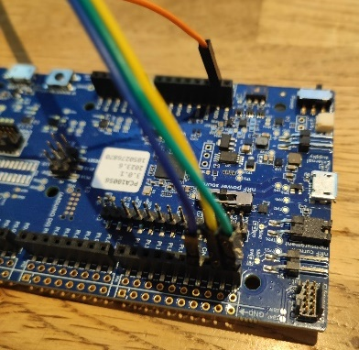
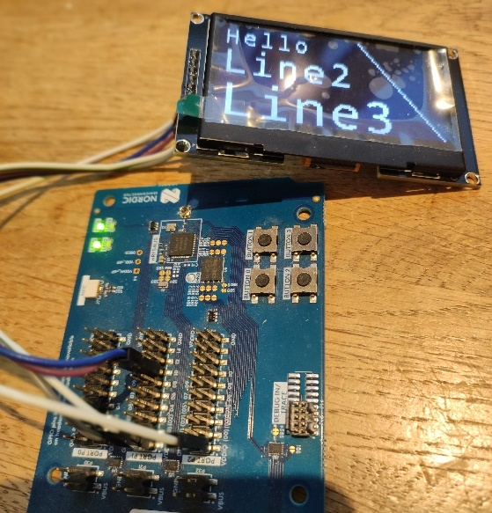
Blinky : Get it running on 52840-DK
Create a device tree overlay for 52840DK
Use i2c0
P0.27 for SCL
P0.26 for SDA
Create a build configuration for nrf52840
Copy the project into another directory (lcd2BD)
Modify the driver to SSD1306 and get the larger display running
Take note Reset needs pulling high

Slide 31
Blinky : LVGL Library (optional)
Goto LVGL — Light and Versatile Embedded Graphics Library
Copy your project to a LVGL directory
Add the LVGL driver
…

