Slide 1
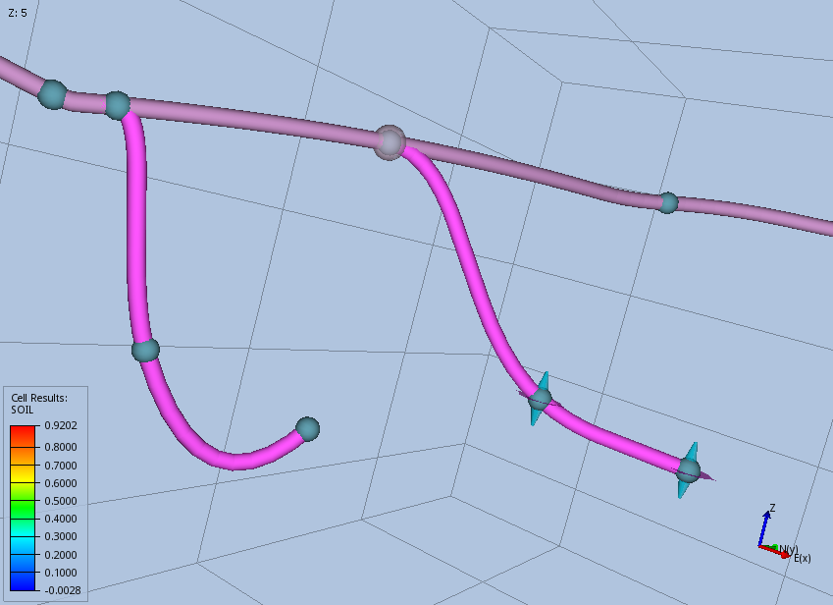
Active Tie In Handle
Inactive Well Target
Inactive Tie In Handle
Active Well Target Handle

