Slide 1

Hospital Management System Database
Technical University of Sofia
Vesselina Belova, Alexander Svilarov, Nikolay Nikolov, Stefan Dimitrov

Slide 2

Project Overview
Objective:
To create a robust, scalable, and efficient relational database to manage hospital operations.
Key Features:
Centralized Data Management: Handles patient records, billing, doctor schedules, room allocations, and services.
Entities: The main components are Patients, Doctors, Rooms, Services, BillReports, and Consultations.
Technology Used: MySQL for database design and implementation.

Slide 3
Stage 1: Requirements Analysis
1
2
3
Purpose:
The database will store and analyze information for a hospital, including patient info, doctor info, bills, room information, and service information.
Scope:
Used by hospitals to organize and analyze data such as patient records, consultations, bills, and room assignments.
Applications:
Doctors need to access patient medical history and prescribe treatments. Administrators need to monitor hospital operations and manage user roles.

Slide 4





Entities Identified
Patients: Personal details and medical history.
Doctors: Specialization, appointments, and treatments.
BillReports: Billing data for services provided.
Rooms: Room assignments.
Services: Treatments, tests, and procedures.

Slide 5

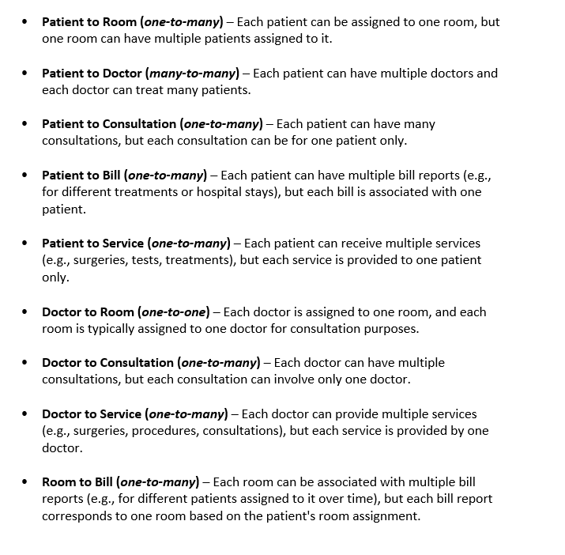
Stage 2: Conceptual Data Modeling
Attributes for Entities:
Each entity has a set of fields (e.g., Patient: ID, Name, Age, Admission Date).
Relationships Between Entities:
E.g. Doctor ↔ Patient: Many-to-Many (a doctor treats multiple patients; a patient can see multiple doctors), Patient ↔ Room: One-to-Many (one room can accommodate multiple patients) etc.
Consultation Table: Mapping table, handling the Doctor-Patient relationship, including fields like consultation date, notes, and diagnosis.

Slide 6
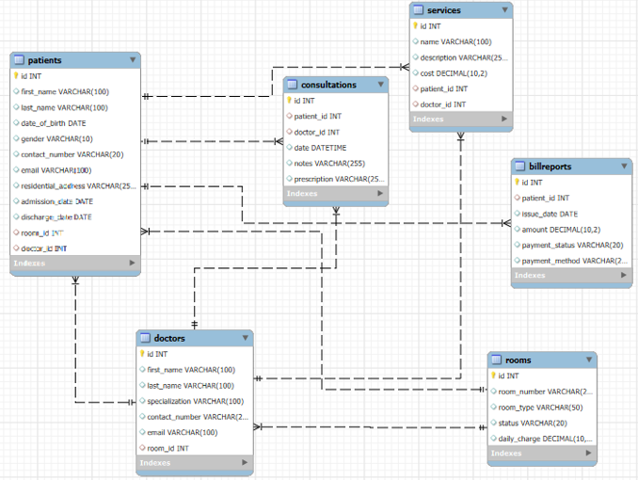
Stage 3: Logical Database Design
Breakdown of Relationships:
Patient ↔ Room: Each room can have multiple patients.
Patient ↔ Bill: Each patient can have multiple bills for treatments and stays.
Doctor ↔ Consultation: One doctor can have many consultations.
Service ↔ Bill: Services provided are recorded in bill reports.

Slide 7
Stage 4: Physical Database Design
Tables Designed:
Patients Table: Includes fields like PatientID, Name, BirthDate, Gender, AdmissionDate.
Doctors Table: Includes DoctorID, Name, Specialization.
Rooms Table: RoomID, RoomType, Capacity.
BillReports Table: BillID, BillAmount, PaymentStatus.
Services Table: ServiceID, Service name, Description.
Consultations Table: ConsultationID, Date, Diagnosis, Notes.
Data Types: Use of appropriate data types (e.g., INT for IDs, VARCHAR for names, DATE for dates, DECIMAL for currencies).

Slide 8
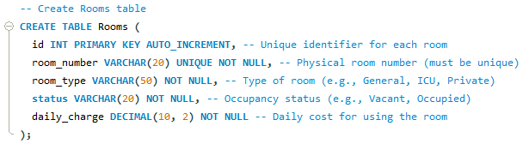
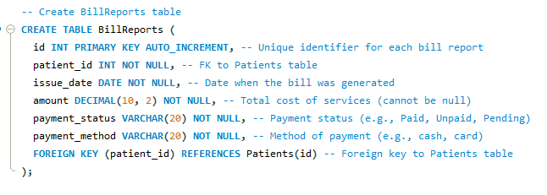
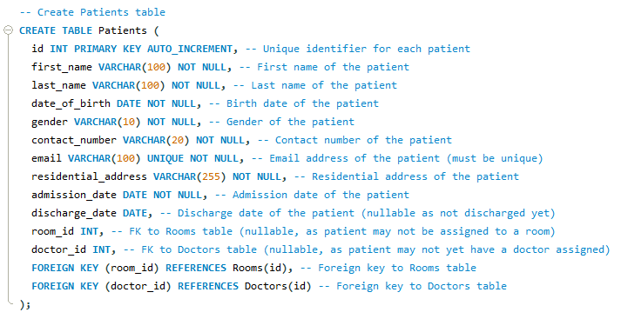
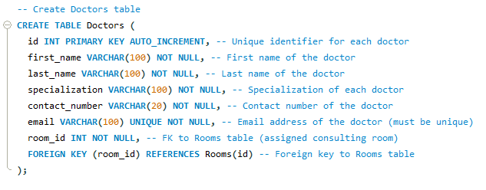
This table stores information about the rooms in the hospital, including room number, type, and capacity.
This table stores information about the bills of patients including date, amount, status and method.
This table stores information about the patients, including their name, address, and medical history.
This table stores information about the doctors, including their name, specialization, and contact details.

Slide 9
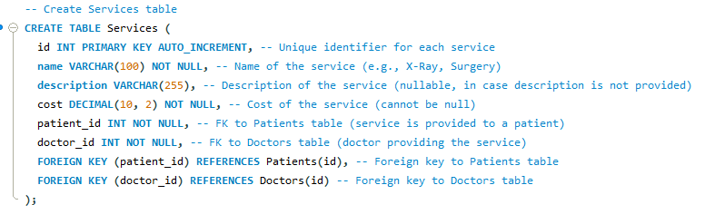
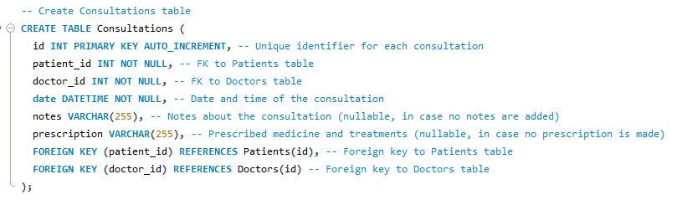
This table stores information about a patient services, cost and doctor who performed the service.
This table stores information about a patient CONSULTATION, prescribed treatment, consultation date etc.

Slide 10
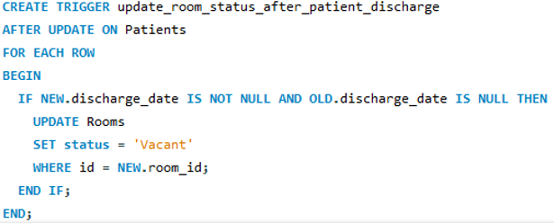
Stage 5: Database Implementation
Triggers:
Automate updates. Example: A trigger updates room availability when a patient is discharged.
Indexes:
Primary Indexes: Improve lookups for key fields like IDs.
Foreign Key Indexes:
Optimize joins between tables.

Slide 11
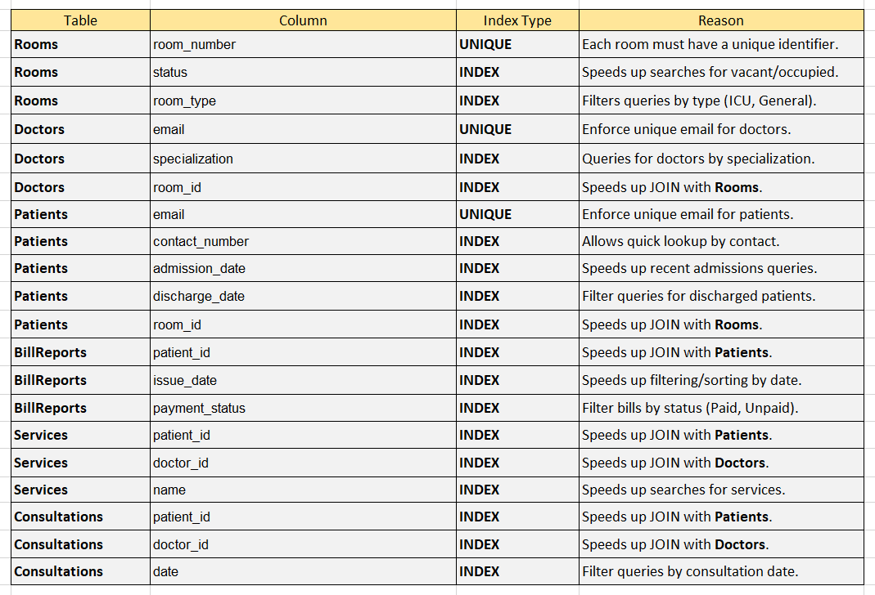
Indexes

Slide 12
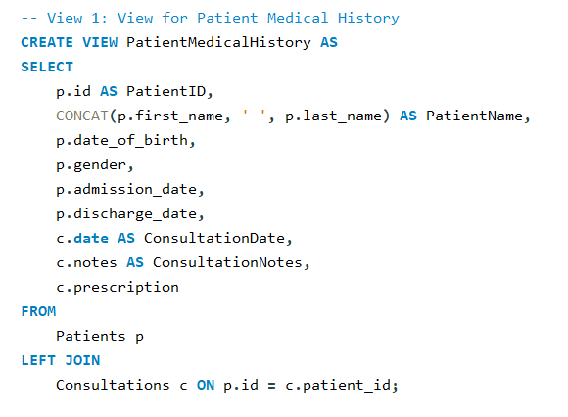
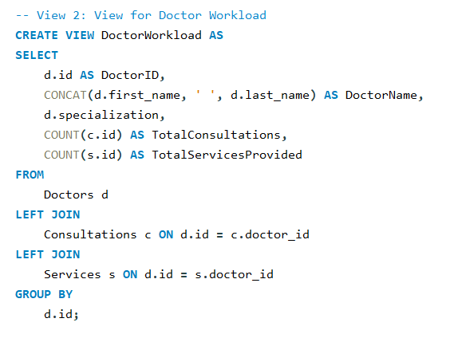
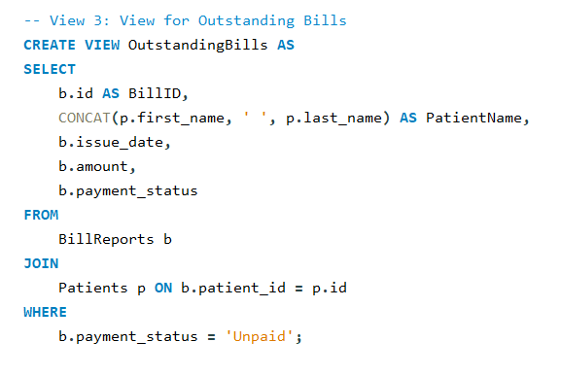
Views
Views:
Patient Medical History View: Combines Patient and Consultation tables for unified medical history.
Doctor Workload View: Summarizes doctor workload (total consultations, services).
Billing View: Displays billing details (amount, status).

Slide 13
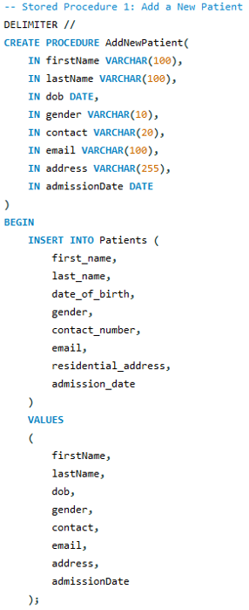
Stored Procedures
Stored Procedures:
Insert Patient Record: Simplifies new patient entry.
Update Discharge Date: Updates patient status upon discharge.
Generate Patient Bill: Automates bill creation.

Slide 14
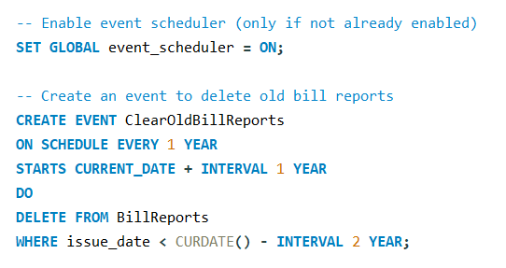
Database Events
Purpose:
Automate repetitive tasks in the database.
Benefits:
Reduces manual effort.
Optimizes database performance by removing outdated data.

Slide 15



Stage 6: Testing & Quality Assurance
Areas of Testing:
Insert Violations: Ensures data integrity when adding records.
Views: Validates accuracy of summarized data.
Triggers: Tests automated processes (e.g., room status updates).
Indexes: Confirms improved query performance.
Procedures: Tests correct execution of stored procedures.
1
4
5

Slide 16

Stage 7: Maintenance & Monitoring
Importance of Backups:
Protects data against failures, errors, or attacks.
Backup Strategy:
Weekly backups using MySQL’s Data Export feature.
Includes tables, triggers, views, and procedures.
Testing Backup/Restore:
Ensures that backups are functional and restorable.

Slide 17




Project Summary
Streamlined Operations
The HMS automates patient management, room allocations, doctor appointments, billing, and medical services.
Robust Database
The database uses MySQL and includes tables for Rooms, Doctors, Patients, Services, BillReports, and Consultations.
Enhanced Security
User roles and permissions ensure data privacy and control for different hospital staff.

Slide 18
Thank you!

