Slide 1
HPML Final Project · Spring 2026
Nano-LLaVa
Optimizing Training Pipeline for Pre-trained Nanochat Extended to Image Captioning
[Team #36]
[Alexander Swartz] · [as7629]
GitHub: https://github.com/AlexanderSwartz/nano-llava
Tracking: https://wandb.ai/as7629-columbia-university/Multimodal-Nanochat/table?nw=nwuseras7629
Dr. Kaoutar El Maghraoui · Columbia University · Week of May 4, 2026

Slide 2
Motivation & Problem
Why this matters
Problem statement
Given pre-trained image encoder and LLM, find the minimal training setup needed to extend an LLM for image captioning.
Optimization Goals:
< 10% of total training time on dataloading
< 5% of total training time on H2D transfer
> 80% GPU utilization
> 5x speedup over in inference tok/sec
Increasing demand for LLMs that a beginner can train with consumer hardware
Extend an LLM to a new modality with minimal changes to model
Reduce training required for image captioning
Leverage both a pre-trained vision encoder and LLM
Only train what is absolutely necessary
HPML · Spring 2026
2 / 14

Slide 3
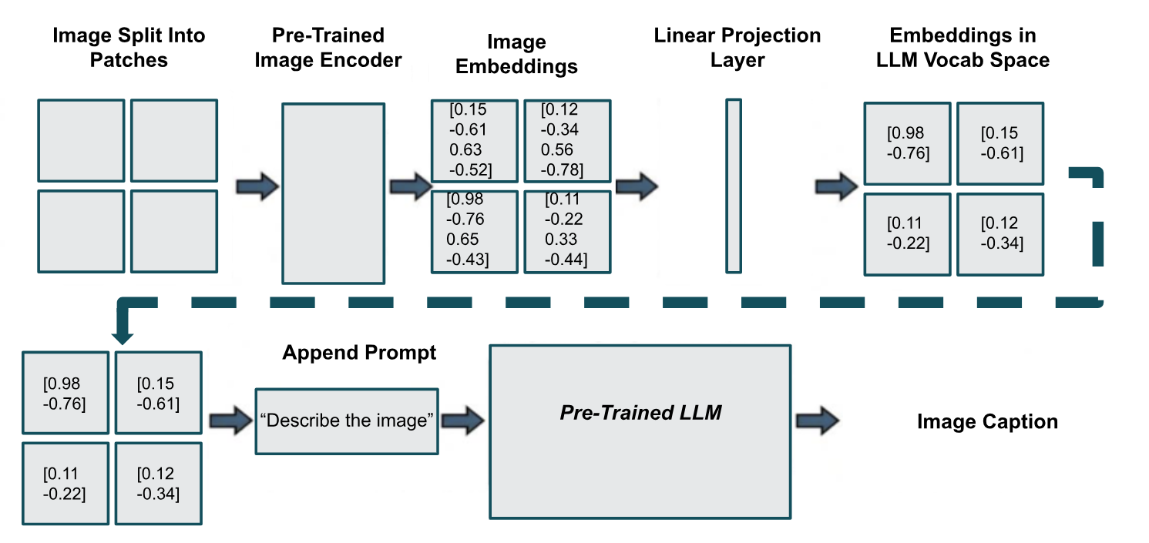
Nano-LLaVa Architecture

Slide 4
Technical Approach — Model & Data
Models
Dataset
Hardware
CLIP Vision Encoder:
ViT-B/32 (Vision Transformer Base, patch size 32)
151M params
HF transformers library
Nanochat:
decoder-only transformer architecture (“GPT from scratch”)
561M params
Loaded weights from smaller, d20 version (20 layers)
Open-source repo for “hackability”
all-MiniLM-L6-v2:
Distilled transformer for semantic similarity test
22.7M params
HF transformer library
COCO Captions train and val 2017
123,287 images, ~ 5 captions each = 616,767 samples
License for each image included in metadata
591,753 training, 25,014 validation
No Test Set (focus on training pipeline, not hyperparameter tuning)
[NVIDIA L4, g2-standard-4 (4 vCPUs, 16 GB Memory), Google, Deep Learning VM with CUDA 12.4, M129, Debian 11, Python 3.10
Software stack:
CUDA 12.4
Pytorch 2.6.0+cu124
HF transformer library (CLIP model and sentence transformer model)
pycocotools.coco
rustbpe + tiktoken
HPML · Spring 2026
3 / 14

Slide 5
Technical Approach — Optimizations Applied
1.
Dataloading and Offline Image Embeddings
Instead of loading the CLIP model and embedding each image during training, pre-compute embeddings and load .pt files during training / validation
2.
AMP-Driven Batch Maximization
Use mixed precision to decrease memory, creating space for larger mini batches on GPU
3.
Batched Decoding
Instead of sequentially decoding image captions, bundle in batches to leverage parallelism
HPML · Spring 2026
4 / 14

Slide 6
Profiling Methodology
Tools
Metrics captured
PyTorch Profiler
Tensorboard GPU Summary
Manual instrumentation
with torch_profiler.record_function("Forward Pass"):
Weights & Biases for run-level tracking
Custom Pipeline Efficiency Metrics:
Dataloader Wait Time, H2D Transfer, and Warmup/Hot Time
Dataloader Wait Time , H2D Transfer, and Warmup/Hot Time
GPU Utilization %, Estimated Achieved Occupancy
Train and Validation Tok/Sec
Time per stage: sync → h2d transfer → fwd → bwd → dataloader prefetch → opt
Task quality metric (bpb, avg semantic similarity score)
HPML · Spring 2026
5 / 14

Slide 7
Results — Headline Numbers
82.68%
8.77x
5.74x
increase in est. SM utilization
speedup in training time
faster tok/sec during inference
online image embeddings → optimized offline embeddings
online -> offline embeddings +
FP32 -> B16 speedup
baseline → optimized batching
HPML · Spring 2026
6 / 14

Slide 8
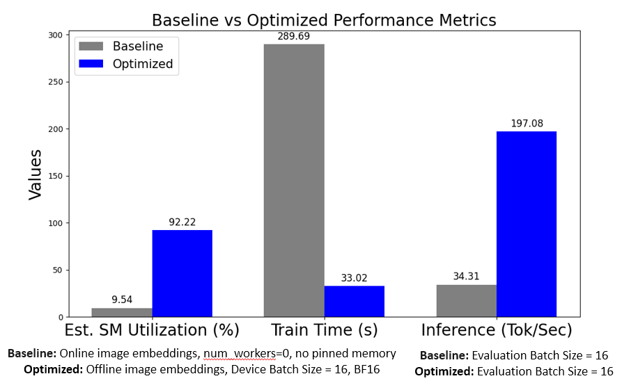
Results — Before vs. After
Takeaway
Offline embeddings and mixed precision provided the greatest training speedup and throughput improvement
Tradeoffs:
Pinned memory increased warmup training time but decreased hot training time
Increasing Device Batch Size too much increases GPU Utilization but slows training, likely from cache spilling
FP32 has better GPU Utilization than BF16, but lower Estimated Achieved Occupancy
Baseline: baseline_online_w0_persistFalse_pinFalse
Optimized: optimized_offline_pinTrue
Baseline: baseline_evalBS1_KVCacheFalse
Optimized: optimized_evalBS16_KVCacheFalse
HPML · Spring 2026
7 / 14

Slide 9
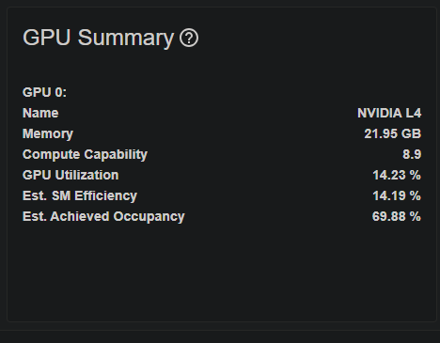
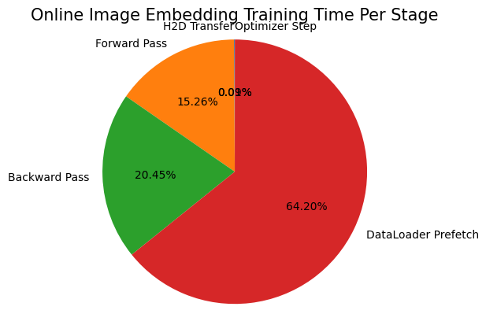
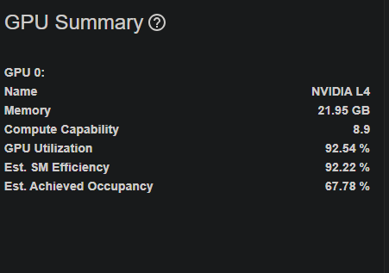
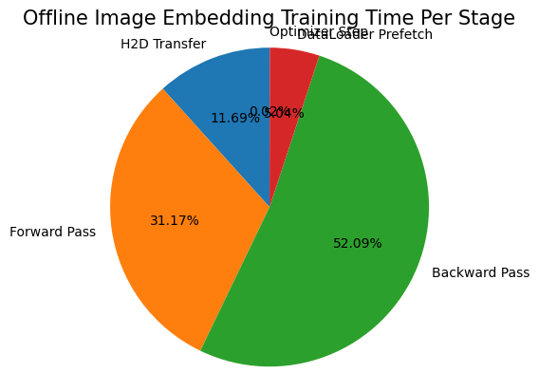
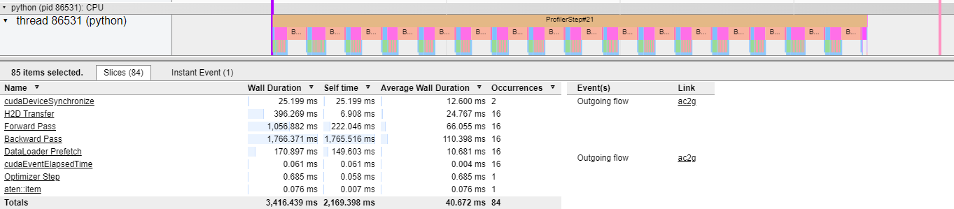
Profiling
Major Bottleneck: DataLoader Prefetch
This is where online image embeddings take place
GPU underutilized before pre-computed image embeddings
BF16 -> FP32 halved % of time in H2D Transfer
HPML · Spring 2026
8 / 14

Slide 10
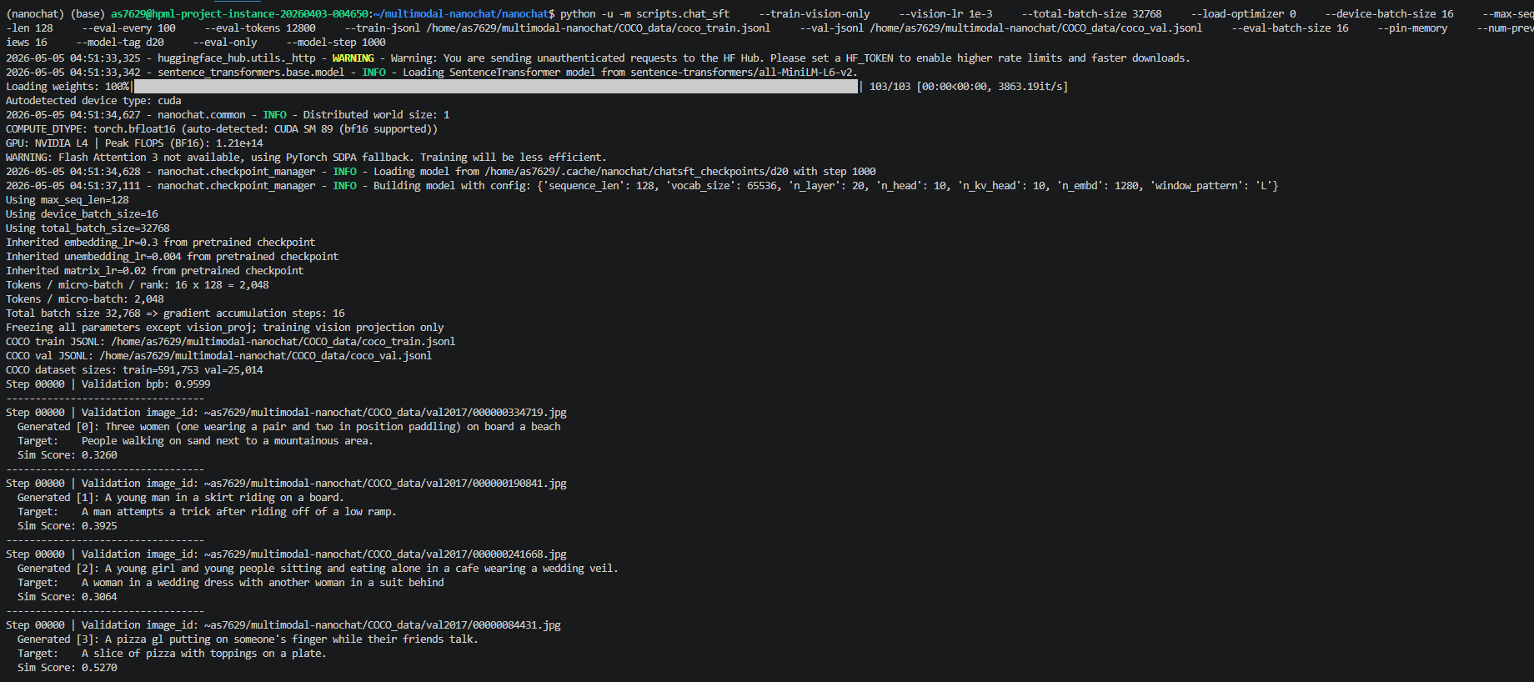
Demo / Visualization
Fallback image
HPML · Spring 2026
9 / 14

Slide 11
Lessons Learned
What worked
What didn't work
Only a single, linear projection layer is needed to adapt an LLM for image captioning
Confirms finding from LLaVa paper
Since CLIP model is frozen, pre-computing image embeddings is free time-save
AMP frees memory, allows for increasing device batch size. Tune together
Optimizing for the correct metrics:
Peak GPU Memory only measures VRAM used
GPU Utilization only measures time GPU is used
Achieved Occupancy actually measures GPU saturation
Torch.compile did not work, likely from incompatibility of nanochat model, pytorch, and CUDA versions
Model Flops Utilization (MFU) is not a meaningful metric when using same hardware and model – just use tok/sec
Increasing device batch size too much increases GPU utilization but slows training, likely from cache spilling
KV Caching is not as useful for smaller contexts
Decreasing total batch size proportionally decreased training time for a fixed number of iterations, but only because this also decreasing samples per iteration
HPML · Spring 2026
10 / 14

Slide 12
Next Steps
Tune total batch size and other hyperparameters to improve caption quality
Use GPU(s) with more memory to enable loading larger Nanochat base model
Unfreeze layers in nanochat model and try different vision project layers
Use Nanochat’s built-in learning rate scheduler
HPML · Spring 2026
11 / 14

Slide 13
Teamwork & Contributions
All design, code, analysis and report was done by me.
Although I started with a group, I did not use any of their work.
HPML · Spring 2026
12 / 14

Slide 14
Thank you
Questions?
GitHub: https://github.com/AlexanderSwartz/nano-llava
Tracking: https://wandb.ai/as7629-columbia-university/Multimodal-Nanochat/table?nw=nwuseras7629
HPML · Spring 2026
13 / 14

Slide 15
Backup — Experimental Setup
Setting | Baseline | Optimized | Δ Improvement
Pinned Memory | False | False | -1.95% Training Time
Num Workers | 0 | 4 | -26.74% Training Time
Time of Image Embedding Computation | Online | Offline | -83.71% Training Time
Device Batch Size | 64 | 16 | -57.51% Peak GPU Memory
Learning rate | 1e-4 | 1e-2 | +19.83% Val. Semantic Similarity
Precision | FP32 | BF16 | + 21.35% Profiler Est. Achieved Efficiency
Evaluation Batch Size | 1 | 16 | +474.41% Inference Tok/Sec
HPML · Spring 2026
14 / 14

Slide 16
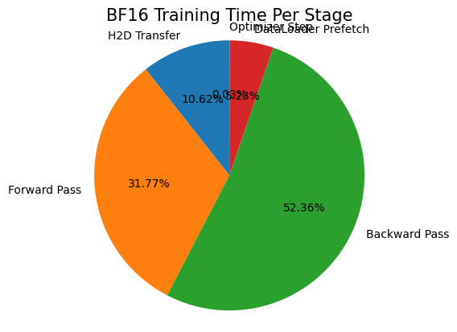
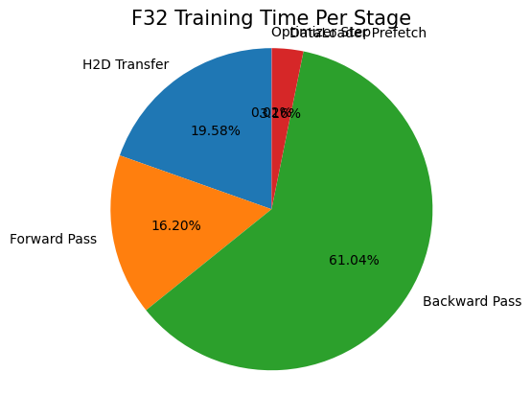

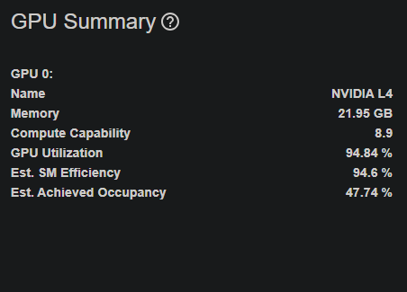
Backup — Mixed Precision Manual Instrumentation Results
Conclusions:
BF16 -> FP32 halved % of time in H2D Transfer
FP32 has better GPU Utilization than BF16, but lower Estimated Achieved Occupancy
Total training time at BF16: 99.62862
Total training time at BF16: 151.3277
HPML · Spring 2026
14 / 14

Slide 17
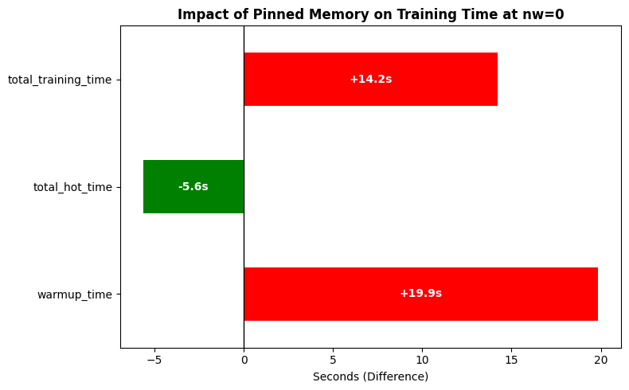
Backup — Pinned Memory During Online Embeddings Results
Conclusions:
Pinning memory created up-front cost, increasing warmup time. The decrease in hot time is worth this up-front cost
HPML · Spring 2026
14 / 14

Slide 18
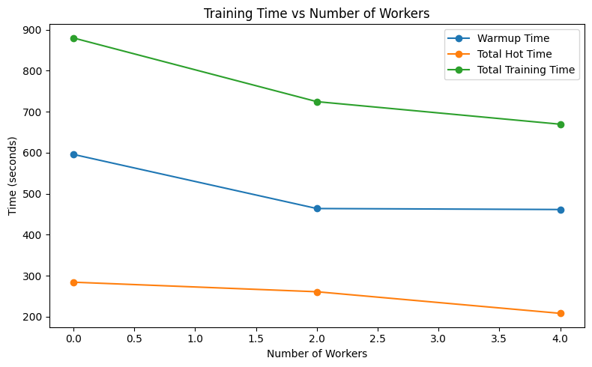
Backup — Num Workers During Online Embeddings Results
Conclusion: Increasing num workers beyond the number of CPUs (4 here) causes diminishing returns due to multiprocesing overhead
HPML · Spring 2026
14 / 14

Slide 19
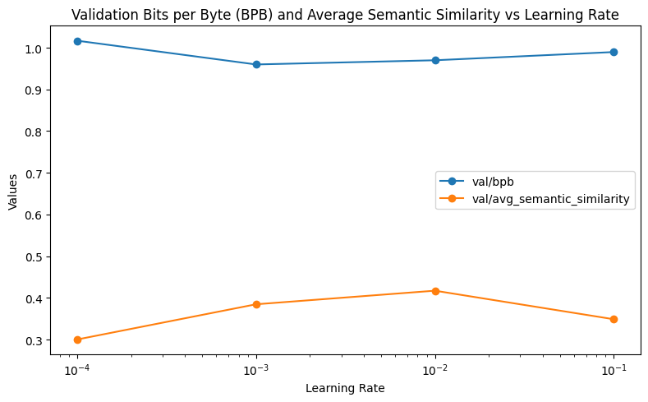
Backup — Learning Rate Tuning Results
Conclusion: Optimal learning rate was set to 10^-2 for best bpb and average semantic similarity
HPML · Spring 2026
14 / 14

Slide 20
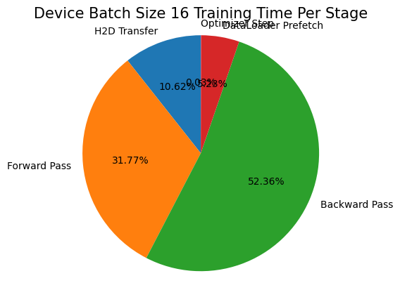
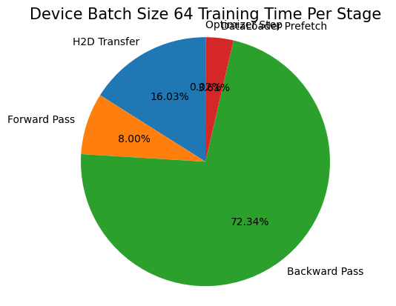
Backup — Device Batch Size Results
Conclusions:
Increasing Device Batch Size will reduce gradient accumulation steps (mini batches), reducing overhead forward calls
Increasing Peak GPU Memory too much can cause cache spilling, increasing time spent moving data
Total training time at BS16: 99.62862
Total training time at BS64: 130.63998
HPML · Spring 2026
14 / 14

Slide 21
Backup — Why isn’t MFU a meaningful metric?
Model Flops Utilization (MFU) is supposed to measure percentage of theoretical peaks FLOPS is being reached
MFU = (Tokens_per_second * FLOPS_per_token) / Peak_Hardware_FLOPS
FLOPS_per_token is always the same for this project (same nanochat model)
Peak_Hardware_FLOPS is always the same for this project (same hardware)
Only changing factor is tok/sec
For this project, MFU = tok/sec * constant_factor
Conclusion: just use tok/sec
HPML · Spring 2026
14 / 14

