Slide 1
Searching for news bias
What news characteristics predict bias between news sources?
Alexander Tyan
Advisor: Allyson Ettinger (TTIC)
Preceptor: Joshua Mausolf

Slide 2
Prior Research
Diverse definitions of Bias
Diverse measures of bias
Conflicting conclusions about bias in the media

Slide 3
Prior Research
Diverse definitions of Bias
Diverse measures of bias
Conflicting conclusions about bias in the media
Hypothesis: News sources dissimilarity conditional on topics

Slide 4
Data and Methods
BBC, CNN, RT, Fox News
RSS Feeds
January – April 2019
Standard Cleaning
Preempting Data Leakage

Slide 5
Topic modeling
Topic | Token | Weight
Unknown | say | 0.03809549
Unknown | not | 0.030164942
Unknown | do | 0.017989479
… | … | ...
Sports | team | 0.027598321
Sports | game | 0.024382351
Sports | win | 0.017087057
… | … | …
Military Nuclear Technology | north_korea | 0.02561758
Military Nuclear Technology | north_korean | 0.018099198
Military Nuclear Technology | iran | 0.015305956
… | … | …
Political Investigation (Cohen/Virginia) | say | 0.050332915
Political Investigation (Cohen/Virginia) | cnn | 0.024718568
Political Investigation (Cohen/Virginia) | report | 0.01599263
Political Investigation (Cohen/Virginia) | tell | 0.01137681
Political Investigation (Cohen/Virginia) | investigation | 0.011040452
Political Investigation (Cohen/Virginia) | statement | 0.010947393
Political Investigation (Cohen/Virginia) | case | 0.009329448
Political Investigation (Cohen/Virginia) | public | 0.008804999
Political Investigation (Cohen/Virginia) | cohen | 0.008026111

Slide 6
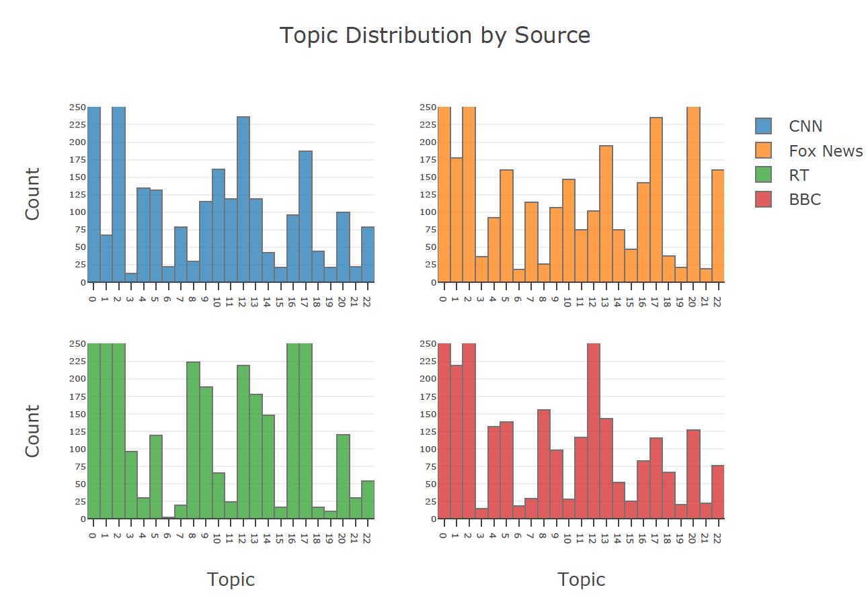

Slide 7
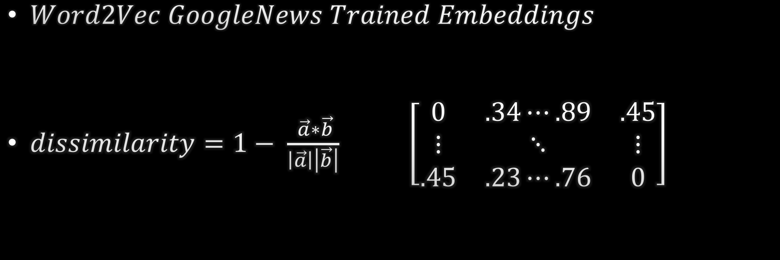
Text vectorization and cosine dissimilarity
$Word2Vec GoogleNews Trained Embeddings$
$dissimilarity=1− \frac{ \vec{a}∗\vec{b}}{\left|\vec{a}\right|\left|\vec{b}\right|}$ $\left[\begin{matrix}0 & .34⋯.89 & .45 \\ ⋮ & ⋱ & ⋮ \\ .45 & .23⋯.76 & 0\end{matrix}\right]$

Slide 8
Text vectorization and cosine dissimilarity
$Word2Vec GoogleNews Trained Embeddings$
$dissimilarity=1− \frac{ \vec{a}∗\vec{b}}{\left|\vec{a}\right|\left|\vec{b}\right|}$ $\left[\begin{matrix}0 & .34⋯.89 & .45 \\ ⋮ & ⋱ & ⋮ \\ .45 & .23⋯.76 & 0\end{matrix}\right]$

Slide 9
PRELIMINARY RESULTS
topic | target source | count | mean | std | min | 25% | 50% | 75% | max
Crime | Fox News | 11160 | 0.829556933 | 0.05382656 | 0.546680808 | 0.799793571 | 0.835678518 | 0.86743091 | 0.983913898
 | RT | 6789 | 0.839204574 | 0.048338039 | 0.622709155 | 0.811861634 | 0.844044447 | 0.872817934 | 0.970934093
US Politics | Fox News | 3848 | 0.883838486 | 0.053207771 | 0.616143465 | 0.859033167 | 0.89343968 | 0.919283092 | 0.986397505
 | RT | 11856 | 0.880364607 | 0.048124528 | 0.603044808 | 0.857095465 | 0.889096975 | 0.914100915 | 0.977500319
 | Mean Difference | Test Statistic | p-value
CNN vs Fox News | -0.05428 | -54.40851 | 0.000
CNN vs RT | -0.04115 | -56.03709 | 0.000

Slide 10
FURTHER STEPS
Topic and Word Embedding validation
NER
Cosine-based bias -> Neural Network Single-Label, Multi-Class Classification within Topics

