Slide 2
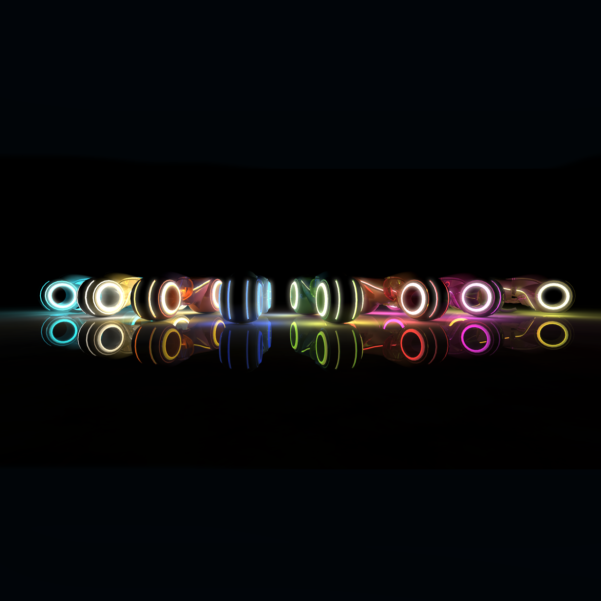

Slide 3
Distributed Systems
TRONIUM a Tron clone
Alexandra, Alexander, Christian, Lukas, Marko, Tom
© Department of Computer Science | ETH Zürich

Slide 4
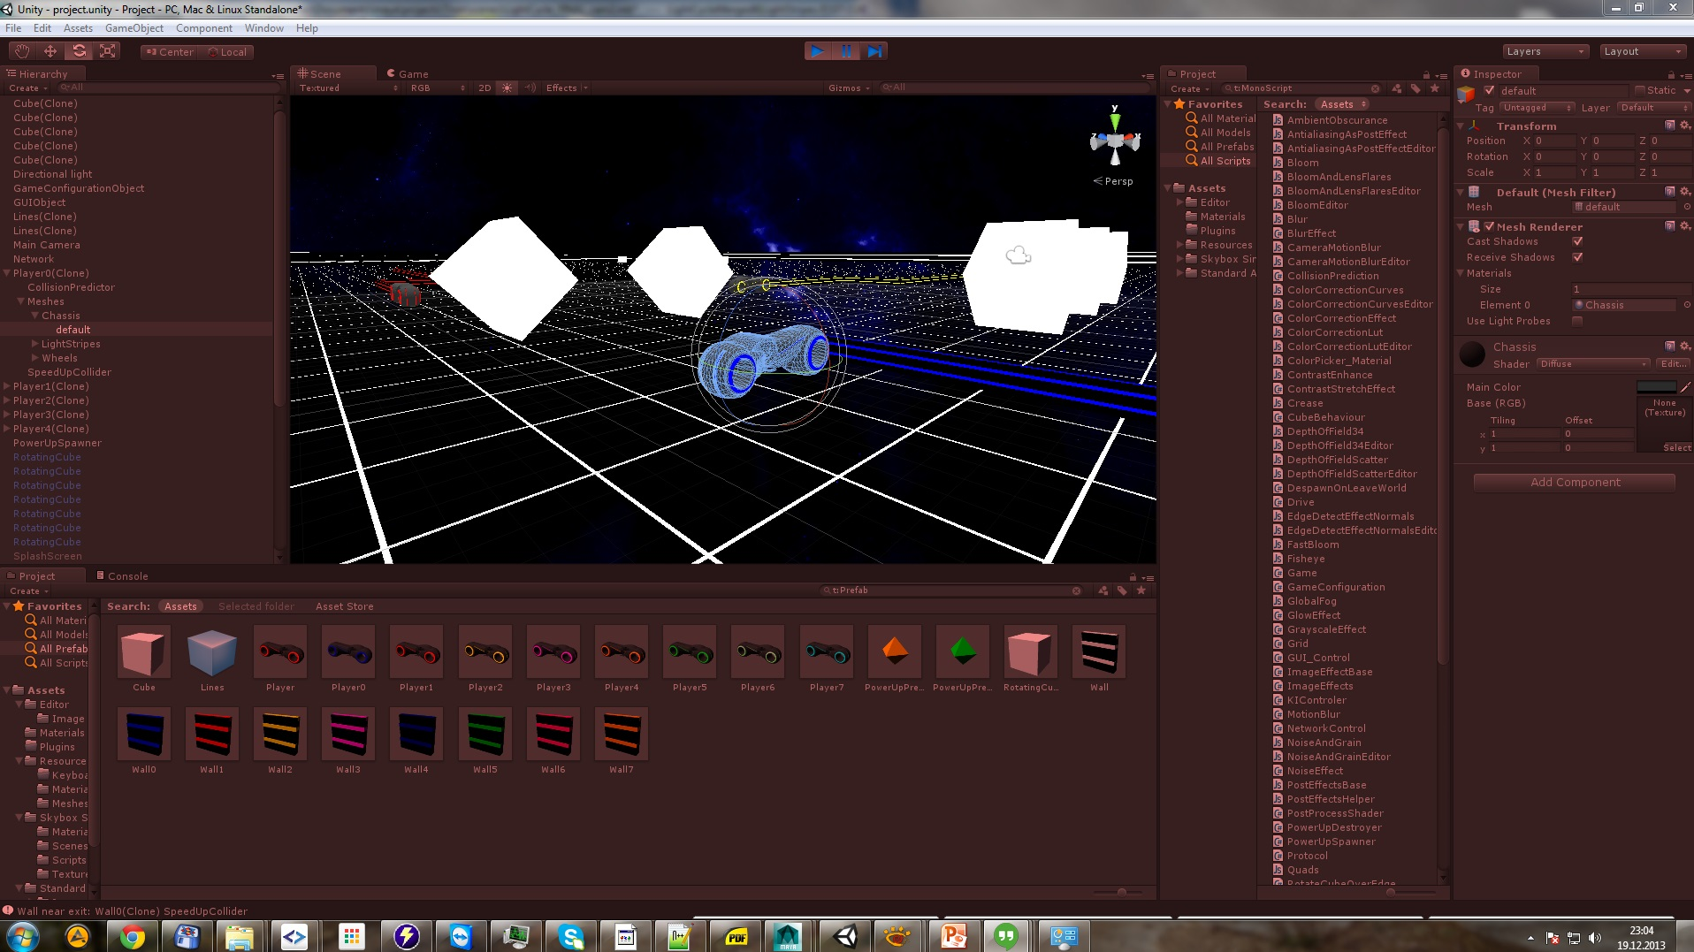

Slide 5
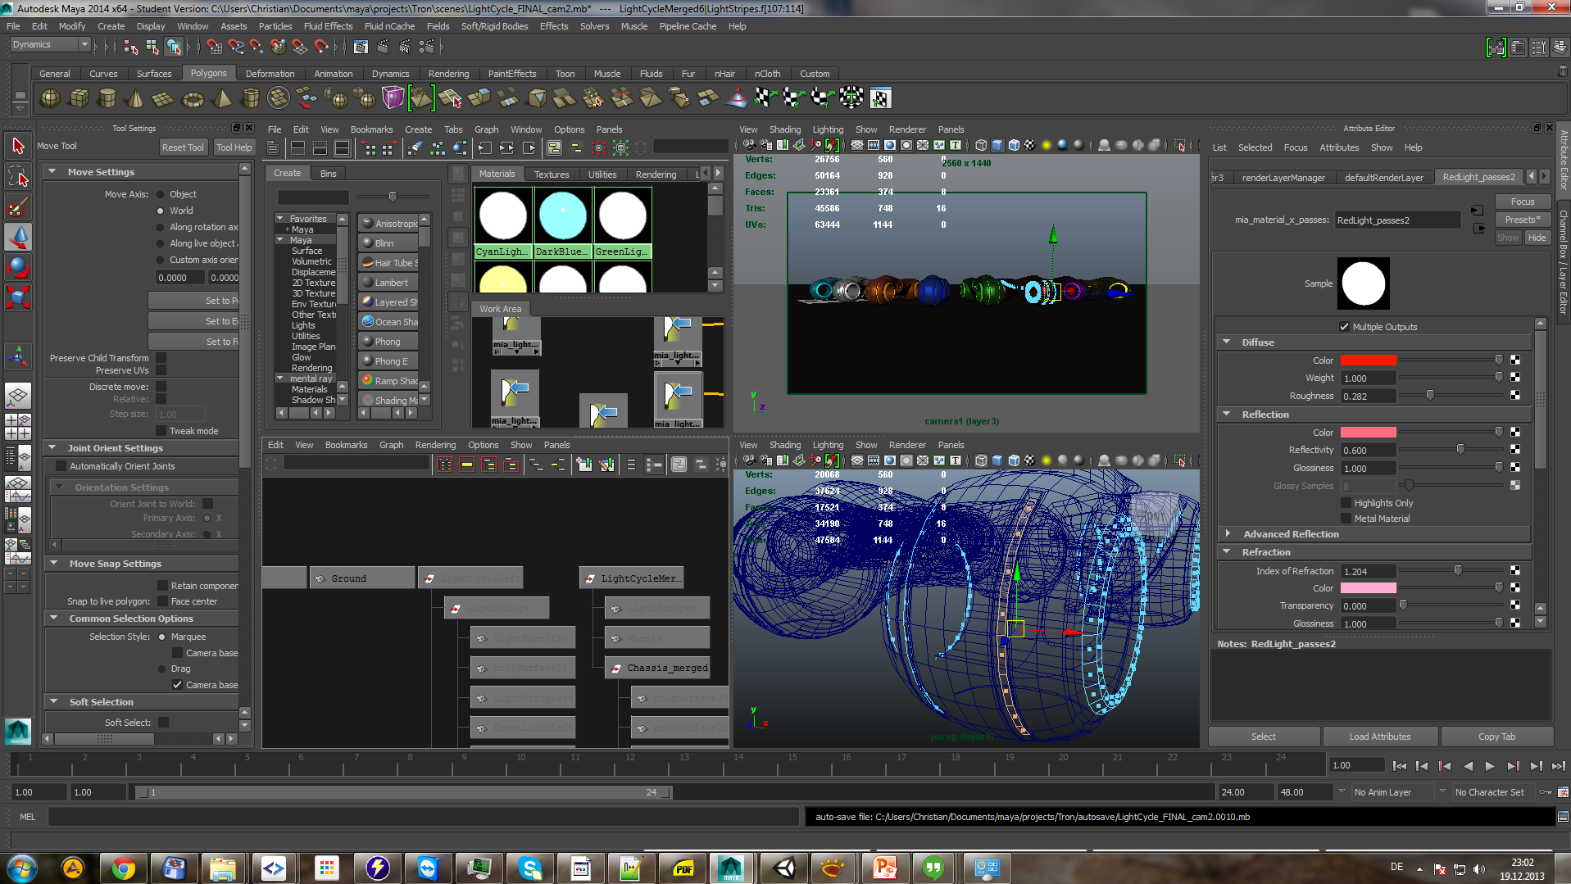

Slide 6
